Slide 1
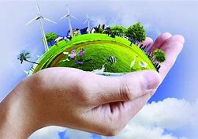
ENVIRONMENT EDUCATION
)

Slide 2

INTRODUCTION
Environment is a sum total of all surroundings of an organism or a group of organisms which provides conditions for its development and growth.

Slide 3
DEFINITIONS
Wikipedia defines Environment Education as organised efforts to teach about how natural environments function and particularly, how human beings can manage their behaviour and ecosystems in order to live sustainably.
According to Tbilisi Declaration, “Environmental education is the result of the reorientation and merging of different disciplines and educational experiences which facilitate an integrated perception of the problems of the environment, enabling more rational actions capable of meeting social needs to be taken.”

Slide 4
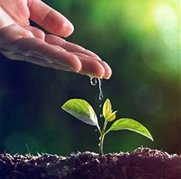
OBJECTIVES
Tbilisi Declaration (1977) extended the aims and developed the following objectives:
Awareness
Knowledge
Attitudes
Skills
Participation

Slide 5

NEED
To protect life-support system
To conserve biological diversity
To achieve food security and improved nutrition
To realise a balance between human population and resource consumption
To protect future generations from environmental problems

Slide 6

Importance
Protection of the atmosphere
Protection of land resources
Conservation of biological diversity
Improvement in living condition of poor
To protect future generation
To maintain balance
To create awareness
Protection of natural resources

Slide 7
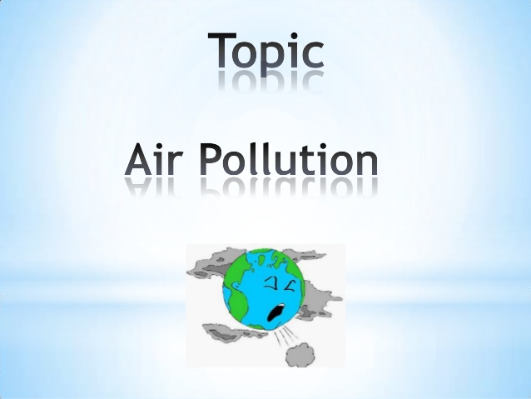

Slide 8
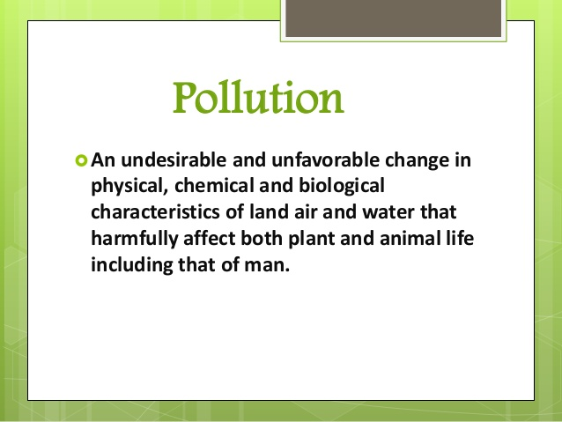

Slide 9
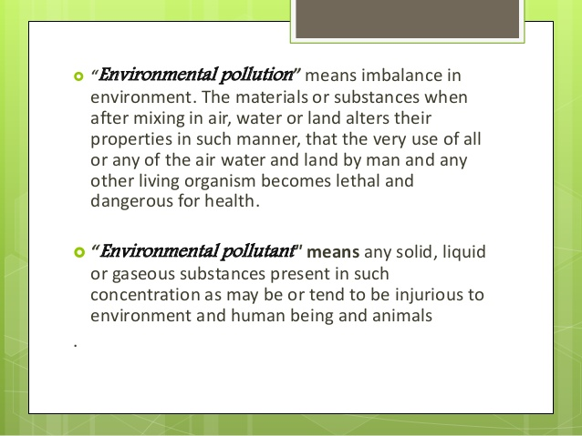

Slide 10
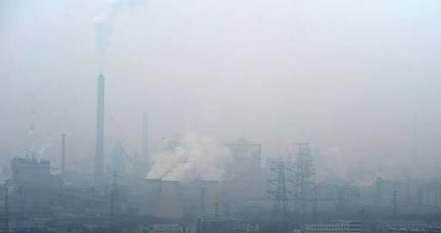
What is Pollution?
Pollution is the introduction of harmful substances or products in the environment.
There are 4 major types of pollution:-
Air pollution
Water pollution
Land pollution
Noise pollution

Slide 11
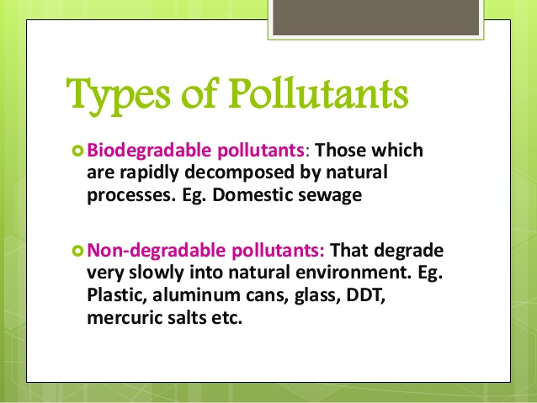

Slide 12
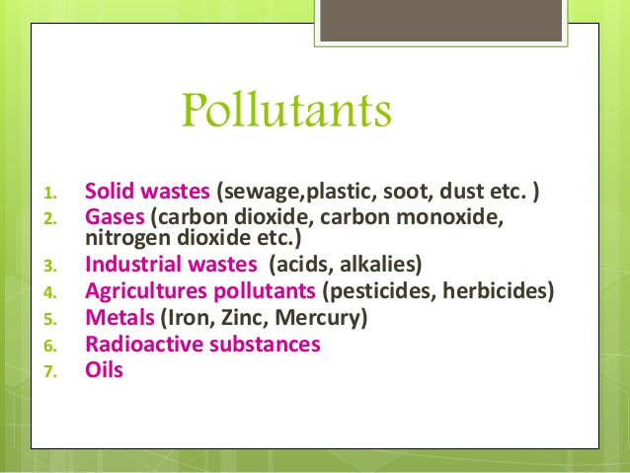

Slide 13
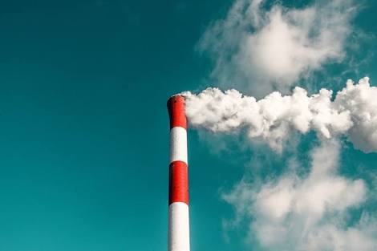
What is Air Pollution?
It is defined as any atmospheric condition in which certain substances are present in such concentration that they produce undesirable effects on human and environment.

Slide 14
Definition of Air Pollution
According to WHO, “The presence of materials in such a concentration which is harmful to man and environment.”
According to survey conducted by National Environmental Engineering Research Institute(NEERI), Air which is inhaled by people in metropolitan cities is so harmful that it affects equivalent to smoking 10 to 20 cigarettes daily.

Slide 15
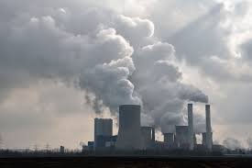
TYPES OF AIR POLLUTION

Slide 16
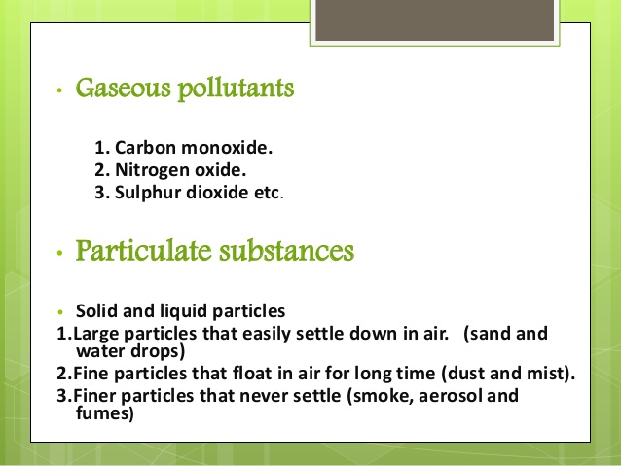

Slide 17
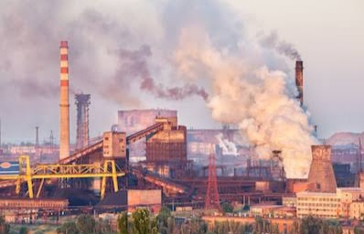
Industrial Pollution
Major pollutant- Sulphur Dioxide and Nitrogen Oxide
Emitted by- cement, steel, paper and sugar industries
Diseases- asthma, heart attack , cancer, etc.

Slide 18
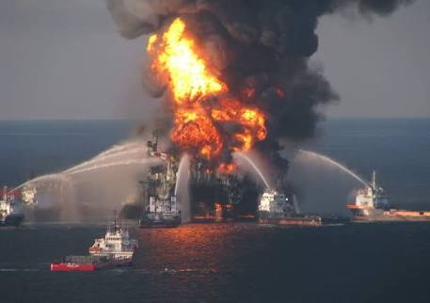
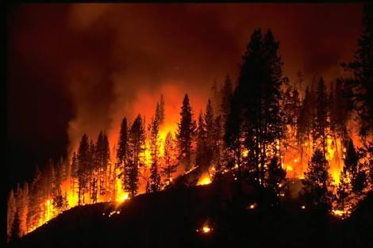
Accidental Air Pollution
Caused by-
Forest fire
Leakage
Blast in industries

Slide 19
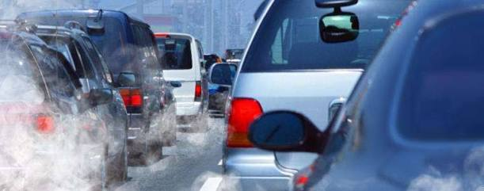
Transport related air pollution
Major source- vehicles and automobiles
Major pollutants- oxides of lead, nitrogen and sulphur
Diseases- respiratory

Slide 20
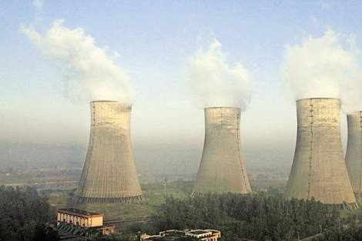
Pollution from Thermal Power Plant
Main reason- burning of coal
Major pollutants- carbon dioxide, sulphur dioxide, fly ash, etc.

Slide 21
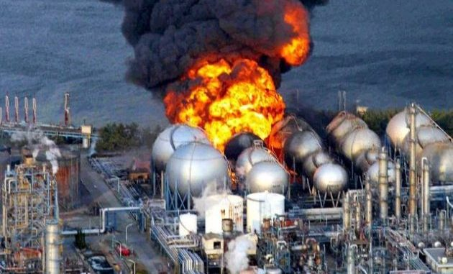
Pollution due to use of Nuclear Energy

Slide 22
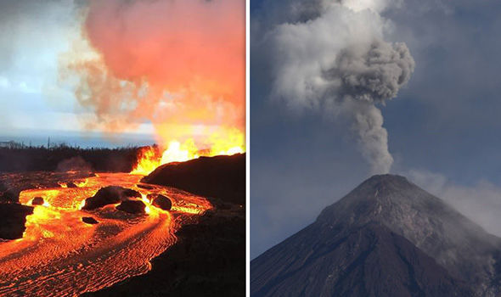
Classification of Pollutants
1. PRIMARY POLLUTANT-
Emitted directly from their sources or processes
2. SECONDARY POLLUTANT-
Not emitted directly

Slide 23
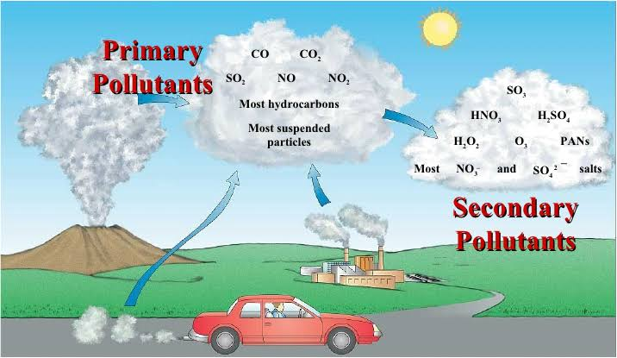

Slide 24
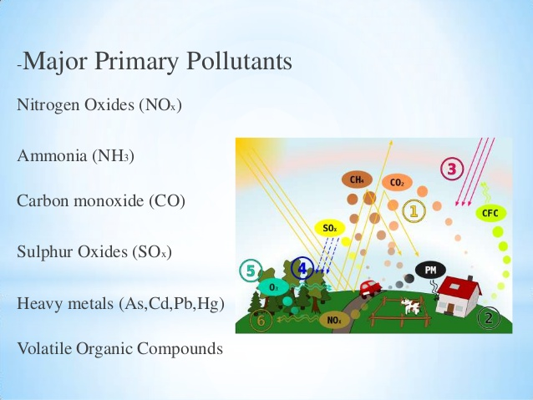

Slide 25
CAUSES OF AIR POLLUTION
“Air pollution is estimated to cause approximately two million premature deaths worldwide per year”

Slide 26
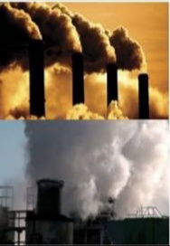
1. Combustion of Fossil Fuel
Sulphur dioxide emitted from burning of fossil fuel like coal, factory combustibles is one major cause of air pollution.

Slide 27
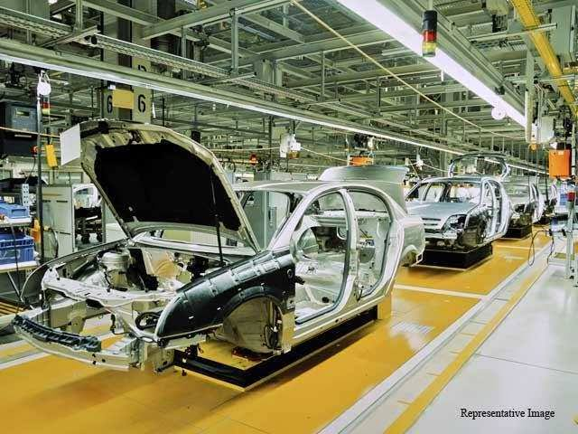
2. Auto Manufacturing
It has lead to increased use of organic products and heavy metals which contribute heavily to air pollution.

Slide 28
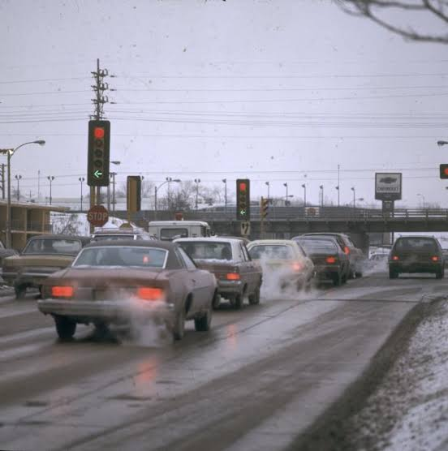
3. Automobile Exhaust
Increase in road and air traffic
Burning of gasoline to power vehicle which are released in the air

Slide 29
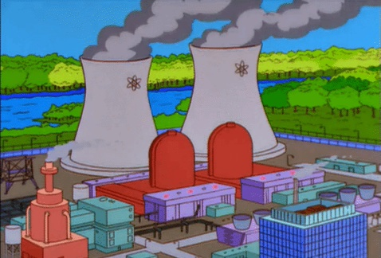
4. Factories and Industries

Slide 30
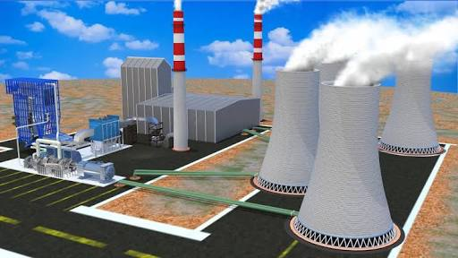
5. Heat and Power Generation Facilities
Thermal power plant emit heat in the atmosphere during combustion.
Incomplete combustion leads to release of toxic air pollutants.

Slide 31
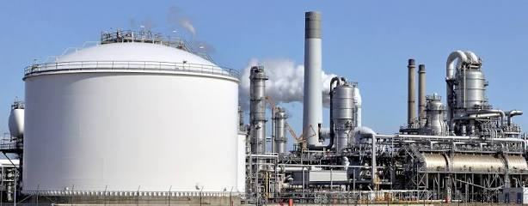
6. Petroleum Refineries
Release hydrocarbons

Slide 32
7. Solid Waste Disposal
8. Radioactive waste
9. Deforestation
10.Mining
11. Smoking
12. Smog

Slide 33
Effects of Air Pollution
Air pollution is a global phenomenon. It has the adverse effect on the following:
Effect on Health
Effect on Plant
Effect on Animal
Effect on Environment
Effect on Buildings

Slide 34
Effect on health
Bronchitis, lung infection/cancer, asthma, heart disease,
Irritation to eyes, nose, throat,
Chronic respiratory, heart diseases and can lead to failure in lungs and kidney.

Slide 35
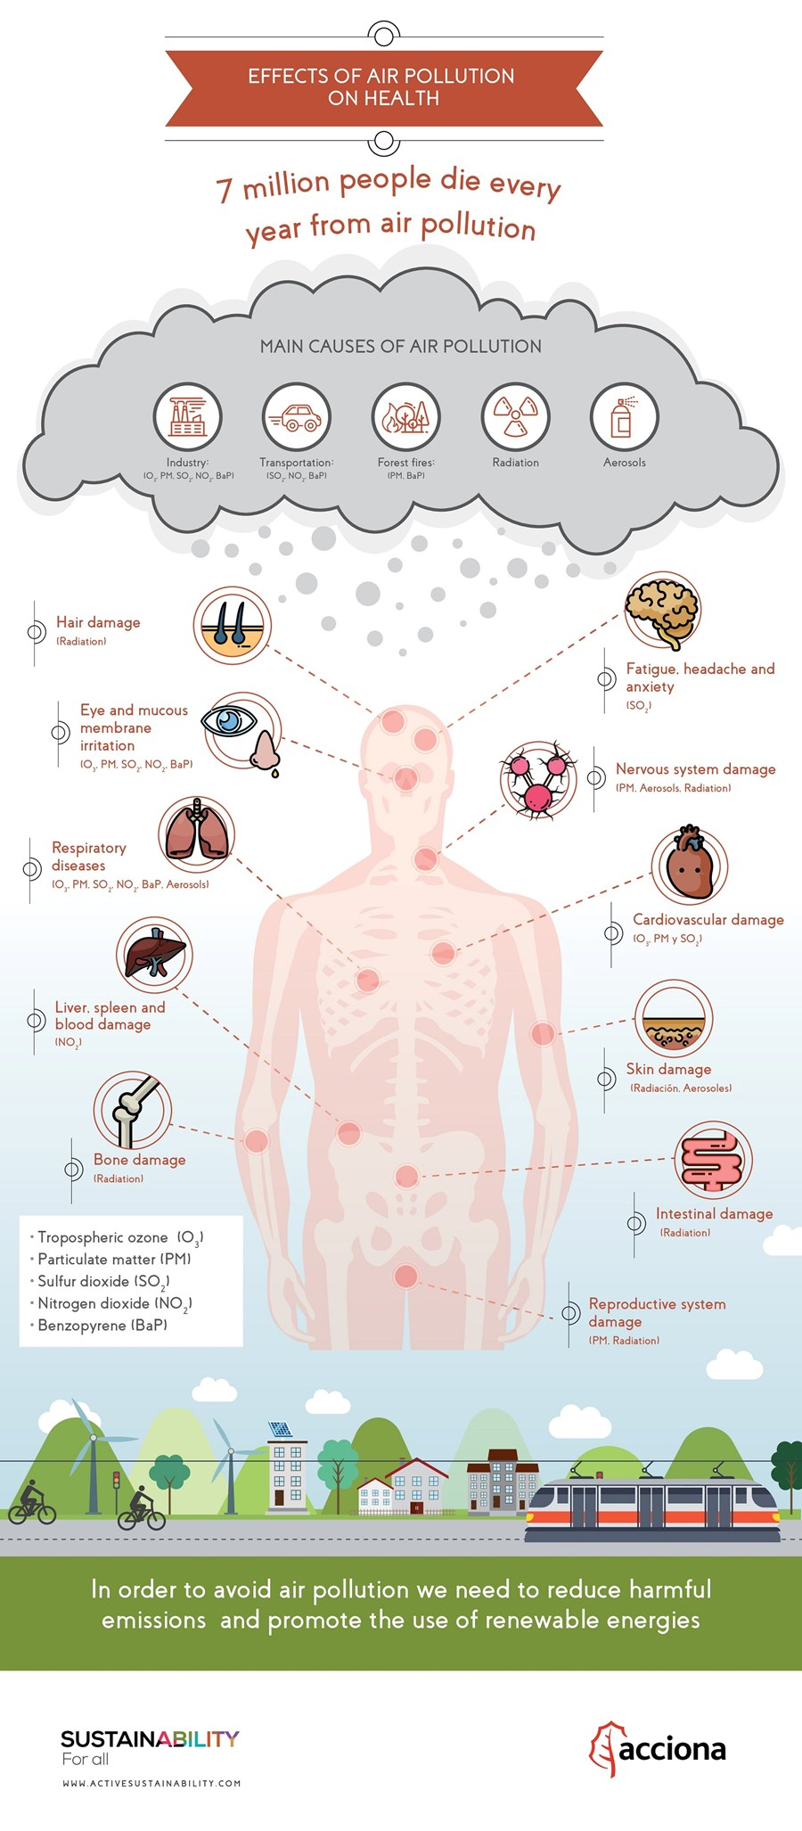

Slide 36
Effect on Plants
Chlorosis,
Acid rain,
Acid rain further makes the soil impure or can kill the nutrients of the soil,
Slow or reduction in plants growth,
Hamper normal respiration of the plants.

Slide 37
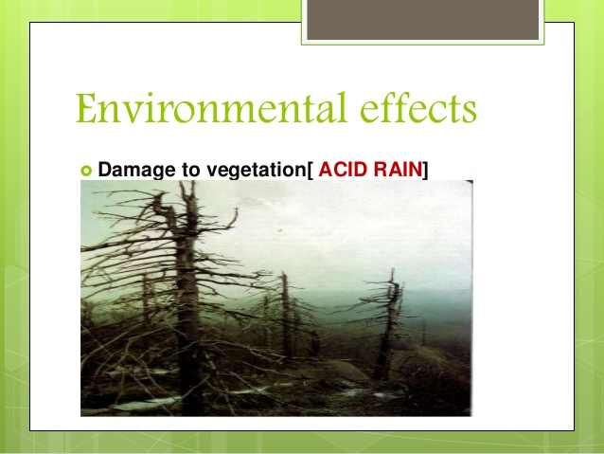

Slide 38
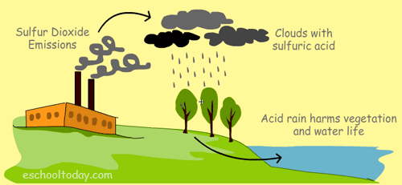

Slide 39
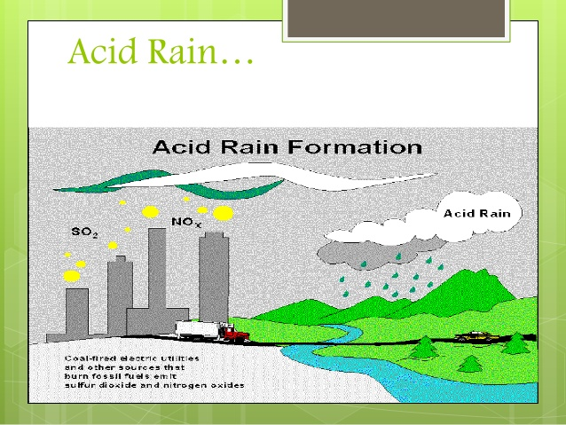

Slide 40
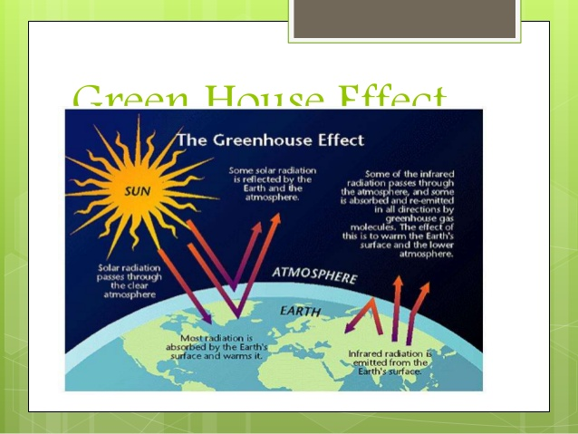

Slide 41
Effect on Animals
Respiratory problems,
Climate change due to air pollution is difficult to be adopted by animals,
Weakening of lungs,
Polar and sea animals are at high risk due to global warming,
Acid rain has also adverse effect on animals’ skin.

Slide 42
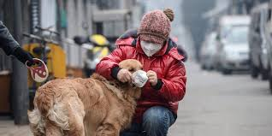
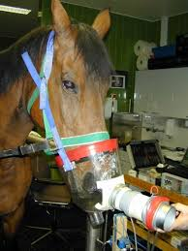


Slide 43
Effect on Environment
Ocean acidification,
Acid rain,
SMOG,
Global warming,
Reduced visibility,
Infertile land,
Climate change.

Slide 44
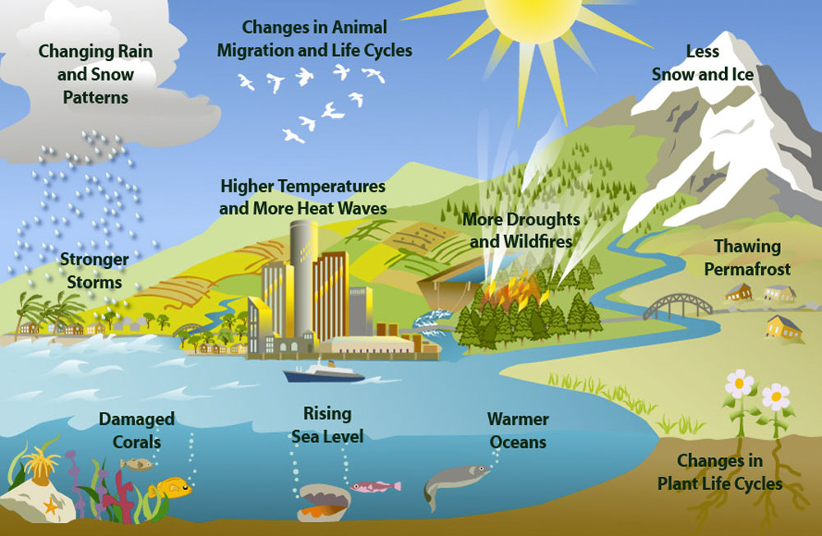

Slide 45
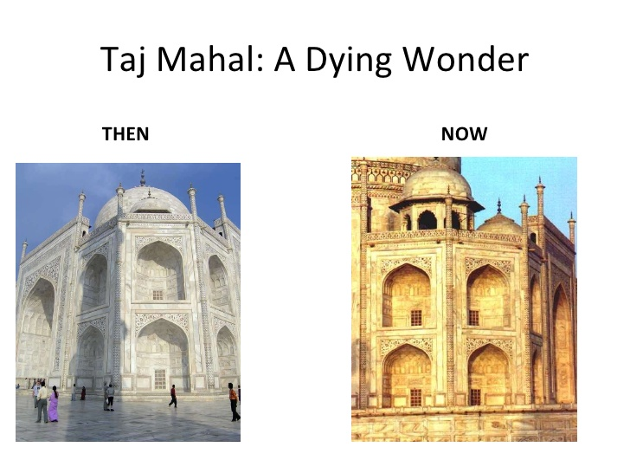
Effect on Buildings
Acid rain cause discoloration, material loss and structural failure,
Damage ferrous and non ferrous material like aluminum copper and silver.

Slide 46
Controlling Air Pollution
Legal efforts are being formed. such as AIR ACT,1981.
Standards laid down by State Board.
Failing person can be imprisoned for 1-1/2 to 6 months or fine 5000rs per day,
CLEAN – India programme- to provide awareness to achieve the aim of sustainable development

Slide 47
Efforts at Individual levels
Use of public transportation/car pooling,
Use of CNG in vehicles,
Use of solar energy,
Industries should be located on the outskirts of the city,
Dried leaves should be used as compost,
Switch of light, fans air conditioners,
More and more tree plantation.

Slide 48
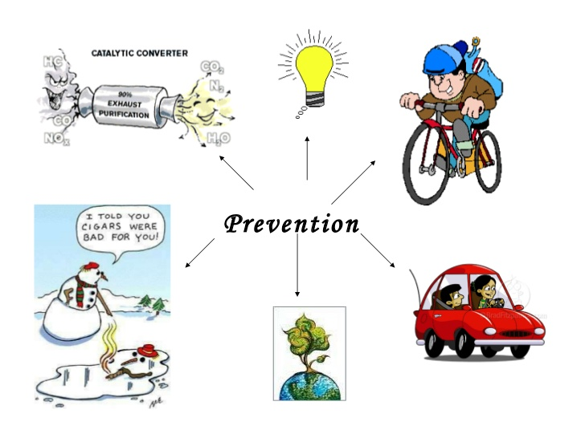

Slide 49
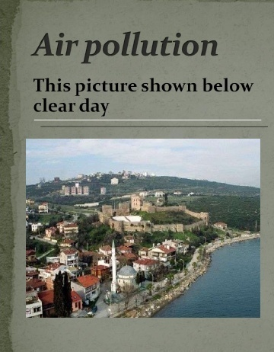
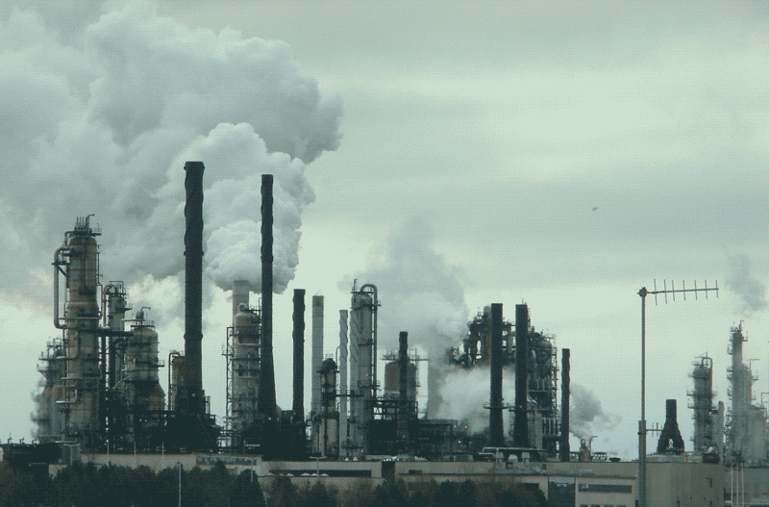

Slide 50
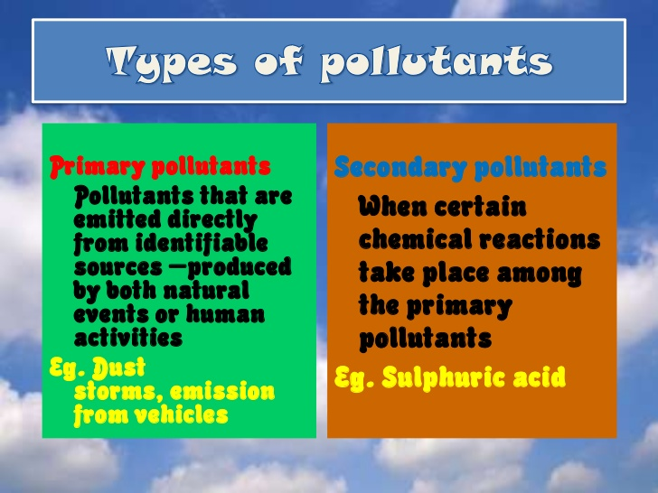
AIR POLLUTANTS
Air pollutant is a substance in the air that can causes harm to humans and the environment.

Slide 51
MAJOR POLLUTANTS
CARBON COMPOUNDS : It consists of carbon monoxide and carbon dioxide.
(CO) is a colourless , odourless and a very poisonous gas.
Incomplete combustion of fossil fuels and vehicular exhaust .
2. SULPHUR COMPOUNDS : It produced during smelting of metallic ores like zinc and copper.

Slide 52
Sulphur released from volcanic eruption, coal pits, forms sulphuric acid which causes acid rain.
3. CHLOROFLUROCARBONS (CFCs) : These are used as coolant like Refrigerators, Air conditioners.
4. Volatile Organic Compounds: VOCs are other major air pollutants.
Methane contributes a lot to enhanced global warming.
Produced by burning fuels such as wood, coal, oil. Solvents like paints, glues etc.

Slide 53
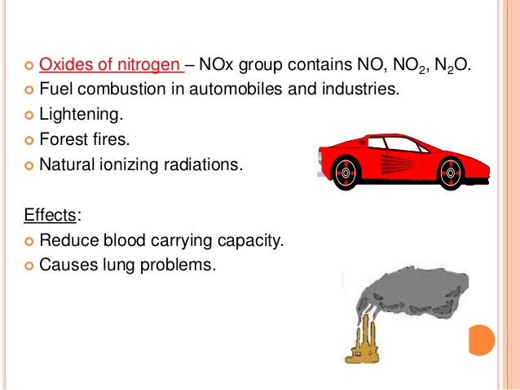

Slide 54
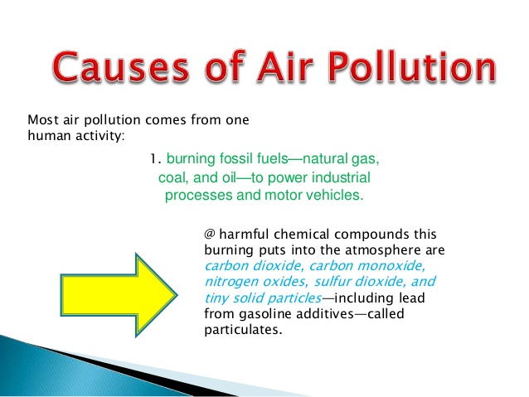

Slide 55
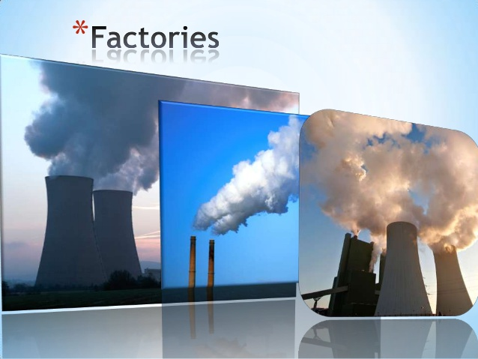
2. VARIOUS FACTORIES AND INDUSTRIES

Slide 56

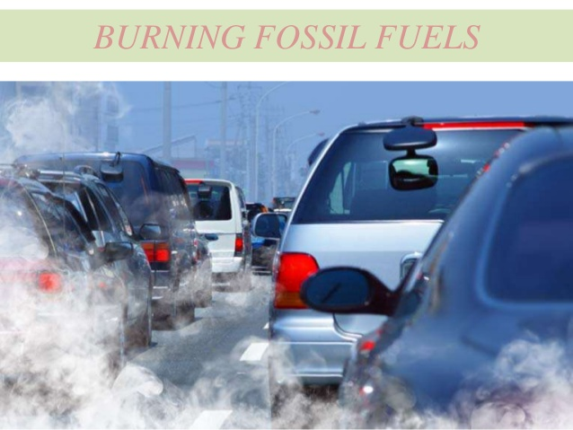
3. AUTOMOBILES EXHAUST

Slide 57
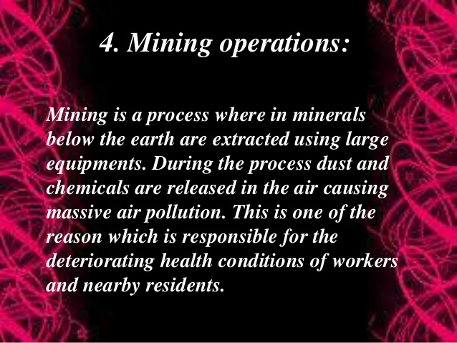

Slide 58
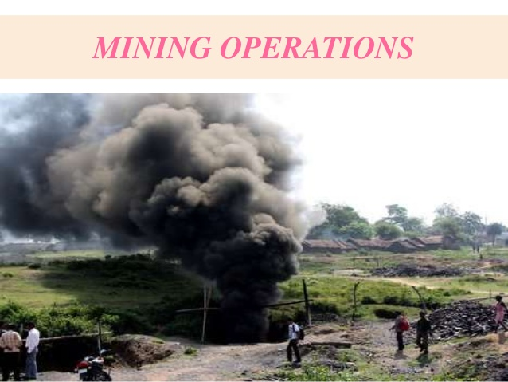

Slide 59
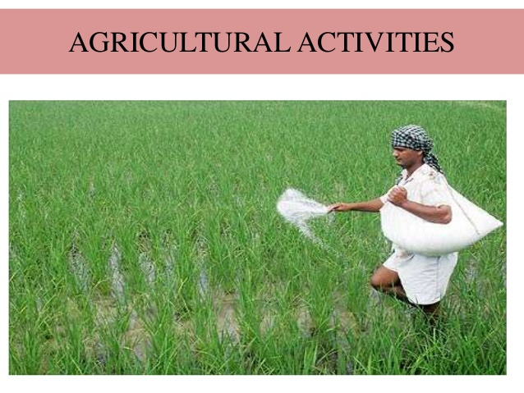

Slide 60
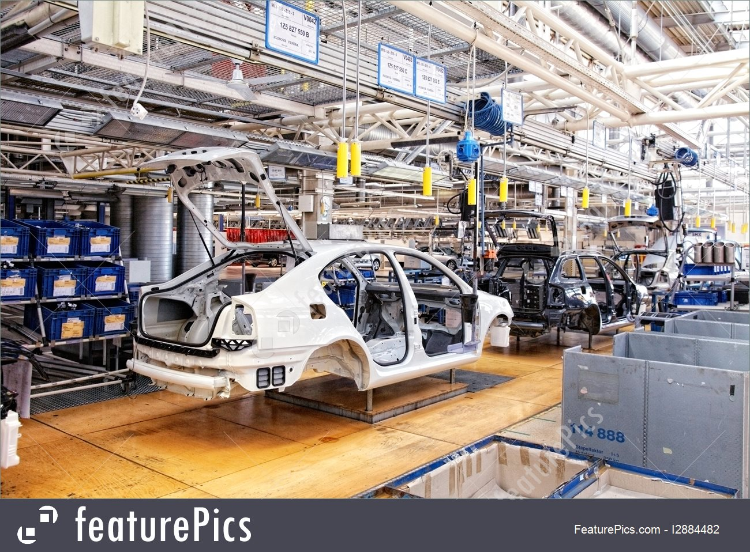
6. AUTO MANUFACTURING
THE INCREASED PRODUCTION OF VEHICLES HAS LED TO THE INCREASE OF USAGE OF ORGANIC PRODUCTS AND HEAVY METALS.

Slide 61
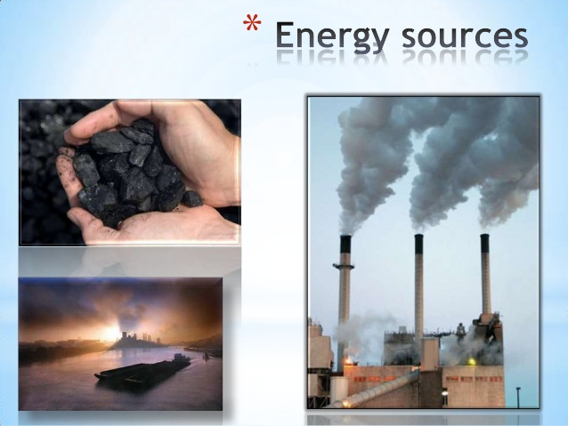
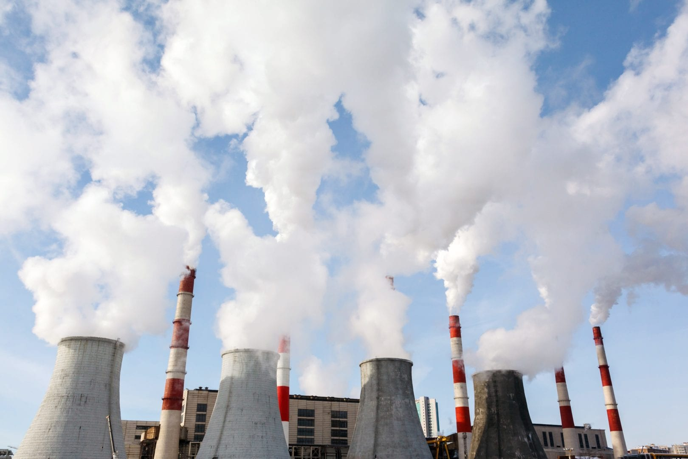
HEAT AND POWER GENERATION FACILITIES
During the process of combustion of waste leads to the release of toxic air pollutants like carbon monoxide, methane etc.

Slide 62
EFFECTS OF AIR POLLUTION
HEALTH EFFECTS : Diseases such as lung cancer, heart diseases, respiratory diseases, irritation to the eyes
Effects on Plants : Due to harmful pollutants the colour of leaf becomes yellow.
some plants even show reduction in growth.

Slide 63
EFFECTS ON ANIMALS : Air Pollution can cause respiratory Problems in animals.
Sea animals are also affect due to climate changes.
ENVIRONMENTAL EFFECTS : Major causes of various environmental disorders including:
ACID RAIN
OCEAN ACIDIFICATION
GLOBAL WARMING
DEPLETION OF OZONE LAYER

Slide 64
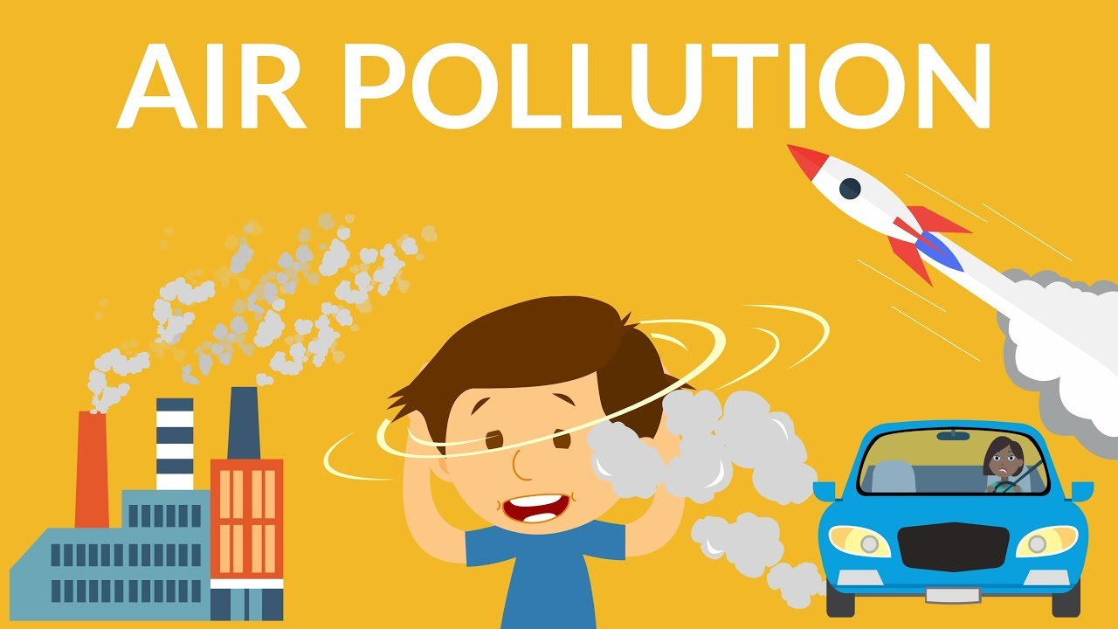

Slide 65
CONTROLLING AIR POLLUTION
THE AIR (Prevention and control of pollution) Act 1981: To prevent , control of air pollution.
The Clean India Programme : is a nationwide programme on environmental assessment , awareness, action involving school students and communities.
Other efforts at individual level

Slide 66
Public transport should be preferred to personal vehicles.
For going to a nearby place, walking or cycles should be preferred.
Sulphur free fuel like CNG
Try to use alternative energy like solar energy, hydroelectric energy and wind energy.
Dried leaves and kitchen waste must be utilized as compost instead of burning them.
Switch off lights, fans, Acs, when not in use.
A large no. of trees should be planted. Trees help in purifying the air.

Slide 67
LAND POLLUTION

Slide 68
INTRODUCTION
Historically, land was used to dump all
sort of waste. No efforts were made to
clean the land. In 1970s the tide of land
pollution swept the whole world and there
was much public concern about the
pollution of the land.

Slide 69
MEANING AND DEFINATION
For a layman,
“Land pollution is
the pollution of
our earth’s land
surface.
Soil pollution is the
contamination of soil
by considerable
quantities of chemicals
or other substances.

Slide 70
SOURCES OF LAND POLLUTION
Herbicides and Pesticides
Industrial Wastes
Urban Waste
Radioactive Pollutants
Acid Rains
Chemical and Metallic Pollutants
Sewage Sludge
Heavy Metals

Slide 71
CAUSES OF LAND POLLUTION
Urbanization
Scrap Metal
Non-biodegradable Waste
Plastic Products
Deforestation
Garbage
Fertilizers
Water Lodging

Slide 72
EFFECTS OF LAND POLLUTION
Loss of Soil Fertility
Effect on Respiratory System
Effect on Pesticides
Skin Problems
Effect on Flora and Fauna
Dangerous Diseases
Birth Effects
Water

Slide 73
CONTROLLING LAND POLLUTION
Reducing Fertilizers and Pesticides use
Reusing the Materials
Landfills
Reducing Weed Growth
Reforestation
Using Different Methods in Harvesting
Recycling and Recovery Materials

Slide 74


Slide 75


Slide 76


Slide 77


Slide 78


Slide 79


Slide 80


Slide 81


Slide 82


Slide 83


Slide 84


Slide 85


Slide 86


Slide 87


Slide 88


Slide 89


Slide 90


Slide 91


Slide 92


Slide 93


Slide 94
CONCLUSION
Clearly the problems associated with the
pollution have the capabilities
to disrupt life on our planet to a great
extent. Time has come when we must
learn about the ways of disposing wastes,
using recycling and reusing techniques

