Slide 1
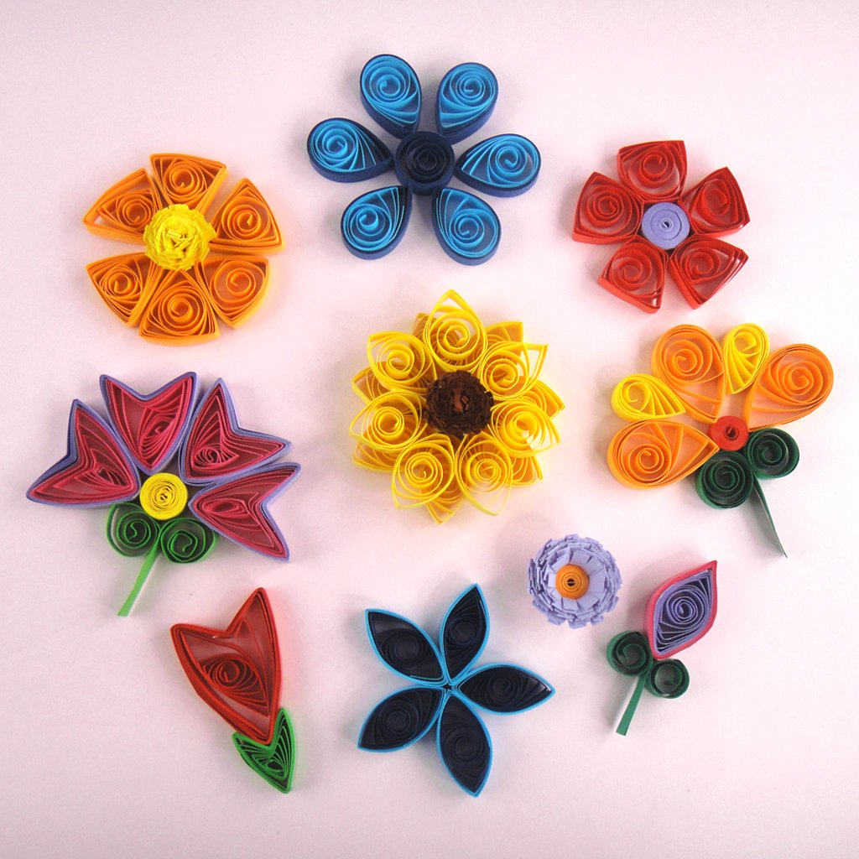
TOPIC: TYPES OF TEST ITEMS

Slide 2
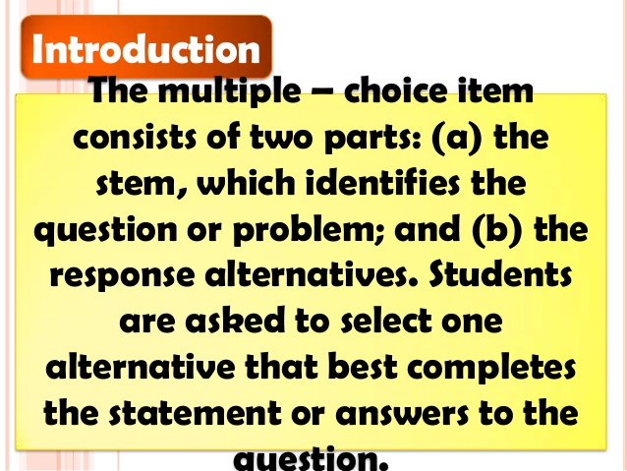
1. MULTIPLE CHOICE TEST ITEMS :

Slide 3

Types
TYPES OF MULTIPLE CHOICE TEST ITEMS :
ONE RIGHT ANSWER TYPE
BEST ANSWER TYPE
WORST ANSWER TYPE
ANALOGY TYPE

Slide 4
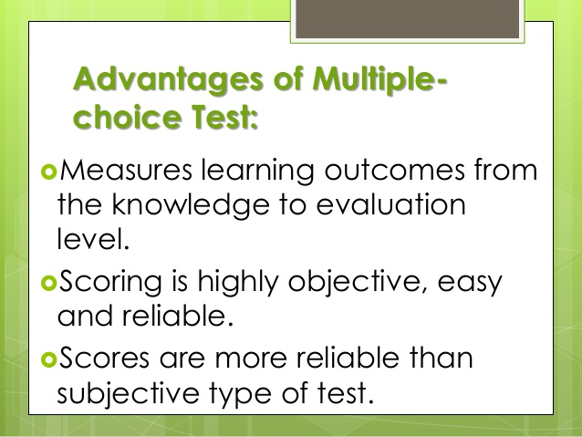
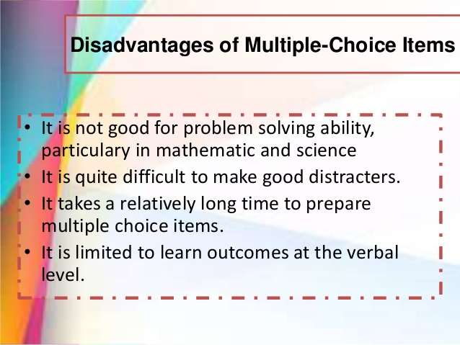

Slide 6

2.TRUE/FALSE OR ALTERNATE RESPONSE ITEMS :
In alternative category items can be written in several forms :true-false , right -wrong , correct -incorrect and two optional multiple choice
TYPES OF TRUE/FALSE RESPONSE ITEMS
True/false or two response items
Simple three response items
Correction items
Cluster-form items
Modified true/false items
Alternative answers items
True/ false or two response items
Simple three response items
Correction items
Cluster-form items
Alternative answeritems type
Modified true /false items

Slide 7
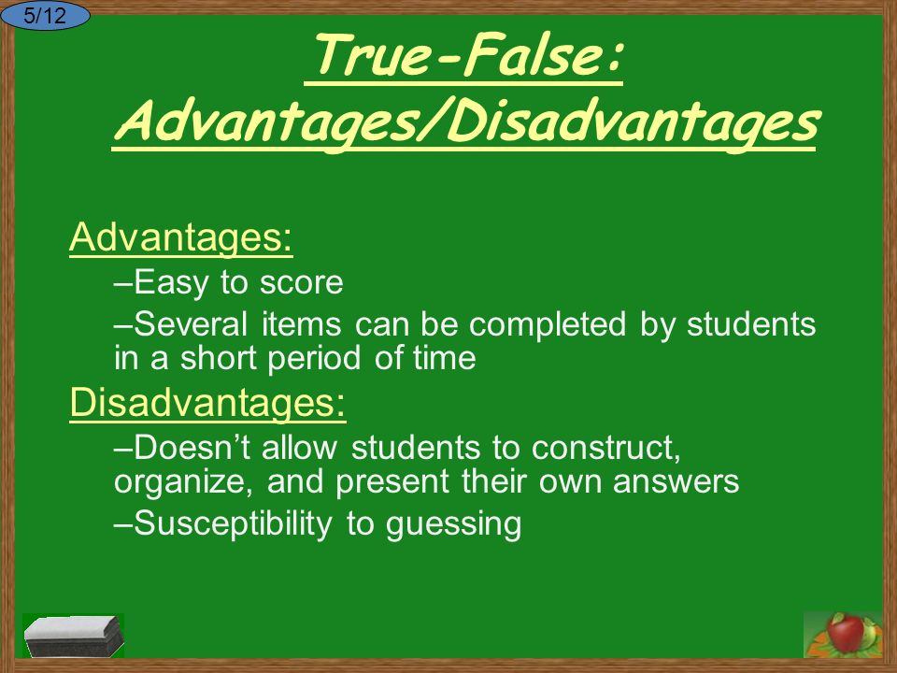

Slide 8
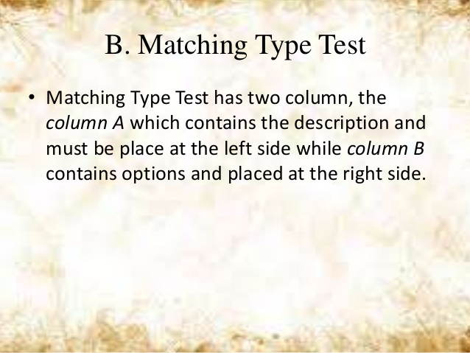
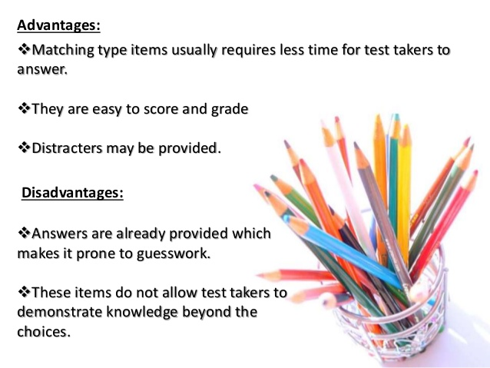
3

Slide 9

4. CLASSIFICATION TYPE ITEMS
In these items, some words or phrases are given, one of which is not related to other. The examinee has to find out that word or phrase.
Example : There are five words, but one word dose not belong to the group. It should be underlined.
1.AGRA, ALIGARH, DELHI, BENGAL, CHANDIGARH.

Slide 10


