Slide 1

SLOW LEARNERS

Slide 2

INTRODUCTION
Who is a slow learner?
Below Average
Low in achieving academic skills
Lag behind in social, emotional
and psychological well being
Very poor in meeting academic
requirements
Perform poorly in school
Inadequate copying skills
Learning rate is slower than
average rate

Slide 3
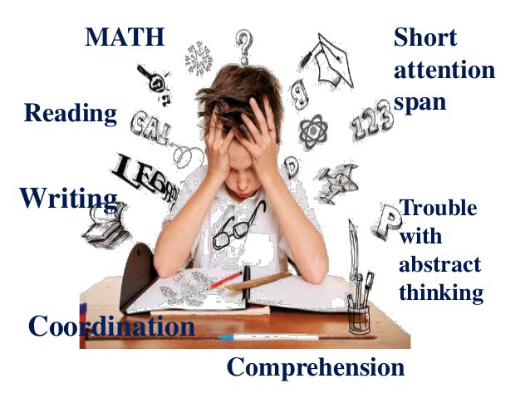

Slide 4
SPECIAL ATTENTION FOR SLOW LEARNERS
The handicaps of physically disabled such as blind ,deaf, dumb, lame etc are apparent to the observer but the handicaps of the slow learners are not always so obvious.
Their handicap is related to their power of thinking and their ability to learn.
They are therefore not so able as most children to meet the normal demands of education and life in modern society.

Slide 5
TYPE OF BACKWARD LEARNERS :
THE FIRST CATEGORY:
It consist of ill health, limited verbal experiences at home and emotional disturbances. They need special educational treatment outside the ordinary schools.
THE SECOND CATEGORY:
It consist of under achievers whose ability is not quite so limited but who nevertheless have more difficulty in learning than average children. failure to recognize and provide for their problem is one of the main contributory causes of their backwardness.
THE THIRD CATEGORY:
It consist of slow learners who have very limited cognitive ability. The causes of their failure range from specific perceptual difficulties to emotional maladjustment. These students need some form of special or remedial teaching to make a marked progress.

Slide 6
CHARACTERISTICS OF SLOW LEARNERS
LIMITED COGNITIVE CAPACITY
INABILITY TO EXPRESS IDEAS
POOR IN HANDWRITING
EMOTIONALLY UNSTABLE
POOR MEMORY
DISTRACTION AND LACK OF CONCENTRATION
POOR PERCEPTUAL ABILITY
POOR IN SOCIAL QUALITIES
INDULGE IN ANTISOCIAL ACTIVITIES

Slide 7
CAUSES OF SLOW LEARNERS
POVERTY :
By impairing children health.
By reducing their learning capacity.
EMOTIONAL FACTORS:
It has already confirmed that slow learning of students is also affected by emotional factors.
INTELLIGENCE OF FAMILY MEMBERS:
Learning is also influence by the intelligence level of his parents as well as family members.

Slide 8
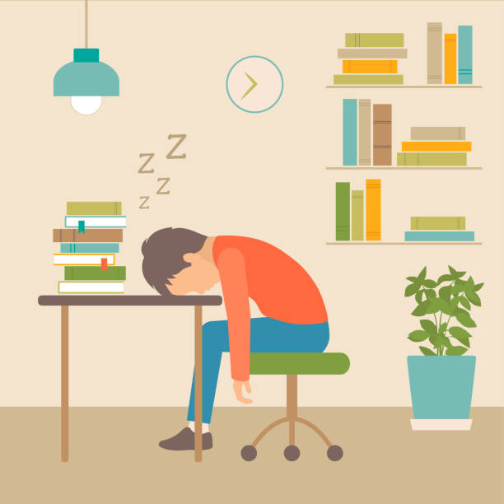
PERSONAL FACTORS:
Slow learning also affected by:
Physical deformities.
Pathological body conditions.
Defects in eye sight.
Defects in hearing and speech.

Slide 9
INDENTIFICATIONS OF SLOW LEARNERS
Early diagnosis of slow learner is necessary at the early stage. Teachers can indentify slow learner through the following techniques.
OBSERVATION:
Continuous observations may be done by teacher by watching the child’s behavior directly or indirectly.
A child’s behavior is not only observed in the classroom but outside also. observation may be done under simple as well as controllable conditions.
The teacher should analyze and interpret the information he/she gets from his/her observation.
To screen the children for slow learners, teachers can use the above tool/checklist.

Slide 10
Before using the checklist on a child, teacher has to make sure that symptoms must be persistent for 5 to 6 months in functioning and it causes significant impairment.
If a teacher find ”YES” to more than 5 behaviors of a child than the child may be considered as a slow learner. However, he/she cannot be tagged as a slow learner.
2. SCHOLASTIC TESTS:
These tests can throw light on areas like Arithmetic, Reading, Spelling, Composition, Writing ,language and comprehension.
General and specific problems of children are identified by the teacher through scholastic tests and cause of anomalies can also be evaluated properly.
Assessment of children’s performance in specific subject is to be based on the cumulative record.

Slide 11

3. CASE STUDY:
Case study is the process of studying and recording the history of a child, his/her family, early life and home environment over a period of time.
It enables the teacher to study the learning difficulties, adjustment problems and behavioral problems of the child.

Slide 12
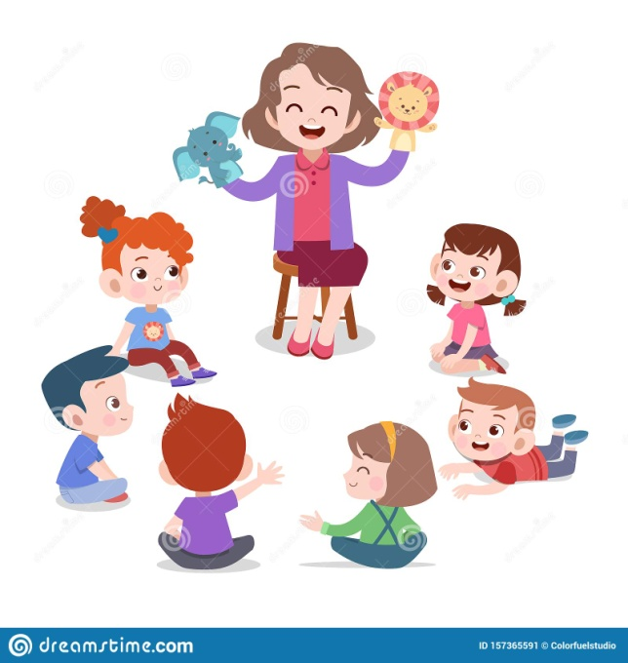
EDUCATIONAL PROGRAMMES F0R SLOW LEARNERS
Healthy Environment
Motivating the slow learners
Regular medical checkup
Individual attention
Development of self-confidence
Flexibility in curriculum
Special method of teaching
Peer tutoring
cross age tutoring
same age tutoring

Slide 13
conclusion
The slow learner requires more help and time to acquire the skills than his average peer . Praising and motivating the child at every stage generates wonders and joy in learning . By different learning style a teacher can increase their learning process. It is only in the hands of the individual teachers to follow the effective techniques, to support the slow learners.

Slide 14


