Slide 1


Slide 2
ROLE OF INDIVIDUAL IN CONSERVATION OF NATURAL RESURCES
Society is build by individuals. If individual of a society are aware they can wake a society progress and prosper. People using natural resources and over exploited it and continue to do so. We have to conserve it

Slide 3
How we conserve natural resources in following ways
Conservation of forest resources
Conservation of land resources
Conservation of water resources
Conservation of energy resources
Conservation of food resources

Slide 4
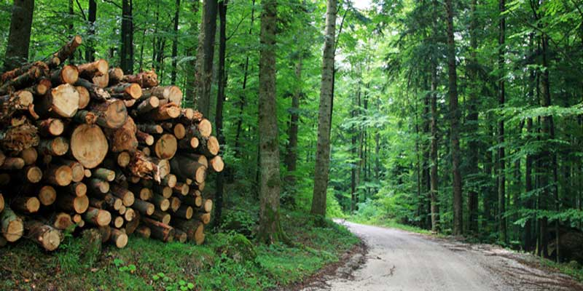
CONSERVATION OF FOREST RESOURCES
Each individual should follow each one teach one , plant one.
Use recycler paper, write both sides of paper.
Motivate people to grow more tree
If trees are cut for timbers ensure new tress are planted
Use substitute of wood
Use old method of teaching
Encourage diverse plantation
Organised programmes like ‘Van Mahotsav’ in institutions to make people aware.
Control over forest fire
Sustained yield by afforestation and reforestation
Proper utilisation of forest and forest product

Slide 5
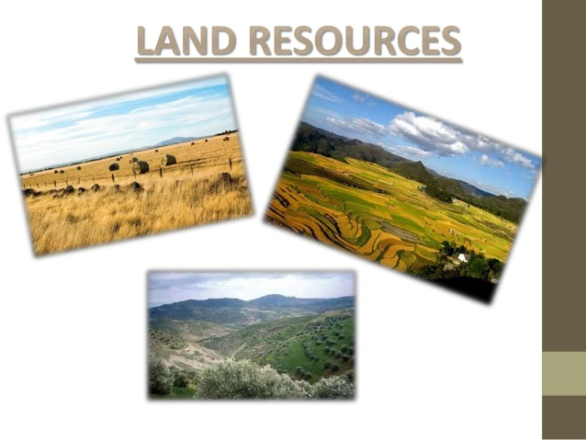
CONSERVATION OF LAND RESOURCES
Avoid using articles which causes land pollution
Use recycle product
Do not over use chemical fertilizers
Avoid over grazing
Check soil erosion
Avoid use of polyethene
Terrace farming
Use septic tank in villages

Slide 6
CONSERVATION OF WATER RESOURCES
QUICK FACTS :-
Total volume of water on earth surface 90%
Usable fresh water 2.5%
Fresh water in ice sheets 70%
Stored ground water 30%
Rainfall in India 4%
Water availability per person 133

Slide 7
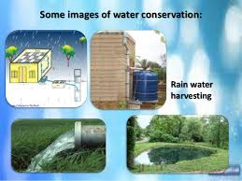
Use minimum water for day to day activites
Use sprinklers methods for irrigation
Follow cropping patterns as per environment conditions
Rain water harvesting
Use bucket of water for both
Keep the tap closed while brushing
Reuse water household level
Waste should not throw in water bodies
Use dual flush toilet
Use cold water instead of warm water
Use grey water in toilet

Slide 8

CONSERVATION OF ENERGY RESOURCES
Turn off electric appliances when not in use
Use energy efficient device
Prefer public transport
Use solar cooker , heater
Use pressure cooker
Use fresh cooked food
Avoid using less electric appliances
Use traditional knowledge to save energy
Use CFL instead of electric bulb
Gobar gas plants should be installed
Use light colour for walls

Slide 9
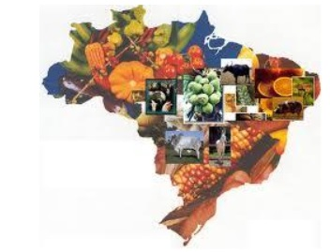
CONSERVATION OF FOOD RESOURCES
Do not waste food
Make efficient use of available food resources
Make use of community resources
Educate people about population pressure on food resources
Avoid using packaged food as it encourages waste generation

Slide 10


