Slide 1
PHYSICAL FITNESS

Slide 2
MEANING
Physical fitness is a state of health and well-being and, more specifically, the ability to perform aspects of sports, occupations and daily activities.
Physical fitness is generally achieved
through proper nutrition
moderate-vigorous physical exercise
and sufficient rest.[

Slide 3
MEANING
Before the industrial revolution, fitness was defined as the capacity to carry out the day’s activities without undue fatigue.
However, with automation and changes in lifestyles physical fitness is now considered a measure of the body's ability to function efficiently and effectively in work and
leisure activities, to be healthy, to resist hypokinetic diseases,
and to meet emergency situations.

Slide 4
COMPONENTS OF PHYSICAL FITNESS
1. Muscular Strength
This is the "power" that helps you to lift and carry heavy objects. Without muscular strength, your body would be weak and unable to keep up with the demands placed upon it.
The way to increase strength is to train with heavy weights, working in the 4 - 6 or 12 - 15 rep ranges. The heavier the weight, the fewer reps you should perform!

Slide 5
2. Muscular Endurance
Endurance is the ability of your muscles to perform contractions for extended periods of time. Rather than just lifting or carrying something for a few seconds, the muscles are used for minutes.
The way to increase strength is to train with light weights, working in the 20 - 25 rep range. Working with lighter weight will train the muscle fibers needed for muscular endurance, and the higher rep range leads to a longer period of exercise.

Slide 6
3. Cardiovascular Endurance
Cardiovascular endurance is your body's ability to keep up with exercise like running, jogging, swimming, cycling, and anything that forces your cardiovascular system (lungs, heart, blood vessels) to work for extended periods of time. Together, the heart and lungs fuel your body with the oxygen needed by your muscles, ensuring that they have the oxygen needed for the work they are doing.
The Cooper Run (running as far as possible in 12 minutes) is a test commonly used to assess cardiovascular endurance, but many trainers use the Step Test (stepping onto a platform for 5 minutes). Both are accurate measures of a subject's cardiovascular endurance.

Slide 7
4. Flexibility
Flexibility is one of the most important, yet often overlooked, components of physical fitness. Without flexibility, the muscles and joints would grow stiff and movement would be limited. Flexibility training ensures that your body can move through its entire range of motion without pain or stiffness.
To test your flexibility, lean forward and try to touch your toes. Those with good flexibility will usually be able to touch their toes, while those with limited flexibility will not. The sit and reach test (sitting on the floor and reaching toward your toes) is another good way to assess your flexibility. The more flexible you are, the closer you will come to touching your toes and beyond.

Slide 8
5. Body Fat Composition
Body fat composition refers to the amount of fat on your body. For example, a 100-pound person with a 25% body fat composition will have a lean body mass of 75 pounds.

Slide 9
CONTD….
To qualify as fit:
Men must have a body fat composition lower than 17 percent
Women must have a body fat composition lower than 24 percent
The average man tends to have about 18 to 24 percent body fat, while the average woman has 25 to 31 percent body fat.
Any program that neglects one or more of these types of fitness is NOT going to benefit your body in the long run. An effective fitness program will attempt to improve all five components of fitness!

Slide 10
Factors usually affect the Physical Fitness
Diet:- Diet plays a major role in fitness . it influences the level of physical fitness and wellness of an individual. Lack of proper nutrition in diet affect our physical fitness
Amount of Training:- The amount of training we perform also influences the physical fitness. Excessive training affects our physical fitness, we should always perform right amount of training
Rest and Relaxation:- Relaxation and rest additionally influence the physical fitness of a person. We should take proper rest in order to maintain our fitness.
Regular Exercise:- Regular exercise is one of the most critical factors which affects the physical fitness of an individual.

Slide 11
Age:- Age is also one of the major factors which affects the physical fitness and wellness of an individual. As we grow up, our physical fitness affects a lot.
Stress and Tension: Stress and tension have a very negative effect on physical fitness and wellness of an individual. We should try to avoid taking stress and tension. We can try yoga and meditation to cope with stress and tension.
Gender:- Gender also affects the level of physical fitness and wellness. Man and woman are completely different in physical fitness

Slide 12
Illness:- Illness also affects the physical fitness and wellness of an individual. If a person is ill for a long time it affects his physical fitness.
Heredity:- Sometimes, heredity also plays a critical role in influencing the physical fitness.
Postural Deformities:- Postural deformities also affect the physical fitness and wellness of a person.
Lifestyle:- Lifestyle of a person also affects the physical fitness and wellness. If a person adopts the healthy lifestyle, he will have good physical fitness and wellness.

Slide 13
IMPORTANCE OF PHYSICAL FITNESS
Decrease risk of disease
Feel great physically
Look better
Sleep better
Live longer
Keep in shape so you can enjoy leisure activities
Avoid injury and safely perform work and home chores
Increase mental health and social wellbeing
Quality of life
Harmonious growth
Improved efficiency
Develop social qualities
Prevention of diseases.

Slide 14
Aerobic and
Anaerobic Exercise

Slide 15
What is aerobic exercise?
Physical activity that increases the supply
of oxygen to the muscles, and that can be
continued for a period of time without
resting.
It lowers your resting heart rate and helps
your respiratory and circulatory systems
stay healthy.

Slide 16
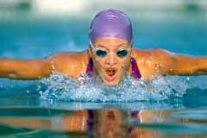
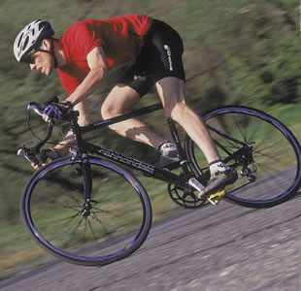
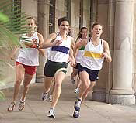
Examples of Aerobic Exercise

Slide 17
What is anaerobic exercise?
Physical activity that increases speed and
muscular strength,
and that cannot be continued for a few minutes without stopping.
It does not necessarily help the body’s respiratory and circulatory systems,
and it does not burn calories as much as aerobic.
It will improve your speed and muscular strength

Slide 18
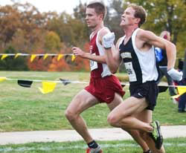
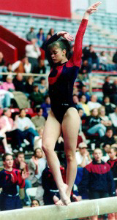
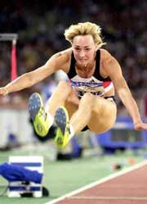
Examples of Anaerobic
Exercise

Slide 19
How to avoid injuries.
Listen to body signals.
Pay attention to sharp pain which signals that something is probably wrong.
Dress for the weather.
Don’t just be a weekend exerciser.

