Slide 1
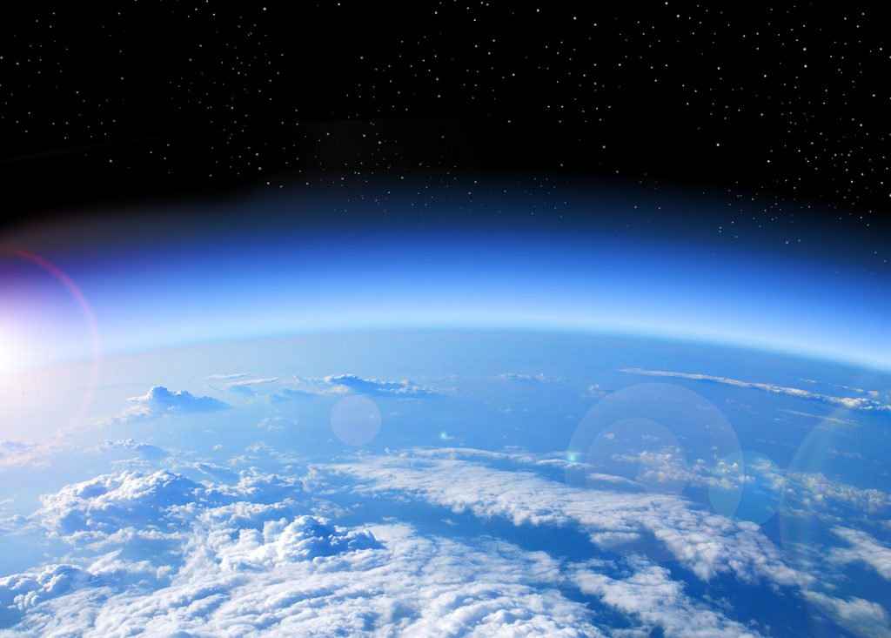
OZONE LAYER DEPLETION

Slide 2

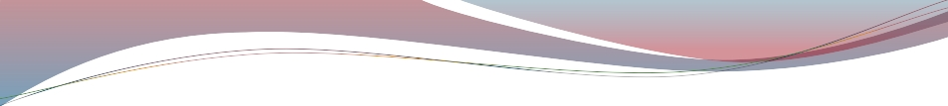

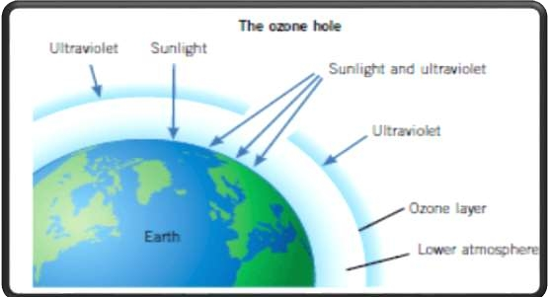
WHAT IS OZONE?
A gas composed of three atoms of oxygen, O 3.
Bluish gas that is harmful to breathe
Nearly 90% of earth’s ozone is in the stratosphere and
referred to as the ozone layer.
Ozone absorbs a band of ultraviolet radiation called UVB.

Slide 3
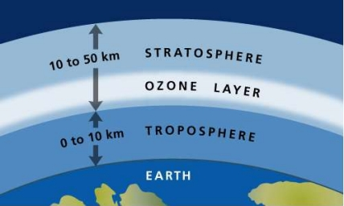
OZONE LAYER
The ozone layer was discovered in 1913 by the French physicists Charles Fabry and Henri Buisson.
The ozone layer refers to a region of Earth's stratosphere that absorbs most of the Sun's UV radiations.

Slide 4
OZONE DEPLETION
The wearing out (reduction) of the amount of ozone in the stratosphere is called ozone layer depletion.
Industries that manufacture things like insulating foams, solvents, soaps, cooling things like Air Conditioners, Refrigerators contain harmful chemicals called chlorofluorocarbons (CFCs) responsible for depletion in ozone layer.

Slide 5
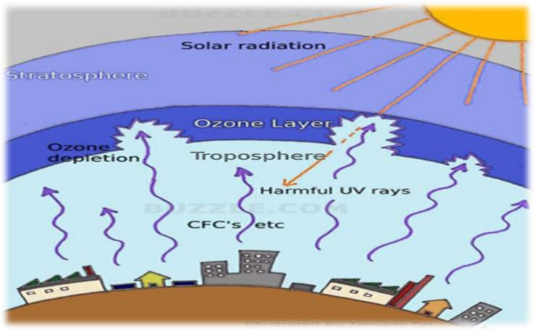
Depletion begins when CFC ’s get into the stratosphere. Ultra
violet radiation from the sun breaks up these CFCs.

Slide 6
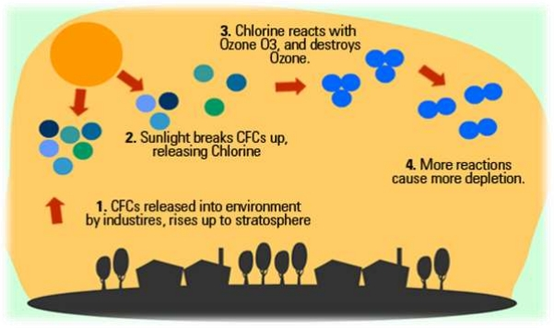
The breaking up action releases Chlorine atoms. Chlorine
atoms react with Ozone, starting a chemical cycle that
destroys the good ozone in that area.
One chlorine atom can break apart more than 100,000
ozone molecules.

Slide 7
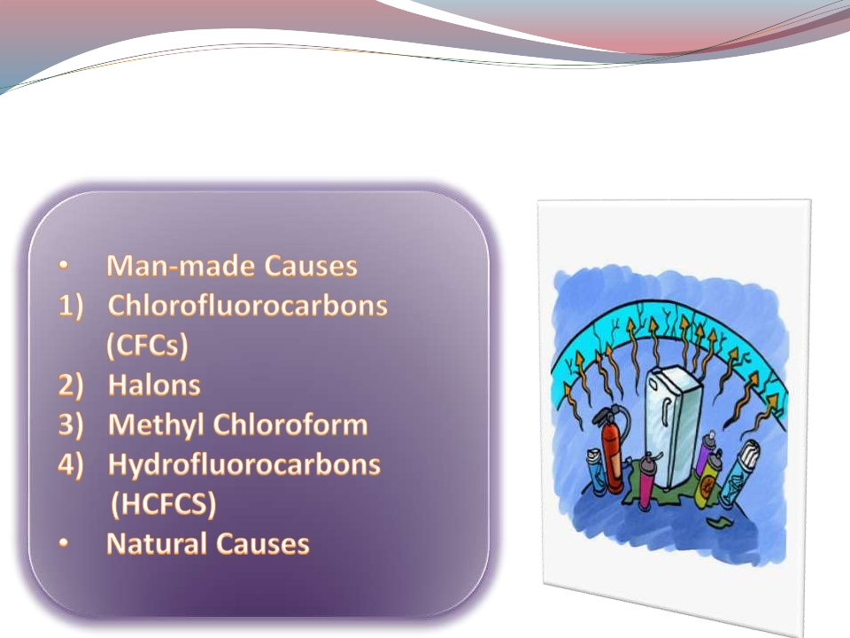
CAUSES OF OZONE
DEPLETION

Slide 8
IMPACTS OF OZONE
DEPLETION
1) HARM TO HUMAN HEALTH:
(a) More skin cancers, sunburns and premature aging of
the skin.
(b) More
cataracts, blindness and other eye diseases.
2) ADVERSE IMPACTS ON AGRICULTURE:
(a) Plant growth, especially in seedlings, is harmed by
more intense UV radiation.
(b) Major crop species are particularly vulnerable to
increased UV, resulting in reduced growth,
photosynthesis and flowering.

Slide 9
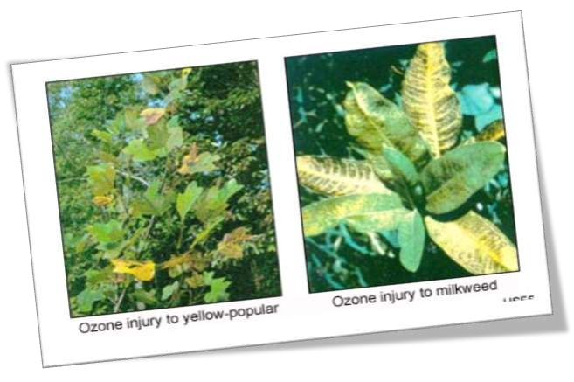
3) EFFECTS ON PLANTS:
Physiological and developmental processes of plants are
affected by UVB radiation, even by the amount of UVB in
present-day sunlight.

Slide 10
4) EFFECT ON ANIMALS:
(a)
In animals, UV overexposure may cause
eye and skin cancers.
(b)
Species of marine animals in their developmental
stage (e.g. young fish, shrimp larvae and crab larvae
have been threatened in recent years by the
increased UV radiation under the Antarctic ozone
hole.)
5) EFFECT ON MATERIALS:
(a)
Wood, plastic, rubber, fabrics and many construction
materials are degraded by UV radiation in terms of quality.

Slide 11
MEASURES TO PREVENT
THE OZONE DEPLETION
1) Limit private vehicle driving
2) Use eco-friendly household cleaning products
3) Avoid using pesticides
4) Developing stringent regulations for
rocket launches
5) Banning the use of dangerous nitrous oxide

Slide 12
The Montreal Protocol, finalized in 1987, is a global agreement to protect the stratospheric ozone layer by phasing out the production and consumption of ozone-depleting substances (ODS).
The United States has been a leader within the Protocol throughout its existence, and has taken strong domestic action to phase out the production and consumption of ODS such as chlorofluorocarbons (CFCs) and halons.
INTERNATIONAL MEASURES

Slide 13

CONCLUSION
Ozone depletion deserves extensive research and attention.
With the release of each and every CFC, our ozone layer takes one small step towards its destruction.
The entire world must unite in order to expel this problem forever.

Slide 14
THANK YOU

