Slide 1
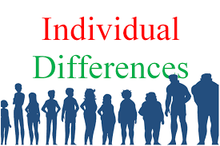
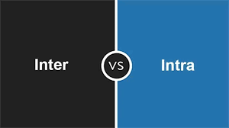

Slide 2
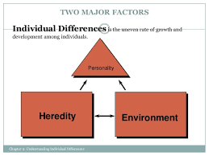

Slide 3
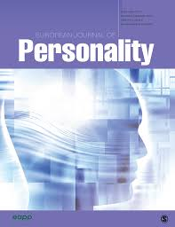
INTRODUCTION
Dissimilarity is principle of nature. No two persons are alike. All the individuals differ from each other.
Every person has the emotions of love, anger, fear and feelings of pleasure and pain. Every man has the need of independence, success and need for acceptance.

Slide 4
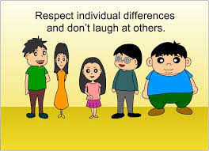

Slide 5
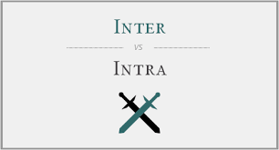
INTER AND INTRA
Inter-individual differences are differences that are observed between people, whereas intra-individual differences are differences that are observed within the same person when they are assessed at different times or in different situations.

Slide 6
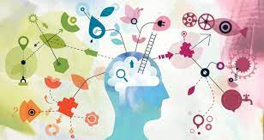
PSYCHOLOGY AND INDIVIDUAL DIFFERENCES
Individuality is the state or quality of being an individual, a person separate from other persons of possessing his or her own needs, goals and desires.
Individual differences typically includes personality, motivation, intelligence, ability, I.Q, interest, values, attitude and self-esteem.

Slide 7
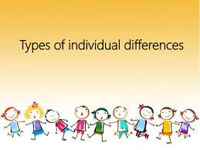

Slide 8
TYPES OF INDIVIDUAL DIFFERENCES
PHYSICAL DIFFERENCES
MENTAL DIFFERENCES
EMOTIONAL DIFFERENCES
DIFFERENCES IN LEARNING
DIFFERENCES IN ACHIEVEMENT
DIFFERENCES IN DEVELOPMENT
DIFFERENCES IN ATTITUDE

Slide 9
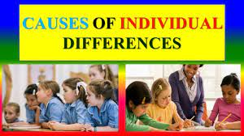

Slide 10
CAUSES OF INDIVIDUAL DIFFERENCES
The cause of individual differences in behaviour among human being are to be found in their varied heredity and environmental condition.
It is now recognized that heredity and environmental influences interact in the production of all the characteristics of the individual.
Individual differences occuring under the same heredity may be difference due to environmental factor and vice versa.
Both heredity and environment play an important role in the development of the personality of an individual and human behaviour.
It is due to heredity and environment that individual differ in physique, character, ambition, values, beliefs, philosophy, temperament, habits, etc.

Slide 11
DIMENSIONS OF INDIVIDUAL DIFFERENCES
Differences in physical growth and development.
Differences in motor skills and related abilities.
Differences in emotional development.
Differences in interests.
Differences in aptitudes.
Differences in values.
Differences in study habits.
Differences in motivation and achievements.

Slide 12
METHODS FOR MEASURING INDIVIDUAL DIFFERENCES
Differential method: English Biologist, Sir Francis Galton was primarily responsible for launching the testing movement on its course. Galton realised the need for measuring the characteristics of related and unrelated persons.
Survey method : another method for measuring the individual differences among human beings is a survey method. In cases where the nature of problems makes laboratory study unfeasible, the Psychologists often goes into the field and make observation of events as they occur. This method makes use of various techniques of collecting data such as tests, questionnaire, observation, interview and use of statistics in analyzing the data.

Slide 13
SURVEY METHOD
FIELD STUDY
DEVELOPMENT
STUDY
DIFFERENTIAL
SURVEY

Slide 14
ROLE OF HEREDITY AND ENVIRONMENT IN INDIVIDUAL DIFFERENCES
Man’s behaviour is influenced by two factors heredity and environment.
The biological characteristics which are transmitted bye the parents to their offspring are heredity.
Heredity traits are innate, they are present at birth.
Difference in traits are due to differences in environment.

Slide 15
INDIVIDUAL DIFFERENCES AND STRESS
Self – esteem : less likely to experience work as stressful.
Tolerance for ambiguity: less likely to see role ambiguity and role conflict as stressful.
Employers reaction : react differently in response to their perception of reality.

Slide 16
GENDER DIFFERENCE APPROACH
Women have greater skills in memory, hand , writing, linguistic ability , drawing and young girl take interest in stories of love and fairy tales.
Men shows greater motor activities, logic skills, physical and chemistry studies and boys take interest in bravery , science , war, scouting, stories of games and sports, games of occupation and skills.
More men are colour blind then women.
Hence , to a large extent , gender determines the direction of growth and development of individual.

Slide 17
INDIVIDUAL DIFFERENCES AND ATHLETIC BEHAVIOUR
Individual behavior can be defined as how an individual behaves at work.
A person’s behaviour is influenced by following factors : aptitude, perception and personality.

Slide 18
INDIVIDUAL
DIFFERENCES
INHERITED
ACQUIRED
PHYSICAL/MENTAL
TEMPERMENT
SOCIAL/CULTURE
EDUCATION/
ENVIRONMENT

Slide 19
INDIVIDUAL DIFFERENCES IN PERSONALITY
PHYSICAL DIFFERENCES :
Different in intelligence
Different in attitude
Different in achievement
Difference in motor ability
Different in account of sex
Racial differences
Differences due to economic status.

Slide 20
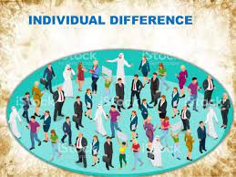

Slide 21
EDUCATIONAL APPLICATIONS OF INDIVIDUAL DIFFERENCES
Individualistic teaching-learning pattern
Knowledge of individual abilities
Strong belief in existence of individual diff.
Methods of instruction
Students grouping
Provision for guidance and counselling
Dynamism in framing and changing curriculum
Manageable size of the class
Individual attention

Slide 22
CONCLUSION
Psychology of individual differences examines how people are similar and how they differ in thinking, feelings and behaviour. For ex. People can be classified according to intelligence and personality characteristics. People are complex, however, there are multiple theories and evidence as to what are the prevailing aspects of psychological differences. Parents as well as teacher should keep individual differences in mind while providing education to children to cater to the differing needs of individuals. Thus, whatever may be the cause, individual differs in their learning abilities.

