Slide 1




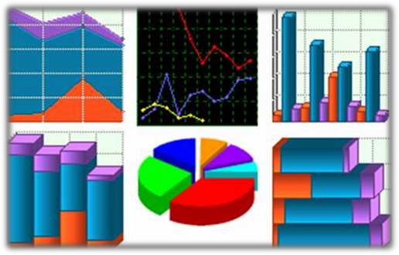
Presentation
on
GRAPHICAL REPRESENTATION OF STATISTICAL DATA

Slide 2

Meaning Of Graphical Representation Of Data
A picture is said to be more effective than words for describing a particular thing.
A graphic representation is the geometrical image of a set of data .
It is a mathematical picture.
It enables us to think about a statistical problem in visual terms.
It is an effective and economic device for the presentation , understanding and interpretation of the collected data.

Slide 3

IMPOTANCE OF GRAPHICAL REPRESENTATION
It is used to make the data understandable to common man.
It helps in easy and quick understanding of data.
Data displayed by graphical representation can be memorised for a long time.
Can be compared at a glance.

Slide 4

Grouped Data
TYPES OF GRAPHICAL REPRESENTATION
Ungrouped Data
 | Line Graph
 | Bar Graph
 | Pie Diagram Or Circle Graph
Histogram
Frequency Polygon
Frequency Curve

Slide 5

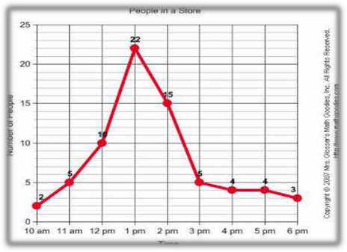
Line graph:
line graphs are simple Mathematical graphs that are drawn on the
graph paper by plotting the data connecting one variable on the horizontal X- axis and other variable of data on the vertical Y-axis.
EXAMPLE:
Time | 10 am | 11 am | 12 pm | 1 pm | 2 pm | 3 pm | 4 pm | 5 pm | 6 pm
No of People | 2 | 6 | 10 | 22 | 15 | 5 | 4 | 4 | 3

Slide 6

Bar graph:
In bar graphs data is represented by bars.
The bars can be made in any direction i.e. vertical or horizontal.
The bars are taken of equal weight and start from a common horizontal or vertical line and their length indicates the corresponding values of statistical data.
When do we use bar diagram ?
When the data are given in whole numbers.
When the data are to be compared easily.

Slide 7

How To Make A Bar Graph ?

Slide 8

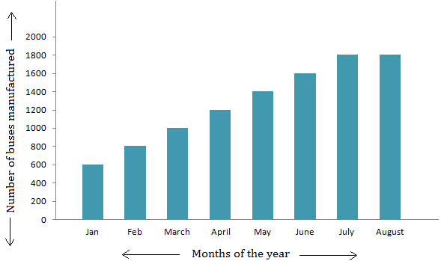
Months | Jan | Feb | Mar | Apr | May | June | Jul | Aug
No. of buses manufacture d | 600 | 800 | 1000 | 1200 | 1400 | 1600 | 1800 | 1800

Slide 9

Pie diagram:
It is a circle in which different components are represented through the sections or portions of a circle.
To draw a pie diagram, first the value of each category is expressed as a percentage of the total and then the angle 360⁰ is divided in the same percentages.
Then at the centre of a circle these angle are drawn simultaneously starting from a particular radius.
In this way we get a set of sectorial areas proportional to the values of the items.

Slide 10

When do we use pie diagram?
When the data are given in percentage.
When different aspect of a variable are to be displayed.
When the data are to be compared normally.

Slide 11

HOW TO MAKE A PIE DIAGRAM ?

Slide 12

EXAMPLE:
(Table: the result of class 10 of a school)
Marks Division | First | Second | Third | Failures
% of student | 20% | 56% | 20% | 4%

Slide 13
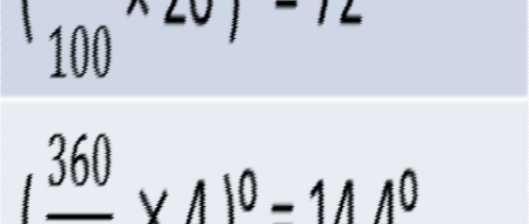
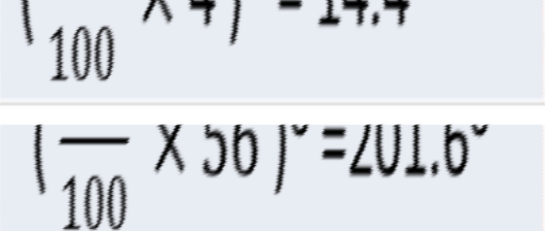
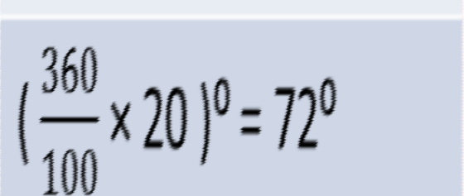
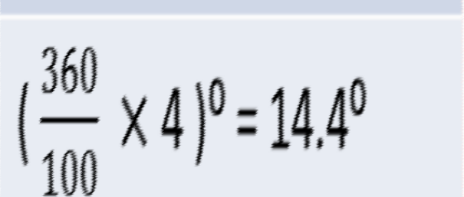
second div.
Marks Division | % of student | Approx . Angle in degree
First | 20%
Second | 56%
Third | 20%
Failures | 4%
first div.
failure
third div.
72
14.4
201.6
72

Slide 14

HISTOGRAM:
A histogram is essentially a bar graph of a frequency distribution.
It can be constructed for equal as well as unequal class intervals.
Area of any rectangle of a histogram is proportional to the frequency of that class.

Slide 15

When do we use histogram ?
When data are given in the form of frequencies.
When class interval has to be displayed by a diagram.
When we need to calculate the Mode of a distribution graphically.

Slide 16


How to make Histogram ?

Slide 17

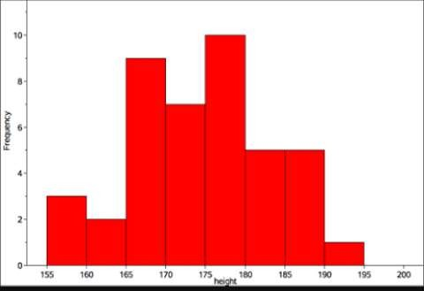
Histogram for equal class width:
Class Interval (Height in cm) | Freq .
155-160 | 3
160-165 | 2
165-170 | 9
170-175 | 7
175-180 | 10
180-185 | 5
185-190 | 5
190-195 | 1

Slide 18

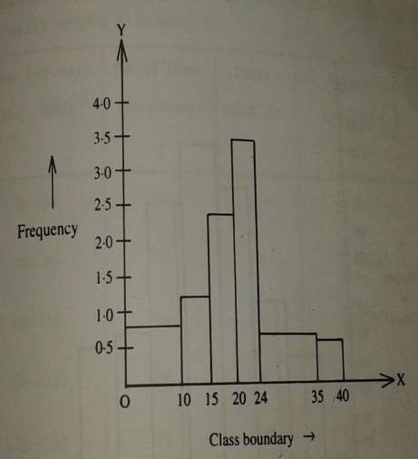
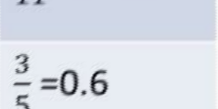
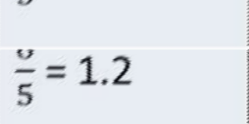
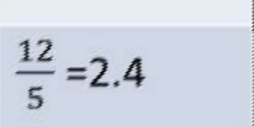
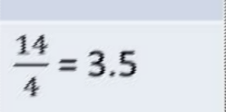
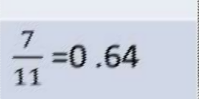
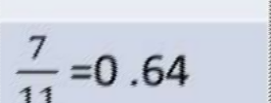
Histogram for unequal class width:
Class bound ary | Fre que ncy | Class Widt h | Frequency Density
0-10 | 8 | 10
10-15 | 6 | 5
15-20 | 12 | 5
20-24 | 14 | 4
24-35 | 7 | 11
35-40 | 3 | 5

Slide 19

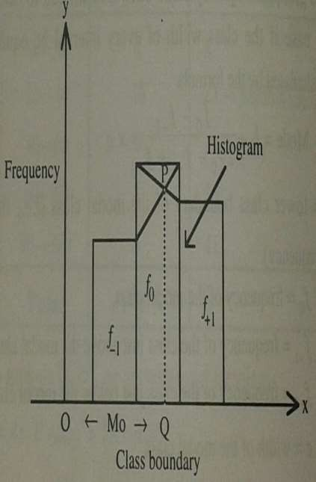
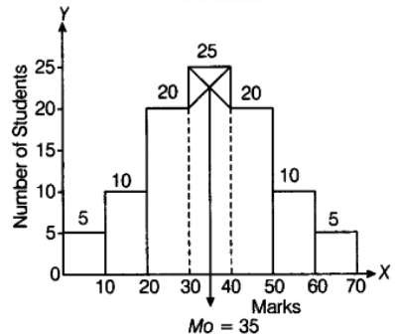
Calculation of MODE through Histogram
Mode = OQ
Mode = 35

Slide 20

CALCULATION 0F MODE
 40,20 and (30,25)
 (30,20) and (40,25)
1st straight line : ^{𝑦−20}
𝑥−40
=
25−20
30−40
5
=> 𝑦 − 20 = ₁₀ ∗ 𝑥 − 40
……………. (1)
2nd Straight line :
𝑦 − 20 25 − 20
=
𝑥 − 30 40 − 30
5
=> 𝑦 − 20 = − ₁₀ ∗ 𝑥 − 30
…………(2)
Solving equations (1) and (2) , we get
𝒙 = 𝟑𝟓

Slide 21

FREQUENCY PLOGON:
A frequency polygon is essentially a line graph .
We can get it from a histogram, if the mid points of the upper bases of the rectangles are connected by straight lines.
But it is not essential to plot a histogram first to draw it.
We can construct it directly from a given frequency distribution.

Slide 22

When do we use Frequency polygon?
When data are given in the form of frequencies.
o When two or more groups have to be displayed in one diagram.
When two or more groups are to be compared.

Slide 23

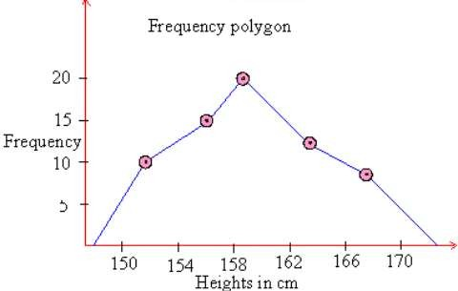
How to draw frequency polygon?
Height in Cm (class interval) | Mid value | frequen cy
150-154 | 152 | 10
154-158 | 156 | 15
158-162 | 160 | 20
162-166 | 164 | 12
166-170 | 168 | 8

Slide 24

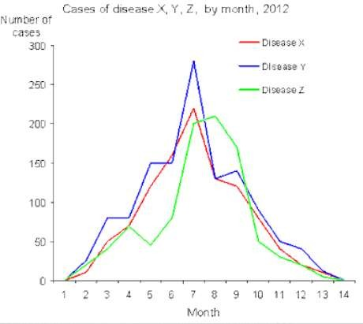
Two or more groups can be compared through Frequency Polygon

Slide 25

FREQUENCY CURVE:
Frequency curve is another type of graphical representation of data.
When then top points of a frequency polygon are joined not by straight lines but by curved ones.
Frequency polygon is drawn using scale while while Frequency curve is drawn using free hand.

Slide 26

When do we use frequency curve ?
When the number of class intervals are very large i.e.,width of the class intervals are very small and the total number of sample values be increased indefinitely.

Slide 27

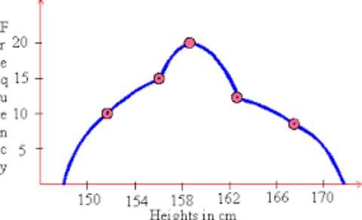
FREQUENCY POLYGON
V/S
FREQUENCY CURVE

Slide 28

CONCLUSION
So we can conclude that statistical data may be presented in a more attractive form with the help of some graphic aids i.e., pictures and diagrams which carries a lot of communication power and the task of understand and interpretation of data becomes simple, accurate and practicable.

Slide 29



