Slide 1

GIFTED CHILDREN

Slide 2

Concept and Meaning of GIFTEDNESS
MEANING- Gifted learners are those whose potential is distinctly above average in below mentioned domains:-
Intellectual
Creative
Social
Physical
They need services and activities not ordinarily provided by the school in order to fully develop their potential.

Slide 3
DEFINITIONS
Sumption and Luecking’s view: “Gifted children are those who posses a superior central nervous system characterized by the potential to perform task requiring a comparatively high degree of intellectual abstraction or creative imagination or both.”
View of Guilford: “the gifted children are those children whose performance is consistently remarkable in music, art, social leadership and other forms of expressions.”

Slide 4

Characteristics of GIFTED CHILDREN
I. Intellectual characteristics
They are quick and have self expression.
They have rich vocabulary.
They are generally better in science and arithmetic.
They posses good common sense and general knowledge.
II. Physical characteristics
Good in their physique and growth.
Taller, stronger, more energetic and healthier.
Pays better coordination and muscular control.

Slide 5

III. Education and occupational characteristics
They learn to read easily
They more advanced in reading and like school.
They superior to their classmates in education activities.
Gifted children tend to be far ahead of average children in academic achievement.
IV. Social characteristics
Many of them are social leaders at school.
Socially, they get along well with others.
They are very eager to co-operate.
They are more trust-worthy and sincere.

Slide 6
V. Moral and ethical characteristics
The gifted children posses moral attitudes, such as fairness, honesty, compassion and justice.
They do the rights and see the right more quickly and profoundly than the average individual.
VI. Emotional characteristics
They are emotionally stable, display emotional maturity and self –sufficient and less prone to neurotic and psychotic disorders.

Slide 7
VII. Personality characteristics
Positive characteristics
Negative characteristics
Express ideas and feeling well
Can move at a rapid pace
Can work consistently
Dominate class discussion
May be making fluent statements with out understanding .
May be impatient to proceed to next level and regulations.
May be frustrated by daily routine work.
May lead discussion “off the track”

Slide 8
CHARACTERISTICS OF GIFTED CHILDREN AS GIVEN BY
CLARK (1988)
CLARK IN 1988, DESCRIBED THE CHARACTERISTICS OF GIFTED CHILDREN ACROSS FIVE DOMAINS:
COGNITIVE
AFFECTIVE
PHYSICAL
INTUITIVE
SOCIETAL

Slide 9
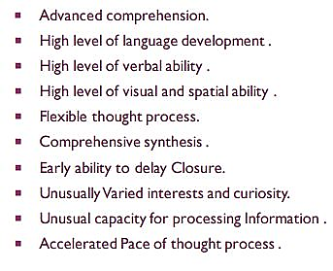
THE COGNITIVE DOMAIN

Slide 10
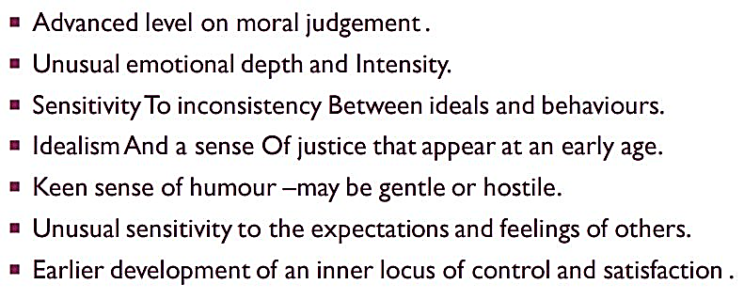
THE AFFECTIVE DOMAIN

Slide 11
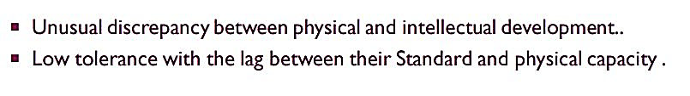
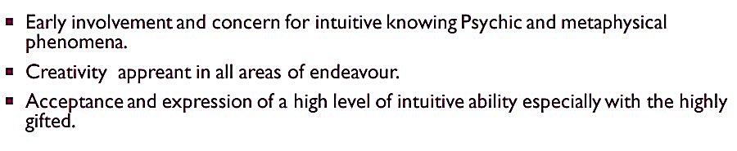
3. THE PHYSICAL DOMAIN
4. THE INTUITIVE DOMAIN

Slide 12
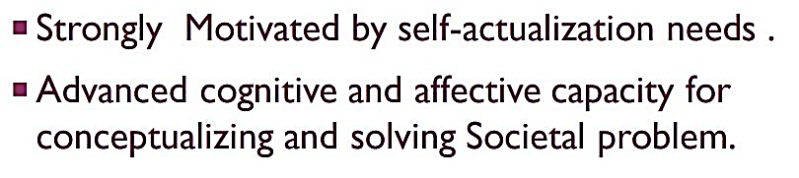

5. THE SOCIETAL DOMAIN

Slide 13
Adjustment problems faced by
GIFTED LEARNERS
SELF ESTEEM ISSUES
JEALOUSY, GUILT
PERFECTIONISM
PEER GROUP ISSUES
ATTENTION AND ORGANISATION
BURNOUT, WEAK HEALTH
UNUSUAL CURIOSITY
INDEPENDENT VIEWS LEAD TO QUARRELS

Slide 14
Causes and Factors for
Maladjustment
Unsuitable curriculum.
Incompetent teachers.
Unintelligent questions of teachers.
Poor library.
Excessive criticism by teacher and peers.
Unintelligent assignment.
Poor socio economic status.
No provision for activities such as intensive work in literature, reviewing books, term papers, editorial etc.

Slide 15
Objectives of education for gifted children.
Carelessness in establishing goals and lack of guidance.
No stimulation or appreciation to individual research or creative work in school and home.
Poor and outdated methods of teaching.
Less challenging work for them.
To develop leadership.
To develop power to work independently.
To develop an attitude of critical thinking.
To develop attentiveness, initiative and creative power
To further increase the range of their knowledge and skill

Slide 16
NEED OF IDENTIFICATION
Society is expanding rapidly and becoming more complex. Therefore so as to meet the shortage of competent pupils important position’s of scientific educational and industrial leader’s, gifted children must be identified.
Gifted children must be identified because they are the children who may invent or discover new things of the benefit of the country in the future life.
When not identified, gifted children may become first class delinquent or truant etc. and their talent may go wasted.

Slide 17
How To Identify
GIFTED LEARNERS?
Identify characteristics
Opinion’s and reports of parent’s, friends and teachers.
Achievement tests
Aptitude tests
Intelligence tests

Slide 18

ROLE OF THE HOME/FAMILY
Identify the gifted children
Make educational provisions for the same
Give them all facilities in the matter of toys and books/ magazines
A gifted child should be handled in a special way. Parents have to play the role of great psychologists.
Parents should assist gifted children in selecting right type of teaching material and other aids.

Slide 19
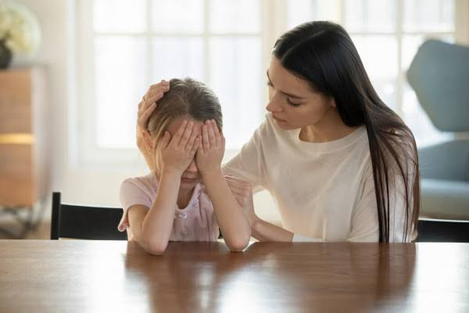
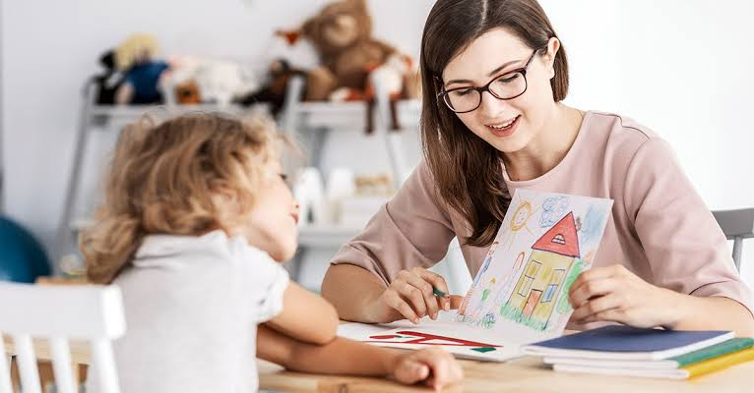
Protect the gifted child from bad company and negetive temptations
Answer the queries of gifted child
Inculcate and encourage the hobbies of gifted child
Provide economic support
Encourage discussion
Promote good mental health
Encourage and appreciate their creative work

Slide 20

SUGGESTIONS FOR TEACHERS
Re-examine teaching methods
Consider gifted children as special projects
Establish goals and select techniques
Discuss the plan with the individual student
Plan with the gifted children as a group
Use large, flexible teaching units
Encourage students to ask questions
Learn ways to evaluate their work

Slide 21
EDUCATIONAL IMPLICATIONS
Identifying the gifted.
Segregation of classes
Rapid promotion
Individual attention
Diversification of courses
To help weak students
Enrichment in co-curricular activities
Engaging in hobby classes
Library, Hostel and scholarship facilities
Competent and noble teachers
Tasks of responsibility
Proper guidance

Slide 22
Existing Programs
Kothari Commission
Navodaya Vidyalayas
Science exhibitions
Essay writing competitions
Competitive examinations
Independent projects
Research and experimentation
Search for talent
Scholarships
Co-curricular activities
Summer vacation programs
Visits
Day-centres
Trained teachers

Slide 23
Any Gifted Child Can Potentially Get In Real Trouble Because Of The Way They Are Handled
– Itzhak Perlman

Slide 24


