Slide 1
Gender stereotypes

Slide 2
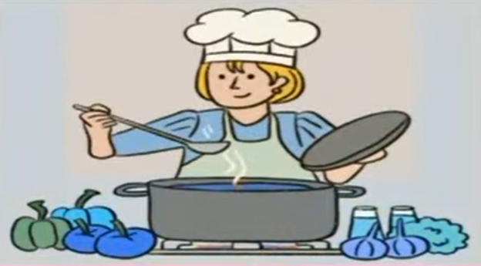
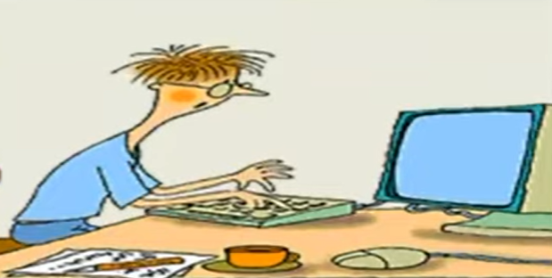
Gender Stereotypes
Stereotypes are characteristics imposed upon groups of people because of their race, nationality and sexual orientation. These characteristics tend to be over simplifications of groups involved. While some people truly do embody the traits of their stereoscope, they are not necessarily representative of all people within that group.
For example, while many people believe the stereotype that all teenagers are lazy, their beliefs are false.

Slide 3

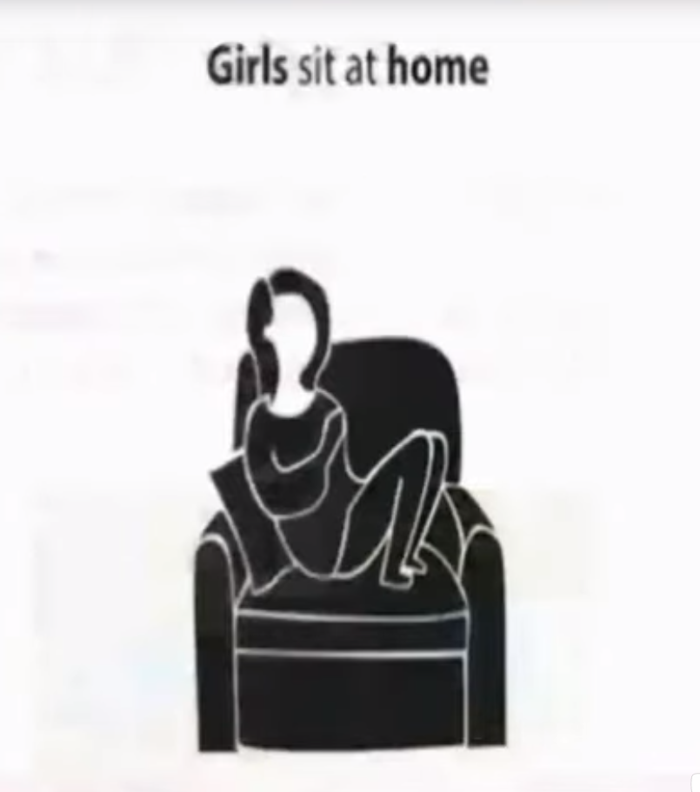
Concepts of Gender Stereotypes
Gender Stereotypes are simplistic generalization about the gender attributes, differences and roles of individuals and/or groups.
Stereotypes can be positive or negative but they rarely communicate accurate information about others.
When people automatically apply gender assumptions to others regardless of evidence to the contrary, they are perpetuating gender stereotyping.

Slide 4
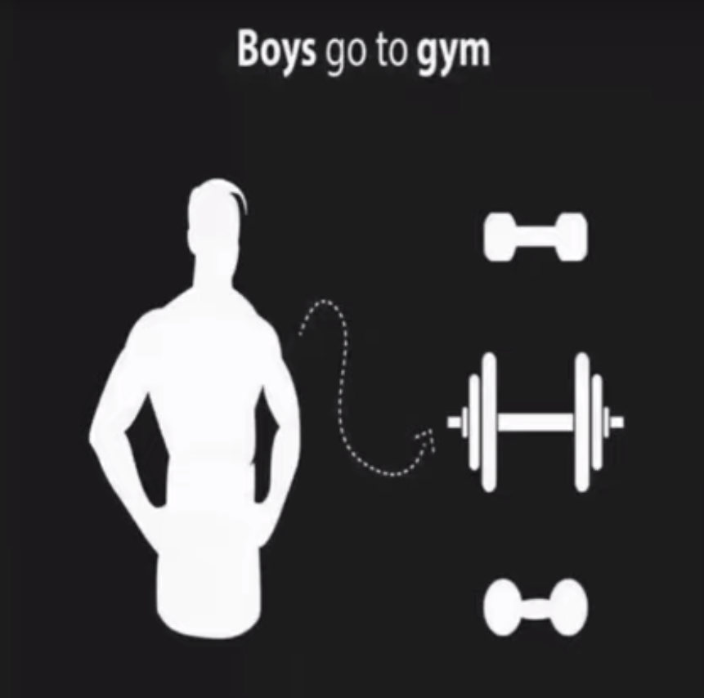
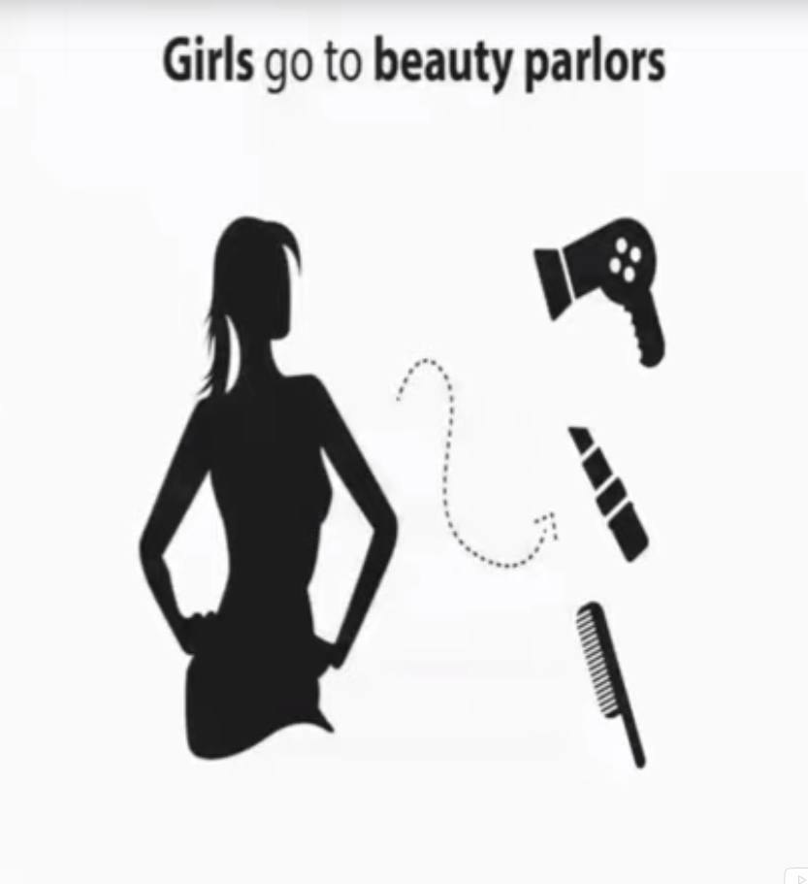
Gender stereotyping originate from local culture and tradition. Children learn what constitutes female and male behaviour from their family and friends, the media and institutions including schools and religious bodies.
Gender stereotypes shape self-perception affect, well-being, attitudes to relationships and influence participation in the world of work.
Gender stereotypes can have a negative impact on both boys and girls. Traditionally, female stereotypical role is to marry and have children. She is also to put her family’s welfare before her own; be loving, compassionate, caring, nurturing and sympathetic and find time to be sexy and feel beautiful.
The male stereotypical role is to be finance provider. He is also to be assertive, competitive, independent, courageous and career-focused; holds his emotions in check and always initiates sex.

Slide 5
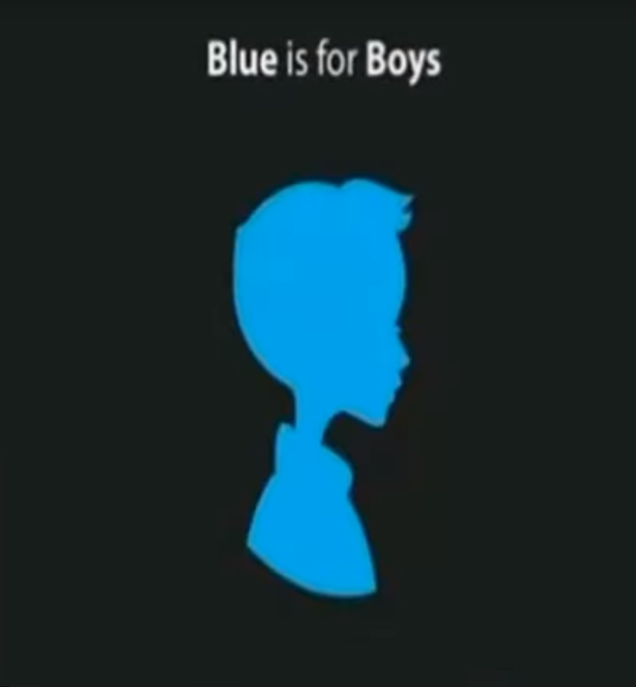
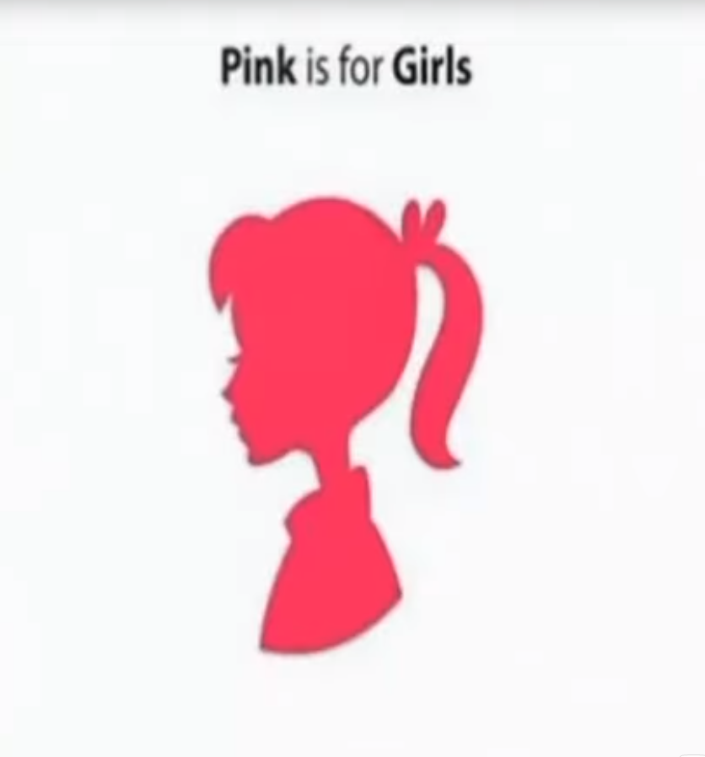
Definition of Gender Stereotype
Gender stereotyping is defined as over-generation of characteristics, differences and attributes of a certain groups based on their gender. It can limit the development of the natural talents and abilities of girls and boys, women and men as well as their educational and professional experiences and life opportunities in general.
According to Webster’s Dictionary: Gender stereotyping is prejudice or discrimination based on sex. It is the behaviour, condition or attitude that fosters stereotypes of social based on sex.
According to Johoda: “ A stereotype denotes opinion about classes of individuals, groups or objects, which are preconceived i.e. which do not derive from new judgements of single phenomenon but a pattern like forms of perceiving and judging.”

Slide 6
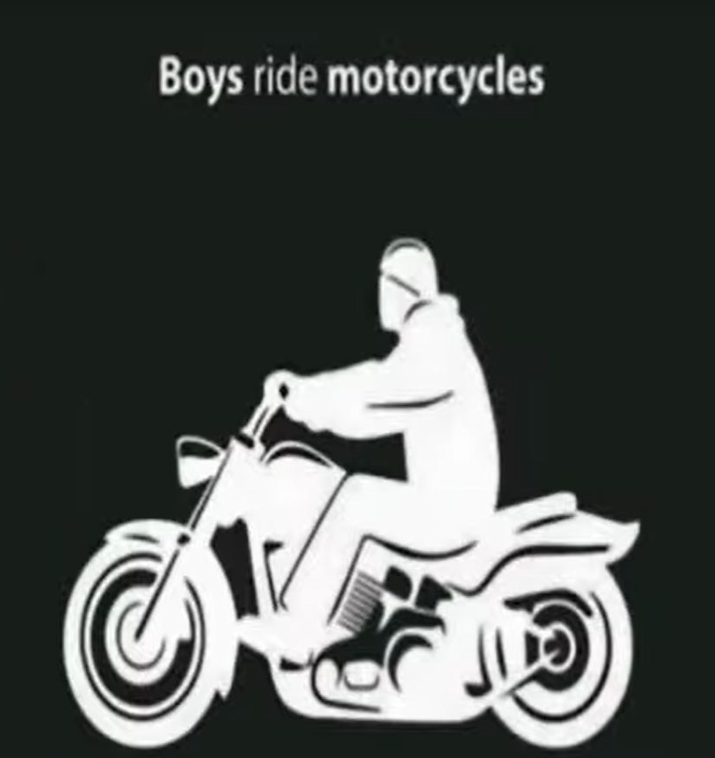
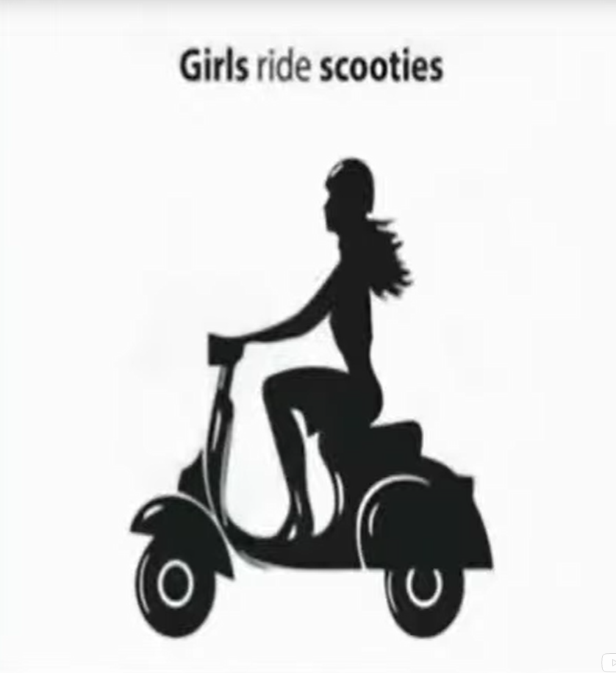
Basic examples of Gender Stereotypes
Personality Traits: Women are supposed to be caring, gentle, affectionate, dependent, timid, passive, obedient, planned, fresh and bright expressing emotions. They are expected to speak and dress modestly and obey men. Whereas men are expected to be tough, not expressing emotions, rational, aggressive, cruel, dominant, merry and self- confident. Men are free to be lazy and messy too.
Domestic Behaviour: Women are expected to do household chores supposed to cook for family. Women are better at child rearing; they needs to stay at home, as and when she delivers the baby. On the other hand, men are better at household repairs. Men are not supposed to cook, sew or care for their children.

Slide 7
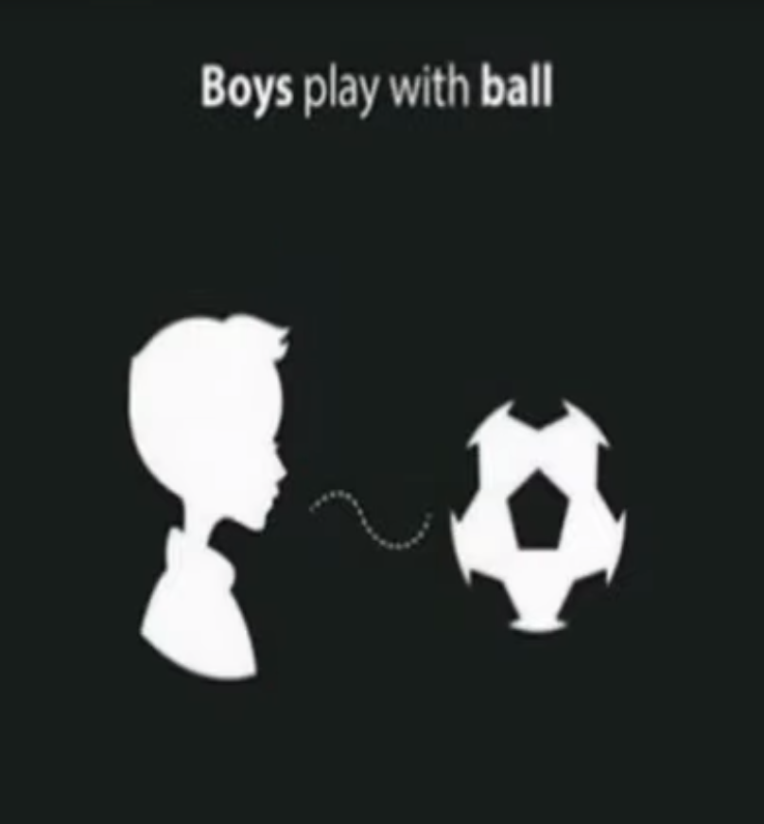
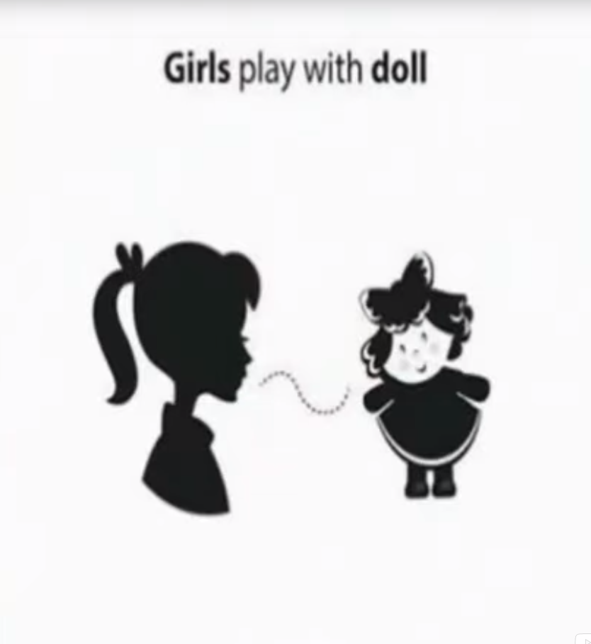
Occupations: Women are supposed to have “pink collar” jobs such as teachers, nurses, secretaries and librarians as they are considered not good in other occupations like combat jobs in army and police, administrative jobs, drivers, fire fighters etc. Women receive lower wages for doing the same work as men. Women get very less representation in politics. On the other hand, men are supposed to have ‘white collar jobs’ like administrators, army men, policemen, fire fighters etc. They are also supposed to be well suited for ‘dirty jobs’ like mechanics, construction workers, plumbers and engineers. Men are supposed to be better politicians too.
Physical Appearance: Generally speaking, women are expected to be short and slender, small and delicate while men are supposed to be tall with broad shoulders. However, physical appearance gender stereotyping varies from culture to culture.
Academic Achievement Area: Some academic areas are considered to be feminine for example reading, spelling art and music, whereas, Mathematics, athletics and mechanical skills are considered masculine.

Slide 8


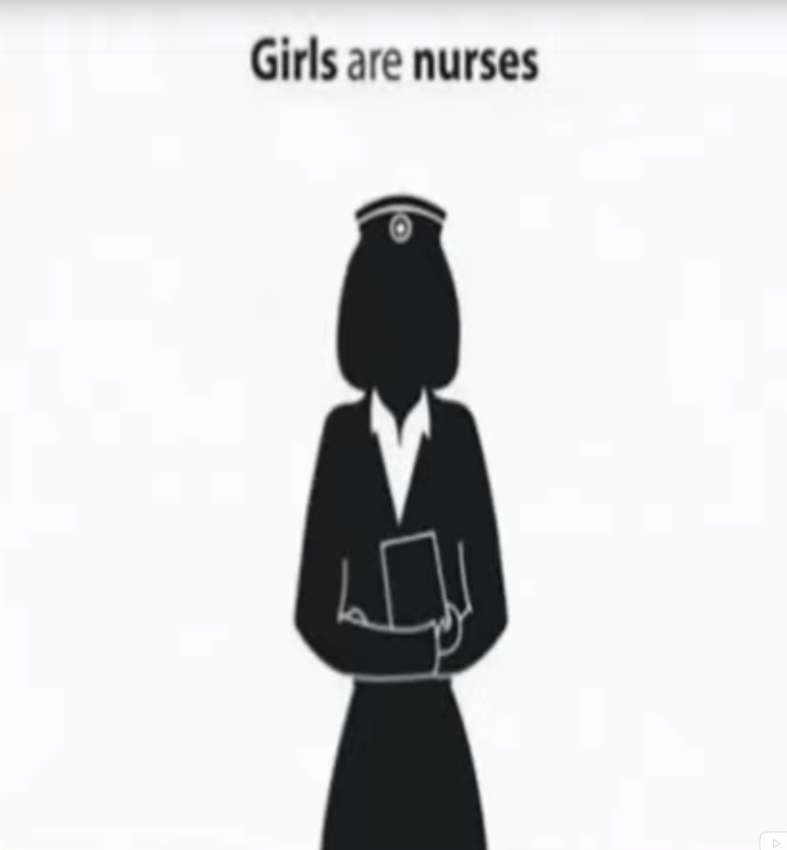
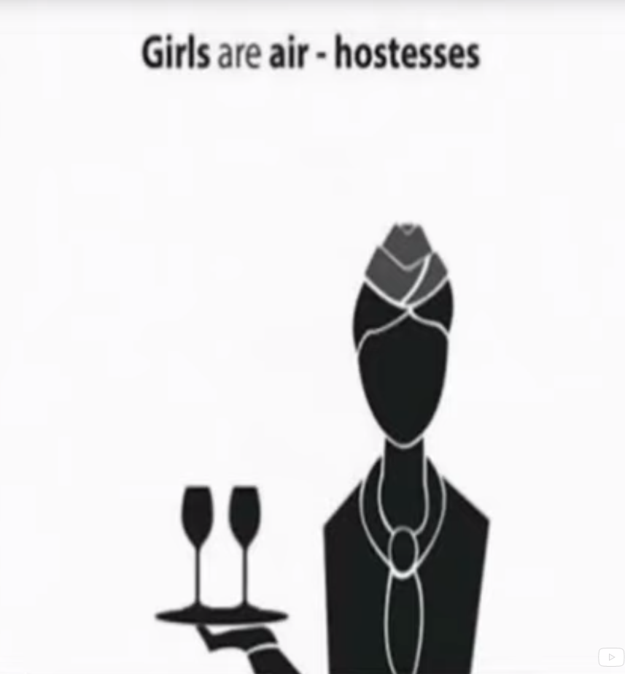
Conclusion
Gender stereotypes are extremely common in society. One of the reason for this may be simple because it is easier on the brain to stereotype. The brain has limited perceptual and memory systems, so what it observes in the society perceives the same. Gender stereotypes appear to have an effect at an early age.

Slide 9
Common gender stereotypes in Indian Culture

Slide 10
Common Gender stereotypes in Indian Culture-
Some gender stereotypes present in Indian culture are given here, which show , what acting like man and being lady like means in our society.
MALE STEREOTYPES: On birth of a boy, subtle stereotyping begins:
Conscious and unconscious motives of having the family race continue theough him bring joy.
Guns and cars are brought for him, preferable blue and never pink.
He is discouraged from cooking and serving.
While choosing a carrier he is considered to be ambitious.
He is likely to have fewer restrictions while going out.
He is encouraged to act strong, to act brave, to be tough etc.

Slide 11
2. FEMALE STEREOTYPES: On the birth of a girl, the equations tend to change from that minute.
Her room is perhaps decorated with the supposed feminine colour pink and dolls are brought for her.
In India, she is considered inferior to a boy child.
While growing , she is allowed to cry and express herself emotionally.
She is not encouraged to go out alone. More restrictions are forced on her.
Balancing home and family arises for her. She is not allowed to do outside for service.
While choosing a career , she is likely to be discourage from choosing careers such as civil services or defence services.
In this way , gender shapes girls and boys knowledge , values, attitudes, feelings, self esteem and skills.

Slide 12
IMPACT/ EFFECT OF GENDER STEREOTYPES
Traditional gender stereotypes are most representative of the dominant culture. Gender stereotypes are extremely common in society. Society has created stereotypes of masculine and feminine behaviours and characteristics:
Expectations of behaviour
Expression of Emotions
Effect on performance
Psychological and Emotional Strain
Recognition of Talents
Limit on choices
Learning and practice the skills
Reinforcement of Inequaltiy
Affect Couple Family Interaction

Slide 13
Effect of Media on Gender Stereotyping
Influence of media on gender stereotyping is powerful and unavoidable. We are constantly being bombarded by media in the form of commercials and advertisements, constantly telling us who is ought to be. Media as entertainment also has a subtle influence on society’s way of thinking. Every message seen or heard on media has some impact on people. All the information presented in media is damaging representation for male and female roles.

Slide 14
Distorted Image of female
Influence on Gender identity
Promotion of special Opinions
Changing Role of Media
In this way , the media has improved greatly in the past few years. Women are slowly gaining leading roles and it is uncommon in films and serials to see men and women depicted as equals, working alongside each other in equally challenging settings. But still there is need for further improvement. Women and men are still misrepresented as stereotypes in the majority of the media.

Slide 15
CONCLUSION
This stereotype becomes embedded in human mind and is passed on from generation to generation as an acceptable view of male and female gender roles. Stereotypes are based on limited information or unverified facts are generalized and not necessarily accurate. They are necessarily untrue, but they blind spots which hamper objective and carefree thinking and behaviour. They mere highlight certain generalised characteristics of people, social groups or communities but neglect the differences between them and between individuals.

