Slide 1


Engaging with popular subject based expository writing : selected articles, biographical writing

Slide 2
Types of writing styles
Types of writing styles
1.
Narrative style
2.
Persuasive style
3.
Descriptive styles
4.
Expository style

Slide 3
Narrative style
Being narrativeTells a story
To tell a story
Novels
Short story
poetry
Situations
Dispute
Conflict
Actions
problems
Definite n logical beginning
Interval
ending
Characters n dialogues

Slide 4
persuasive style
To convince
To tell a story
Complaint letters
Editorials
commercials
Takes a stand to make u agree
Reasons,arguments
justifications

Slide 5
descriptive style
To describe
Poetry,diary
Fiction etc
visualisation
Places,events,people,situations
Poetic in nature

Slide 6
Expository style
To explain
Textbook writing
News story
Recipes etc
Logical order n
sequence
Facts n figures
Explanation in a process

Slide 7

What is Expository Writing?
Exposition is a type of oral or written discourse that is used to explain, describe, give information or inform. The creator of an expository text can not assume that the reader or listener has prior knowledge or prior understanding of the topic that is being discussed. One important point to keep in mind for the author is to try to use words that clearly show what they are talking about rather then blatantly telling the reader what is being discussed. Since clarity requires strong organization, one of the most important mechanisms that can be used to improve our skills in exposition is to provide directions to improve the organization of the text.

Slide 8
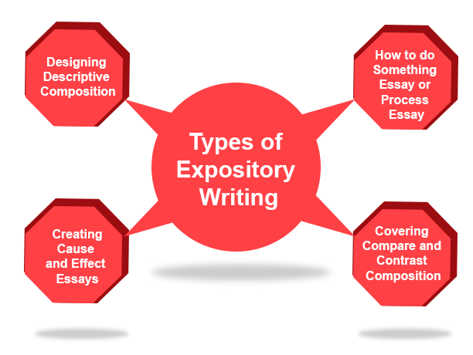
Types…
//

Slide 9
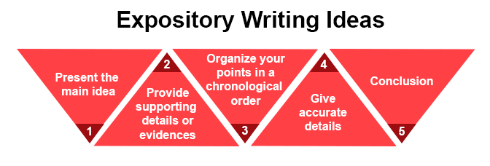
Expository Writing Ideas
Expository writing contains specific information about a topic. Here, some important tips are discussed that will help you in writing a good expository essay:

Slide 10

Ideas…
Present the main idea: Start your essay with an introductory paragraph and describe the main idea to readers in a clear and concise manner.
Provide supporting details or evidences: Clear your main point with the help of sufficient facts and figures. Collect all the evidences, facts or figures from books, newspapers or from the internet and justify your point to the readers.
Organize your points in a chronological order: Based on the type of expository essays, write and organize the information or instruction in a systematic manner. For example, if you are writing about any recipe, then first mention the ingredients and after that the method of cooking.
Give accurate details: Do not give any wrong information to readers. It is ideal to provide only that information, which you can justify through your supporting details.
Conclusion: In the last paragraph, recapitulate your essay and restate the main idea.

Slide 11
Cont..
The primary intent of the Expository Writing Program contained at this web site will be to help move students closer to mastering the hows, whens, and wheres to select different oral and written expository styles for a variety of real world contexts.
Students will greatly benefit from understanding the varying types of oral and writing styles they can use for academic and workplace activities. The following information discusses the different types of writing that can be used and provides you with examples of some expository writing prompts that you may expect to encounter

Slide 12

Types of Expository Essays
1. Cause and Effect Essays:
Such essays delve into the reasons that cause something and then, discuss its results or effects. They are the most popular types of academic essays. Types of Expository essay writing examples that come under this category are:
Discuss the causes of deterioration of Murray-Darling Basin and its effects on Australian economy. (Covers both ‘causes’ and ‘effects’)
5 Main Causes of Dementia (Delves only into the ‘causes’)
Why are oil spills a serious threat to marine environment? (Discuses only the ‘effects’)

Slide 13
2. Problem and Solution Essays:
Problem-solution essays are a popular type for short essays and subject exams. They consider all the problems related a particular situation or topic, and suggest solutions to those problems. It usually has four components – Situation, Problem, Solution, and Evaluation.
The ‘Situation’ is often stated in the essay prompt and you may touch upon it in the ‘Introduction’. ‘Evaluation’ can be a part of the ‘Conclusion’ of your Expository Essay or may be omitted altogether in shorter essays.
Types of Expository essay writing examples that come under this category might include situations like:
Junk food is causing lifestyle diseases. How to avoid it?
Bullying in schools should be stopped immediately. Discuss.
Refugees should be accepted with restrictions. Is it necessary?

Slide 14
3. Classification Essays:
In Classification essays, we sort out things into different categories on the basis of pre-defined criteria for each category. Each category in which we put things should have features unique to it and ideally, should not overlap with other categories.
Such essays can be very useful when we are trying to study unique features of certain set of things in a specialized subject area.

Slide 15
4. Comparison or Contrast Essays:
Compare-and-contrast essays are often assigned to students to gauge their understanding about a subject. It is possible that in shorter essays, you might be required to discuss just similarities or differences between two topics.

Slide 16
5. Definition Essays:
Definition essays seem simple but they are not. They have to be thorough and are often quite lengthy. When you choose to ‘define’ a word, be sure to choose something on which you can get lots of information easily.
To add depth to your definition essay, you can discuss about the word’s history and origins, and add your own perspective to it. Words that are disputable or controversial are good for writing definition essays.

Slide 17

Types of Expository Writing Structure you may use
Both Problem & Solution Expository Essays, and Cause & Effect Expository Essays can be structured in two ways:
Block Structure, and
Chain Structure
Block Structure
Block structure of writing Expository Essays have more clarity and are preferred for shorter essays.
It looks something like this:

Slide 18
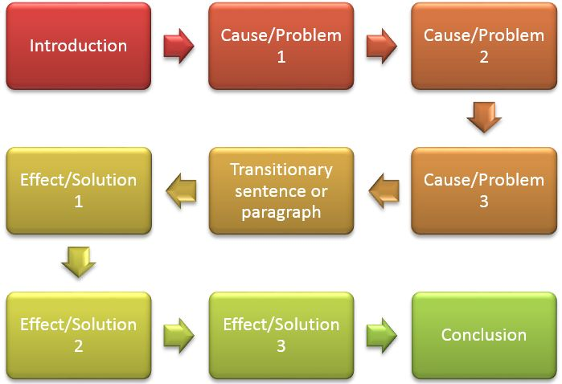
Block Structure
Block structure of writing Expository Essays have more clarity and are preferred for shorter essays.

Slide 19
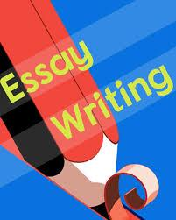
z
Chain Structure
Chain structure of writing Expository Essays are preferable for longer essays as it keeps relating a cause directly to its effects throughout the essay – and hence, is easier to understand.

Slide 20
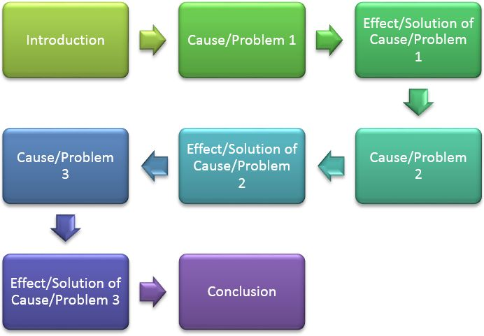
Chain Structure
It looks something like this:

Slide 21

Compare and Contrast Expository Essays
employ the ‘block’ structure mentioned
above as well as ‘point-by-point’ structure.
The point-by-point structure is quite
straightforward and good for Classification
Essays too.
It looks like this:
Point-by-Point Essay Writing Structure

Slide 22
Expository texts are
Text books
directions
biographies
guides
News articles
encyclopedias
journals
Insruction manuals
recipes

Slide 23
Expository texts features
True facts
Title
Index
Glossary
headings
Different topics
guides
Diagrams
Photographs
captions
New learning
Research reading or
pleasure
Talk with readers
recipes

Slide 24
Teaching text structure-strategies
Discussion with students
Order of inducing
perdictions
Signal words/cues
Think aloud strategy
Explicit instruction
Releasing of
Responsibilities
model
Use of graphic organizers
Non linguistic representations
Writing text structure
Connecting reading n writing
Treasure hunt
Use of summary
Frame questions
practice
Writing of different
Text structure

Slide 25
Cause-effect model
Effect-1
Effect-4
Effect-3
Effect-2
Effect-5
cause

Slide 26
Problem solution model
solution
1
2
solution
1
2
solution
1
2
problem

Slide 27
Chronological model
First event
Second event
Third event
Fourth event

Slide 28
Comparison model
.
.

Slide 29

Steps of expository writing
Choose a topic
Source materials
Thesis statement
Style of development
drafting
Topic headings
summary

Slide 30

Advantages of Expository Writing
Expository texts are very useful in communicating step by step, instructional information as well as explaining or describing a difficult subject. It is a format that allows the reader to easily follow and understand instructions that can serve as functional knowledge of a topic.The clear and concise style of the writing allows the reader to utilize the information in an unambiguous, straightforward way. The data driven, factually based presentation of the information assures the reader that the information is based on experience and is objective.

Slide 31

Disadvantages of Expository Writing
The chronological nature of an expository explanation may not be suitable for the nonsequential nature of events. Whereas assembling a piece of furniture, or cooking a recipe, might necessitate a step-by-step procedure for a consistent result, natural events are typically not linear. An expository history may be described to explain the cause and effect sequence of an event, however, that history is typically only one of many possible histories. The nature of an expository text might place the author, and subsequently the reader, in the position of understanding the topic through the customs of the expository text. This could include forcing a topic into a singular, cause and effect sequence, as well as a writing style that infers an absolute objectivity free from opinion.

Slide 32


