Slide 1
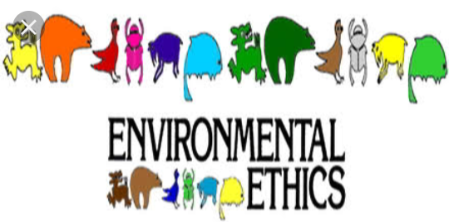

Slide 2
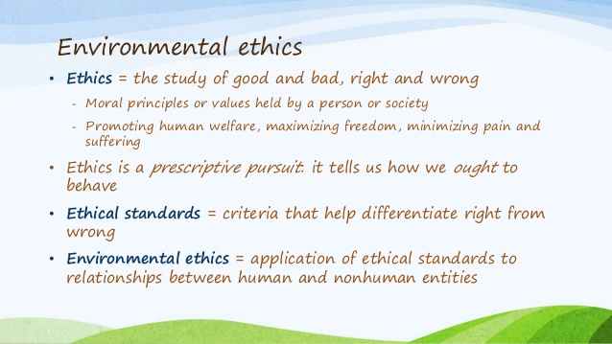

Slide 3
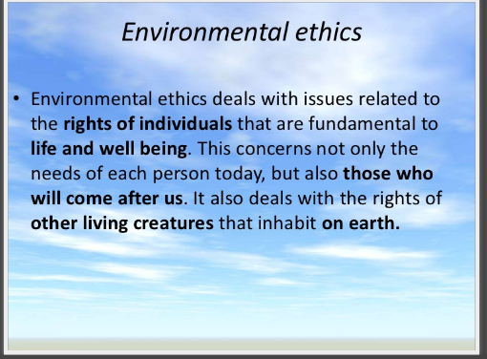


Slide 4
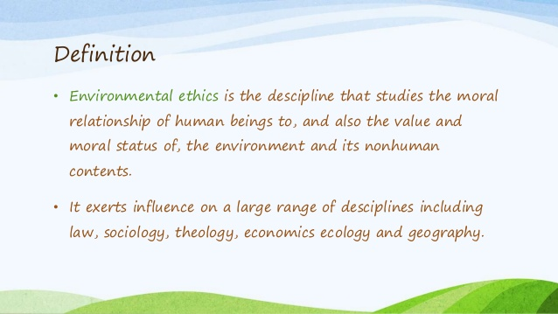

Slide 5
INTRODUCTION
Ethics (derived from the Greek word ‘ethikos’ meaning arising from habit) is the study of value or quality, and it is a major branch of philosophy. Ethics are concerned with what is right and what is wrong, irrespective of the culture and society. Environmental ethics are moral principles that define one’s responsibility towards the environment. Environmental ethics believes that humans are a part of the natural environment which includes matter and energy. It is essential that every human being respect and honour the environment and use morals and ethics while dealing with the natural resources.

Slide 6
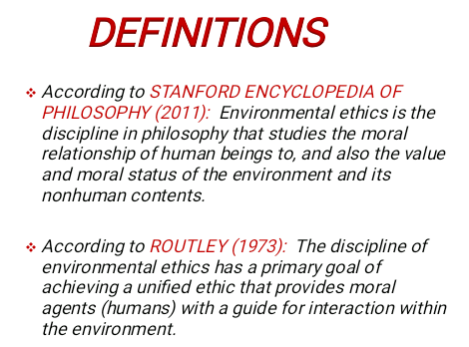

Slide 7
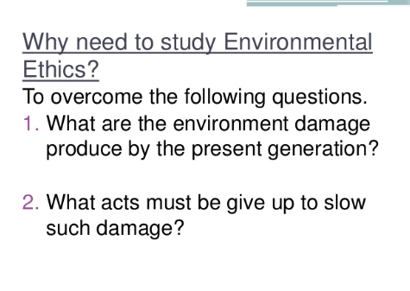


Slide 8
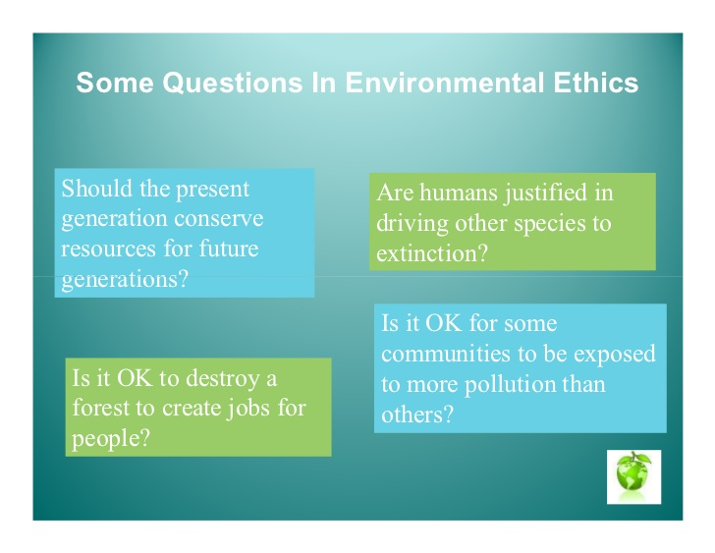

Slide 9
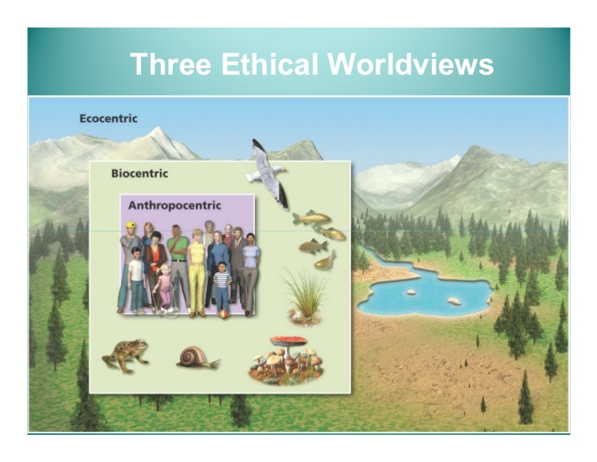

Slide 10
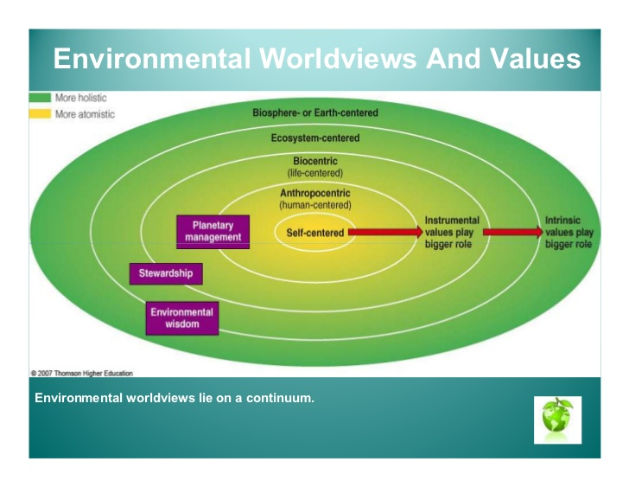

Slide 11
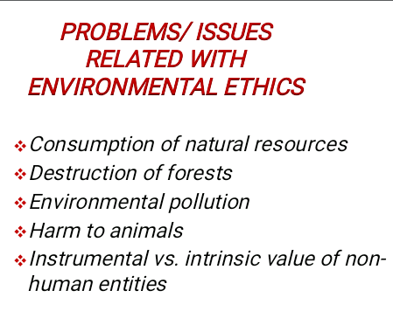
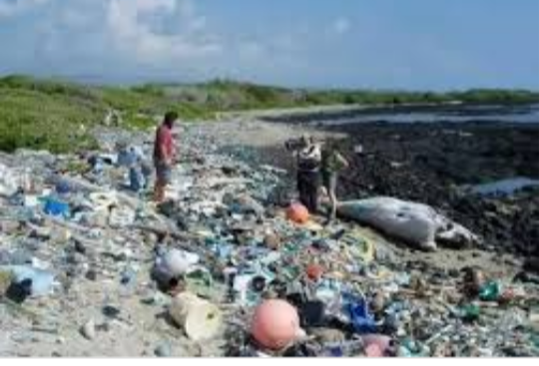

Slide 12
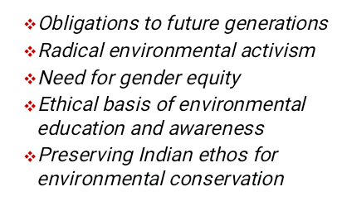
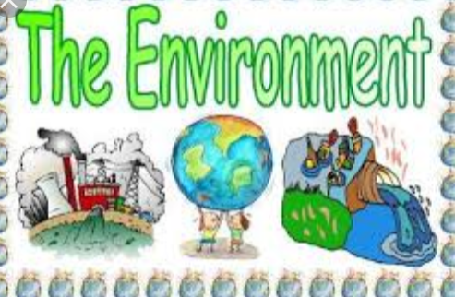

Slide 13
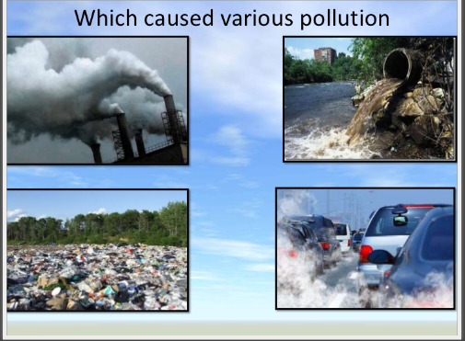

Slide 14
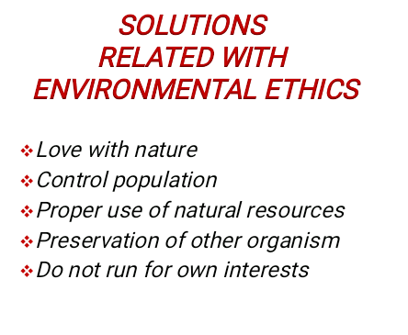
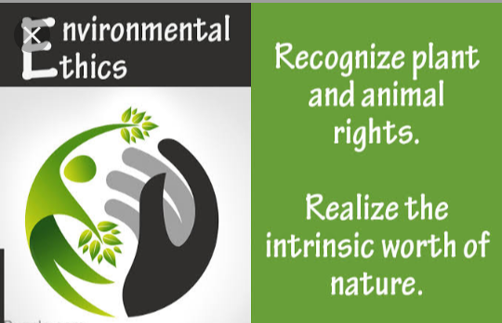

Slide 15
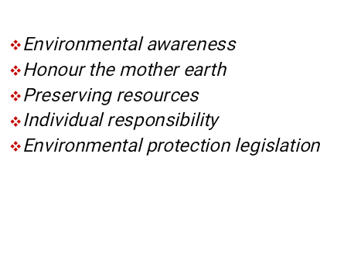



Slide 16
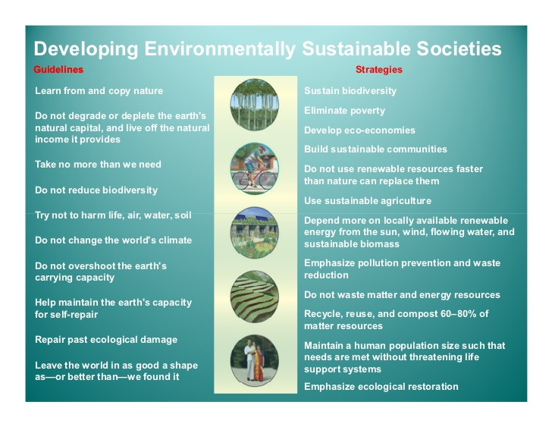

Slide 17
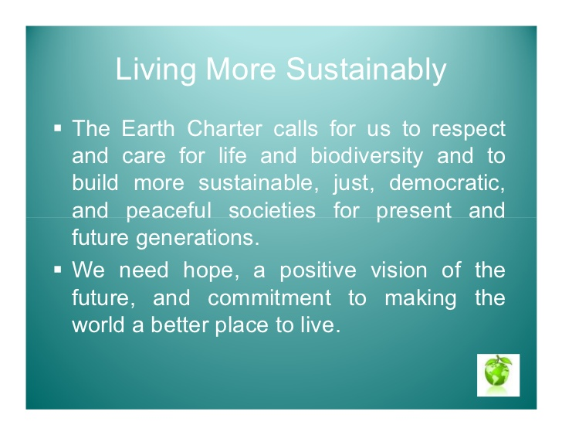

Slide 18

THANK YOU

