Slide 1


Slide 2
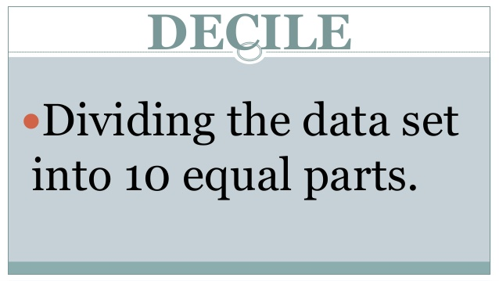

Slide 3
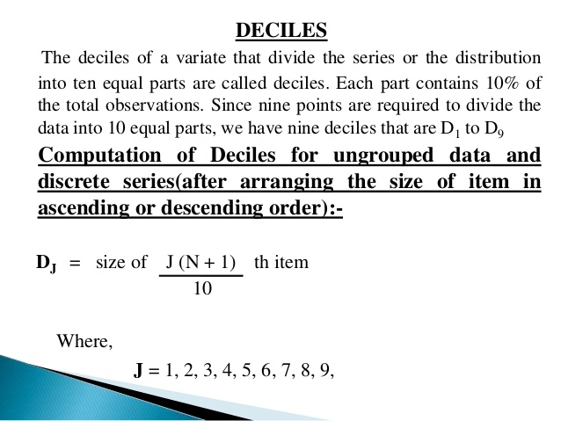

Slide 4
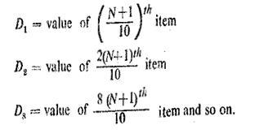
FORMULAS
INDIVIDUAL AND DISCRETE SERIES

Slide 5
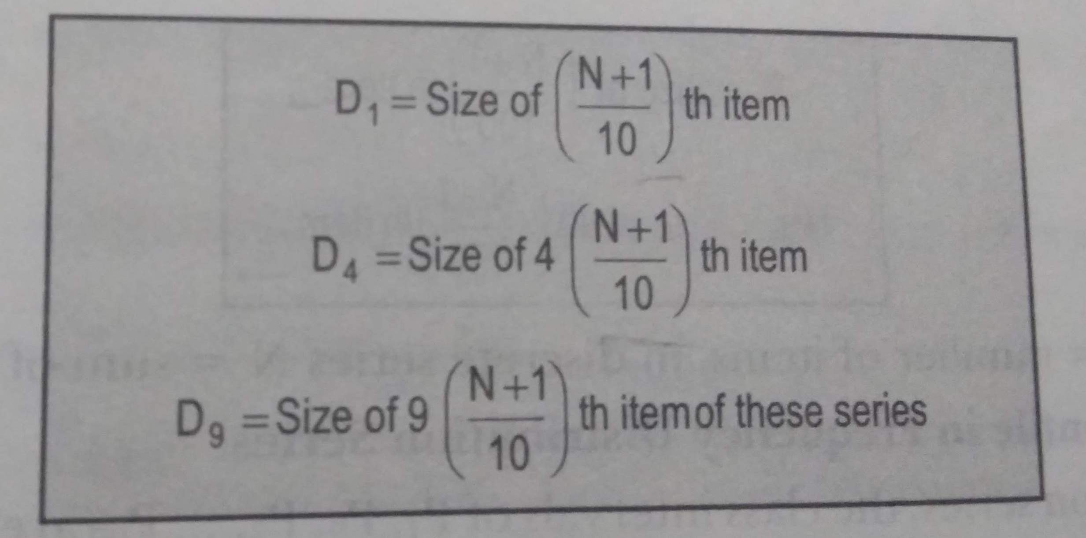
Here;
L1 = lower limit
C.F = Cumulative frequency above median group
f = frequency with in group
i = Class interval

Slide 6
Sr. no. | Marks | Sr. no. | Marks
1 | 15 | 11 | 22
2 | 15 | 12 | 23
3 | 16 | 13 | 24
4 | 17 | 14 | 25
5 | 17 | 15 | 25
6 | 18 | 16 | 25
7 | 19 | 17 | 26
8 | 20 | 18 | 27
9 | 20 | 19 | 29
10 | 21 | 20 | 30

Slide 7
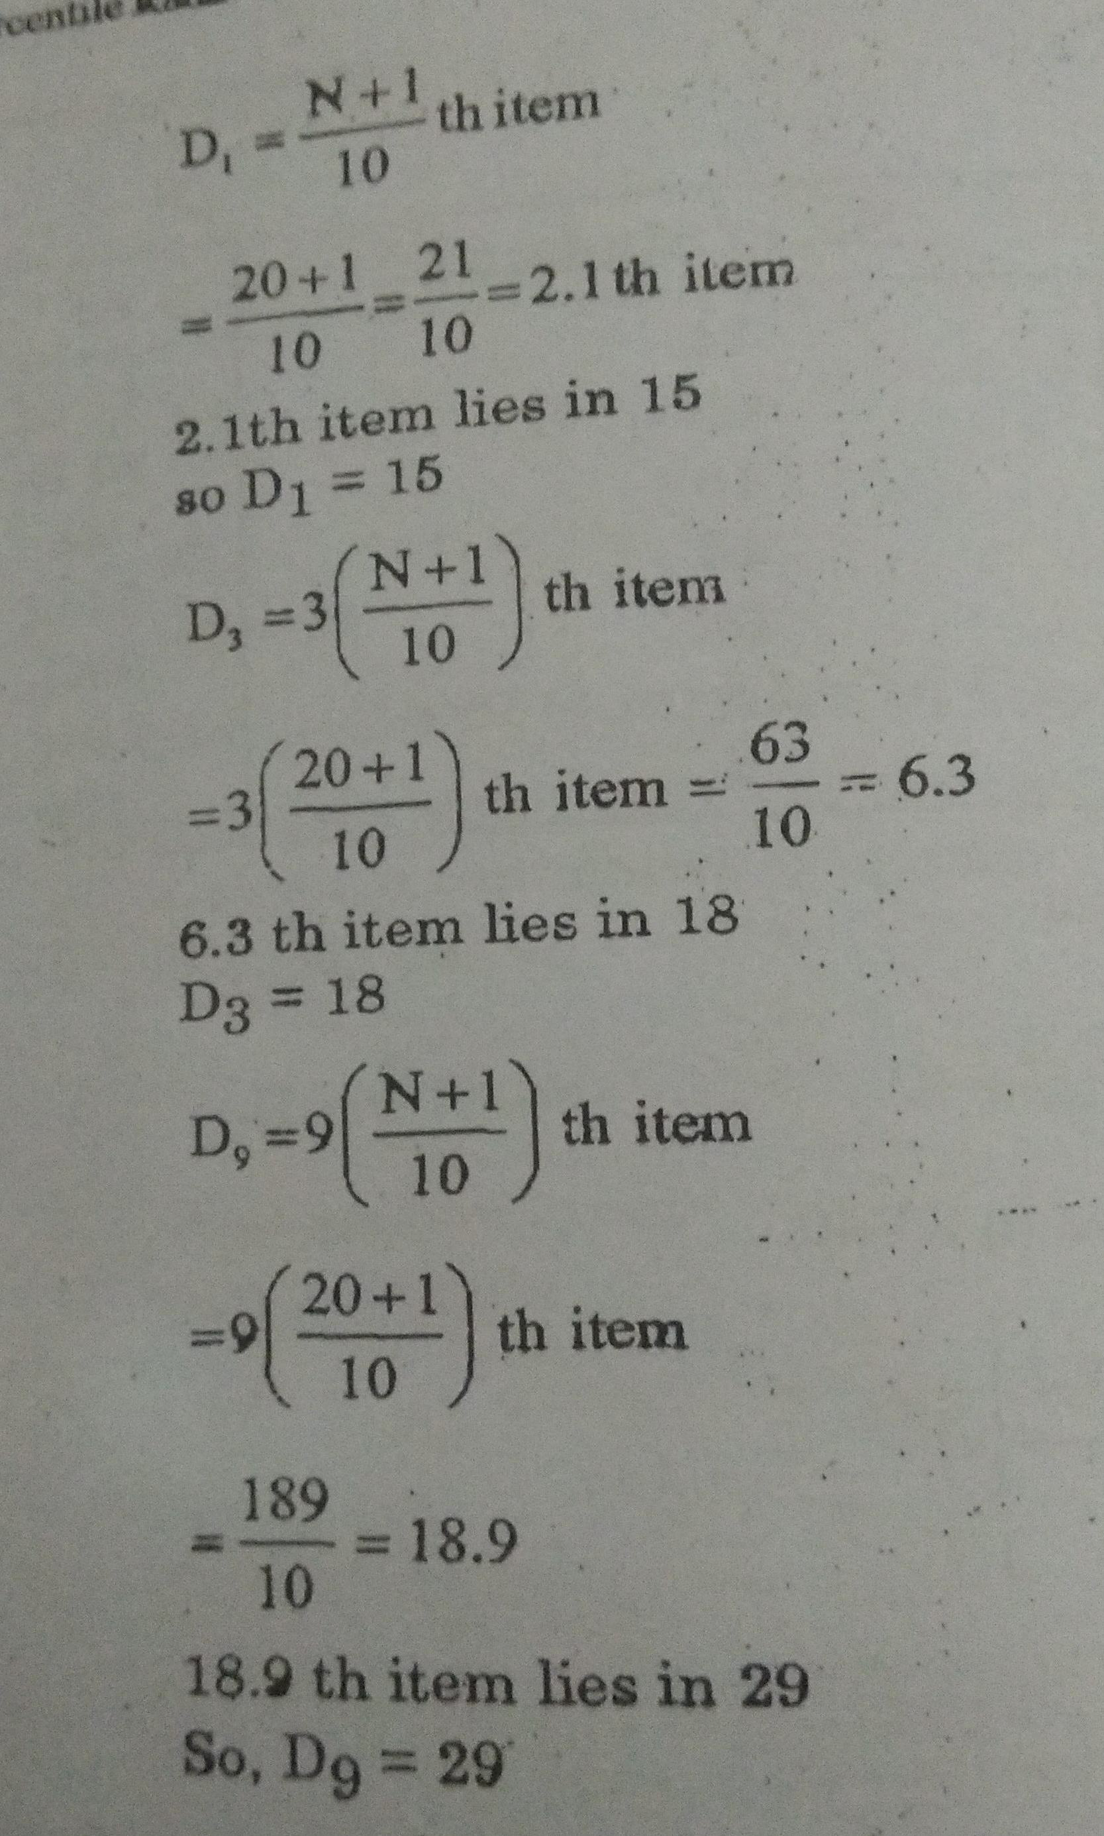
SOLUTION :

Slide 8
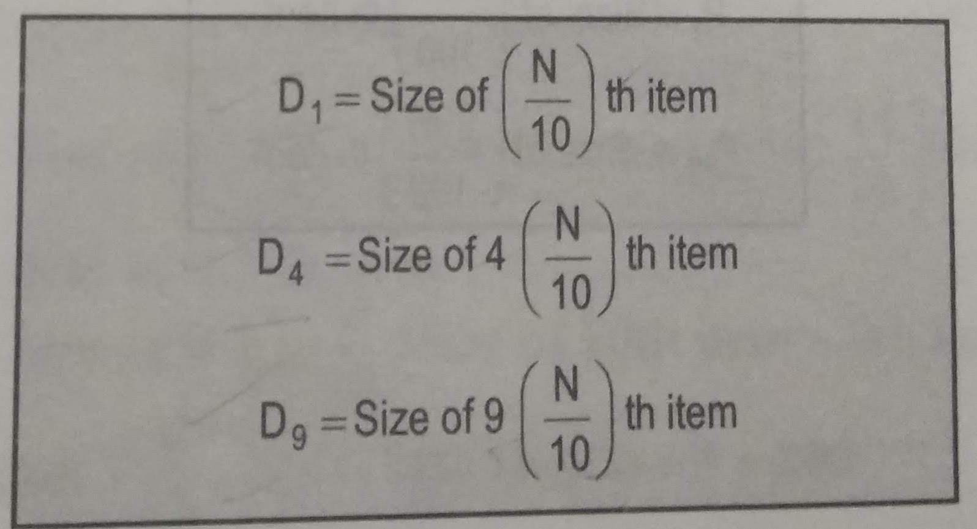
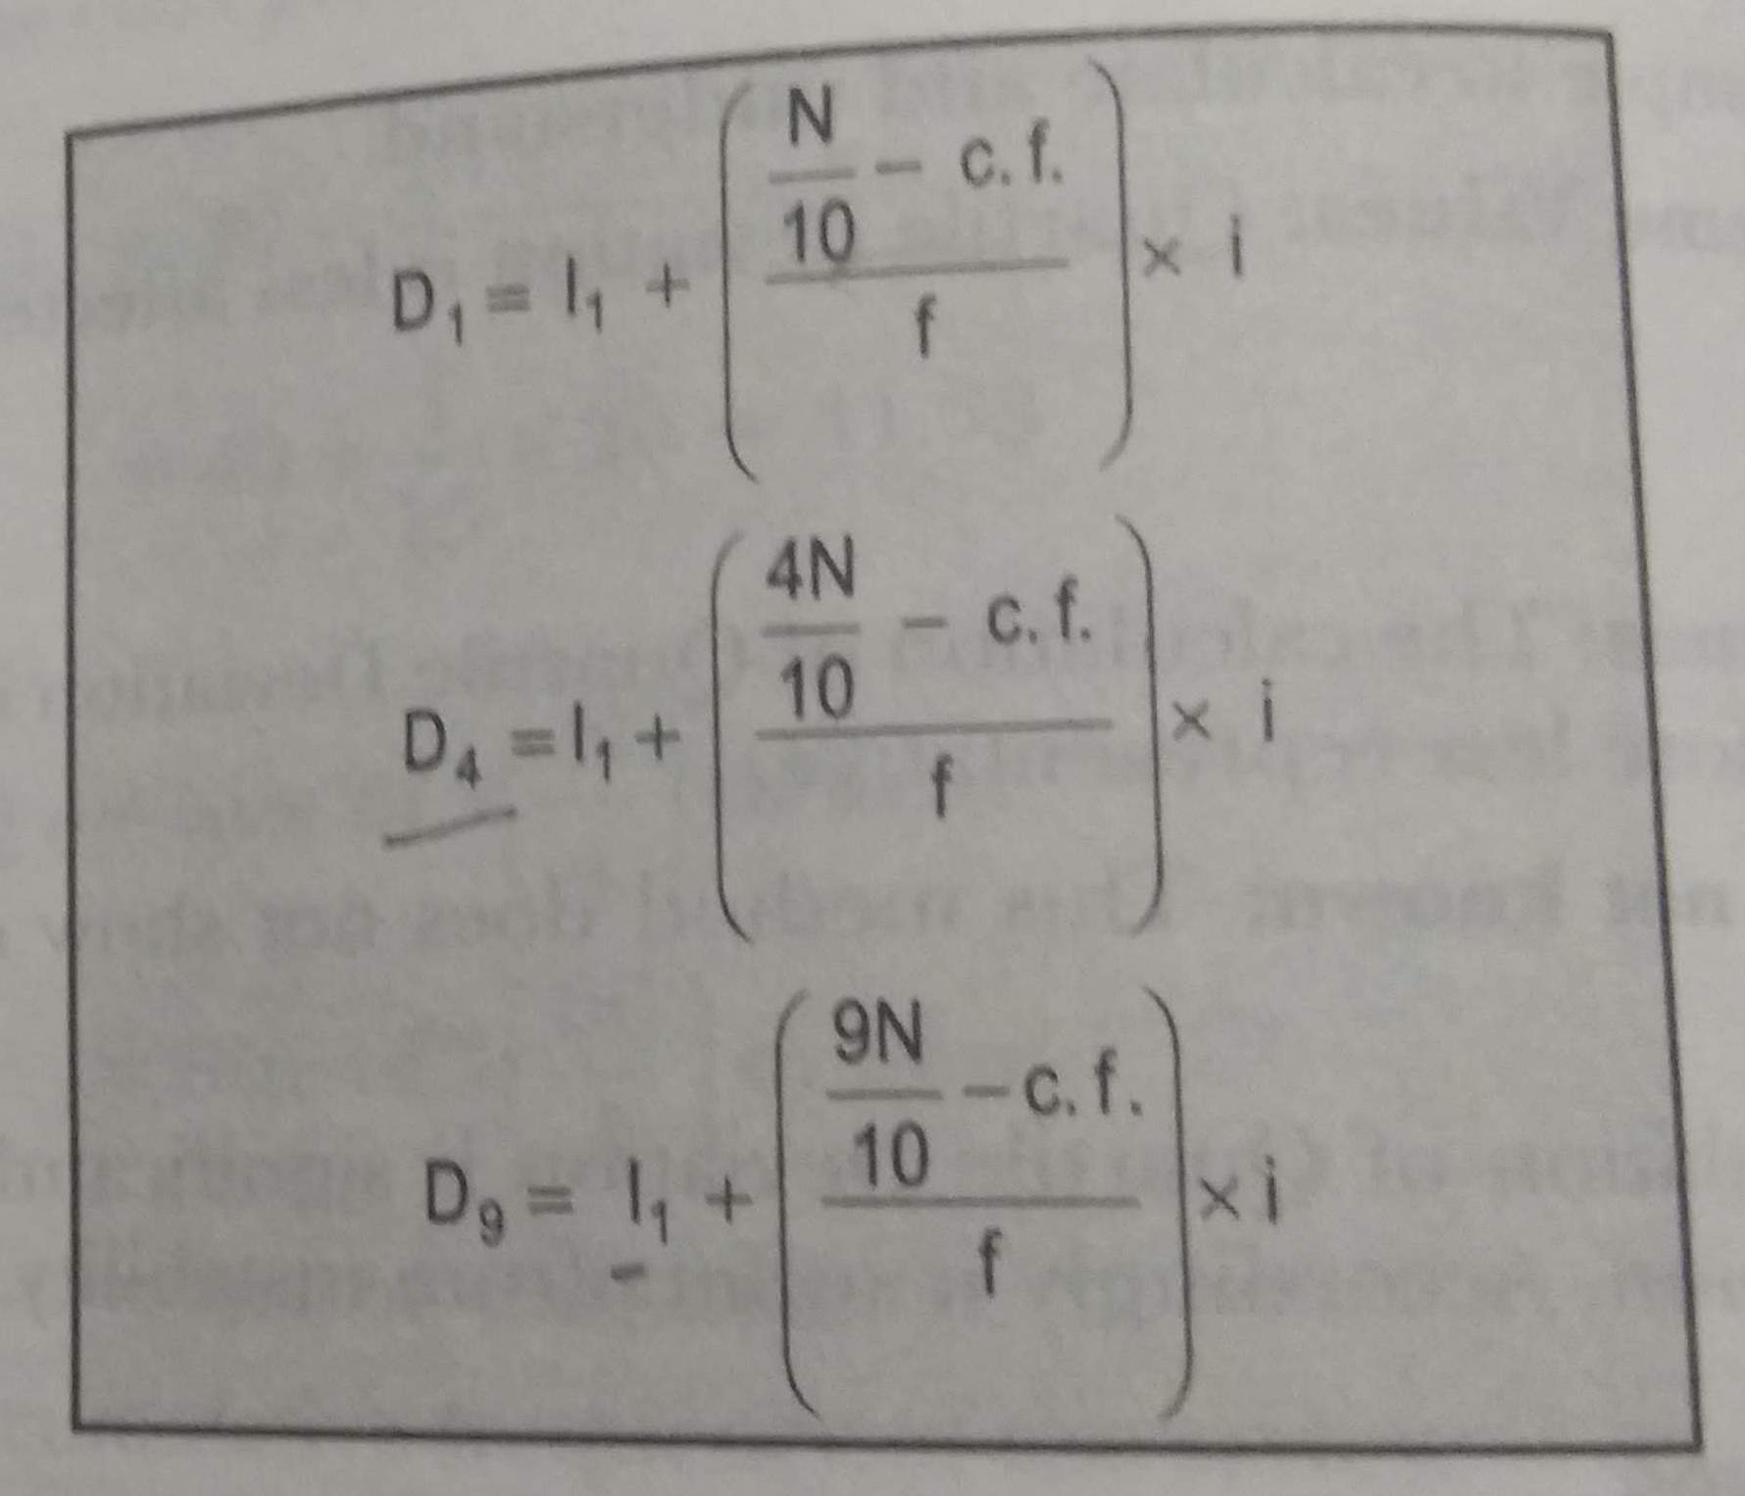
Formula of Continuous series:

Slide 9
Calculation of deciles in continuous series:
Marks | Frequency | cumulative frequency
30-35 | 14 | 14
35-40 | 16 | 30
40- 45 | 18 | 48
45-50 | 23 | 71
50-55 | 18 | 89
55-60 | 8 | 97
60-65 | 3 | 100

Slide 10
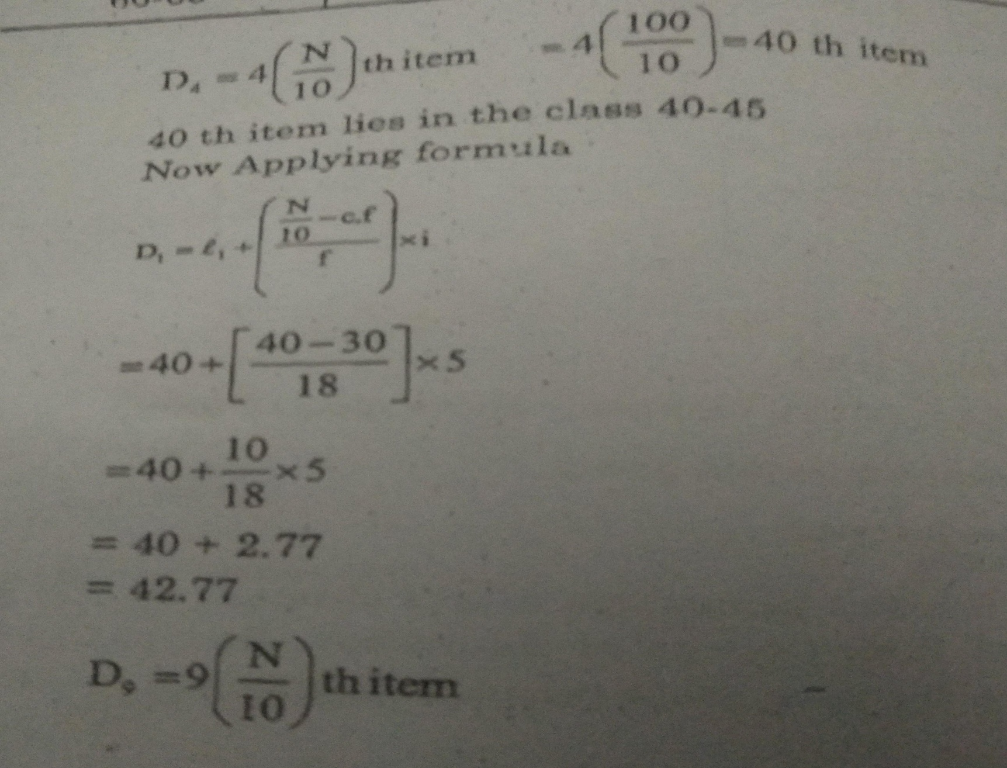
SOLUTION :

Slide 11


