Slide 1

CURRICULUM needs for
GIFTED LEARNERS

Slide 2

INTRODUCTION
Curriculum needs for Gifted learners:
Gifted learners are those who give evidence of high achievement capacity in areas such as intellectual, creative, artistic or leadership capacity or in specific academic fields and who need services of activities not ordinary provided by the school in order to fully develop these capabilities.

Slide 3
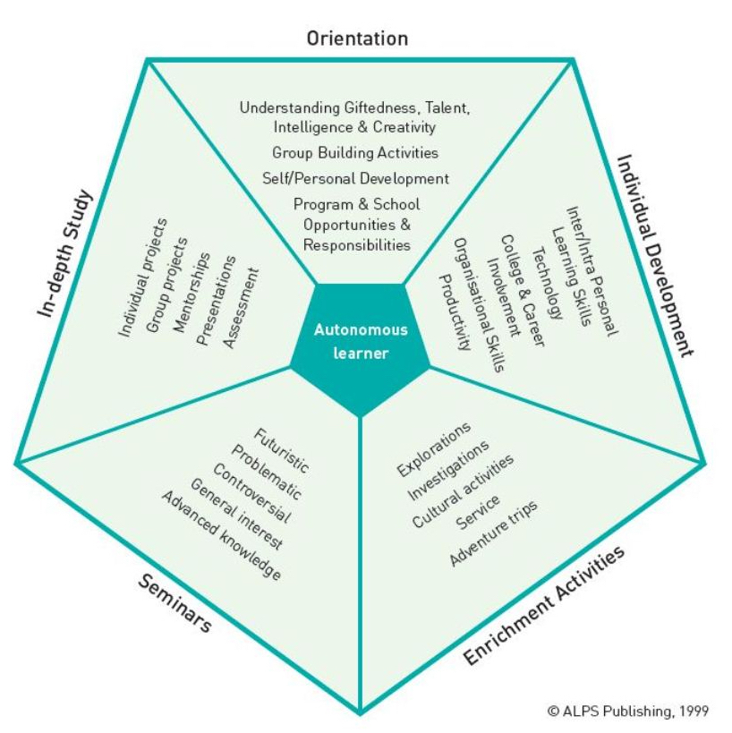
Curriculum needs for Gifted learners
According to Van Tassel Baska (2003), curriculum for Gifted learners include the following:
1. Cognitive, affective, social and aesthetic areas of curriculum experiences.
2. Incorporates both accelerated and enriching learning.
3. Thoughtfully planned and incorporate explicit assessment.

Slide 4
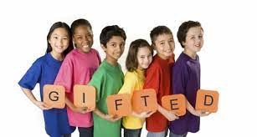

Slide 5
MEANING OF GIFTED LEARNERS
Gifted learner means a child or youth who performs at or shows the potential for performing at remarkably high level of accomplishment when compared to others of same age, experience or environment.
And ,who
1.Exhibits high performance capability in an intellectual, creative or artistic area
2.Possess an unusual capacity for leadership ; or
3.Excels in specific academic field

Slide 6
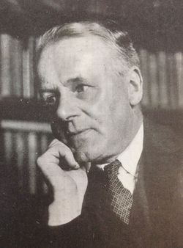
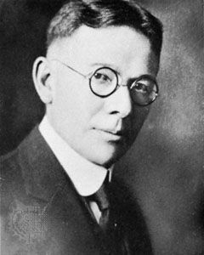
DEFINITIONS OF GIFTED LEARNERS
According to James Drever
“Children possessing high intellectual ability, generally or in a particular field are gifted learners
SIR James Drever
ACCORDING TO TERMAN AND WITTY
“THE GIFTED LEARNERS ARE THOSE WHO ARE SUPERIOR IN PHYSICAL DEVELOPMENT, EDUCATIONAL ACHIEVEMENTS, INTELLIGENCE AND SOCIAL PERSONALITIES “
Lewis Terman

Slide 7
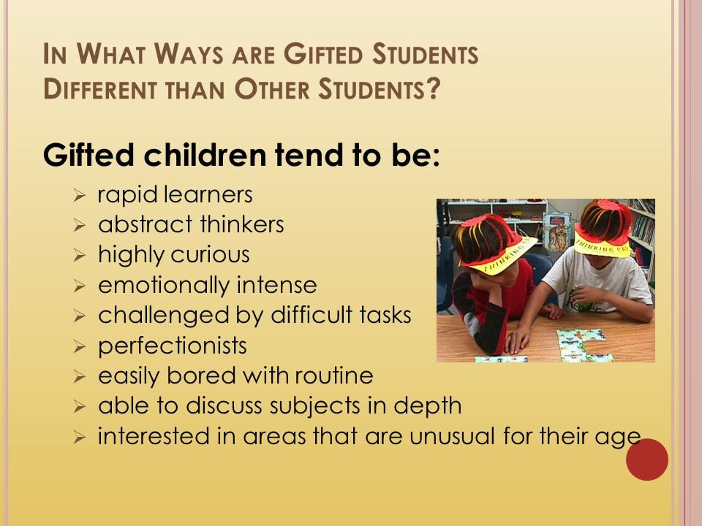
THIS CERTIFICATE IS PRESENTED TO:
Christian Boyle
BY
School Name
DATE
SIGNATURE

Slide 8

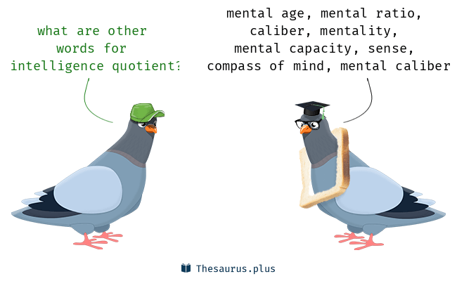
IQ is an synonym for intelligence quotient.
IQ is the measurement of your intelligence and is expressed in number.
A person’s IQ can be calculated by having the person taken an intelligence test.
The average IQ is 100,if you achieve more than this it means you are smarter than the average.
Person lower score means that you are somewhat less smart.

Slide 9
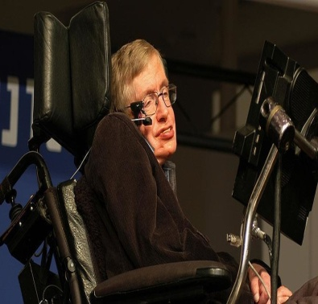
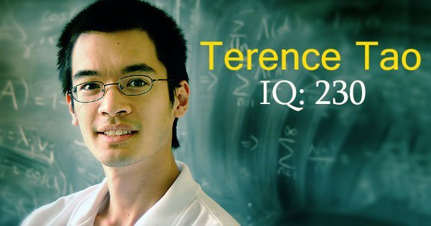
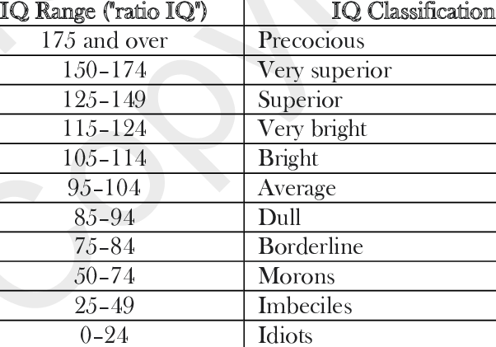
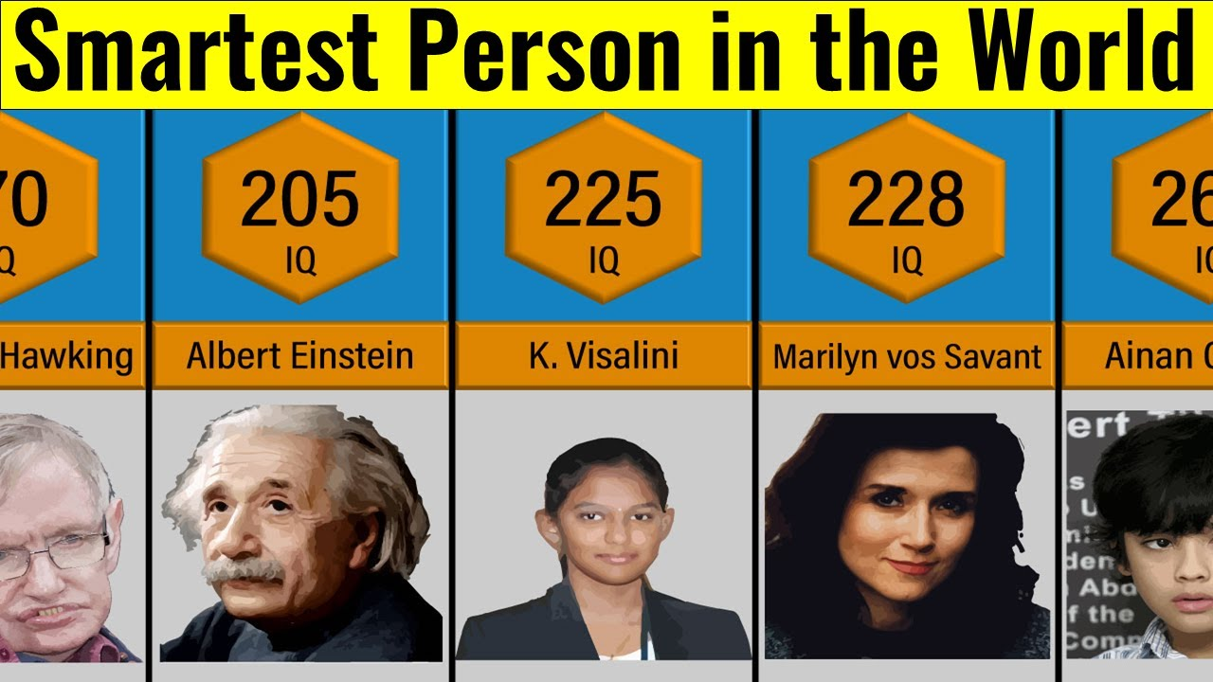
MEASUREMENT OF I.Q.

Slide 10
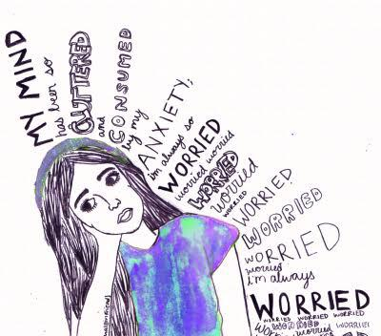
Need of Giftedness
Every Country needs Gifted Person for its progress and prosperity because they are person who may invent or discover new things.
Interpersonal Relationship with peers
Academically Appropriate Challenges
Attention
Needs of
Giftedness
Motivation
Gifted Children should be given education according to their needs and caliber.
Individualized Education
Performance Anxiety
Verbal Communication

Slide 11

Common Characteristics of
Gifted Students
Unusual alertness, even in infancy
Rapid learner; puts thoughts together quickly
Excellent memory
Unusually large vocabulary and complex sentence structure for age
Advanced comprehension of word nuances, metaphors and abstract ideas
Enjoys solving problems, especially with numbers and puzzles
Often self-taught reading and writing skills as preschooler
Deep, intense feelings and reactions
Highly sensitive
Thinking is abstract, complex, logical, and insightful
Idealism and sense of justice at early age

Slide 12
Curriculum and
Giftedness
As a group Giftedness include gifted and talented students.
The two terms gifted and talented are two adjectives that are used to describe individuals with great natural abilities developed to a level significantly ahead of their age and experience.
Their potential can be placed at at least top 10% of their age peers.
In the context of education, these two terms have specific meanings.
The main difference between gifted and talented actually depends on the area the child shows a talent in.

Slide 13
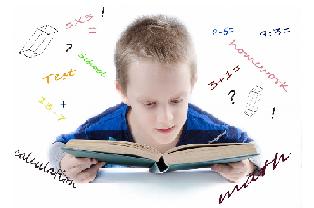
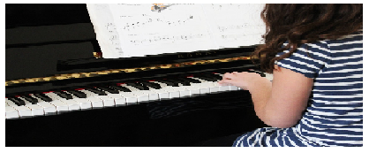
GIFTED V/S TALENTED
Gifted means showing above average potential in following domains of human ability – intellectual, social, creative, physical. | Talented means having a natural aptitude or skill for something.
Gifted learners have outstanding abilities in one or more academic subjects. | Talented learners have exceptional abilities in one or more practical subjects.
Gifted learners show aptitude for subjects like maths, science, history, geography | Talented learners show skills in areas like dance, music, arts, etc.

Slide 14

Curriculum for gifted students
Curriculum for gifted learner has been guided why certain beliefs given by van tassel baska (2003). These include the following points:
1.The need of gifted learners and encompass cognitive ,affective, social and aesthetic areas of curriculum experiences.
2.Gifted students are best served by a curriculum that incorporates both accelerated and enriching.
3.Curriculum experiences for gifted learners need to be thoughtfully planned and incorporate explicit assessment.

Slide 15

An effective curriculum for gifted students need not To be different from average basic or common curriculum. It should be Modified to Meet their needs. The unique characteristics of students must serve as a basis for decisions on how curriculum should be modified. In Scholars vieW ,Differentiation of the Curriculum maY Be the only adjustment required for gifted students.

Slide 16
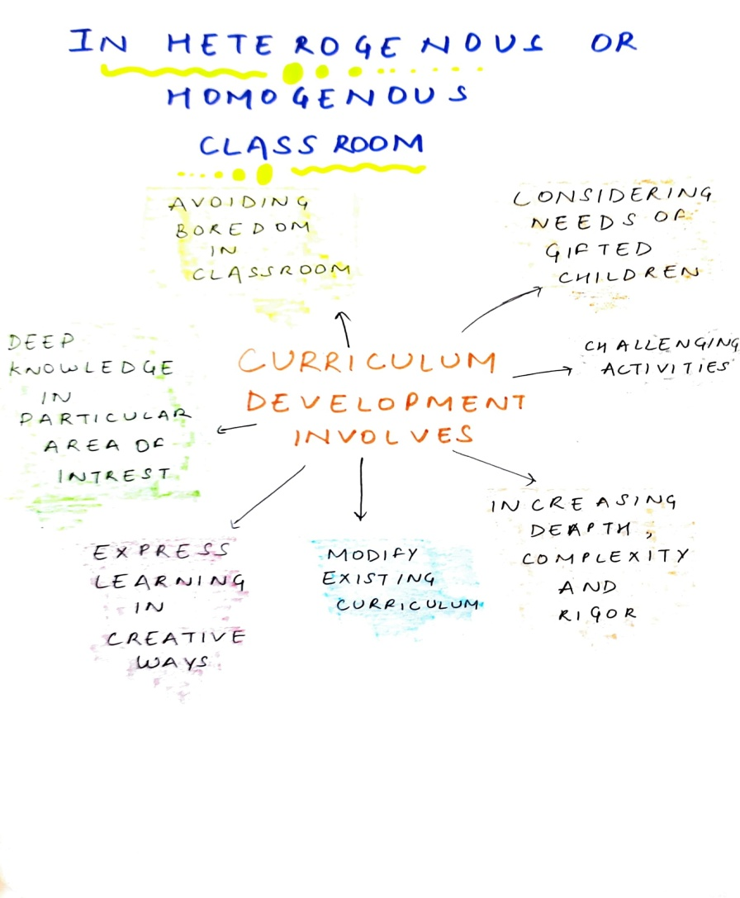

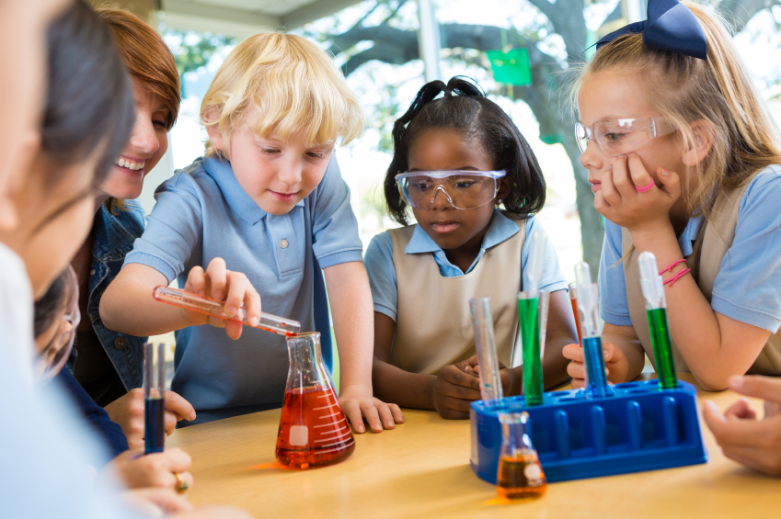

Slide 17
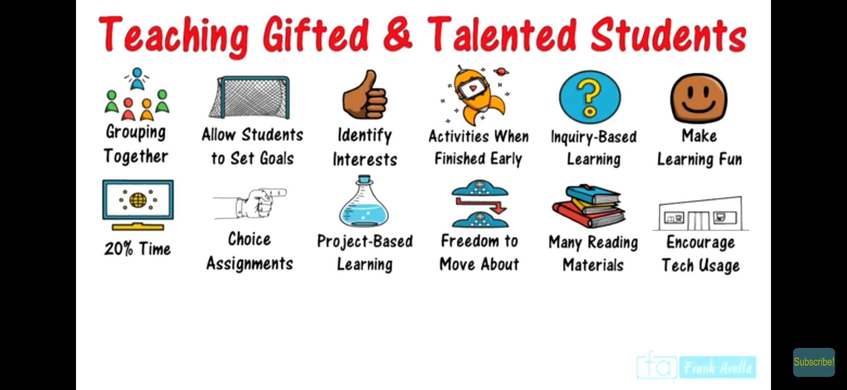

Slide 18
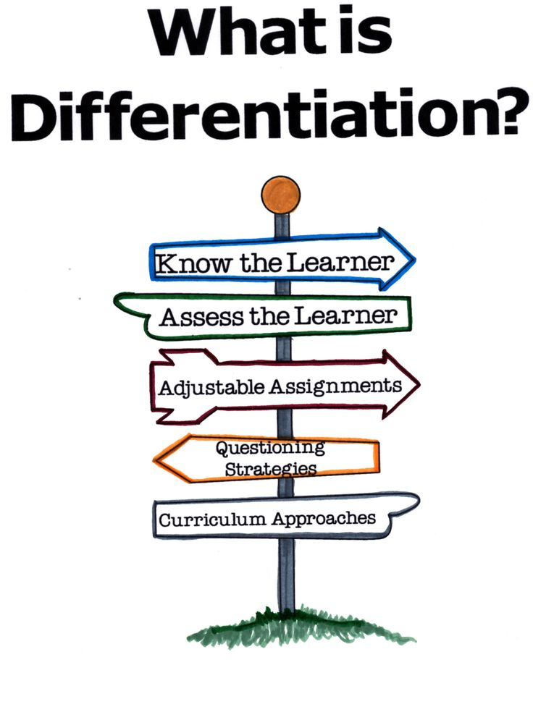
DIFFERENTIATION OF CURRICULUM
“Robinson”
Understanding individual differences
“Tomlinson”
Ensuring what a student learns, how she/ he learns and how the student demonstrates what he/she learned is a match for student’s readiness level, interests, and preferred mode of learning.
Devising institutional strategies
Systemically implementation

Slide 19
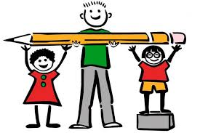
Modification of the curriculum through adjustments in the
Content
Process
Skills
The curriculum is tailored in such a way , so that the students can
Learn
Find, solve and act
Manipulate

Slide 20

DIFFERENTIATED
CURRICULUM
2. Teachers offer different approaches to
What students learn,
How they learn( process), and
How students demonstrate ( product).
1. Programme of activities that offers a variety of entry points for students.

Slide 21
This programme may be of two types:
Indepth or Vertical
Inbreadth or horizontal

Slide 22

Indepth or vertical: According to this programme, the gifted student is assigned task to find the deeper elements of the topic.
For example: On the topic of 'transportation' in social studies the class in general studies the means of transportation and their benefits and drawbacks. But the gifted students may be asked to interview some persons associated with transportation to know the actual position and then collect information regarding the history, development and future of transportation or to devise new ways of transformation, etc.

Slide 23
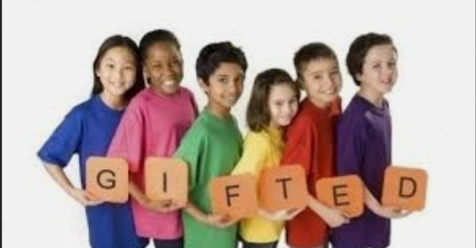
Inbreadth or horizontal: It means studying additional studies related to subjects. This enlarge the perspective of gifted students. This can be done by following methods:
Encouraging the gifted students
Offering additional learning
Encouraging teachers
These are the curriculum needs of the gifted students and must be fulfilled for their full development.

Slide 24
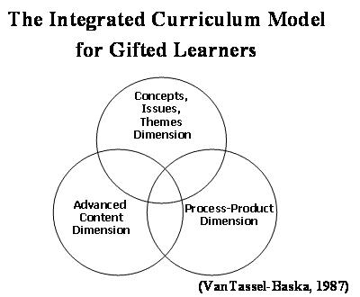
Process of Differentiation of curriculum
Differentiation includes Enrichment and Extension Activities.
1. Enrichment : It refers to the broadening of the Curriculum to develop knowledge, application, thinking, skills and attitude, to a degree of complexity appropriate to the students’ developmental level.

Slide 25
Extensive activities
Special assignments
Panel discussions
Summer schools for gifted students
Counselling services
2. Extensive Activities :
It involves the deepening of students’ knowledge, understanding and skills.
Providing activities to the gifted students which gave them an opportunity to study a subject more broadly and deeply than the average child of the class.

Slide 26
DEVELOPING AN EFFECTIVE CURRICULUM FOR GIFTED STUDENT
How student access the curriculum
Students demonstrate learning
CONTENT
PRODUCT REPONSE
Ways n sequencing of learning by teachers.
How learning is structured
PROCESS
ENVIRONMET

Slide 27
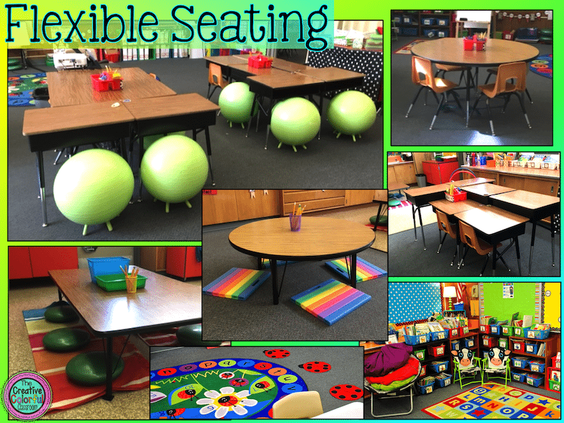

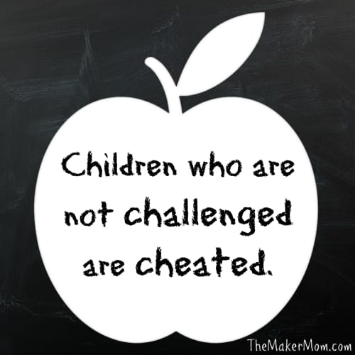
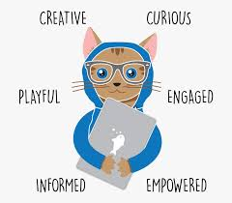

Curriculum FOR GIFTED STUDENTS

Slide 28
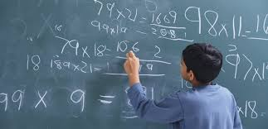

Seven guiding principles by passow

Slide 29
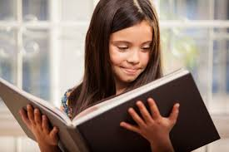
1.ENRICHMENT OF CONTENT
2.DEVELOPMENT OF PRODUCTIVE THINKING SKILLS
3. TO EXPLORE CHANGING WORLD KNOWLEDGE
4.SPECIALIZED RESOURCES

Slide 30
5. SELF - DIRECTED LEARNING
6. DEVELOPMENT OF INTER-RELATIONSHIPS
7. EVALUATION AND CURRICULA

Slide 31
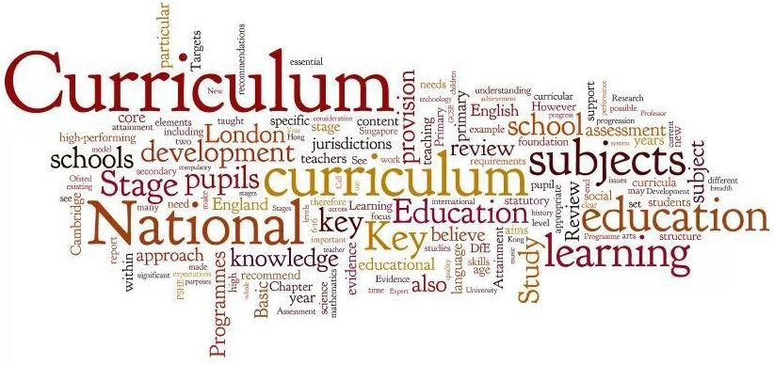

Slide 32
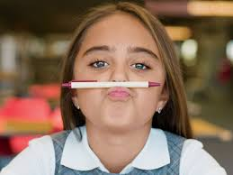
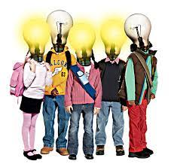
Conclusion:
Such type of differential curriculum for gifted students will produce well - educated, knowledgeable students who think clearly and critically about the knowledge. However, development of curriculum for the gifted is a challenging task. But gifted children are real assist of a nation and those must be fostered properly for the progress of a nation.

Slide 33


