Slide 1


Slide 2
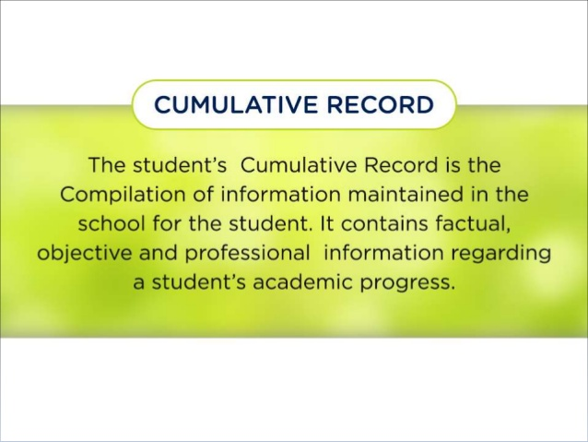
Introduction

Slide 3
Contd.
Basically a Cumulative Record Card is a document in which it is recorded cumulatively useful and reliable information about a particular pupil or student at one place. Hence presenting a complete and growing picture of the individual concerned for the purpose of helping him during his long stay at school. And at the time of leaving it helps in the solution of his manifold problems of educational, vocational and personal-social nature and thus assisting him in his best development.
According to Jones, a Cumulative Record is, “A permanent record of a student which is kept up-to-date by the school; it is his educational history with information about his school achievement, attendance, health, test scores and similar pertinent data,”
If the Cumulative Record is kept together in a folder it is called Cumulative Record Folder (CRF). If the Cumulative Record is kept in an envelop it is called a Cumulative Record Envelop (CRE). If the cumulative Record is kept in a card it is called a Cumulative Record Card (CRC).

Slide 4
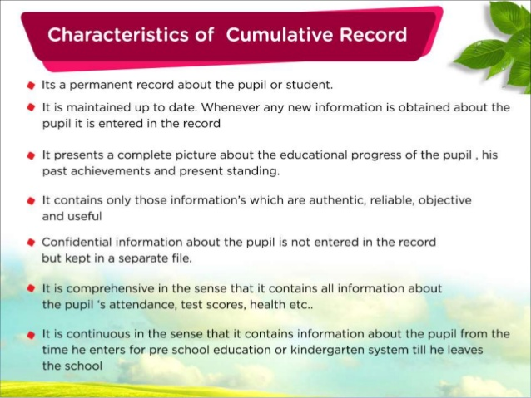
Characteristics

Slide 5
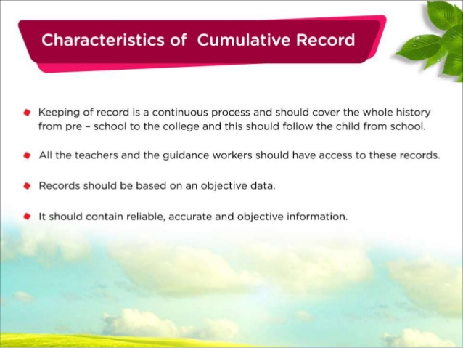

Slide 6
Principles for the maintenance of cumulative record
Continuity . accuracy
. Usability . comprehensive
Economy .complete
Recency .valid
Accessibility
Co-operated venture
Uniformity
Evalution
Objectivity

Slide 7
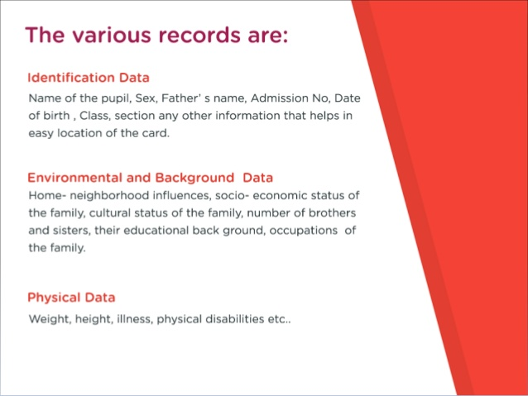
Contents of the cumulative record

Slide 8
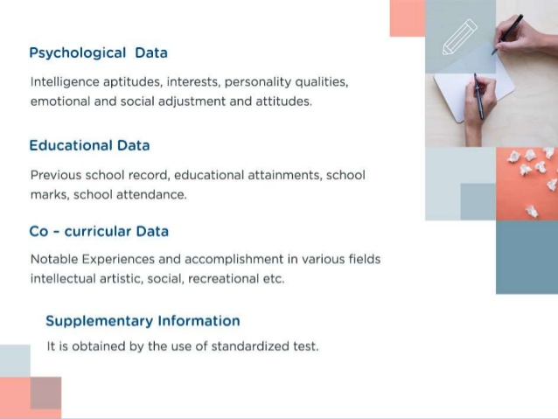
Contd.

Slide 9
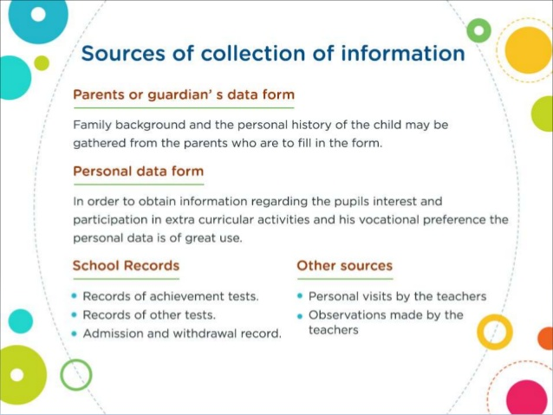
Sources of collection of data

Slide 10
. Uses of Cumulative Record Card
(i) The CRC is useful for guidance worker and counsellor as it provides a comprehensive, objective picture about the student including his strength and weaknesses.
(ii) The CRC is useful for guidance counsellor to help pupil in educational achievement, vocational choice and personal progress so far adjustment is concerned.
(iii) The CRC is useful for headmaster/principal to ascertain the pupil’s performances in different subjects and his limitations.
(iv) The CRC is useful for parents to provide special privileges to make up the deficiencies what lie in case of his child.
(v) The CRC is useful for teachers to know the students and his progress and weaknesses at a glance.
(vi) The CRC does not give chance for overlapping of data collected by different teachers about the students.
(vii) The CRC is useful in making case study about the students.
(viii) The CRC is useful for the students for the vocational purposes.
It helps in preparing certificates.
It is useful for evaluation.

Slide 11
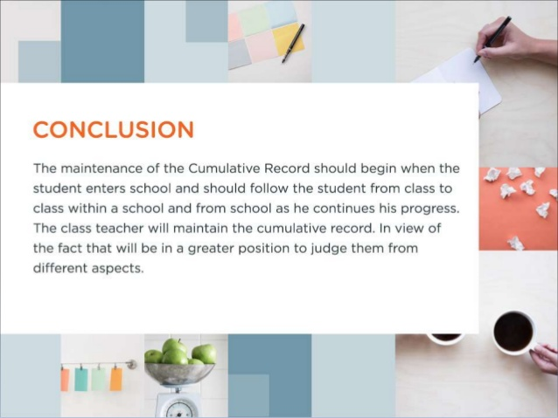
Limitations of Cumulative Record Card
:
(i) The entire data is of little use if they are not collected properly objectively and accurately.
(ii) The purpose of CRC is not served if it is not maintained secretly and confidentially.
(iii) Sometimes the information’s and its interpretations of CRC becomes confusing as the information’s are collected by different teachers.
(iv) The CRC needs much money to come to light which is not possible in the part of school to spend on this head.
(v) The maintenance of CRC is a hard some job like clerical work in the part of teachers.
(vi) It is a lengthy process which needs much time to be worked out.

