Slide 1
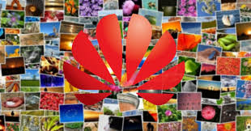
Collage

Slide 2
Collage: Meaning
Collage is a work of formal art, primarily in the visual arts, made from an assemblage of different forms, thus creating a new whole.
It is artwork made by pasting pieces of paper or other materials to a flat surface. They are made of various light to medium weight materials that can be successfully attached. The materials are cut, torn and shaped then arranged and glued to heavy backing board.

Slide 3
A collage may include...
newspaper clippings or magazine cuttings
Ribbons
bits of colored papers
or hand-made papers,
portions of other artwork,
photographs and other found objects
These are glued to a piece of paper or canvas.

Slide 4
History
The term collage derives from the French word "coller" meaning "glue". This term was coined by both Georges Braque and Pablo Picasso in the beginning of the 20th century when collage became a distinctive part of modern art.
The origins of collage can be traced back hundreds of years, but this technique made a dramatic reappearance in the early 20th century as an art form of novelty.

Slide 5
History…cont..
Techniques of collage were first used at the time of the invention of paper in China, around 200 BC. The use of collage, however, remained very limited until the 10th century in Japan, when calligraphers began to apply glued paper, using texts on surfaces, when writing their poems.
The technique appeared in medieval Europe during the 13th century.
Gold leaf panels started to be applied in Gothic cathedrals around the 15th and 16th centuries
Gemstones and other precious metals were applied to religious images, icons, and also, to coats of arms.

Slide 6
Types of Collages
Wood Collage
Decoupage
Magazine collage
Photomontage
Mosaic
3D collage
Digital Collage

Slide 7
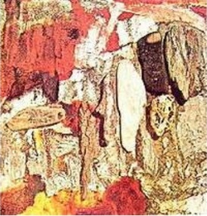
Wood Collage
It uses only natural wood - such as driftwood, or parts of found and unaltered logs, branches, sticks, or bark to make collage.

Slide 8
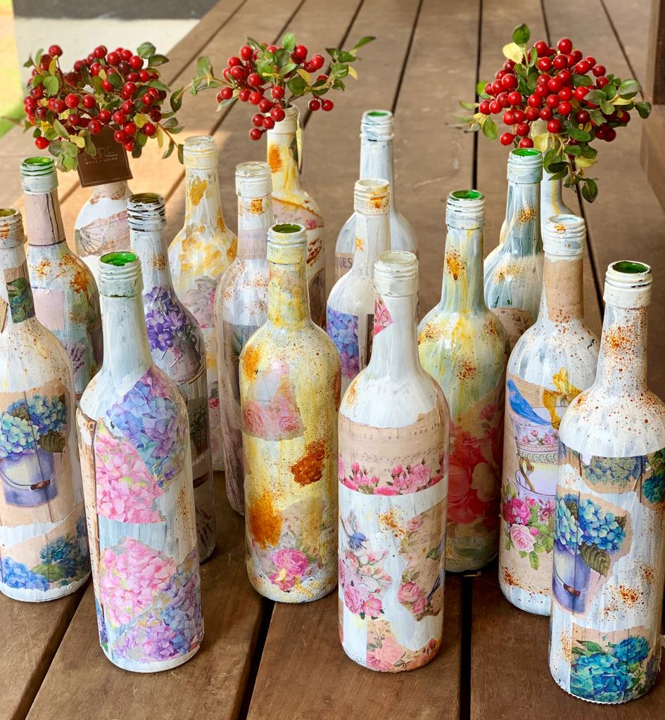
Decoupage
Decoupage is a type of collage usually defined as a craft. It is the process of placing a picture into an object for decoration. Decoupage is the art of decorating an object by gluing colored paper, cutouts onto it in combination with special paint effects and other decorative elements. The picture is often coated with varnish or some other sealant for protection.

Slide 9
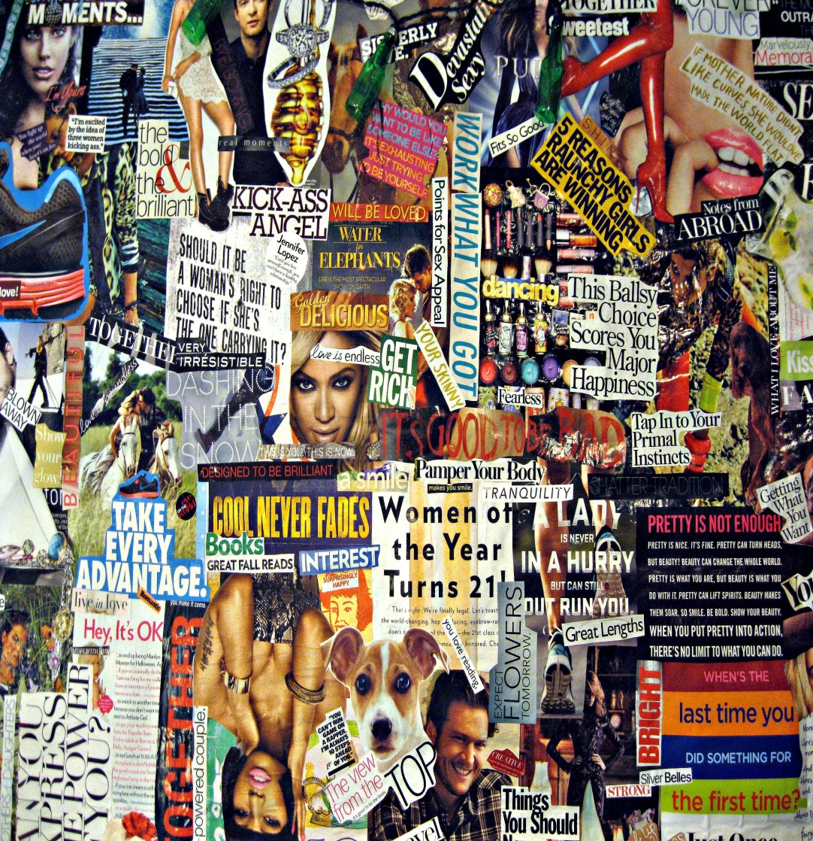
Magazine collage
Magazine collage are made from random things in magazines. They can be cut out and then stuck onto common surface.

Slide 10
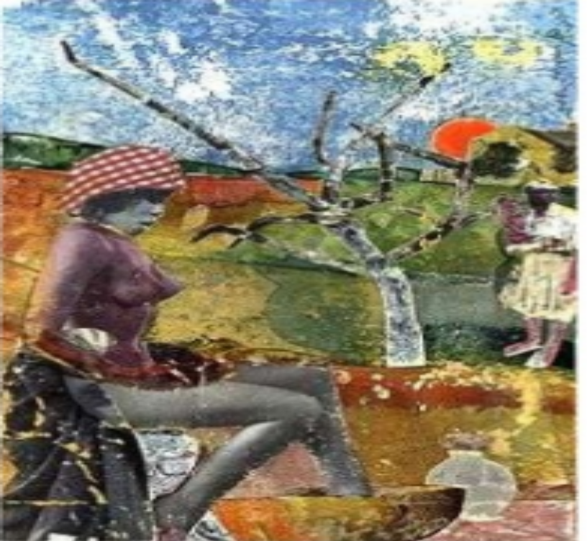
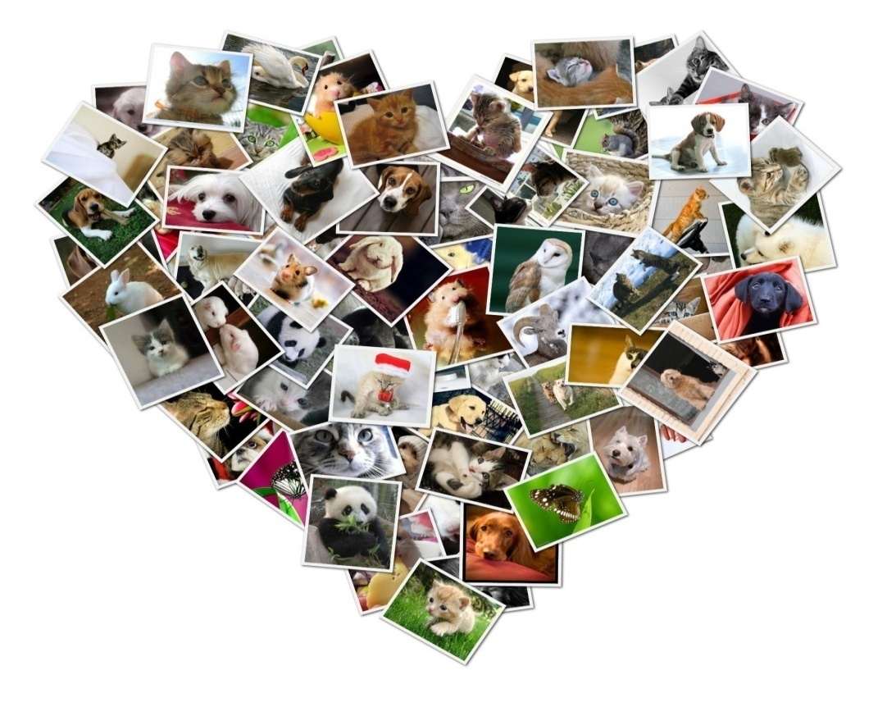
Photomontage
This is the most popular types of collage. Collage made from photographs, or parts of photographs. They are put together through the use of photos and sticking them to the one surface.

Slide 11
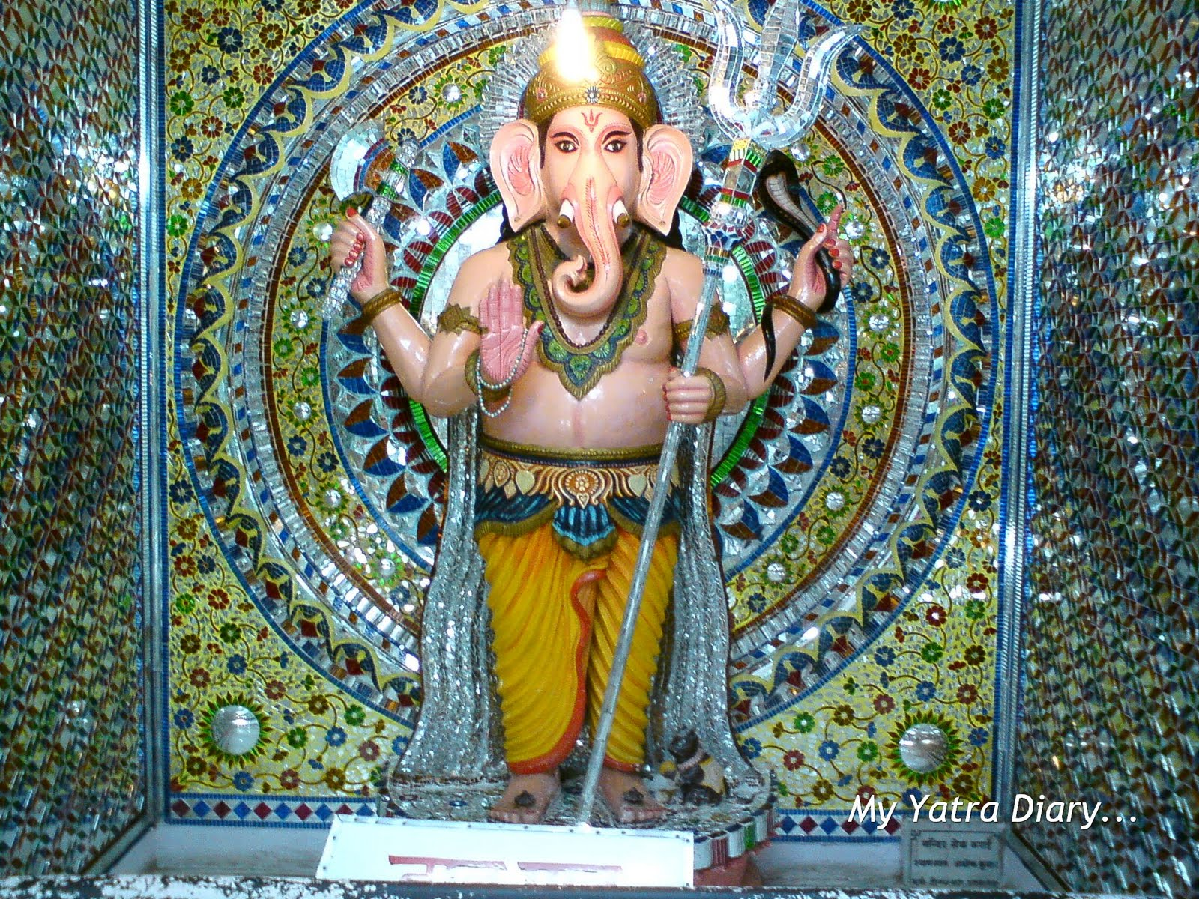
Mosaic
Mosaic is a image made from an assemblage of small pieces of colored glass, stone, marbles, or other materials. We can find such collages in temples, churches.

Slide 12
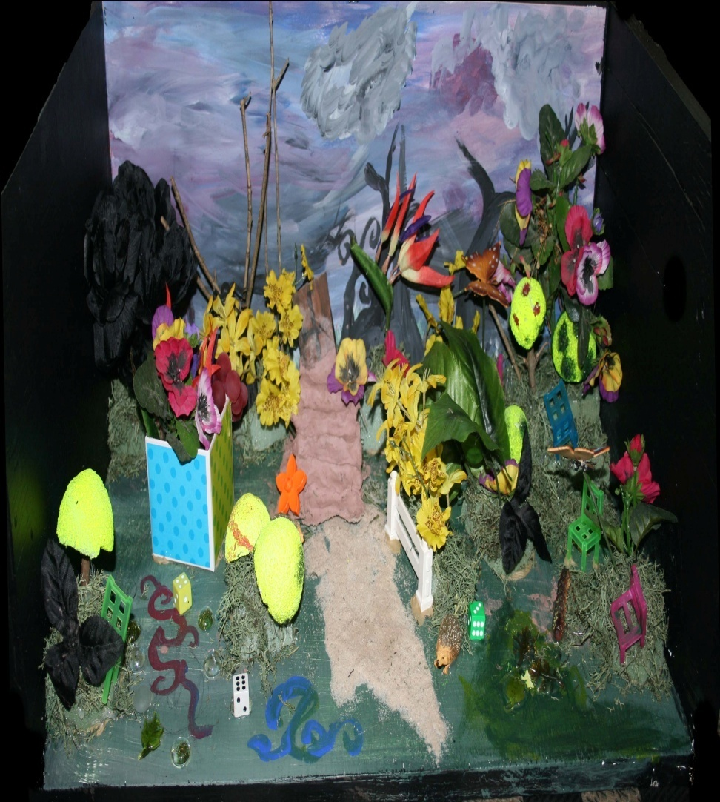
3D Collage
3D collage art is placing 3D items on a surface and creating something new. Some of the items that can be used are: rocks, beads, coins, buttons,sticks etc.

Slide 13
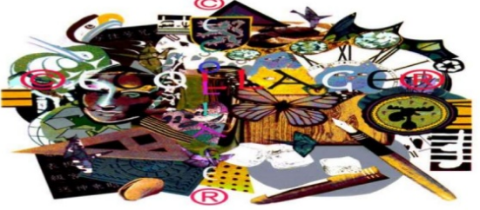
Digital Collage/ E-collage
Digital collage is the technique of using computer tools to make the collage. It is commonly used in the creation of digital art.

