Slide 1
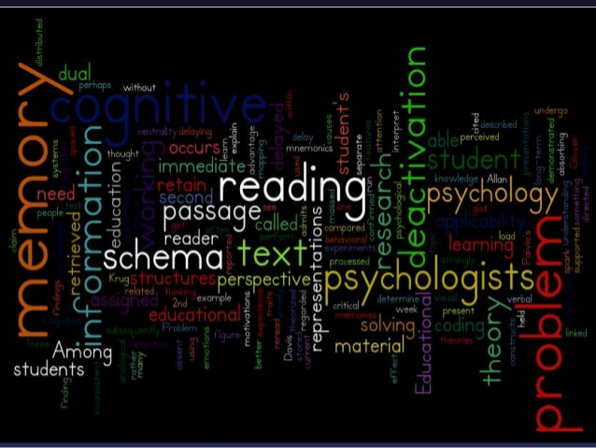
COGNITIVISM

Slide 2

Introduction
Cognitive development was a progressive
reorganization of mental processes as a result of biological maturation and environmental experience.

Slide 3

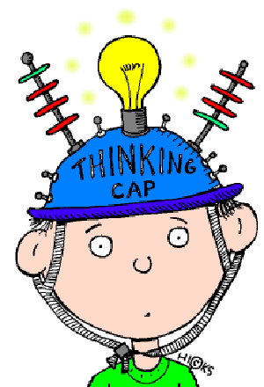
Children construct an understanding of the world around them, then experience discrepancies between what they already know and what they discover in their environment.

Slide 4
The Cognitive Level of analysis:
The human mind is quite sophisticated. It can manipulate abstract symbols like words and images.
These mental representations can refer to objects, ideas, and people in the real world; people use them when they think, make plans, imagine, or daydream.
You have an idea of how you look somewhere in your mind – a self-representation. You also have ideas about how other people are.

Slide 5
The Cognitive Level of analysis:
Mental representations are organized in categories, and the mind contains all sorts of mental representations stored in memory.
Cognitive schemas – pre-stored mental representations.
Mental representations – how we store images and ideas in memory.
Researchers believe that what we already know (cognitive schemas) affects the way we interpret events and store knowledge in out memory.

Slide 6
What is Cognitive Psychology?
Study of mental processes
Study of the way in which the brain processes information
It concerns the way we take in information from the outside world, how we make sense of that information and what use we make of it.

Slide 7
What are “mental processes”?
Definition: "the process of thinking"; "the cognitive operation of remembering"
Ex. Functions or processes such as perception, introspection, memory, creativity, imagination, conception, belief, reasoning, volition, and emotion—
In other words, all the different things that we can do with our minds.

Slide 8
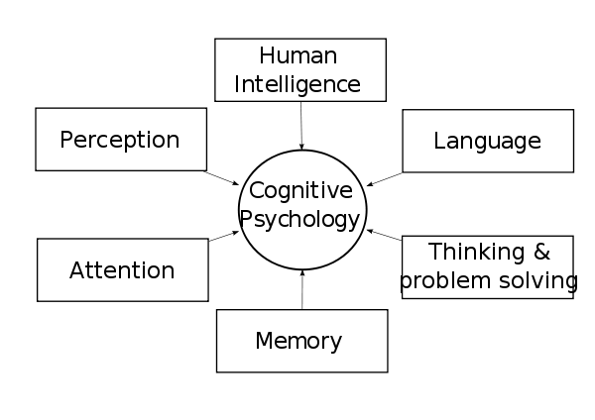
Cognitive Psychology:
The study of mental representations and processes.

Slide 9
Meaning and Concept
Cognitivism is an approach applied in teaching learning to understand the process of cognitive development of children.
To interrelate different aspects of instruction to match them with children’s cognitive abilities.

Slide 10
Meaning
Cognition refers to mental activity and behaviour through which knowledge of the world is attained and processed…
Including attention abilities, learning, perception and thinking.
Contribution of many psychologists---Werner, Piaget, Bruner.

Slide 11
Assumptions of Cognitivism
Child is not mechanistic
Perception and attention abilities are fundamental for children’s cognitive development
Learning or thinking is not a blind drill
Child’s mind is dynamic and a developing reality
Any environment may have different psychological meaning to different individuals.

Slide 12
Assumptions of Cognitivism
Structural relationship between different materials
Profiting from the past experiences
Thinking is not merely a pure intellectual operation
Development is directed by self modification
Learner centred methods and techniques.

Slide 13
Principles
Cognitive psychology is based on two principles:
(1) Human cognition can at least in principle be fully revealed by the scientific method, that is, individual components of mental processes can be identified and understood and
(2) Internal mental processes can be described in terms of rules or algorithms in information processing models.

Slide 14
Approaches
Very much like physics----
experiments and simulations/modelling are the major research tools in cognitive psychology.
Often, the predictions of the models are directly compared to human behaviour.
With the ease of access and wide use of brain imaging techniques, cognitive psychology has seen increasing influence of cognitive neuroscience over the past decade.
There are currently three main approaches in cognitive psychology: experimental cognitive psychology, computational cognitive psychology, and neural cognitive psychology.

Slide 15
Approaches to cognitive psychology
1) Experimental cognitive psychology treats cognitive psychology as one of the natural sciences and applies experimental methods to investigate human cognition.
Psychophysical responses, response time, and eye tracking are often measured in experimental cognitive psychology.
2) Computational cognitive psychology develops formal mathematical and computational models of human cognition based on symbolic and subsymbolic representations, and dynamical systems.
Neural cognitive psychology uses brain imaging (e.g., EEG, MEG, fMRI, PET, SPECT, Optical Imaging) and neurobiological methods (e.g., lesion patients) to understand the neural basis of human cognition.
The three approaches are often inter-linked and provide both independent and complementary insights in every sub-domain of cognitive psychology.

Slide 16
Applications
Cognitive psychology research has produced an extensive body of principles, representations, and algorithms. Successful applications range from custom-built expert systems to mass-produced software and consumer electronics:
(1) Development of computer interfaces that collaborate with users to meet their information needs and operate as intelligent agents,
(2) Development of a flexible information infrastructure based on knowledge representation and reasoning methods,
(3) Development of smart tools in the financial industry,
(4) Development of mobile, intelligent robots that can perform tasks usually reserved for humans,
(5) Development of bionic components of the perceptual and cognitive neural system such as retinal implants.

Slide 17
Areas of Application in Cognitive Psychology
Moral development - This includes how moral dilemmas change your moral reasoning in the stages of moral development.
Eyewitness testimony - Study of how a witness’s testimony is affected by stress, focusing on a weapon, or leading questions.
Forgetting - This area covers long and short term memory.
Selective attention - Humans have limited capacity for paying attention so this studies the selection of what deserves our attention.
Perception - This covers the processing of sensual inputs and how the brain turns them into sensual perceptions.
Child development - This deals with the process of cognitive processes as we grow.
Cognitive behavioral therapy - This uses the fact that thought patterns can affect behavior and tries to help people with mental health problems.

Slide 18
Cognitive psychology
Cognitive psychology declined in the first half of the 20th century with the rise of “behaviorism"
The Cognitive Revolution began in the mid-1950s when researchers in several fields began to develop theories of mind based on complex representations and computational procedures

Slide 19
Sub-domains /Areas of Cognitive Psychology
Traditionally, cognitive psychology includes human perception, attention, learning, memory, conceptformation, reasoning, judgment and decision-making, problem solving, and language processing.
For some, social and cultural factors, emotion, consciousness, animal cognition, evolutionary approaches have also become part of cognitive psychology.

Slide 20
Perception
Perception - This includes the senses and the processing of what we sense. This also includes what we sense and how it interacts with what we already know.
Those studying perception seek to understand how we construct subjective interpretations of proximal information from the environment.
Perceptual systems are composed of separate senses (e.g., visual, auditory, somatosensory –sense organ like sight, taste)
Current research also focuses on how these separate representations and modules interact and are integrated into coherent percepts.

Slide 21
Attention
Attention - Sometimes our cognitive processing systems get overloaded and we have to select information to process further. This deals with how and why performance improves with attention.
Attention solves the problem of information overload in cognitive processing systems by selecting some information for further processing,
OR by managing resources applied to several sources of information simultaneously
Brain imaging studies have documented effects of attention on activation in early visual cortices, and have investigated the networks for attention control.

Slide 22
Learning
This is the study of new cognitive or conceptual information that is taken in and how that process occurs.
It includes implicit learning that takes into account previous experience on performance.
Learning: Learning improves the response of the organism to the environment.
Cognitive psychologists study which new information is acquired and the conditions under which it is acquired.

Slide 23
Memory
Memory - Studying human memory is a large part of cognitive psychology.
It covers the process of acquiring, storing and retrieving memory, including facts, skills and capacity.
The study of the capacity and fragility of human memory is one of the most developed aspects of cognitive psychology.
Memory study focuses on how memories are acquired, stored, and retrieved.
Memory domains have been functionally divided into memory for facts, for procedures or skills, and working and short-term memory capacity.

Slide 24
Concept Formation:
Concept or category formation refers to the ability to organize the perception and classification of experiences by the construction of functionally relevant categories.
This aspect studies human’s ability to organize experiences into categories.
Response to stimulus is determined by the relevant category and the knowledge associated with that particular category.

Slide 25
Judgment and decision
Human judgment and decision making is ubiquitous ( seems to be everywhere) – voluntary behavior implicitly or explicitly requires judgment and choice.
Judgment and decision - This is the study of decision making. Any behavior, implicit or explicit, requires judgment and then a decision or choice.

Slide 26
Reasoning
Reasoning is the process by which logical arguments are evaluated or constructed.
Original investigations of reasoning focused on the extent to which humans correctly applied the philosophically derived rules of inference in deduction and the many ways in which humans fail to appreciate some deductions and falsely conclude others.
This can be affected by educated intuitive guesses, fallacies or stereotypes.

Slide 27
Problem Solving
Problem solving - Solving problems is a way that humans achieve goals.
The cognitive psychology of problem solving is the study of how humans pursue goal directed behavior.
Problem solving may engage perception, memory, attention, and executive function, and so many brain areas may be engaged in problem solving tasks, with an emphasis on pre-frontal executive functions.

Slide 28
Language Processing:
Language processing - This is the study of how language is acquired, comprehended and produced. It also focuses on the psychology of reading.
This includes processing words, sentences, concepts, inferences and semantic assumptions.

Slide 29
Planning and Development
Psychologists rejected mechanical approach
Concentrates on giving opportunities to the child
To discover knowledge in his own way
Learner and teacher have distinct place for ineracting with each other.

Slide 30
Planning and Development……
The Learner
TLP is learner centred
Learner is active and participated
Children as growing, developing, reflecting individuals
Learner’s capabilities are accepted and recognized
Strategies are conscious cognitive
Environment provides them numerous opportunities
Learner is the master of the show
Shallow and deep techniques

Slide 31
Planning and Development……
The Teacher
Teacher as a provider or facilitator
Teacher provides needed help
Help in acquiring language and arts
To embed material with cultural contexts
Help in developing learning skills
Help in developing language skills
To motivate learners to acquire knowledge

Slide 32
Planning and Development……
The Teacher
Teacher to present himself as a good role model
Teacher to provide expert guidance
To present problems to solve
To encourage learners to take initiative
To encourage mutual discussion and healthy interaction
To encourage children critical and divergent responses

Slide 33
Planning and Development……
The Teaching learning Process
More flexibility and dynamism
More autonomy to the learner
Encouraging healthy and open discussion
Thoughtful mode of operation is adopted
Space for independent thinking
More useful methods and techniques
Provision for expert support and guidance
Feasibility of interactional process
TLP is more lively , interesting and useful

Slide 34
Conclusion
Cognitivism is a major force in psychology
Emphasizes the internal mental processes
Improved our methods of studying mental processes
Study of varieties of conciousness
Differences in levels of awareness

