Slide 1
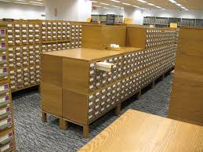
Topic: Cataloguing
For B.Ed Ist Semester Students
(Punjabi University)
By
Ms. Sarita Gulati
Librarian
Shivalik Institute of Education and Research,Mohali

Slide 2
The word catalogue comes from the Greek word KATALOGOS. Kata means “according to” and logos mean “order”.
“Catalogue” is work in which the contents are arranged in a particular order/plan. It means ‘list of book of a particular library arranged in some systematic order’.

Slide 3
According to Dr. S.R. Ranganathan “Library catalogue is a list of documents in a library, it may be printed or handwritten form, it may be on card or loose leaves”.
According to C.A. Cutter ,” A library catalogue is a list of books which is arranged on some definite plan.

Slide 4
Library catalogue provides bibliographical information of the documents such as author, title, edition, place of publication, publisher, place in each entry .
It gives the location number of the document such as call number of the document which is very useful to locate the book on the shelf in the library.

Slide 5
Objectives of Library catalogue
To enable the user to find a book written by a particular author, title or subject.
To find out the total collection of documents by a particular author, subject.
To find out the latest added books in the library
To know the latest edition of a document.

Slide 6
Need and Purpose
1 To facilitate the reader to easily locate the books.
2 Increases in number of documents will require a catalogue. So a library having large collection must have a catalogue.
3. Catalogue guide the reader whether a book is available in that library or not, and if available, where it can be found.
4. Library catalogue saves the reader time as it fulfills every approach to a document.

Slide 7
Functions of Library Catalogue
It informs us whether a particular book by a particular author is available or not in the library.
It help us to find out total collection of documents in particular library.
It provides the location of a documents in a library.
It gives bibliographic information of a document.
It help us to find the latest added books in the library.
It serves as good reference tool.
To know the richness and weakness of library.

Slide 8
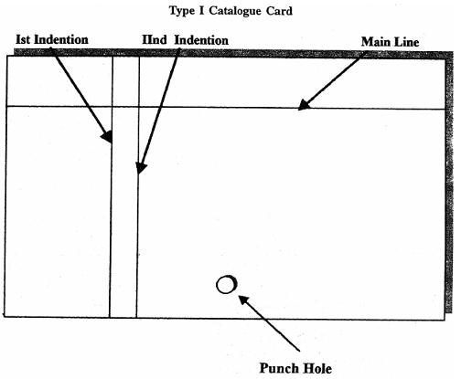
Card Catalogue

Slide 9
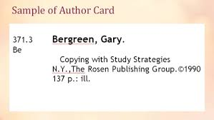
Author card

Slide 10
CATALOGUE
OUTER FORM
INNER FORM
PHYSICAL /
CONVENTIONAL
PURE FORM
NON-CONVENTIONAL
MIXED FORM

Slide 11
Physical Forms/Conventional
Catalogue
Loose leaf catalogue
Guard catalogue
Printed book catalogue
Card catalogue
Kardex catalogue

Slide 12
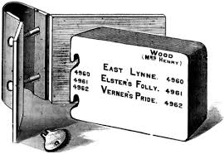
Loose leaf catalogue- Entries are made on slips of papers. Entries can be handwritten or printed. Entries are bound into loose leaf binder. One loose leaf binder can accommodate about 500-600 slips. It is an oldest system started in western countries. It is possible to insert new entries in old sequence and also unwanted entries can be taken out.

Slide 13
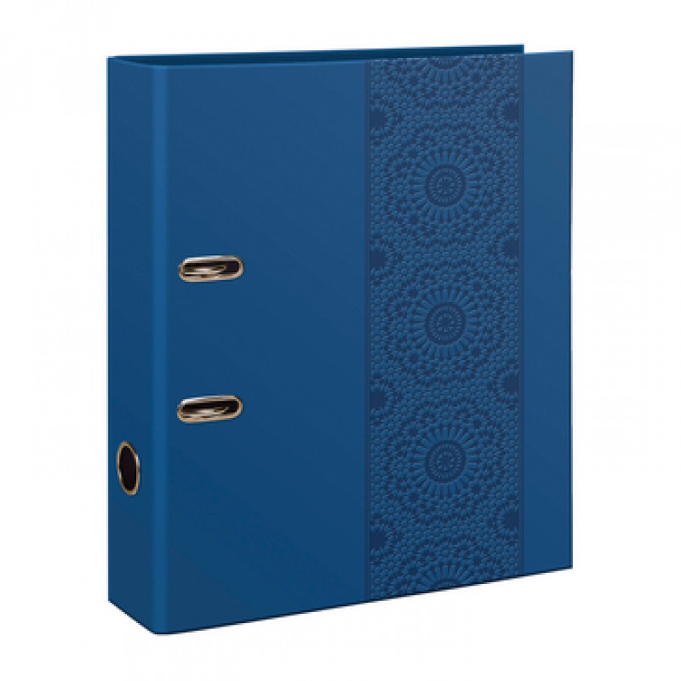
Guard catalogue- It is just an improve version of loose leaf form. When the catalogue entries are prepared and pasted on thick sheets of paper according to some order and these sheets are put together in guard file and it is known as guard form of catalogue.

Slide 14
Printed book catalogue – As the name suggests, it resembles to a book or register. The entries are printed on separate sheets as per a desired arrangement and the sheets are then bound together to form a book. It is easy to prepare but lacks flexibility. Entries for new books can’t be accommodated at proper place. Hence require frequent revision.

Slide 15
Card catalogue - It is the most popular form. In this , entries are made on card, arranged in systematic order. These cards are kept in drawer. These are secured by means of locking rods which run through the hole at the bottom of each card. The card is made up of thick sheet of paper. The size of card is 3*5 (inches) or 12* 7.5 cm.

Slide 16
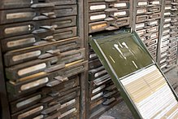
Kardex Catalogue - These special cards are used in periodical sections to store information about periodical acquired in the library. When catalogue entries are printed on specially printed card of bigger size (7*5) inches.

Slide 17
Non- conventional form/Technical forms
MARC (Machine readable catalogue)
OPAC (Online public access catalogue)

Slide 18
MARC (Machine readable catalogue) - Catalogue entries are prepared on magnetic tapes and disks and these are used with the help of computer.
OPAC (Online public access catalogue) - OPAC is a database of bibliographic record describing the holdings usually of one particular library which allows searching by author, subject, title and offers online access through public terminal.

Slide 19
Inner forms of catalogue
It refers to form of construction of the catalogue. Kinds of inner forms are illustrated below.
Pure forms (satisfy one approach)
2 ) Mixed forms (satisfy more than one approach)

Slide 20
A) Pure forms (satisfy one approach)
Author – Catalogue made according to author and then arranged alphabetically by author
Title – Catalogue made according to title and then arranged alphabetically by title
Alphabetical subject – Catalogue entries made according to subject and then arranged alphabetically by subject.. eg psychology

Slide 21
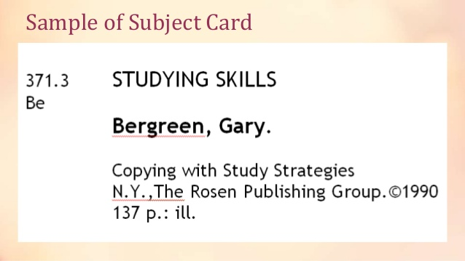
Subject catalogue

Slide 22
2 ) Mixed forms (satisfy more than one approach)
Author-title catalogue: It satisfies two approaches. 2 entries are made for one document of author and title and then they are merged together and arranged alphabetically.
Name catalogue: When catalogue entries are made under names only and then these are arranged in alphabetical order. Name could be name of author, editor, translator, illustrator etc.

Slide 23
Classified catalogue: Here entries are arranged according to class number.
Dictionary/alphabetical catalogue: When we make catalogue entries under name of author, title, subject, series, and editor of series etc for each and every book available in the library and all these entries are arranged in one alphabetical sequence it is known as dictionary catalogue.

