Slide 1
Aesthetics
For B.Ed Ist Semester Students
(Punjabi University)
By
Ms. Sarita Gulati
Librarian
Shivalik Institute of Education and Research, Mohali

Slide 2
Introduction
Aesthetic is the philosophical branch of inquiry concerned with beauty, art and perception. It explains how people perceive and access the meaning, importance and purpose of art. Aesthetics examines what makes something beautiful, disgusting, funny, silly, entertaining, boring, tragic etc. Judgments of aesthetics clearly rely on our ability to determinate at a sensory level.

Slide 3
What is Aesthetics?
Aesthetics is the study of beauty and taste, whether in the form of the comic, the tragic, or the sublime/outstanding. The word comes from the Greek word aisthetikos, referring to sensory perception and understanding or sensuous knowledge.
" Aesthetics is the branch of philosophy that deals with the nature and expression of beauty.
It deals with opinions on perception i.e Aesthetics is where we comment upon the appearance.

Slide 4
It explains how people perceive and access the meaning, importance and purpose of art.
It is the study of taste according to the taste of senses. The property of sensory taste are beautiful, dynamic, graceful. Aesthetics is being interested in how something looks and feels. Example car is beautiful or admire paintings when visiting an art museum.

Slide 5
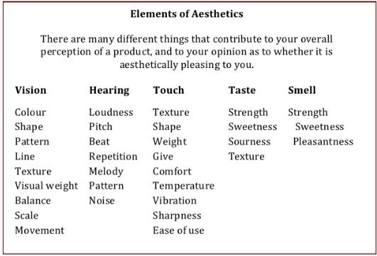

Slide 6
Definition of Aesthetics
According to Barnett Newman “ Aesthetic is for the artist as ornithology is for the birds.”
According to Britannica ”Aesthetic means’ the philosophical study of beauty and taste’. To simplify, aesthetic is the ‘why’ when you think something looks nice.
Kant defined aesthetics as both, “analysis of taste and the analysis of sensible cognition or intuition”.

Slide 7

a particular taste for or approach to what is pleasing to the senses--especially sight.

Slide 8



We make informal aesthetic choices every day.
From what we wear . . .

Slide 9



to the things we buy: books, music, and objects for our homes.

Slide 10


The aesthetic choices we make influence many parts of our lives.
We all have a personal aesthetic (preferences and tastes based on what we see)

Slide 11

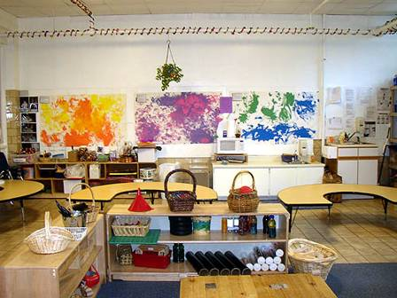
How would you describe the aesthetic quality of your classroom at school?

Slide 12
HISTORY
In the eighteen century, the German Philosopher Alexander Gottlieb Baumgarter picked up the term and changed its meaning into gratification(that gives pleasure) of the senses or sensuous delight (Goldman, 2001).
Since work of art are (mostly) produced for this reason, i.e. to gratify our senses, the concept has since been applied to any aspect of the experiences of art, such as aesthetic judgment, aesthetic attitude, aesthetic understanding, aesthetic emotion, aesthetic value. These all are considered part of the aesthetic experience and although we can still experience nature or people aesthetically, the phrase is most often used in relation to the arts. Especially visual art.
.

Slide 13
Nature of Aesthetics
Aesthetic is perceptual: Aesthetic is the philosophical study of beauty and taste. The term aesthetic originate from Greek word “aisthetikos” of sense perception. It is related to the study of sensory values. Aesthetic refers to the visual attractiveness. Good aesthetic of a art leads to its better usability, user awareness or pleasure.
Aesthetics is Axiological: Axiology is the study of values. Axiology study two types of values: ethics and aesthetics. Aesthetics deals with the values of fascination and harmony. So when aesthetic is compared with axiology it becomes the science of nature, art forms and manifestations(show/present) with both beautiful and terrible. This science studies human creative attitude to reality and its experiences.

Slide 14
Aesthetic is Descriptive : Some aesthetic terms like tragic, dramatic, epic are descriptive, they do not imply any judgment but they tell us something about the kind of work and its global structure.
Aesthetic has many branches: General aesthetics has many branches like aesthetic of theatre, aesthetics of environment, aesthetics of fashion, aesthetics of manners and many more.
Aesthetic is Objective as well as Subjective: Pluto said Things that are beautiful always is objective aesthetics. Example sunset. David humes wrote that the beauty of things existed in mind which contemplates them, aesthesis become subjective. Subjective art is an interpretation of the artist, his mood, his feeling, his dream, his passion, his vision; it is a state of his mind.

Slide 15
Aesthetics is Normative( related to behaviour): Some aesthetics terms like beautiful, elegant, graceful, well balanced, ugly, disorganized are normative, they are typically used as evaluative expressions, which imply praise or disapproval. There is a certain normative constraint on our judgment of taste or beauty.
Aesthesis is Interdisciplinary (involving two or more discipline): It is co-opted with other scholarly disciplines and relied on them for knowledge, categories and methods. It concentrates on the integration of humanities, nature, sciences along with practical disciplines like medicines with aesthetics.

Slide 16
Aesthetics is Interpretive: Interpretation implies the conscious task of making sense out of a piece of writing. An aesthetic interpretation expresses a particular emotional or experiential understanding most often used in reference to a poem, or piece of literature and may also apply to a work of visual art or performance.
Aesthesis is a philosophical science: Aesthetics is a philosophical science concerned with the most general principle of aesthetic cognition of the work through any human activity, especially art which formulates, confirms and perfects the result of this cognition, according to the laws of beautiful.

Slide 17
Importance
It promotes Holistic development : Aesthetics is a necessary component to be included in developing a child holistically( physically, mentally, emotionally and socially). It supports in achieving the academic, emotional and social goals of education .
It develops the skill of appreciation in children: Children who are exposed to beauty experiences will develop the skill to appreciate things that are taught to them in their school setting. This development will ultimately lead to the appreciation and valuing of good design and things in their adulthood.
It enhances Concept Development : The concept development they acquire during the process of studying with aesthetic experiences enable them to solve problems that involves thinking and imagining.

Slide 18
It is the richest sources for understanding culture: Aesthetics helps people to understand and appreciate other cultures. Some of the information and knowledge we acquire about people from the past centuries were not recorded in the form of written words but rather in the form of drawings and paintings. so art is the richest source for understanding culture as it reveals the human activities and aesthetics helps us to appreciate this art.
Helps in development of Aesthetic Awareness (being aware of beauty ): Aesthetic responses lies at the heart of many daily events. Children develop aesthetic awareness if they are surrounded by beautiful environment and experiences around them.
Helps in reducing stress and enhancing positive Behaviour : The exposure of beauty in nature for art experiences encouraged children to express their thoughts freely as well as observing the surroundings without obstruction or hindrance. This leads to reduction in stress level and subsequently leads to positive behaviour in children .

Slide 19
Helps in building connections with Environment: There is so much of natural beauty all around us and aesthetic education teaches us to enjoy and appreciate this beauty so that they can enjoy and at the same time make connection to the environment as well as appreciate their art.
Helps them enjoy their success: Art develop children’s skills in eye-hand coordination, makes them persistent, patience and good working habits. Besides visual arts, performing together during music, drama or dance also gives children the opportunities to develop social skills as they work together as a team cooperatively and aesthetics helps them to enjoy every movement they live, while developing these qualities.

Slide 20
Helps in development of different domains: Through Aesthetic education children acquire knowledge understanding and skills that help them in the development of physical, intellectual, emotional and social domain .
Education opens up New areas of learning : Aesthetic education develops awareness among students by concentrating on arts, the study of music, dance, drama and visual arts. In this way aesthetic education opens up areas of learning too seldom experienced in school. These new areas are:
To develop the ability to evaluate the work of art.
To develop the creative capabilities among students
The self-esteem gained from experience that teach self respect and mutual respect.
To provide the opportunity to combine mind and emotions, cognition and sensory experience, analysis and intuition toward understanding something as a whole .

Slide 21
Aesthetics make us happy. On an emotional level they elicit feelings of happiness and calm. They connect us to our ability to reflect on and appreciate the world around us which in turn gives us feelings of contentment and hope.

