Slide 1
Trial & error theory
S-R theory

Slide 2

Trial and error theory by thorndike
Edward L. Thorndike's pioneer investigations in the fields of human and animal learning are among the most influential in the history of Psychology. In 1912, he was recognized for his accomplishments and elected president of the American Psychological Association. In 1934, the American Association for the Advancement of Science elected Thorndike as the only social scientist to head this professional organization. Thorndike retired in 1939, but worked actively until his death in 1949. His work was a major influence on SKINNER
(Lefrancois, 1972) Kearsley, G. (n.d.) Connectionism (E. Thorndike).

Slide 3
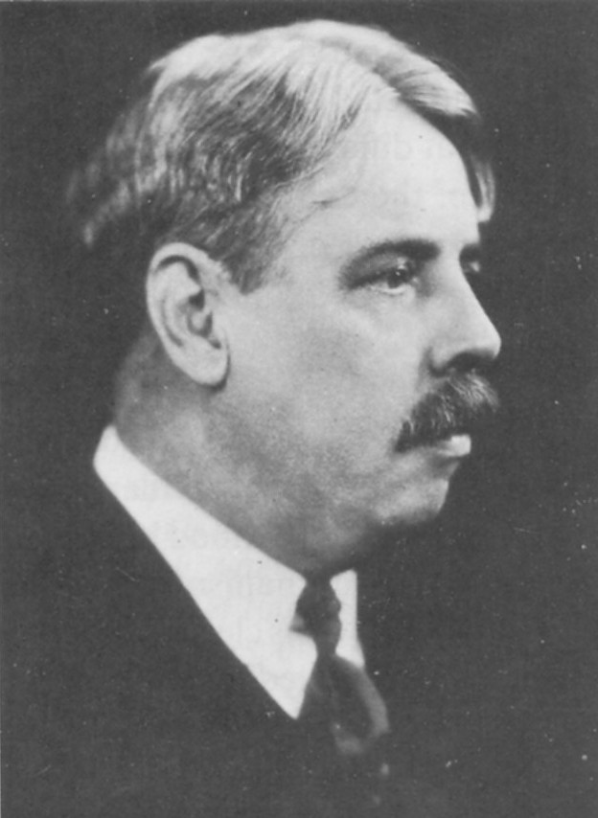
Thorndike
Interested in studying animal intelligence
He found that animal intelligence is based on the ability to form connections
Set up puzzle-box experiments to investigate instrumental conditioning

Slide 4

Behaviourist Thoery/ Thorndike's Theory of Connectionism/ Trial and Error Learning/ S-R Bond Theory
Trial and Error is a method of learning
in which various responses are
tentatively tried and some discarded
until a solution is attained.

Slide 5
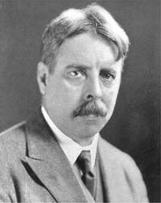
Trial & Error learning - Thorndike
Describes an organism’s attempts to learn/solve a problem by trying alternative possibilities until a correct solution or desirable outcome is achieved
Usually involves
A number of attempts & a number of errors - Before correct behaviour is learnt
Motivation (to achieve a goal)
Exploration – either random or purposeful
Reward – the correct response is rewarded –
which will lead to repeat performance of the correct response, strengthening the association between the behaviour & its outcome
Once learnt behaviour will usually be performed quickly and with fewer errors

Slide 6
The Puzzle Box Experiment
Thorndike's Experiment on cat in the puzzle is widely known and often quoted in psychology of learning. The experimental set up was very simple. A hungry cat was confined in a puzzle box and outside the box a dish of food was kept. The cat, in the box had to pull a string to come out of the box. The cat in the box made several random movement of jumping, dashing and running to get out of the box. The cat atlast succeeded in pulling the string. The door of the puzzle box opened, the cat came out and ate the food.

Slide 7
Trial & error theory
reward
exploration
motivation
Random attempts

Slide 8
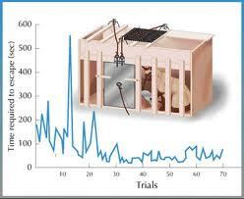
Thorndike’s Puzzle-box experiment
Thorndike put a hungry cat in a ‘puzzle box’ & placed fish, just out of reach
At first the cat to escape from the box through trial & error (random voluntary movements)
Eventually the cat accidentally pulled the string, escaped from the box so that it could reach its reinforcement (the fish)
When the cat was put back in the box, once again it went through a series of incorrect responses before pushing the lever
The cat became progressively quicker at escaping (and had fewer incorrect behaviours)

Slide 9
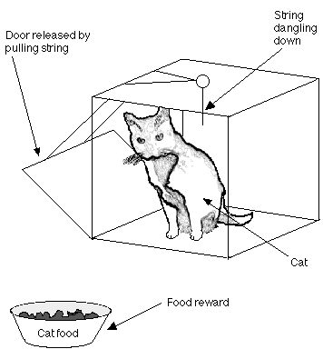
Thorndike ‘Law of Effect’
Thorndike concluded that the cat had learned the association between its behaviour (pulling the string) & the consequences (reaching the food)
Results led Thorndike to devise the ‘Law of effect’ that is a behaviour that is followed by a satisfying consequence is strengthened (more likely to happen) than a behaviour that is followed by an annoying consequence which is weakened (less likely to occur)
The food was a satisfying consequence – hence the cat would try to escape
Behaviour that kept the cat in the box (annoying consequence) was less likely to occur

Slide 10
Features of Trial and Error Learning
Learning by trial and error is gradual process.
For learning to occur, the learner must be definitely motivated.
The learner makes random and variable response.
Some responses do lead to the goal (annoying response)
Some responses lead to the goal. (satisfying responses)
With the increase in number of trials the annoying responses will tend to be eliminated and the satisfying responses will be strengthened and repeated.
The time taken to perform the task (to repeat the satisfying response) decreases with successive trials.

Slide 11

Three laws of learning:
LAW OF READINESS
LAW OF EXERCISE
LAW OF EFFECT

Slide 12

LAW OF READINESS
First primary law of learning, according to him, is the ‘Law of Readiness’ or the ‘Law of Action Tendency’, which means that learning takes place when an action tendency is aroused through preparatory adjustment, set or attitude. Readiness means a preparation of action. If one is not prepared to learn, learning cannot be automatically instilled in him, for example, unless the typist, in order to learn typing prepares himself to start, he would not make much progress in a lethargic & unprepared manner.

Slide 13
LAW OF EXERCISE
The law of exercise had two parts: (a) the law of use and (b) the law of disuse. This law stated that connections grow stronger when used—where strength is defined as “vigor and duration as well as the frequency of its making”—and grow weaker when not used.

Slide 14
LAW OF EFFECT
which states that responses which occur just prior to a satisfying state of affairs are more likely to be repeated, and responses just prior to an annoying state of affairs are more likely NOT to be repeated. The second contribution was his rejection of the notion that man is simply another animal that can reason. He believed intelligence should be defined solely in terms of greater or lesser ability to form connections.

Slide 15
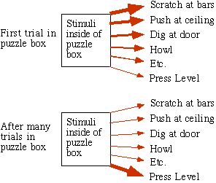
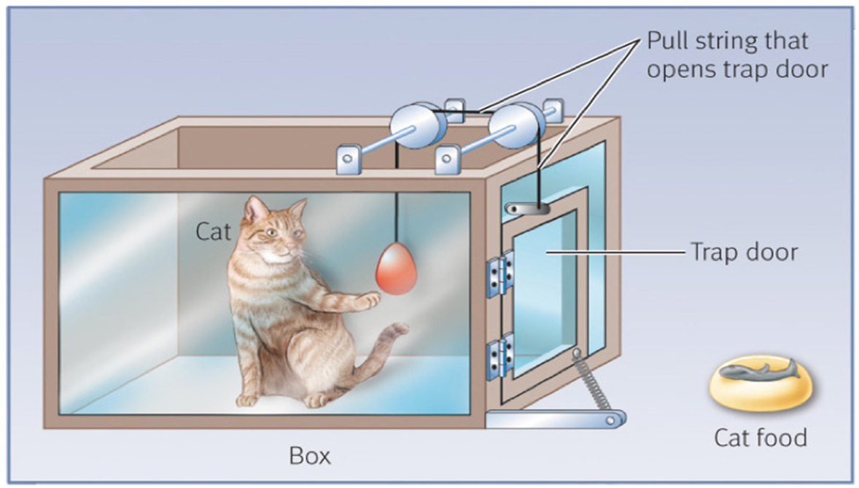
Figure III. Trials
Figure IV. Simplified graph of the result of the puzzle box experiment.
Notes:
Fig3.Initially, the cat’s responses were largely instinctual, but over time, the pressing lever response was strengthened while the others were weakened

Slide 16
EDUCATIONAL IMPLICATIONS
READINESS
MOTIVATION
EXPERIENCE
STRENGTHENING OF BOND
IMPORTANCE OF REPETITION
ROLE OF REWARD & PUNISHMENT
GRADING OF TASK
USE OF EXPERIMENTS
SKILL LEARNING
SCIENIFIC INVENTIONS
FORMULATION OF HABITS
USE OF INSIGHTFUL LEARNING
TRANSFER OF LEARNING

Slide 17
LIMITATIONS
ENERGY CONSUMING
RANDOM EFFORTS
EMPHASIS ON ROTE LLEARNING
NOT USEFUL FOR BRIGHT STUDENTS
NOT USEFUL FOR
HIGHER CLASSES

Slide 18

EDUCATIONAL IMPLICATIONS
1) According to this theory the task can be started from the easier aspect towards its difficult side. This approach will benefit the weaker and backward children.
2) A small child learns some skills through trial and error method only such as sitting, standing, walking, running etc. In teaching also the child rectifies the writing after committing mistakes.
3) In this theory more emphasis has been laid on motivation. Thus, before starting teaching in the classroom the students should be properly motivated.

Slide 19

4) Practice leads a man towards maturity. Practice is the main feature of trial and error method. Practice helps in reducing the errors committed by the child in learning any concept.
5) Habits are formed as a result of repeitition. With the help of this theory the wrong habits of the children can be modified and the good habits strengthened.
6) The effects of rewards and punishment also affect the learning of the child. Thus, the theory lays emphasis on the use of reward and punishment in the class by the teacher.

Slide 20
7) The theory may be found quite helpful in changing the behaviour of the deliquent children. The teacher should cure such children making use of this theory.
8) With the help of this theory the teacher can control the negative emotions of the children such as anger, jealousy etc.
9) The teacher can improve his teaching methods making use of this theory. He must observe the effects of his teaching methods on the students and should not hesitate to make necessary changes in them, if required.
10) The theory pays more emphasis on oral drill work. Thus, a teacher should conduct oral drill of the taught contents. This help in strengthening the learning more.

