Slide 1
TOOLS OF ASSESSMENT
ASSIGNMENT PROJECTS
TESTS
BY DR.GOGGI GUPTA
M.SC (CHEMISTRY) M.ED PH.D (EDUCATION)

Slide 2

ASSIGNMENTS

Slide 3
MEANING
Assignment, in education refers to a teaching activity, given by a teacher to his students in the shape of a problem, a project, a reading test etc.
An example of an assignment is homework given to a student.

Slide 4
Definition
Basavanthappa has defined assignment as “the part of instructional activity devoted to the clear recognition and acceptance by the pupil of the next unit of learning to take place and of the processes by which learning may be achieved most effectively.”

Slide 5
CHARACTERISTICS OF A GOOD ASSIGNMENT
Definite, clear and interesting
Related to the topic.
Should appeal to public curiosity
Sufficiently challenging to stimulate interest.
Describe appropriate format and documentation style
Should be flexible

Slide 6
Principles of Assignment Planning
Related to purpose
Challenging but not threaten
Co-relate with previous knowledge and experience
Motivates the students
co-ooperatively made

Slide 7
STRUCTURE OF ASSIGNMENT
Outline
Introduction
Continuity of ideas
Use of ‘I’ and ‘YOU’
Use of examples
Word count
Inclusion of tables/figures
Conclusion
Bibliography

Slide 8
Types of assignments for assessment
Essays
Oral presentations
Research papers
Projects
Case studies
Labs
Group assignments

Slide 9
ADVANTAGES
Students learning of various types can be assessed by the teacher with the help of assignments.
Assignments are easier and less time-consuming to construct than examinations
These promote HOTS i.e. application, synthesis and evaluation

Slide 10
Provides opportunity in self-learning for the students
Assignments provides sufficient flexibility in learning pace of the students. The slow learners too adapt with this method
The student has his own responsibility in learning process. Teacher acts as a role of guide only
It provides better feedback and gives exact solution for the problems faced by students in the learning process

Slide 11
LIMITATIONS
Typically more time consuming to grade than examinations
May require additional resources like lab space or other facilities
May require class time, for example for presentations, group projects etc.
May be less effective for introductory level content

Slide 12
There are divergent group of students in class, it poses problems for teacher assigning a unique or uniform topic for assignment
It gives more burden to teacher. Resources are less. The slow learners need much more attention from the teacher. It gives more burden to the teacher.

Slide 13
2.PROJECTS

Slide 14
Exponent of project method was- W.H.KALPATRIK
DEFINITION- “project is defined as the problematic act carried out to completion in its most natural setting.”
Acc. To Kilpatrick- “A project is a whole hearted purposeful activity proceeding in a social environment.”
It is based on philosophy of Pragmatism.
It is used to achieve cognitive and affective objectives.
Main focus is to socialize the child and to develop the ability of problem solving.

Slide 15
STRUCTURE
Teacher places the real problems related to life situations before students and the students realize its utility in their life.
Students prepare plans for solving the problem.
Can be carried out individually or in groups.

Slide 16

TYPES OF PROJECTS
CONSTRUCTIVE
PROBLEM CENTRED
ARTISTIC
GROUP PRACTICE

Slide 17


PRINCIPLES OF PROJECT WORK
Principle of Utility
Principle of Learning by Doing
Principle of Readiness
Principle of Socialization

Slide 18
PROCEDURE OF PROJECT STRATEGY
To identify the problem
To select and define the problem
Planning for Finding the solution
Implement the plan
Evaluate the Workability of project plan
Prepare the Record of the project

Slide 19
Assessing Projects
Assessment is an integral part of project work.
Teachers acts as consultants to offer guidance and feedback to students.
USE OF RUBRICS: rubrics state the criteria or
expectations learners must meet in order to receive credit for their project.
Rubrics generally include descriptors, arranged hierarchally to define work that is deemed excellent, acceptable, unacceptable and so on
Project assessment should include the final as well as formative assessment

Slide 20
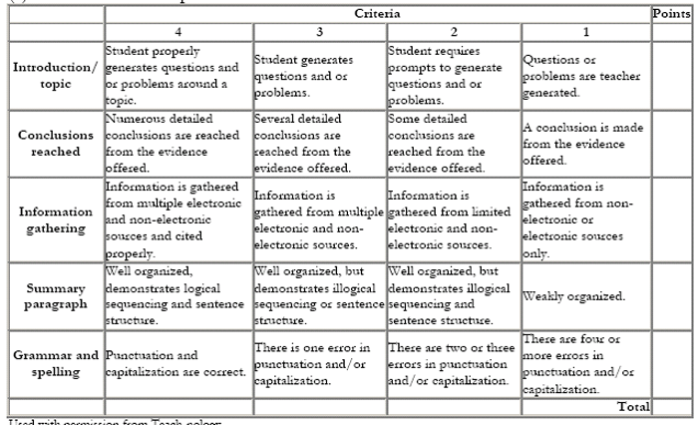
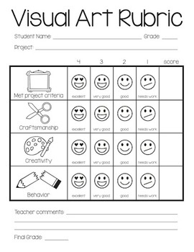

Slide 21
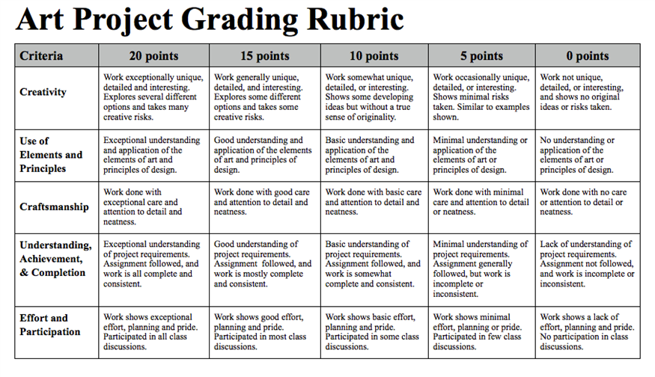

Slide 22
Meaning of Test
A test is a means to elicit and gather response which would provide legitimate evidence about the extent of acquisition of a particular attributes, such as knowledge, skill, intelligence, aptitude or the like,by an individual ora group.

Slide 23
Type of Test Used
Achievement Test-
Achievement tests determine what the students already have learned and if they are more advanced than their grade level peers. they may be academic specific i.e. Language,Maths arts etc.or standardized tests such as SATs, ITBS or MATs.

Slide 24
Ability Tests-
Intelligence quotient or cognitive abilities tests scores are used for assessment or to identify gifted and talent students. While these test provide information for the intellectual domain these tests are not as helpful in identifying

