Slide 1

Sustainable development

Slide 2

Outline
Introduction
Concept
Meaning
Definition
Principle
Importance
Education and sustainable development
Conclusion

Slide 3

Introduction
Sustainability is the capacity to endure .
For humans , sustainability is the potential for long tem maintenance of well being .
Education and learning creates necessary and beneficial conditions for all people to make a common effort to meet this challenge .
Education is an essential tool for achieving sustainability .

Slide 4

Concept
Sustainable development is “ development that meets the needs of the present without compromising the ability of future generations to meet their own needs .”
This contains two concepts :
Concept of Need
Concept of limitation

Slide 5

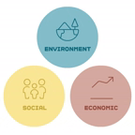

Slide 6

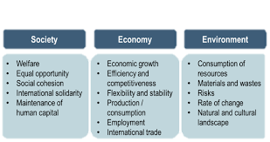
Three pillars of sustainability

Slide 7
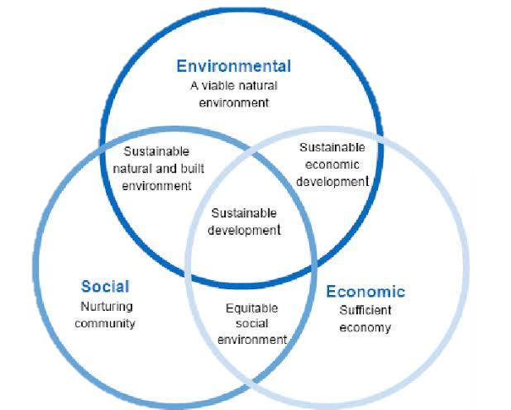

Slide 8

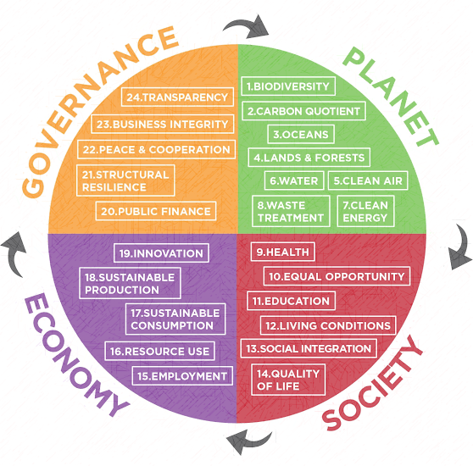
Evolution

Slide 9

Meaning
Sustainable development is a pattern of resource use that aims to meet human needs while preserving the environment , so that these needs can be met not only in the present but also for the future generations.
Wikipedia has defined it as a social – ecological process .

Slide 10

Sustainable development
Sustainable development
Preserving national resources and eco system
Improvement of lifestyles and
well being

Slide 11

Principles
People have different visions and views about the actual and attainable meaning of sustainable development.
"The Rio Declaration on Environment and Development (1992)" fleshes out the definition by listing the following principles of sustainability:
1. People are entitled to a healthy and productive life in harmony with nature.
2. Development today must not undermine the development and environment needs of present and future generations.

Slide 12
sss
3. Nations have the sovereign right to exploit their own resources, but without causing environmental damaged beyond their borders.
4. Nations shall develop international laws to provide compensation for damage that activities under their control cause to areas beyond their borders.
5 .Peace, development and environmental protection are interdependent and indivisible.

Slide 13
6. In order to achieve sustained development, environmental protection shall constitute an integral part of the development process, and cannot be considered in isolation from it.
7. Eradicating poverty and reducing disparities in living standards in different parts of the world are essential to achieve sustainable development and meet the needs of the majority of people.

Slide 14
8. Nations shall co-operate to conserve, protect, and restore the health and integrity of the Earth's ecosystem.
9. Nations should reduce and eliminate unsustainable patterns of production and consumption and promote appropriate demographic policies.
10. Facilitate and encourage public awareness and participation by making environmental information widely available.

Slide 15
13. The polluter should, in principles, bear the cost of pollution.
14. Nations shall warn one another of natural disasters or activities that may have harmful transboundary impacts.
15. Nations should share knowledge and innovative technologies to achieve the goal of sustainability.
16. The full participation of women is essential to achieve sustainable development.

Slide 16
Definition
Brundtlan Report (1987)- "Sustainable development is development that meets the needs of the present without compromising the ability of future generations to meet their own needs.“
Rio Declaration (1992)- "Human beings are at the Centre of concern for sustainable development. They are entitled to a healthy and productive life in harmony with nature .
World Business Council on Sustainable Development- "Sustainable development involves the simultaneous pursuit of economic prosperity, envital quality and social equity.

Slide 17
Importance
Worthy principle
Justifiable development
Protection of natural resources
Sustainable economic growth
Enhancement of Resource – base
Warning about Global population Growth
Control over climate change
Provision of Basic Human Needs

Slide 18

Importance for city development
Importance in Agriculture Field
Importance Sustaining Bio – diversity
Importance for Financial Stability
Pursuit of Excellence
Protection of Technological Resources

Slide 19
UN DECADE OF EDUCATION FOR SUSTAINABLE DEVELOPMENT DESD (2005-2014)
Education is a powerful tool for achieving sustainability.
The current economic development trends which are being followed are not sustainable and that public awareness, education and training are essential for moving society towards sustainability.
Therefore, the united nation general assembly has declared 2005-14 to be the decade of education for sustainable development and the decade was led by UNESCO and developed an international implementation scheme for the decade.

Slide 20
History of ESD
Sustainable development stands for meeting the development needs of present generations without jeopardizing the ability of future generations to meet their own development needs.
Sustainable development was first endorsed at the un general assembly in 1987,
From 1987 to 1992, the concept of sustainable development matured as committees discussed, negotiated and wrote the 40 chapters of 'agenda 21'.
Initial thoughts concerning ESD were captured in chapter 36 of 'agenda 21', "promoting education, public awareness and training."

Slide 21
ESD was initiated by pupils outside of the education community like UN organization for economic co-operation and development, and organization of American states.
The concept and content of ESD in these cases are developed by ministries, such as those of environment and health, and then given to educators to deliver.
Earth Summit in Rio (1992) was devoted to "Promoting Education, Public Awareness and Training", it identified four major thrusts to education for Sustainable Development (ESD)

Slide 22
Promoting and improvement of Basic Education.
Reorienting existing education at all levels
Developing Public Understanding and awareness
Training.

Slide 23
Three types of education concerning sustainability
Education for sustainability (Efs)
Education for sustainable development (ESD)
Sustainability education (SE)

Slide 24
Education for sustained development
(ESD)
ESD is about learning to think and act in a way to safeguard the well being of the people and planet.

Slide 25
Central aspect
Learner developing their ability to critically analyze and evaluate issues of global and inter generational character and to propose strategies for solving the problems that arise from these issues.
What we about to learn
They learn about the environmental, social, cultural and economic aspects of sustainability.
What it involves
ESD involves integrating knowledge of economic, social and environmental development
What it can provides
About providing opportunities for learners to participate in democratic discussions about what is important to them personally, and for society in the future.

Slide 26
"Action competence" is the central, concept in education for sustainability.
Action competence includes both knowledge about development and the willingness to influence it.
Hence, education for sustainable development is aimed at empowering learners with the ability and the desire to work towards realizing sustainable development locally and globally.

Slide 27
Education about sustainable development and ESD
There is a difference between these two terms:
Education about sustainability is an awareness lesson or theoretical discussion.
Education for Sustainable Development is the use of education as a tool to achieve sustainability.
ESD calls for giving people knowledge and skills for life long learning to help them find new solutions to their environmental, economic and social issues.
ESD promises to make the world more livable for this and future generations. It is not only indoctrination but 'action competence'.

Slide 28
International Conferences and About ESD
1. Bonn Conference (2009)
2. Agenda 21
3. Baltic 21 (1998)
4. UNESCO Draft Strategy for ESD (2004)
Bonn Conference (2009)
The world conference on ESD was held in Bonn (Germany) by UNESCO and German Federal Ministry of Education and Research.
It stressed that education a fundamental human right. And key to sustainable development and peace
It is the need of the 21st Century

Slide 29
Agenda 21
The entire chapter 36 of Agenda 21 dedicated to education, stating "education is critical for promoting sustainable development and improving the capacity of the people to address environment and development issues."
Baltic 21 (1998)
In the Basic Principles of Baltic 21 (conference of 11 Baltic sea countries), the need to promote education and public awareness on sustainable development issues is recognized.
UNESCO Draft Strategy
As stated in this Draft Strategy, Education (primary agent) is more than the transfer of knowledge and skills from the teacher to the apprentice.
It is about building up human capital and social cohesion that will support decision making about our common future.

Slide 30
Role of education
Awareness for Sustainable Development
Behavioural change
Contribution to three axes
The social perspective
The economic perspective
The environmental perspective
Development of human resource for ESD
Development of skills of worker
Ensures sustainable future
Fostering future leader
Decision making about future
Implementation of decisions

Slide 31
Individual and national implication
Role of quality education
Thus, quality education is pre-requisite for sustainable development. Achieving sustainable development requires:
Recognition of the challenge.
Collective responsibility and constructive partnership.
Acting with determination and
The indivisibility of human dignity
Education provides the skills for:
Learning to know
Learning to live together
Learning to do
Learning to be.

Slide 32
Meeting new challenges: new curriculum
At international level, there are two most important issues concerning sustainable development. They are-population and Resource consumption.
The problem of population can be mended by educating people for example:- fertility rate.
The opposite is true for the relationship between education and resource use.
More educated population demands for higher resources which can be harmful for the environment

Slide 33
Therefore, simply educating citizen to higher levels is not sufficient but the challenge is to raise the education levels, without creating an ever growing demand for resources and consumer goods and the accompanying production of pollutants.
In this context, there is a need to re-examine curriculum for every country of the world, at all levels addressing the need for more sustainable production and consumption patterns.
While it is evident that it is difficult to teach environmental literacy, economic literacy or civics without basic literacy, it is also evident that simply increasing basic literacy, as it is currently taught in most countries, will not support a sustainable society.

Slide 34
Role of teacher of sustainable development
Education is key to a nation's ability to develop and achieve sustainable targets.
Teacher can play their part by educating the people in this direction.
Being the agents of social change and by playing active role in molding the behavior pattern of children, teachers can promote desired qualities and competencies among them for sustainable development.
It all depends upon their knowledge, commitment and devotion towards this issue.

Slide 35
Awareness through Education
Awareness is a prelude to information.
In democratic societies, action towards sustainable development will ultimately depend on public awareness, understanding and support.
Common information and shared understandings, however, are important in not only for public support, but also for carrying out worth consultative and participatory approaches in all fields.
Here education should not be equated with school or formal education alone. It includes non-formal and informal modes of instruction also.

Slide 36
More Knowledgeable People
Teaching Methodology in Schools
Young Children's Ideas about Pollution
Change of Conception
Classroom Environment
Quality of Life
Efforts by UNESCO

Slide 37
Evaluation of sustainable development
No doubt that sustainable development is essential for the survival of the world but it has many disadvantages also. These given here:
It has been argued that since 1960s, the concept of sustainable development has slided from 'conservation management' to 'economic development', whereby, the original meaning of the concept has stretched somewhat.
According to eco-vitality it is normally more costly to create goods and services in an environmentally Safeway then in non sustainable and harmful manner.

Slide 38
No only the cost of sustainable development activities higher but organizing, monitoring and administrative costs are all factors that comes into play when it comes to sustainable development.
For example, fishing indiscriminately may waste most of the catch, but it is far less expensive than using selective fishing methods.
Sustainable development of an economy is a way that does not deplete natural resources. Unfortunately, it can be incredibly difficult to do this and in many countries it is practically impossible.

Slide 39
For several companies, the problem is not that sustainable development is impossible but it is less rewarding financially and it requires more work, which can be more than the company can handle for its survival.
Therefore Another disadvantages to sustainable development is the fact that in developing countries starting company is very difficult.

Slide 40
Conclusion
To sum it up, sustainable development is the key to ensuring a safer future for the forthcoming generations. It will also help to tackle environmental issues such as climate change, global warming, loss of species, and shortage of natural resources. So, we must need to develop habits so that we can also contribute to this great purpose.

Slide 41

Thank you

