Slide 1
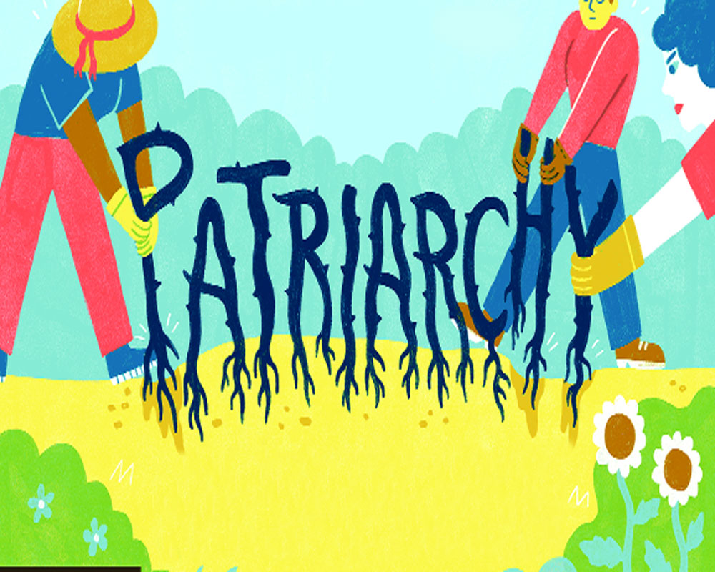

Slide 2
INTRODUCTION
Patriarchy, defined as greater male than female social power and status, emerged with the development of new roles in more complex societies.
Patriarchy is a system of society where the men are the head-of-the-household, carry the most power and where the family lineage passes on through men.
An example of a Patriarchy society is where men hold the control and make all the rules and women stay home and care for the kids.

Slide 3
Meaning
The word ‘Patriarchy’ was used to describe a specific type of male-dominated family’- the large household of the patriarch, which included women, junior men, children, slaves and domestic servants, all under the rule of this dominant male.
A society in which the oldest male is the leader of the family, or a society controlled by men in which they use their power to their own advantage:

Slide 4
Concept and Definition
Concept: Patriarchy literally means ‘rule of fathers’.
The word ‘Patriarchy’ is derived from Greek words: ‘Patria’ meaning father and ‘arche’ meaning ‘Rule’ and refers to a society in which male members predominate in positions of power.
A social system that gives power and control to men rather than women.

Slide 5
Definitions
Sylvia Walby defines patriarchy as a 'system of social structures and practices. in which men dominate, oppress, and exploit women'.
Mitchell, a feminist psychologist, used the word patriarchy, “to refer to kinship systems in which men exchange women.”
According to Collins Dictionary, “ Patriarchy is a system in which men have all or most of the power and importance in a society or group.

Slide 6
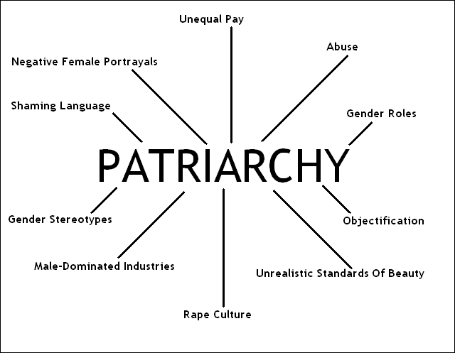

Slide 7
Scope of Patriarchal Control
Women’s productive or Labour power.
Women’s Reproduction.
Religion.
Politics.
Control over Women’s Sexuality.
Women’s Mobility.
Property and Other Economic Resources.

Slide 8

Characteristics of a Patriarchal System
Male Dominance: In a Patriarchal system, men hold power, dominance and privilege.
The term male dominance evolved in the twentieth century as a conceptual label to characterize the unequal power relations between men as a group and women as a group.

Slide 9
Male as Primary Authority figure:
A social system in which the male acts as the primary authority figure central to social organization, and where fathers hold authority over women, children, and property”.
Male vs. Female Identification:
Men are considered with the qualities of control strength, forcefulness, rationality, strong work, competitiveness etc. Emotional, expressiveness , compassion and ability to nurture are examples of subordinate qualities.

Slide 10
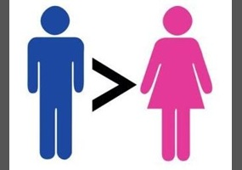
Men are considered as superior.
Men will be the focus and developer of all events and inventions.
Men will be the heroes in all situations.
Histories will tend to celebrate male achievements.

Slide 11

Oppression of women will be visible.

Slide 12
THEORIES OF THE ORIGIN OF PATRIARCHY

Slide 13
Human Reproduction Theory
In early human history , life was short and therefore to balance the high rate and maintain the population, women had to give birth to many children.
The survival of human race was rested on it.
As a result, around the world women assumed tasks that were associated with the home and child care, while men took over the hunting of large animals and other tasks that required both, greater speed and longer absence from the residences.
In this way, women became second class citizens, subject to men’s decision and PATRIARCHY system were established in the society.

Slide 14
MARVIN HERRIES (1977) Theory:
Marvin Herris proposed that because men are stronger than most women and survival in tribal groups required hand-to-hand combat, men became the warriors and women became the reward that enticed men to risk their lives in battle.

Slide 15
Frederich Engels Theory:
Frederich Engels on Marxist lines, proposed that patriarchy came with the development of private property. But, he could not explain why private property should have produced male dominance.
Gerda Lerner afterward suggested that patriarchy may even have had different origin in different position.
Whatever may be the cause of origin, a circular system of the thought was evolved. Men came to think of themselves as inherently superior based on evidence that they dominated society.

Slide 16
Causes of Patriarchy
Male dominance.
Male guardianship.
Because of reproduction.
Violent Environment.
Male wanted to control women’s sexuality.
Oppression of women

Slide 17
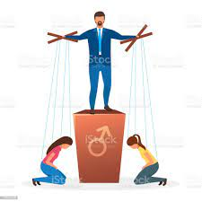
Impacts
on
Indian
Society

Slide 18
Social discrimination
Widespread domestic violence
Women as a liability
Dowry tradition

Slide 19
No special facilities to working women
Depressed status in family
No part in decision making
Low financial Independence

Slide 20

How to combat Patriarchy

Slide 21
Culture of excellence
Compassionate and responsible
Reframe Patriarchy
Promote equality
Teach boys to communicate their emotion

Slide 22
CONCLUSION
Patriarchy is a social system in which power is held by men through cultural norms and customs that favour man and withhold the opportunity from women.
It is a system of social structures and practices in which man dominate ,oppress and exploit women .
it can manifest itself socially ,politically and economically.

Slide 23


