Slide 1
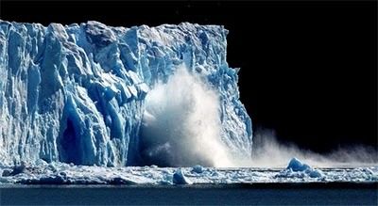
Polar ice melting

Slide 2
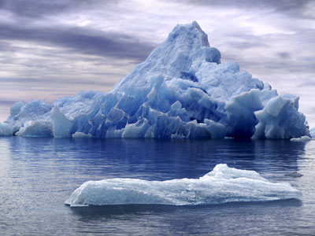
POLAR ICE MELTING AND RISING OF SEA LEVEL
According to Wikipedia, a Polar ice cap is a high-latitude region of a planet or natural satellite that is a solid landmass with ice covering it.
The ice cap are found at the poles due to the angle of sunlight reaching our Earth. At the equator, sunlight hits the earth at a 90 angle, transferring a high level of sun energy. In contract, sunlight hits the polar Regions at a more indirect angle.

Slide 3
Cont…
The same amount of sunlight reaches these parte of Earth, but it gets spread out over a larger area, so the area receives less solar energy. This limited solar energy makes for cold temperatures and very little precipitation (either rain or snow) all year round, which helps maintains the polar ice caps. Polar ice caps and glaciers hold more than three- quarters of the earth’s freshwater and provide feeding and resting platforms for polar bears, seals and marine birds.

Slide 4
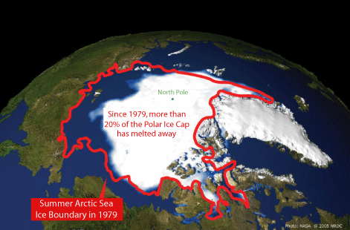
Sadly, the Earth’s Polar ice caps have transformed over the past 12,000 years and they are appearing to be melting. The Polar Regions are particularly vulnerable to Global Warming. This polar ice melting can be a dangerous thing for life.

Slide 5
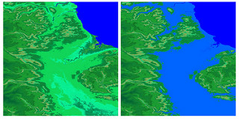
Antarctica is region where many icebergs come from. Icebergs are formed when ice breaks off from these glaciers and fall into the ocean displacing water, which could cause sea levels to rise at an alarming rate.

Slide 6
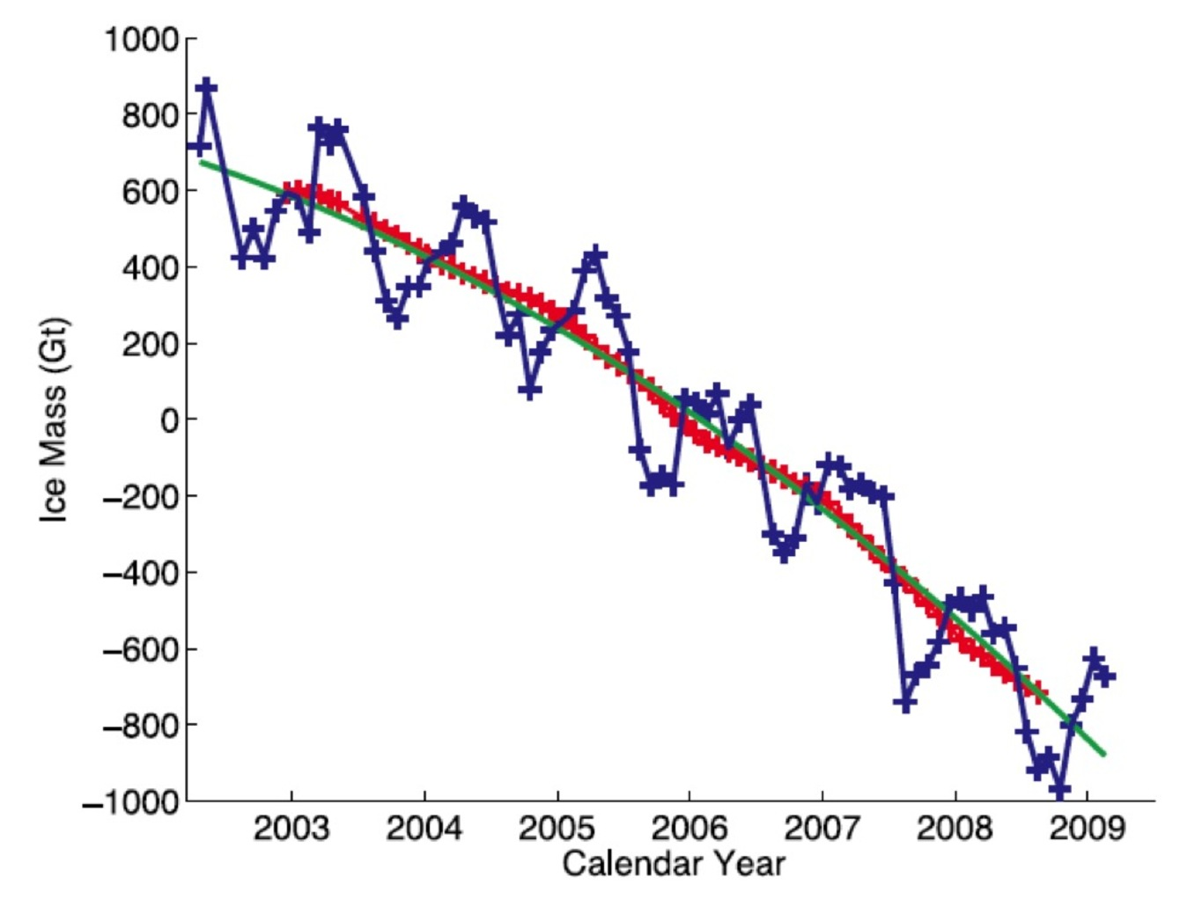
Causes of ice melting and rising of sea level
Between 1906 and 2005, Earth’s average temperature at the Earth’s surface increased by about three- fourth of a degree Celsius. For the last half of the period, warming occurred at nearly twice the rate of the first half of the period. NASA estimates that the years between 2005 and 2010 were the warmest since temperatures have been reliably measured in the late 1800’s (Hansen et al.,2010).
Climate change is faster and more sever in the Arctic than in most of the rest world. The Arctic is warming at a rate of almost twice the global average.

Slide 7
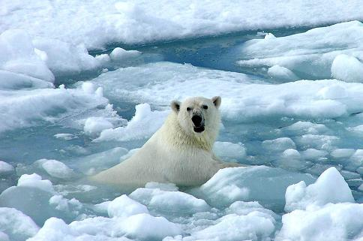
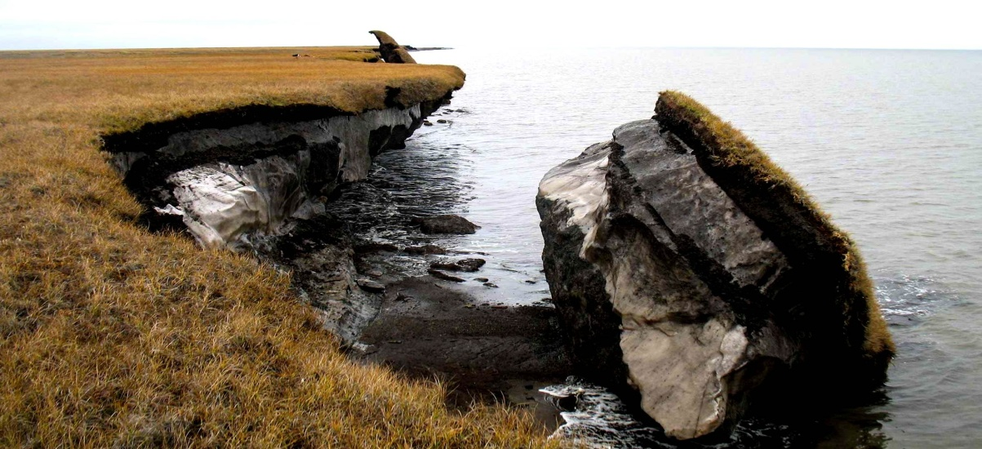
Impacts of polar ice melting and rising of sea level
Melting of ice raises sea levels.
Melting of ice means more heat is absorbed.
Melting ‘Permafrost’ increases global warming.
Melting of sea ice can influence on winter weather.
Melting of Polar Ice threaten Wildlife.

Slide 8
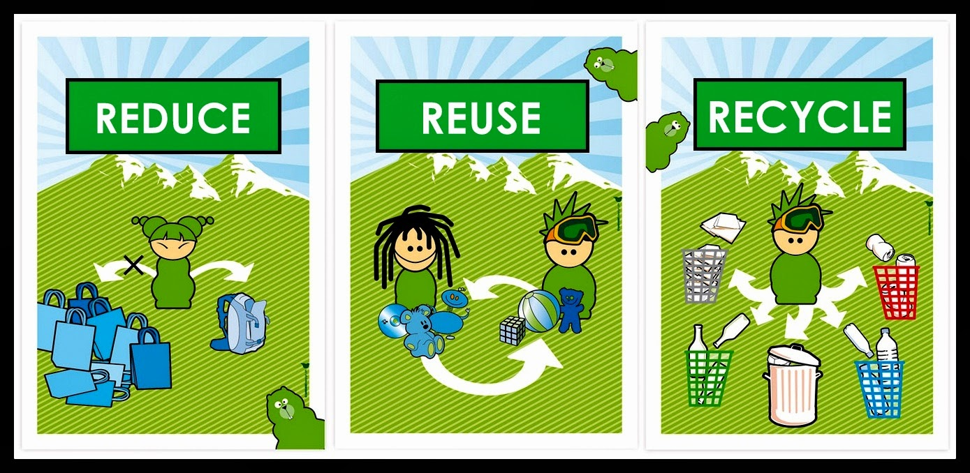
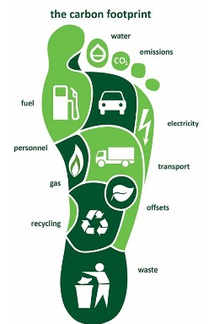
Prevention of reducing polar ice melting
Greenhouse gas emission.
Lowering carbon footprints.
Reduce toxins released into the atmosphere.
Reduce, Reuse, Recycle.
Less use of Heaters and air conditioners.
Buy energy efficient products.
Less use of fossil fuels and mining of fossil fuels.
Planting of more trees.

Slide 9


