Slide 1
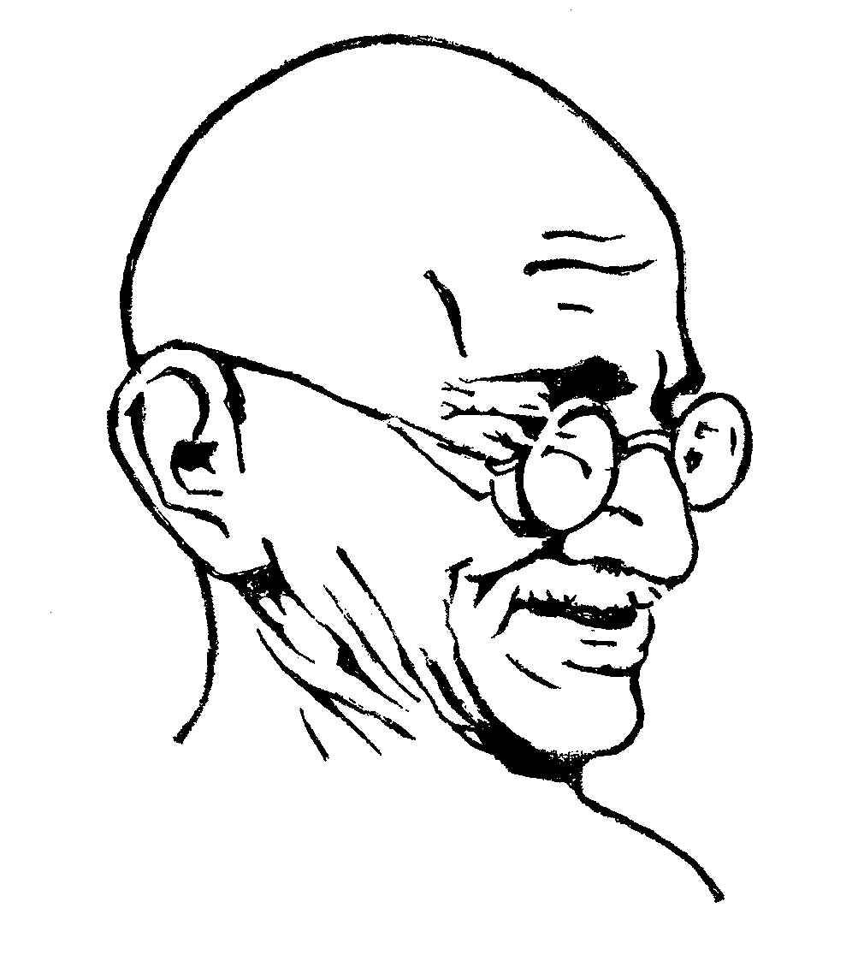
The contibution of Gandhiji to Education

Slide 2
Brief Life Sketch
Mohandas Karamchand Gandhi was born on October 2, 1869 at Porbander, a small town on the western coast of India.
His father's name was Karamchand Gandhi. His mother's name was Putlibai .
He completed his high school in India.
His father died in 1888.Then in 1888 he sailed from Bombay to England to study law.
He became a lawyer. He went to south Africa to file a case . Out there he was ill-treated by the British . So he fought for the South Africans . When he came to India he fought for the Indians.

Slide 3
Gandhi’s Philosophy of Life
His belief in God.
Sense of Human Unity.
Truth.
Non-Violence(Ahinsa).
Love.
Brotherhood of Man.
Satyagraha.
Service unto Humanity.
Spiritual Nature of individual.
Fearlessness

Slide 4
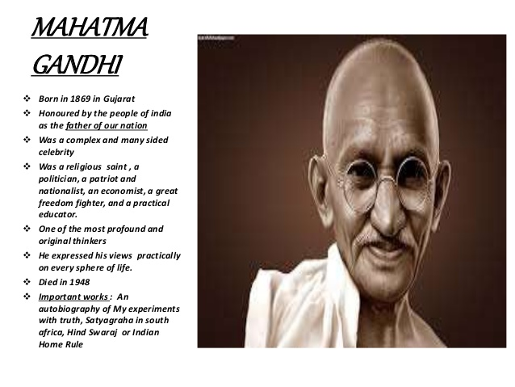

Slide 5
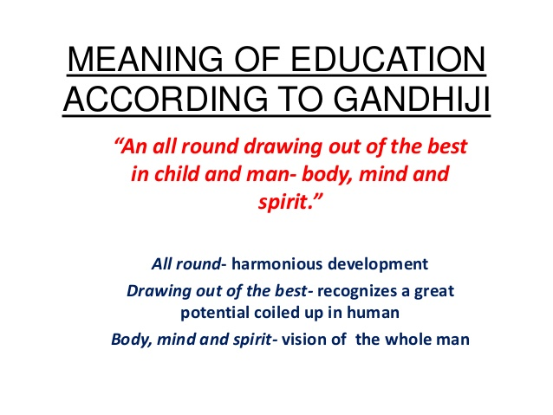

Slide 6
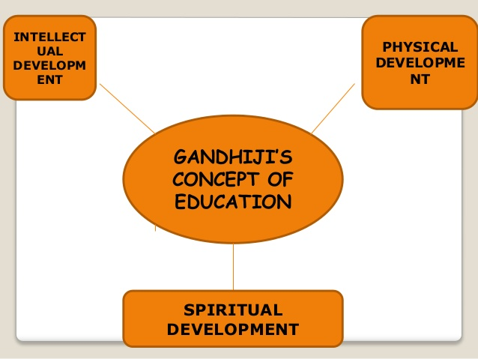
Gandhiji’s concept of education includes harmonious development of all aspects of the human personality

Slide 7
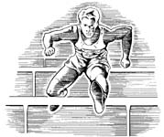
Gandhiji’s concept of education includes harmonious development of all aspects of the human personality
Physical development
A sound mind exists in a sound body. Hence Gandhiji attached a lot of importance to physical development through sports , play and productive activities.

Slide 8
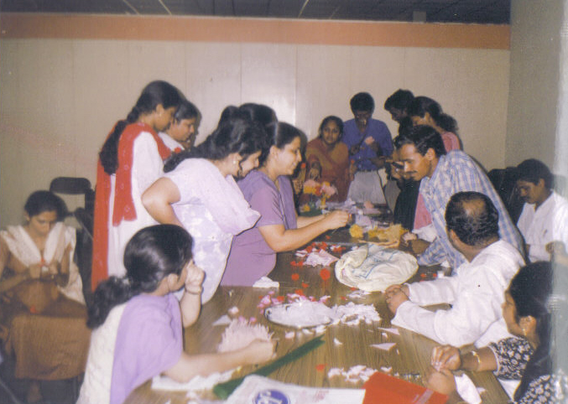
Gandhiji’s concept of education includes harmonious development of all aspects of the human personality
Intellectual development
Educational experiences must cater to the intellectual development of the person . Personality development is linked with education thro’ work experience , productivity and the process of socialisation.

Slide 9
Gandhiji’s concept of education includes harmonious development of all aspects of the human personality
Spiritual development
To Gandhiji education should draw out and stimulate the spiritual aspects of a child as much as intellectual and physical aspects.

Slide 10
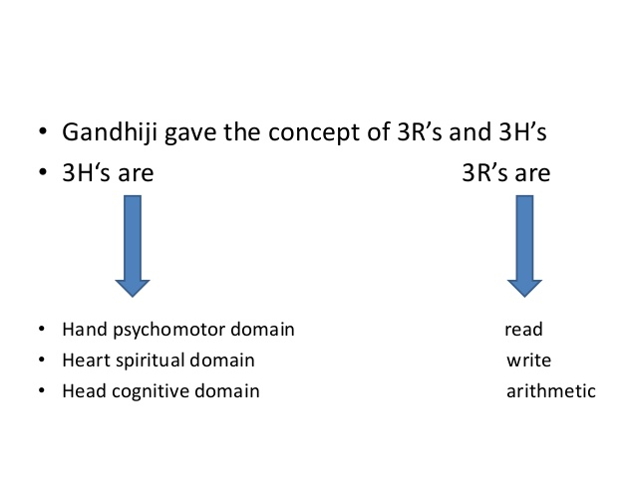

Slide 11
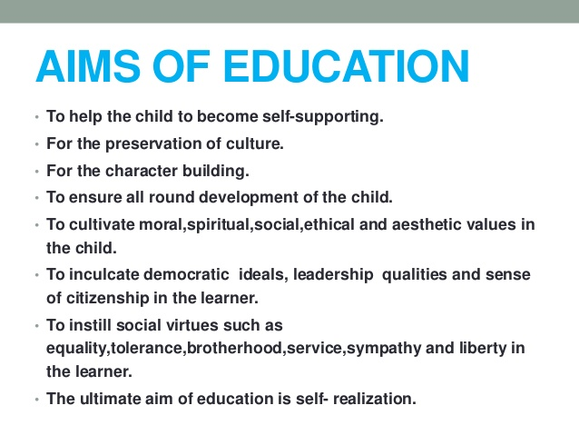

Slide 12

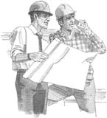
Aims of education according to Gandhiji
I have done a secretarial course and am earning well as a secretary.
We architects have a degree in architecture
Education should be self supporting. It must enable one to earn a living and thus cut the root of unemployment.

Slide 13
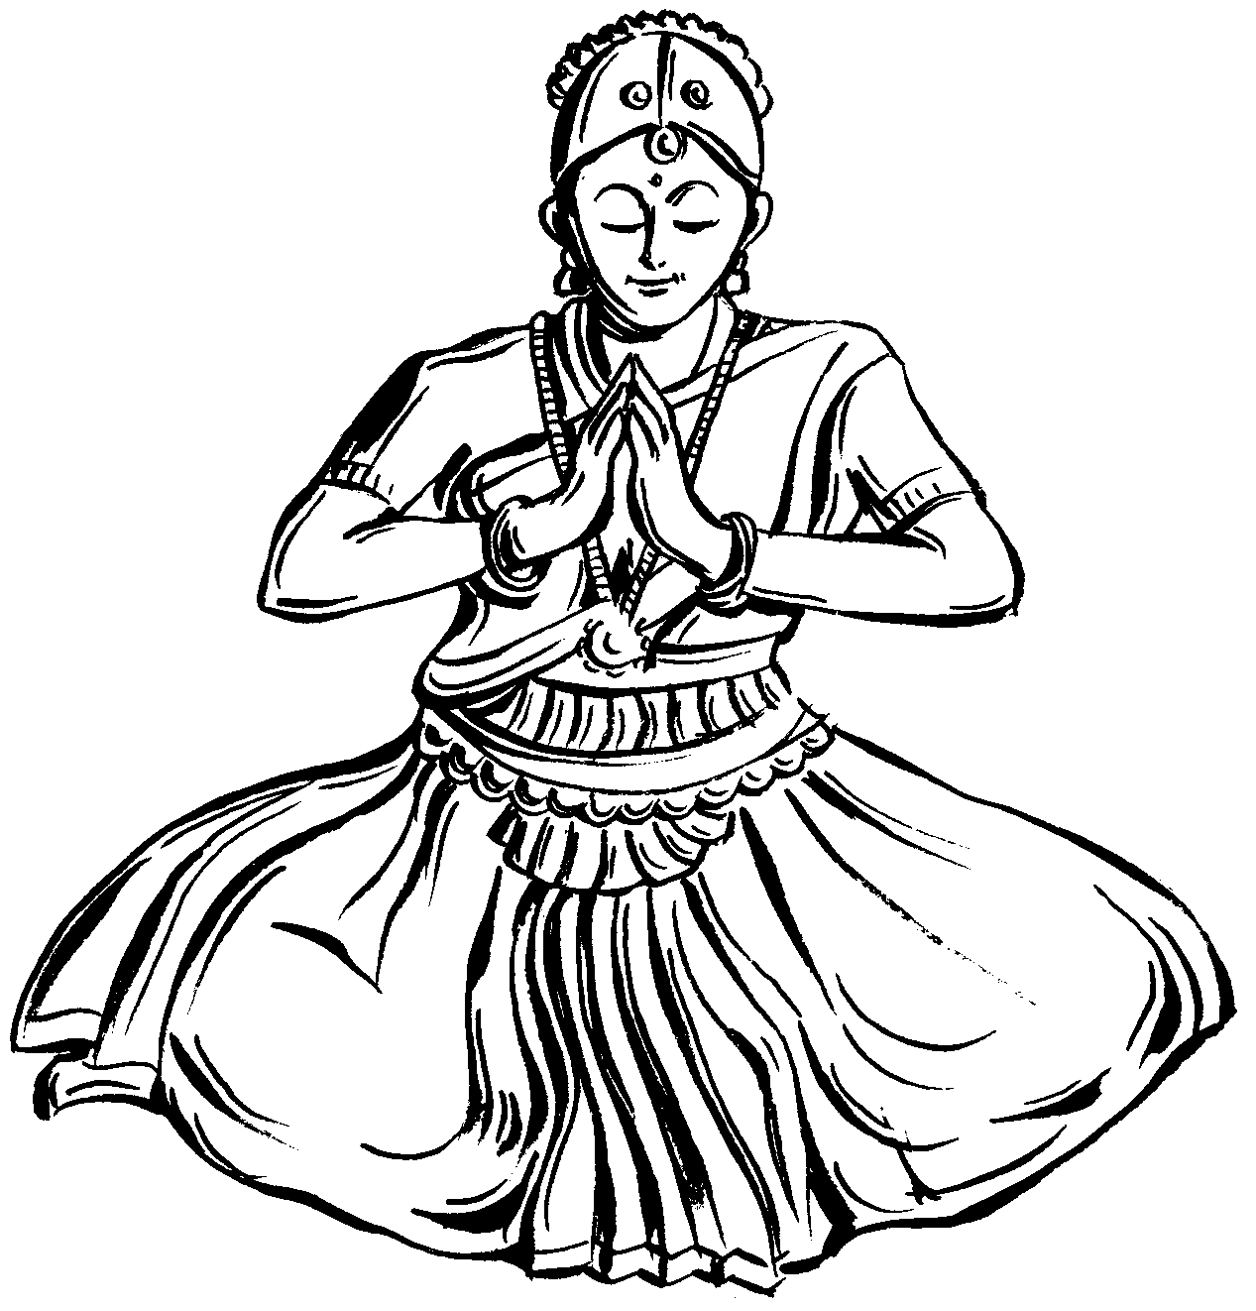

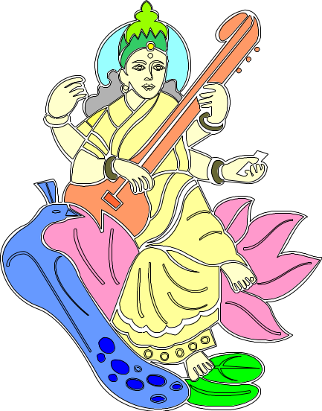
Aims of education according to Gandhiji
Preservation of our culture should be an important aim of education. Culture must pervade all aspects of human behaviour

Slide 14
Aims of education according to Gandhiji
Character building must be an important aim of education. Strength, courage , virtues and the ability to be selfless are all aspects of character. Character building is more important than literacy

Slide 15
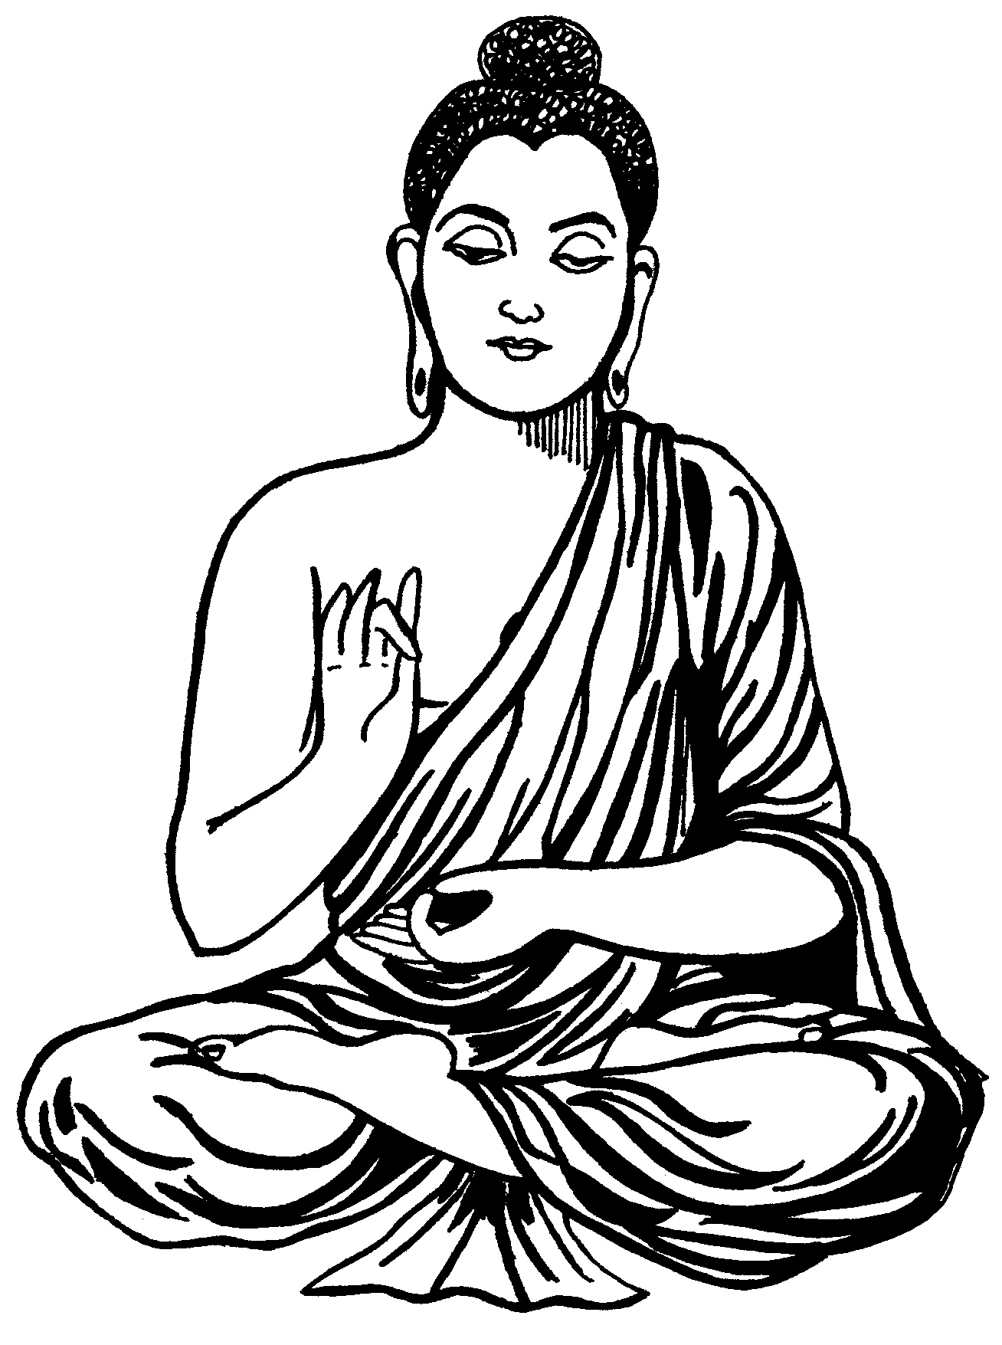
Aims of education according to Gandhiji
Education should help to cultivate higher values in life such as moral , aesthetic, social and spiritual values and to practise self restraint , self realisation , self insight and self analysis

Slide 16



Aims of education according to Gandhiji
Gandhiji emphasised on the all round development of the three H’s ---- Head , Heart and Hand

Slide 17
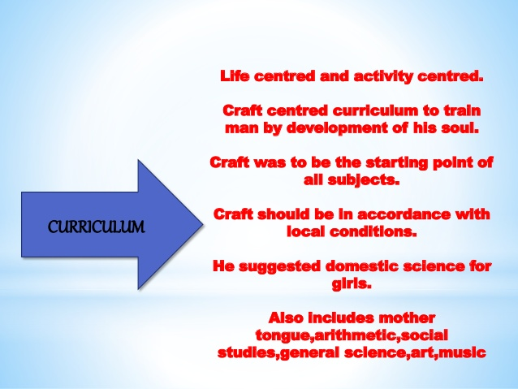

Slide 18

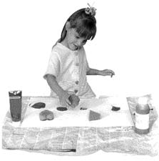
Curriculum suggested by Gandhiji
Gandhiji advocated craft centered curriculum to train man by development of his soul.
Craft was to be the starting
point of all subjects.

Slide 19
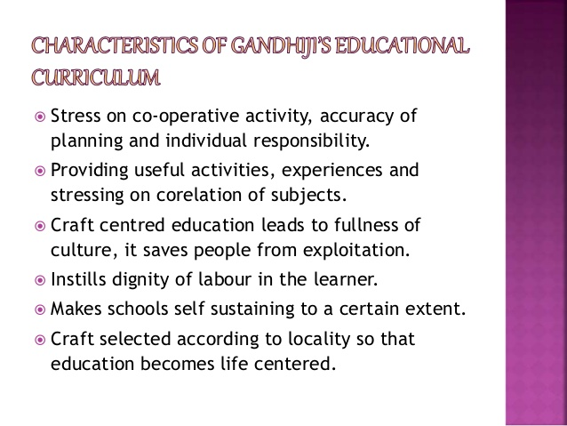

Slide 20
Characteristics of craft centred curriculum
Stress on co operative activity , accuracy of planning and individual responsibility

Slide 21

Characteristics of craft centred curriculum
Providing useful activities and experiences and stressing on co relation of subjects
Never realised how Maths , Art and geography were so closely related

Slide 22
Characteristics of craft centred curriculum
Craft centred education leads to fullness of culture. It saves people from exploitation.
I can use my art to earn a living

Slide 23
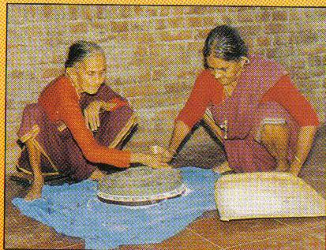
Characteristics of craft centred curriculum
Craft selected should be that of the locality so that education becomes life oriented

Slide 24
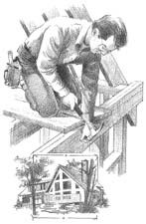
Characteristics of craft centred curriculum
Craft centred education instills dignity of labour in the learner.
I am not ashamed of physical work.

Slide 25

Characteristics of craft centred curriculum
We have made a profit of Rs 20, 000 from our craft department . We can furnish our library
Craft centred education makes the schools self sustaining to a certain extent

Slide 26



Subjects in the curriculum
Craft according to local conditions
Mother tongue
Arithmetic
Social sciences
Art and music
Domestic science for girls
Spinning
All subjects to be taught with craft as centre of co relation

Slide 27
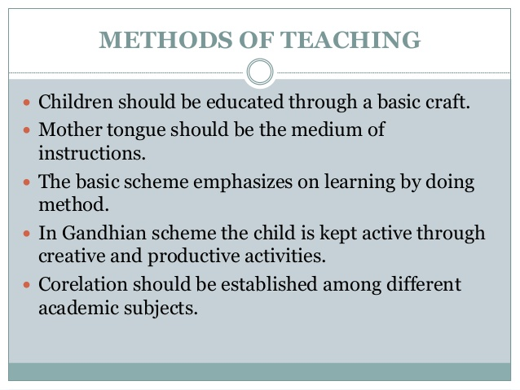

Slide 28

Concept of discipline
Self discipline that is not imposed from outside sources.
Self discipline emerges from a life of self restraint , fearlessness , utility and self sacrifice
Social discipline will come from craft activities

Slide 29

Teacher
The teacher is an example by his or her attitudes and values
The teacher should possess the qualities he wishes to inculcate in the pupils
Energetic
The teacher should help the pupil to distinguish between truth and false, good and bad
The teacher should provide a free & fearless learning environment

Slide 30
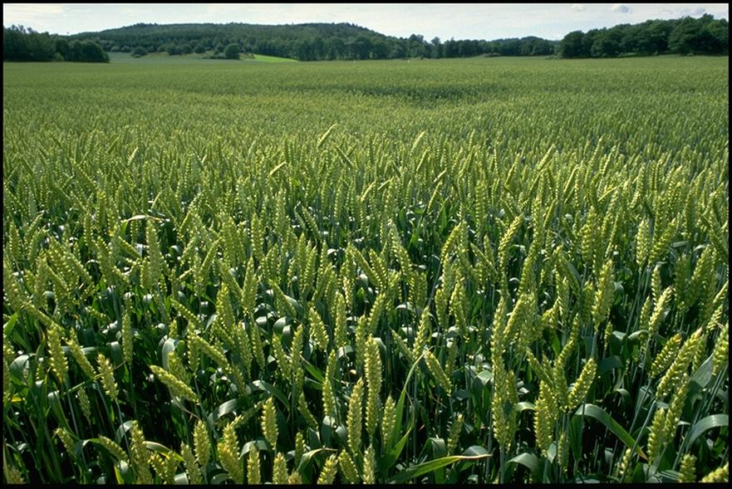

Text books
Do not load the child with books
The teacher is the real text book
Text books should be suitable for Indian context
For primary oral education is enough as the child learns more by observation

Slide 31
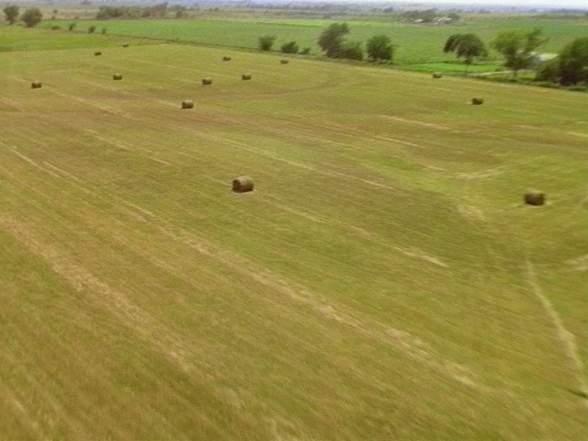
Gandhiji’s Wardha Scheme of education
Free and compulsory education upto the age of fourteen years. Primary and secondary education to be combined . Higher education to private enterprises.
At the age of fourteen the child is equipped with effective literacy and control over senses

Slide 32
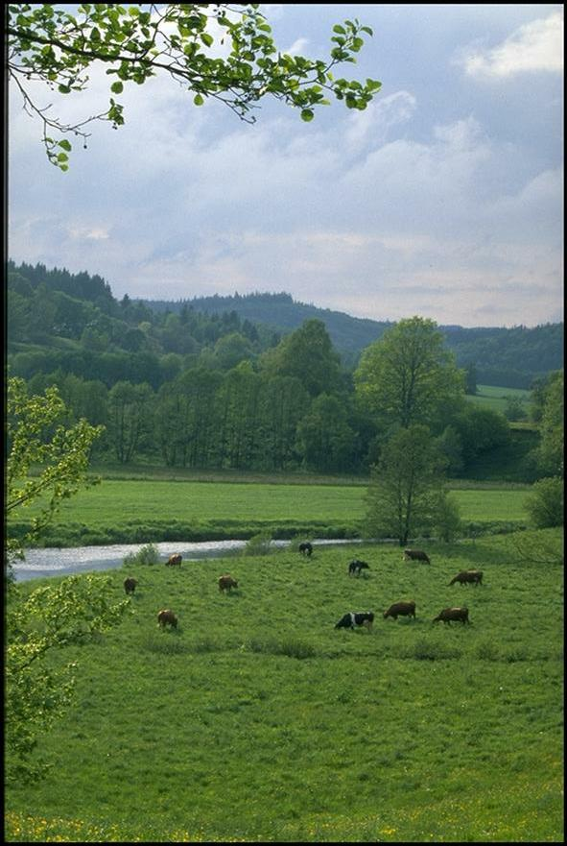
Self reliance will be the aim of education. After seven years of education the child is a productive member of society. Unemployment will be eradicated

Slide 33
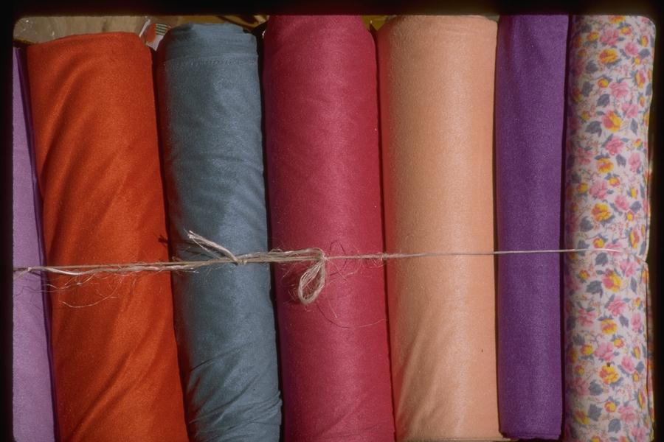

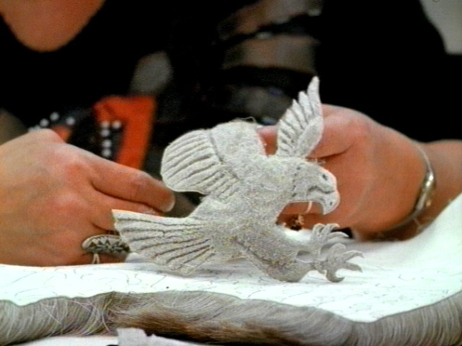
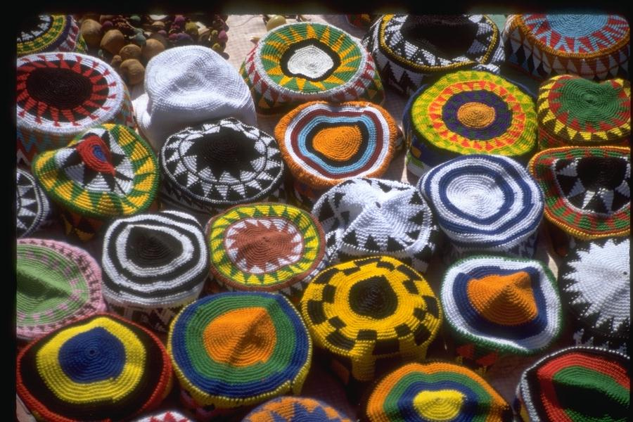
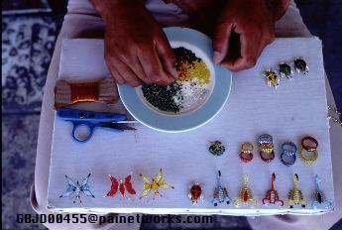
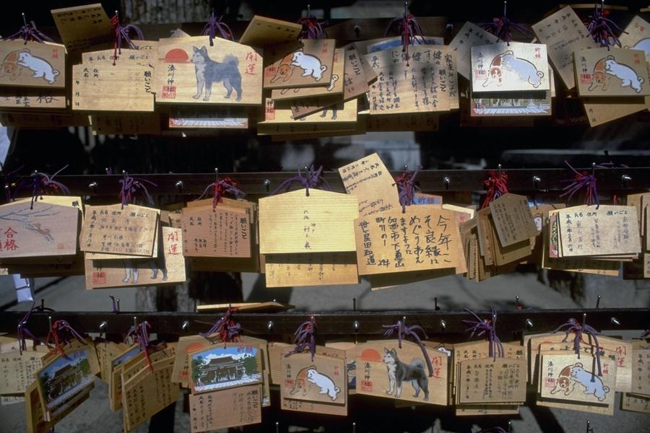
Productive work as spinning , weaving , pottery , basket making will be the centre around which all subjects are centred. Emphasis will be on co operation , planning and accuracy

Slide 34

Mother tongue to be the medium of instruction
Only mother tongue facilitates natural expression
Forcing a foreign language leads to waste of time and energy and is un psychological

Slide 35
Psychological principles of Basic Education
Life centred education
Child centred education
Play and creative work
Co relation
Love and sympathy
Learning by doing
Utilisation of instincts

Slide 36
“Gandhiji’s philosophy of education is naturalistic in its setting, idealistic in its aim, pragmatic in its methods and programmes.” ….. Dr Patel.
In the present day this system should help HRD , enhance productivity and combat unemployment and poverty. Basic Education thus is the foundation of techno pedagogy and vocationalisation of education

Slide 37
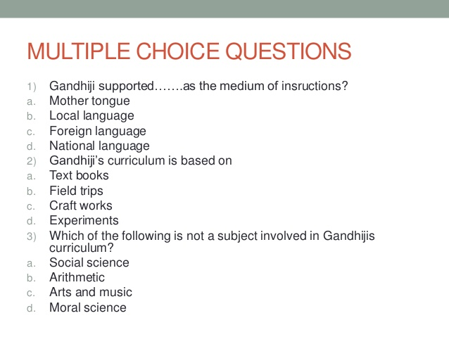

Slide 38
