Slide 1



Types of evaluation
BY DR.GOGGI GUPTA
M.SC (CHEMISTRY) M.ED PH.D (EDUCATION)

Slide 2
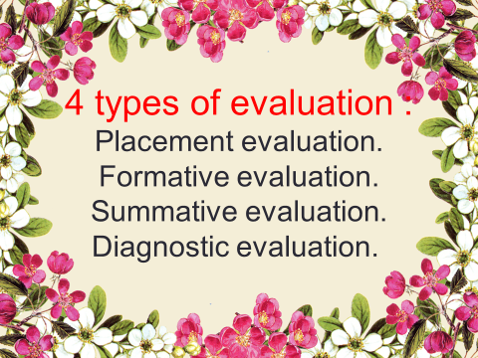

Slide 3
PLACEMENT EVALUATION
It is the type of evaluation that determines pupils performance at the beginning of instruction. In other words , it is concerned with the pupils entry performance.

Slide 4
Placement evaluation, also referred to as pre-assessment or initial assessment, is conducted to establish a baseline from which individual student growth can be measured. This type of an assessment is used to know what the student's skill level is about the subject.

Slide 5
It is designed to place the right person in the right place.
It require use of a variety of techniques, aptitude tests , pre-tests on course objectives, oberservational techniques and so on.
The Goal of placement evaluation is to determine the position in the instructional sequence.
Placement assessment are used to ‘Place’ student into a course level, or academic programme.

Slide 6



FORMATIVE EVALUATION
Formative evaluation term was coined by Scrivan in 1967.
Definition: Formative evaluation refers to the evaluation of worth of the instructional programme which is still going on and can still be modified.
Formative evaluation is assessment for learning, not of learning.

Slide 7
FEATURES
1.Part of the instructional process.
2.Provides feedback to teachers and students.
3. It gives emphasis on learning, not allocating grades or marks.
4.Developmental in nature.
5.Diagnose strength and weaknesses of pupils.
6.Results of formative evaluation are produced on the spot, students and teachers get them immediately.

Slide 8
TECHNIQUES AND TOOLS USED FOR FORMATIVE EVALUATION
TOOLS | TECHNIQUES
1. OBJECTIVE TYPE | 1. TESTS
2. SHORT ANSWER TYPE QUESTIONS | 2. ASSIGNMENTS
3. LONG ANSWER TYPE QUESTIONS | 3. QUIZZES AND COMPETITIONS
4. OBSERVATION SCHEDULE | 4. DEBATES
5. ACTIVITY SCHEDULE | 5. ELOCUTION
6. DIALOGUE/CONVERSATIONS | 6. GROUP DISCUSSION
7. CLASS PRESENTATIONS. | 7. PROJECTS

Slide 9
ADVANTAGES
Formative evaluation is a reflective process that promotes student learning.
It can help students to take control of their own learning.
It makes the learning process more funfilled.
FOR TEACHERS
To monitor and guide students learning.
To decide what is to be taught and to whom.
To provide feedback to students.

Slide 10
FOR PARENTS
Plan educational resources.
Establish home learning environments.
Assist with instruction based on their understanding of the achievements of their children.
FOR SCHOOL and AUTHORITIES
Planning development activities.
Working with parents and parents’ groups.
Planning extended enrichment or remedial programmes.

Slide 11
LIMITATIONS
Intensive dedication require on the part of teachers and students to continue ongoing assessment.
It is highly time consuming process.
Students need different kinds of formative evaluation at different stages in their learning journeys.

Slide 12
SUMMATIVE EVALUATION

Slide 13
Summative evaluation comes at the end of the course or unit of instruction. It is designed to determine the extent to which the instructional objectives have been achieved and is used primarily for assigning course grade or for clarifying pupils mastery of the intended learning outcomes.
According to SCRIVAN(1967), “ Summative evaluation is a method to judge the worth of a curriculum at the end of the syllabus, when the focus is on the outcome.”

Slide 14
Features/characteristics of summative evaluation
Carried out at the end of the course of learning
Procedure to access or grade educands level of learning, in certain period of time
Use well defined evaluation designs
Descriptive analysis
Positive, tending to stress what students can do rather than what they cannot
Provides reinforcement to teachers
Gives overall result of the teaching-learning process

Slide 15
Types of summative assessment
Outcome evaluation
Impact evaluation
Cost-effectiveness and cost-benefit analysis
Secondary analysis
Meta-analysis

Slide 16


Tests for students summative evaluation
1. Pencil or paper tests
Limited-choice questions
Open-ended questions
2. Diagnostic test
3. Performance tests

Slide 17
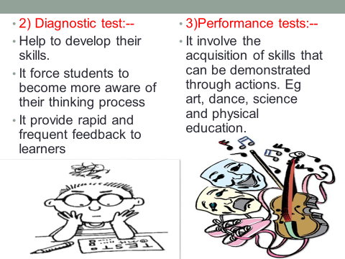

Slide 18

Advantages of summative evaluation
Employed at the end of learning experiences to indicate student progress
Records achievement of students through the award of certificates and diplomas
Inticipate further achievement of the students
Allows learners to progress to higher studies
Judges to what extent objectives are realized on the basis of the learner’s performance
Helps in planning and organization of further teaching
Determines whether a new curriculum, programme, syllabus or subject is better than the one it is intended to replace or other alternatives
Results are used for classifying, placement and prediction for future success

Slide 19


Slide 20

MEANING
In general, diagnostic evaluation deals with the process of evaluation with the aim of defining a problem and taking a required action to resolve the problem.
Diagnostic evaluation involves the process of documentation which enables the researcher or evaluator to define a problem.
This process is a form of inquiring technique used in a problem solving. One could not solve a problem without first defining the problem and its degree and magnitude.

Slide 21


Slide 22


Slide 23
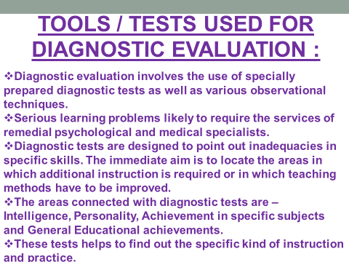

Slide 24

