Slide 1

Educational Psychology
Educational Psychology consists of two words Psychology and Education.
While General Psychology is a pure science, Educational Psychology is its application in the field of education with the aim of socializing human beings and modifying their behavior

Slide 2
Definitions
Crow and Crow-Educational Psychology describes and explains the learning experiences of an individual from birth through old age. Skinner defines Educational Psychology as ―that branch of Psychology which deals with teaching and learning
Stephen – Educational Psychology is the systematic study of the educational growth and development of a child.
Judd – Educational Psychology is the Science which explains the changes that take place in individuals as they pass through the various stages of development.
Peel- Educational Psychology is the science of Education.

Slide 3
CONCEPT
Educational psychology is one of the branches of applied psychology concerned with the application of the principles, and other resource of psychology to the solution of the problems confronting the teacher attempting to direct the growth of children toward defined objectives. Stated differently, the Central theme of Educational Psychology is Psychology of learning
Educational psychology is concerned with an understanding of:
The child - his development, his need and his potentialities
The learning situation including group dynamics and its effect on learning
The learning process-its nature and the ways to make it effective

Slide 4

NATURE OF EDUCATIONAL PSYCHOLOGY
Applied :It is an applied branch of fundamental Psychology.
Combination :It combines two fields i.e. Education and psychology.
Scientific :It is the scientific study of human behavior in educational situations
Related with Growth & Development :It is concerned with these factors, principles and techniques which relate to the various aspects of a child‘s growth and development.
Concerned with learning : It is concerned with learning situation and process by which learning can be more efficient and effective.
Connected with various branches :Educational Psychology, draws heavily from various branches of psychology, biology sociology and anthropology
Not as exact as natural sciences: Educational Psychology is not as exact as natural sciences since the human behavior cannot be predicated exactly ,because it is dynamic.

Slide 5
Science of education
:Educational Psychology is a science of education dealing primarily with how, when and what of education.
Applied positive science
It is not a normative a science as it is not concerned with the value of education and does not concern itself with ‗What ought to be‘. It only describes what it is, it is an applied positive science.
limited to educational environment
While psychology deals with the behaviour of all individuals in all walks of life, Educational Psychology limits its dealing with the behaviour of the pupil in relation to educational environment.
Technical Guidance It does not concern with the what and why of education. It gives the necessary knowledge and skill (Technical Guidance) for giving education to the pupil in a satisfactory way

Slide 6
Scope of Educational Pychology-
Five major areas covered by Educational Psychology are:
The Learner
The Learning Process
The Learning Situation
The Teaching Situation
Evaluation of Learning Performance
The Teacher

Slide 7


The Learner
Educational Psychology acquaints us with need of knowing the learner and deals with the techniques of knowing him/her well. Following are the topics studies included in it:-the innate abilities ,Learner Teacher ,Learning Process Learning content (curriculum),Teaching Strategies ,Evaluation of Learning outcome and capabilities of the individual and their measurements, the overt, convert, conscious as well as unconscious behavior of the learner, the characteristics of his growth and development at each stage beginning from childhood to adulthood.

Slide 8

The Learning Process
After knowing the learner and deciding what learning experiences are to be provided, the emerging problem is to help the learner in acquiring these learning experiences with ease and confidence. Hence, it deals with the nature of learning and how it takes place and contains the topics such as laws, principles and theories of learning; remembering and forgetting, perceiving, concept formation, thinking, reasoning process, problem solving, transfer of training, ways and means of effective learning etc.

Slide 9
Learning Situation
It also deals with the environment factors and learning situation which come midway between the learner and the teacher. Topics like classroom climate and group dynamics techniques and aids which facilitate learning, evaluation techniques, and practices, guidance and counseling etc. which help in the smooth functioning of the teaching learning process.

Slide 10
Teaching Situation
It suggests the techniques of teaching. It also helps in deciding what learning situation should be provided by the teacher to the learner according to his mental and physical age, his previous knowledge and interest levels. By describing the learner‘s characteristics, what teaching aids are appropriate for the particular subject can be decided.

Slide 11
Evaluation of Learning Performance
The main objective of education is all-round development of the learner. It includes cognitive, affective and psychomotor aspects of personality. Educational Psychology suggests various tool and techniques for assessment and evaluation such as performance test, oral test and written test. It does not stop at measurement only. After the testing, results of the test are analyzed, causes for poor performance, backwardness in any aspect of development is corrected by guidance and counselling in study habits, examination techniques and learning styles. These are analyzed and the learner is helped so that he can overcome the difficulties.

Slide 12

The Teacher
Educational Psychology emphasizes the need of knowing the self for a teacher to play his role properly in the process of education. It throws light on the essential personality traits, interests, aptitudes, the characteristics of effective teaching etc., so The Teacher as to inspire, help teacher handle the stress, conflict and anxiety by giving insight into their own personality.

Slide 13
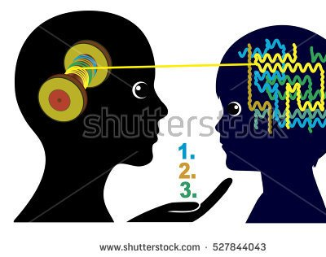
Importance of Educational Psychology

Slide 14
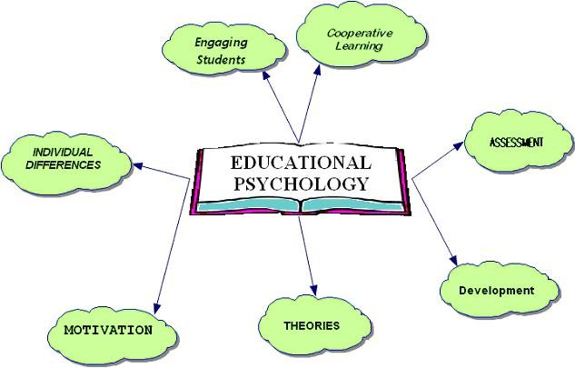

Slide 15
Importance OF EDUCATIONAL PSYCHOLOGY
To provide a thorough knowledge of the nature of the child to provide an understanding of the nature, aims and purposes of education.
To acquire familiarity with the technical vocabulary and to further an understanding and an appreciation of the scientific procedures by which the data of educational psychology are obtained
To provide a significant knowledge of developmental process with particular emphasis upon the promotion, guidance and control of mental and moral aspects.

Slide 16
to provide an understanding of the principles governing learning, together with knowledge of the techniques for guiding improvement in learning and their application to the practical problems in the classroom.
to present the theories underlying the measurement and evaluation of mental abilities, aptitudes, achievements, interest and personality organization.
to present the principles and conclusions regarding the prevention of all types of maladjustments together with the approved practices for achieving satisfactory adjustmentsthe ―Culminating Function
to inculcate in the prospectiveteacher the realization that the most essential purpose of teaching is that the student learn.

Slide 17

To enrich the teacher with the laws and fundamentals of the theories that explain the educational process and control them, in order to apply them scientifically and objectively in the school environment and classroom and provide these theories possible suggestions for some problems that may be exposed to the teacher or student during different educational situations.
The most important information and skills provided by educational psychology to the educational staff; exclusion and exclusion of educational theories and opinions based on personal impressions and inaccurate and subjective observations. Some of these opinions were based on personal experiences and subjective viewpoints and often contradict the foundations of facts and theories Scientific, and evaluate these theories by subjecting them to scientific research organized educational and thoughtful.

Slide 18
Provide assistance to individuals in charge of the educational process, in order to identify the inputs and elements of the educational process, such as the characteristics of the learners and the educational environment, and their outputs from evaluation and measurement tools, and educational and educational tests.
Provide the teacher with the skills of scientific description, and the theoretical understanding of the educational process of education, and this through the achievement of the goals of general educational psychology of understanding the educational process and its components, and predict their output, and try to control.

Slide 19
To instruct the teaching staff to take advantage of the relevant psychological theories in the process of growth and developmental characteristics that follow the age stages, in addition to studying the learning motivations, mental skills, intelligence, thinking, remembering and problem solving to understand the mechanism of learning and teaching , Appropriate in all these areas.

Slide 20
To provide the teacher with a foundation of the correct rules and laws of the theories of learning and education, which enables him to choose the applications of psychological psychological principles and their suitability to a particular educational position, so that the teacher to assess the appropriate method according to the school environment and psychological characteristics of the teacher and student.

Slide 21
To help the teacher in determining the strengths and weaknesses in the mechanism of the work of the educational process and its results, and thus highlights the importance of studying the factors affecting the success or failure of the educational process and the achievement of its objectives. The most important of these factors: methods and strategies of learning and suitability for the categories of students, The student's personality, social circumstances and level of mental and cognitive maturity, as well as the amount of motivation for the learning process. The general and emotional atmosphere of the classroom has a great impact on the functioning of the educational process correctly and effectively. Rai, which was touched by educational psychology with theoretical and applied scientific research.

Slide 22
Educational psychology offers strategies and methods that will help the teacher to understand the student's psychology and psychology through the development of educational curricula in the light of the students' abilities and aptitudes so as not to overload them and to research the psychological problems facing the student at different age levels. To research the motivation of students to the process of learning and employment to reach students to the stage of acceptance and positive interaction , and thus to achieve the success of the educational process.

Slide 23

Growth and development
Human beings keep changing. During their lives, they change in size, appearance and psychological makeup. The way they change differs from individual to individual. However, the fundamental underlying patterns of growth and development remain more or less the same and take place in an orderly way. Each individual, with his unique heredity and the way he is nurtured, determines the way he traverses the broad highway of his life at his rate of progress. He will attain the size, shape, capacities and developmental status in a way, which is peculiar to him at each stages of life.
In this chapter ,we shall discuss the concept, principles and various stages of growth & development. Children differ in physical, cognitive, social, and emotional growth patterns. They also differ in the ways they interact with and respond to their environment as well as play with affection. Having an understanding of the sequence of growth and development prepares teachers to help and give attention to all the children.

Slide 24
Can you recall events from your early childhood?
You might have a few vague and blurred memories about your childhood. The experiences of that period form the basis of the type of person you are today.
How human beings grow, change and adjust themselves to their environment is the focus of development and behavior as also the concepts, principles and theories of growth of development.
The human being is never static. From conception to death, they undergoes changes. There are progressive changes in response to environmental conditions. Their body organs and psychological functions show the curves of capacity and achievement as well as slow erosion and decay.
Cognitive abilities develop and then degenerate; basic metabolism reaches a peak, then declines, the endocrine function flourishes, and then fades.
There is a rise and fall of physical energy in terms of both the force and speed of action with age. In fact, no organ or function of human beings has yet been found which is independent of age determinants. At the time of conception, a child has genetic potentialities that are partly predictable and partly unpredictable. These genetic potentialities are determined by the nature of his biological inheritance. Still there is room for a tremendous range in the ways he uses the genetic potentialities, depending upon the environment that may help or hinder the development of those potentialities.

Slide 25

The Meaning of Growth and Development
The terms growth and development are often used interchangeably. Actually, they are conceptually different. Neither growth nor development takes place all by itself.

Slide 26
Growth
Growth refers to quantitative changes in size, which include physical changes in height, weight, size, internal organs, etc. As an individual develops, old features like baby fat, hair and teeth, etc., disappear and new features like facial hair are acquired. When maturity comes, the second set of teeth, primary and secondary sex characteristics, etc., appear. Similar changes occur in all aspects of the personality. During infancy and childhood, the body steadily becomes larger, taller and heavier. To designate this, change the term growth is used. Growth involves changes in body proportions as well as in overall stature and weight. The term growth thus indicates an increase in bodily dimensions. However, the rate of growth differs from one part of the body to the other.

Slide 27
DEVELOPMENT
Development refers to qualitative changes taking place simultaneously with quantitative changes of growth. It may be defined as a progressive series of orderly, coherent changes. The term progressive signifies that changes are directional, that they lead forward rather than backward. The terms Orderly and coherent‘ suggest that a definite relationship between the changes taking place and those that precede or will follow them. Development represents changes in an organism from its origin to its death, but more particularly the progressive changes that take place from origin to maturity

Slide 28
DIFFERENCE
BETWEEN
GROWTH &
DEVELOPMENT
Growth refers to physiological changes.
Changes in the quantitative respect is termed as growth.
Growth does not continue throughout life.
Growth may or may not bring development.
Development refers to overall changes in the individual. It involves changes in an orderly and coherent type towards the goal of maturity.
Development changes in the quality along with quantitative aspect.
Development continues throughout life.
Development is possible without growth.

Slide 29
DIFFERENCE
Growth stops after maturation
Growth occurs due to the multiplication of cells.
Growth is cellular.
Growth is one of the part of the developmental process.
Growth may be referred to describe the changes in particular aspects of the body and behavior of the organism
The changes produced by growth are subjects of measurements. They may be quantified and observable in nature.
Development is progressive.
Development occurs due to both maturation and interaction with the environment.
Development is organizational.
Development is a wider and comprehensive term.
Development describes the changes in the organism.
Development brings qualitative changes which are difficult to measure directly. They are assessed through keen observation of behavior in different situations

Slide 30
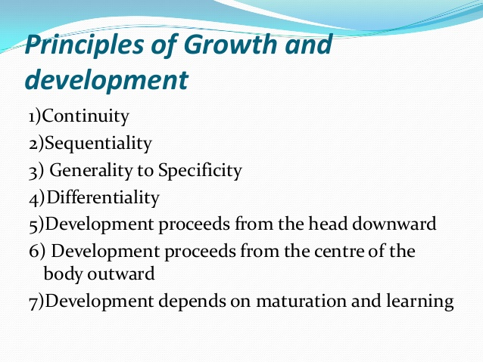

Slide 31
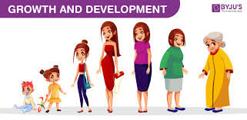
The Principles of Growth and Development
Development follows a pattern or a sequence: Development tends to proceed from the head downward. This is called the cephalocaudal principle.
According to this principle, the child first gains control of the head, then the arms, then the legs. Infants gain control of head and face movements within the first two months after birth. In the next few months, they can lift themselves up using their arms. By 6 to 12 months of age, infants start to gain leg control and may be able to crawl, stand, or walk.

Slide 32
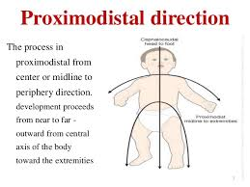
The Proximodistal principle
Development also proceeds from the center of the body outward according to the proximodistal principle. Accordingly, the spinal cord develops before other parts of the body. The child‘s arms develop before the hands, and the hands
and feet develop before the fingers
and toes. Fingers and toes are the
last to develop.

Slide 33

Development proceeds from general to specific responses:
It moves from a generalized to localized behavior. The newborn infant moves its whole body at one time instead of moving only one part of it. It makes random kicking with its legs before it can coordinate the leg muscles well enough to crawl or to walk.

Slide 34
Development is a continuous process:
Development does not occur in spurts. Growth continues from the moments of conception until the individual reaches' maturity. It takes place at slow regular pace rather than by leaps and bounds‘. Although development is a continuous process, yet the tempo of growth is not even, during infancy and early years growth occurs swiftly and later it slackens

Slide 35
Different aspects of growth develop at different rates
Neither all parts of the body grow at the same rate nor do all aspects of mental growth proceed equally. They reach maturity at different times. Development also depends on maturation. Maturation refers to the sequence of biological changes in children. These orderly changes give children new abilities. Much of the maturation depends on changes in the brain and the nervous system. These changes assist children to improve their thinking abilities and motor skills. A rich learning environment helps children develop to their potential.

Slide 36
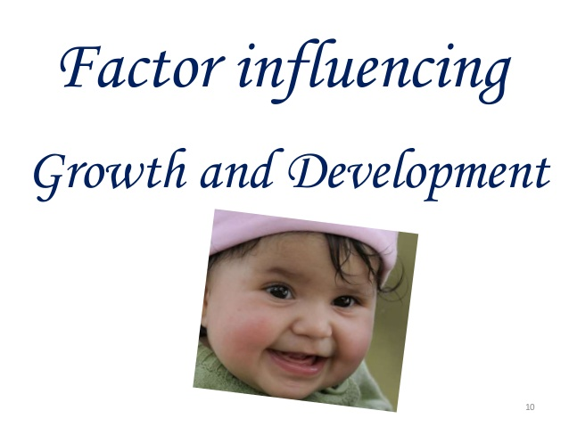

Slide 37
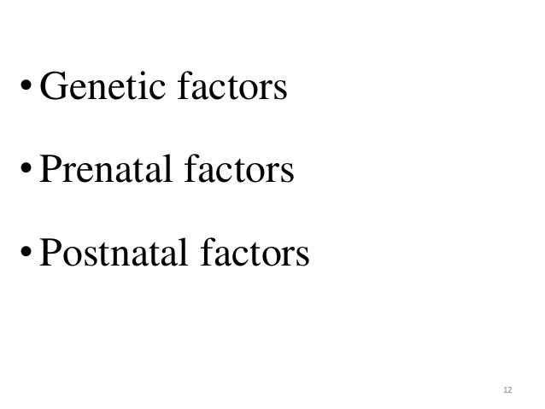
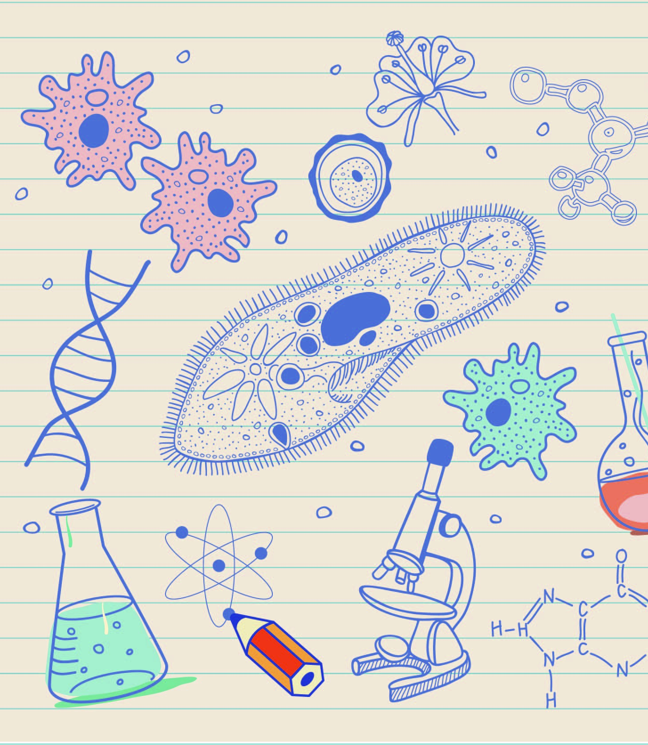

Slide 38
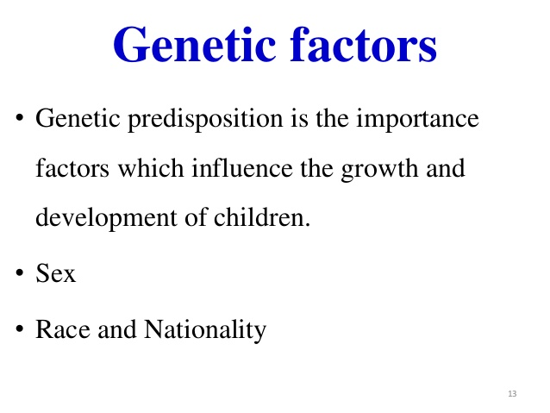


Slide 39
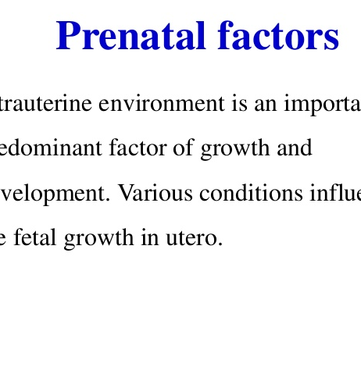
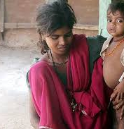
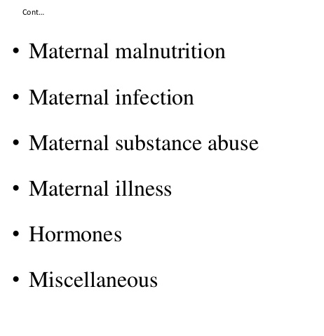

Slide 40
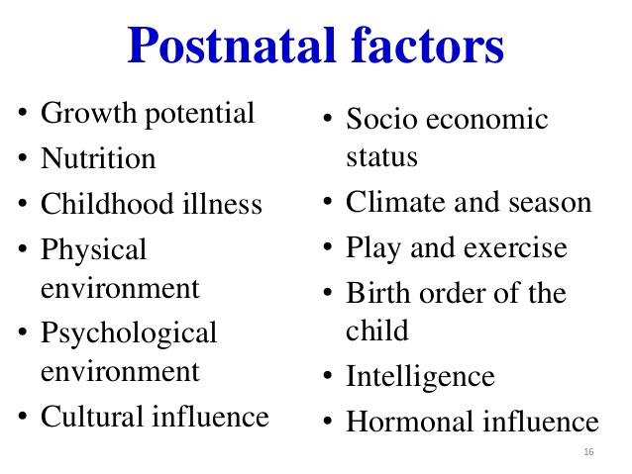
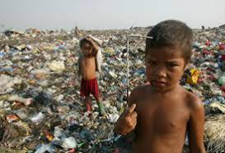

Slide 41
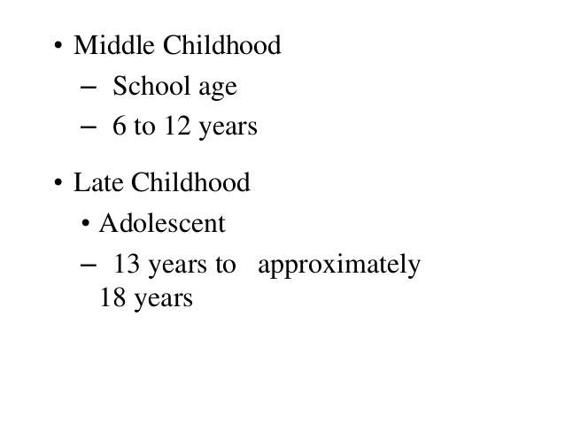
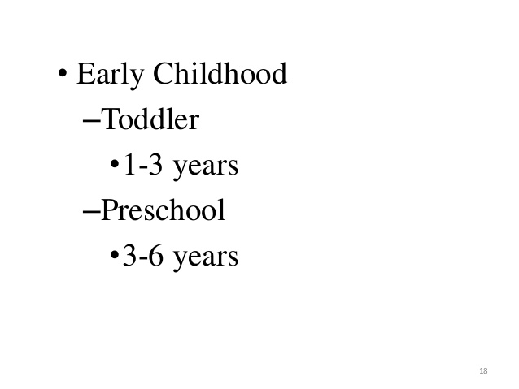
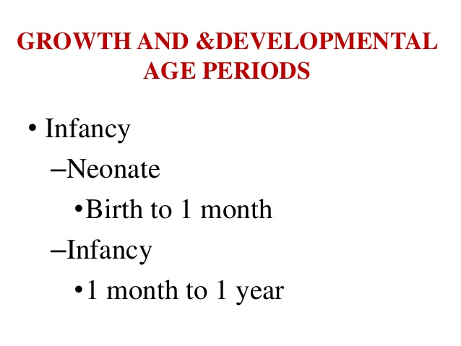

Slide 42
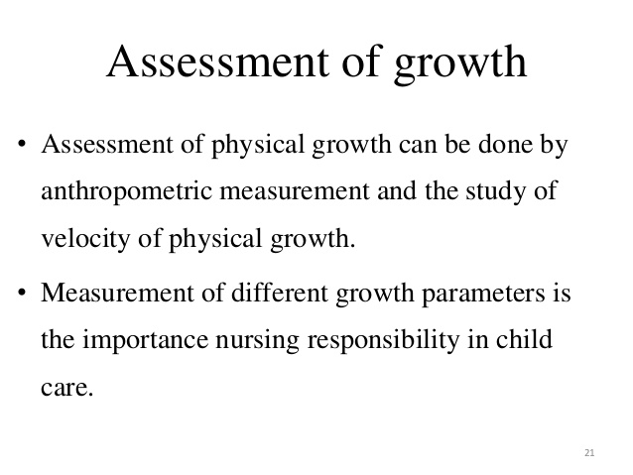

Slide 43
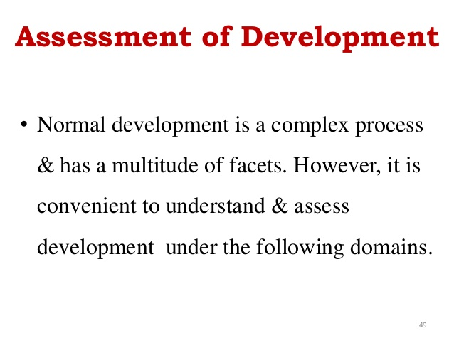

Slide 44
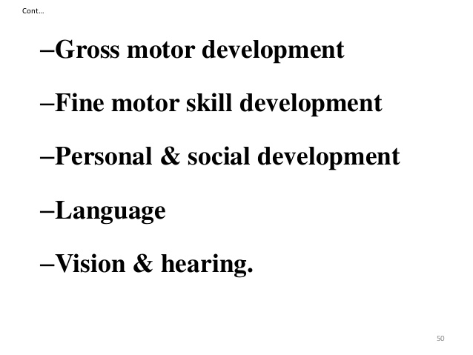
ASSESSMENT OF DEVELOPMENT

Slide 45
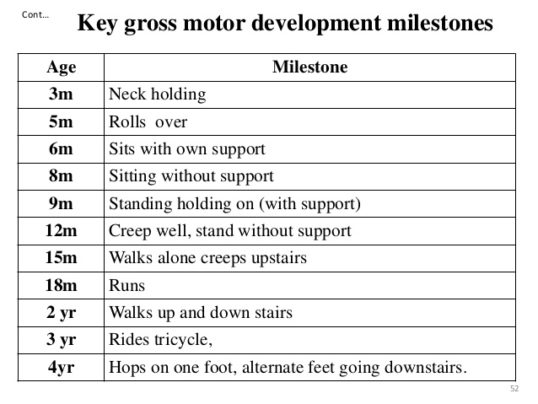
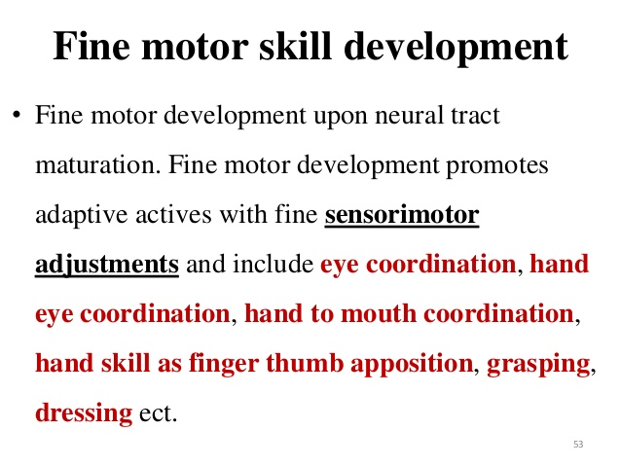

Slide 46
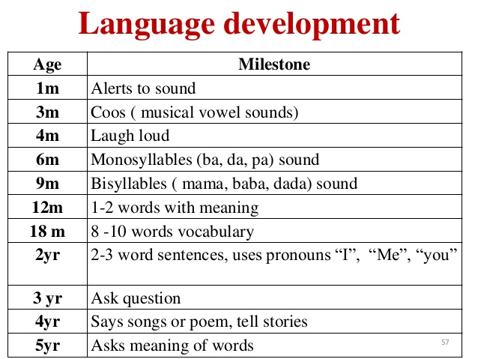
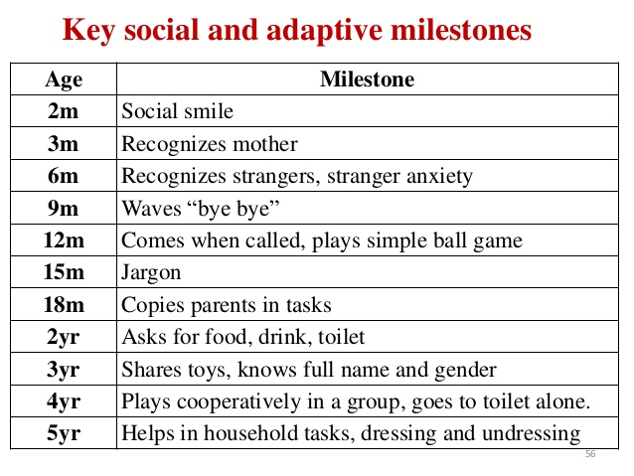

Slide 47
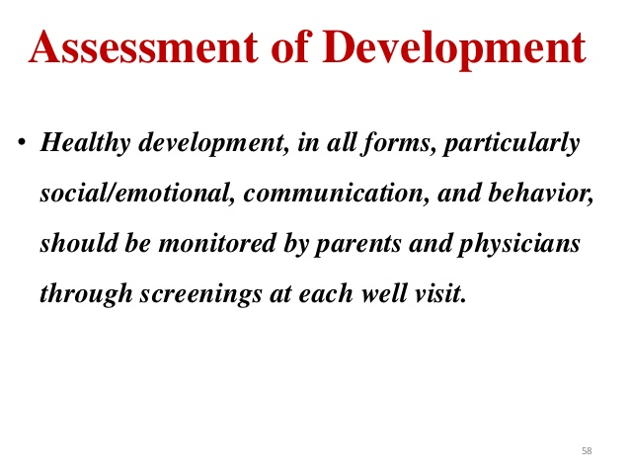

Slide 48
Influence of heredity and environment on growth and development
The individual’s personality is the product of both heredity and environment. In some cases heredity may overpower development and in certain other cases environment may very strongly influence growth and development. It is because of this difference, individuals differ in physique, character and other personality traits.
• A Child’s development represent the interaction of Heredity and Environment.
• Heredity determines the potential of child, while the Environment influences the extent to which that potential is achieved

Slide 49
There are two factors that affect the development of a child .
They are: 1. Heredity 2. Environment
What is Heredity?
The transfer of physical or mental characteristics from parent to child through genes is called heredity.
Genes are inherited traits encoded into a person's DNA.
What does heredity influence?
Heredity influences the different aspects of growth and development i.e., height, weight and structure of the body, color of hair and eye, intelligence, interest and certain behaviors.
Heredity is a static social structure meaning once we inherit certain genes they cannot be modified or changed.
What is Environment?
The word environment in this context means the environment around the child, his interaction with his family, his neighborhood, his school, the nutrition the child receives.

Slide 50
Every human being is born as a result of conception which takes place due to certain biological Factors and process. When two germ cells meet together an organism’s life starts. In the ovary of the female an ovum or an egg cell is present. Ovum is a kind of female’s egg cell. In the ovum 23 pairs of chromosomes are present in different shapes and sizes. In the male’s sperm there are also present numerous germ cells.In a germ cell there are 23 pairs of chromosomes as is the case with female’s ovum. When a chromosome of female meets the chromosomes of male. Fertilization takes place and the life begins to take place. It is this cell or chromosomes which in the process of heredity an individual gets from his/ her parents .

Slide 51
The child carries with himself several physiological and psychological peculiarities that are present in the parents. In fact it is the heredity that determines structure, complexion, structure of hair, height. Facial features nasal index etc. of the child. Thus different types of the genes help in the formation of a body. According to geneticists, sex is also inherited. They say that there are two big chromosomes. They have named these chromosomes as ‘X’ and ‘Y’. In the germ cells of the male there is one big ‘X’ chromosome-and a small ‘Y’ chromosome.If the germ cell engaged in the formation of a creature an ‘X’ chromosome of the mother and the other ‘X’ chromosome of the father enter, then the child will be a female, and contrary to this, if in the germ cell an ‘X’ and a ‘Y’ chromosome enter, the child will be a male.
A study of chromosomes has revealed that genes of the ‘X’ chromosome are comparatively stronger than the genes of the ‘Y’ chromosome. An individual’s heredity depends on the genes of his parents, that is, whatever one gives to his children is through the genes.

Slide 52
Environment
Environment is nothing but the sum total of the surroundings in which an individual has to live. Psychologically an individual’s environment is related to all those stimuli which he faces from the moment of fertilization till death. Environment is generally divided into two categories-natural and social. Natural environment refers to all those things and forces on and around the earth that influence a person.
Social environment we mean the environment which the person sees around himself on acquiring consciousness in the society, i.e., language, religion, custom, tradition, means of communication, means of luxury, family, school, social groups etc.By human society we mean those institutions or organizations which human beings have established for their own protection and security. Psychologists like Freud, Havelock, Eills have accepted the fact that social environment is very much responsible for changing in human behaviour and its personality.

Slide 53

What are the environmental factors which influence development?
Physical factors: Physical and geographical conditions influences a childs behavior, responses, and attitudes. For examples, a person born in Chennai would be more tolerant to hot, humid environment, as compared to someone born in Himachal Pradesh.
Family: Family plays an important role in a childs development since the first interaction a child has, is with his/ her family. The behaviors that a child observers, the values she or he is taught are all through this initial interactions.

Slide 54
School and teachers
The school environment, and the teachers also play a very important role in the grooming of a child.
The teachers are the first role models for a child, and through the way a teacher conducts herself, or interacts with the child affects the knowledge they acquire, and the people they become.
There are various other environmental factors, in addition to these, like the book a child reads, or what he/she watches on TV, the sport they play, affects their development.

Slide 55
Both heredity and environment have their share in molding the life and personality of the individual
.
• Heredity is responsible for all the inborn traits, the instincts, emotions, I.Q., reflex action and physical traits.
• Environment is responsible for the growth and development of the physical, mental and social traits.
• The two forces heredity and environment are not opposed to each other, but are complementary like seed and soil. The heredity is the raw material out of which the object is to be prepared, and environment in the technique and other material for the manufacture.
• Two individuals of the same heredity might differ when put in dissimilar environments. Again two individuals of differing heredity would probably differ inspite of identical environments. So we can predict that if we change either factor, the product is changed.

