Slide 1
Topic : Library Management
For B.Ed Ist Semester Students
(Punjabi University)
By
Ms. Sarita Gulati
Librarian
Shivalik Institute of Education and Research, Mohali

Slide 2
Management is defined as the process of planning, organizing, directing and controlling to accomplish organizational objectives through the coordinated use of human and material resources.
It is the process of efficiently getting activities completed with and through other people. (It is an art of getting things done through others)

Slide 3
Management insists on three
Essential Elements :
Management is a process: It is a process or series of continuing and related activities.
Management requires ‘effective’ performance : It involves and concentrates on reaching organizational goals on time.
Management needs efficiency : Efficiency means doing the task correctly and with minimum cost.

Slide 4
The essential characteristics of
Management are as follows –
Management is goal oriented process: It always aims to achieve certain organizational goals.
Management is Universal/pervasive – Management is found in every walk of life as it is a universal concept. It is essential to all organization, small or big.
Management is a continuous Process– Management is an ongoing process . All the functions of management (planning, organizing, staffing, directing and controlling) are performed on the continuous process.

Slide 5
Management is Dynamic- Management is applied to human groups which work in society. The ever changing social environment directly and indirectly influence the group activities. Hence, changing environments provide a challenge to management. Efficient management can not stay static. It must adopt itself to changing conditions. (An organization must change itself and its goals as per the environment.)
Management is a group activity– Various departments in the organization must work in harmony with one another. It require team work and coordination.

Slide 6
Library Management

Slide 7
Library management is the process of coordinating total resources of an organization/Library towards the accomplishment of desired goals through the execution of a group of inter related functions such as planning, organizing, staffing , directing and controlling.

Slide 8
Library Management
The management of a library means, efficient
(accurately) and effective (on time) management of material, machinery, men and money to meet the objectives of the library.
Libraries are simply service-oriented and not-for-profit institutions.

Slide 9
LIBRARY MANAGEMENT FUNCTIONS
Planning
Organizing
Directing
Staffing
Controlling
Coordinating
Reporting
Budgeting

Slide 10
PLANNING: It requires wide knowledge, foresight, experience and sound judgment. It means where we are and where we want to go(outlining how the tasks must be performed, and indicating when they should be performed). It prepare short term and long term plan to attain goals. While preparing the plans type of users, his need and level should kept in view.
ORGANIZING: Organizing means to put plans into action and allocation of duties to the members of staff for attainment of the objectives of the library. All the activities of the library are to be identified and then divided into manageable groups and sub groups. The authority is delegated to subordinates and the responsibility for performance is fixed.

Slide 11
Directing: It involves issuing instructions to the subordinates, guiding , motivating and supervising them.
Staffing : It means finding the personnel/staff requirements at different levels. Staffing includes recruitment, training, promotion, transfer, demotion or termination.
Controlling : This function deals with the steps taken to ensure that the performance of the persons confirm to the plans and objectives of the library. On the basis of defects revealed by the process of control, management can reveal its future plans.

Slide 12
Coordinating : Without proper coordination , it is difficult to manage the affairs of the library. So there must be proper coordination among various units/sections working in the library.
Reporting : Reporting is a mirror for library services. The librarian keeps the library committee or library authority informed through reporting about various activities, services, achievements and problems of the library.

Slide 13
Budgeting : Budgeting is the heart of management. No organization can function properly without adequate finances. The librarian has the overall responsibility for preparing of the budget on the basis of the needs of the library. Librarian has to convince the authorities about the usefulness of the services rendered by libraries. The budget is finally approved by the library authority.

Slide 14
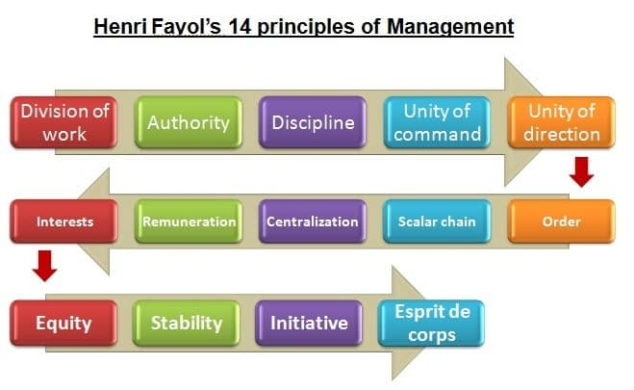
Fayol's Principles of Management

Slide 15
Division of work: It refers to the division of work among various individuals in the library. (no more or less)
Authority (power) and Responsibility(duty) : They both go hand in hand. Authority is the power to give orders to the subordinates. Responsibility means duty which the subordinate is expected to perform. So, there should be equality between both.
Discipline: Discipline is essential for smooth management of an institution. Maintenance of discipline in an institution depends upon the quality of leadership and the character of staff members.

Slide 16
Unity of command: One person, one boss. An individual should receive guidance, instructions and orders from only one superior. Dual command should be avoided.
Unity of direction: There should be One head and one plan for all the operations which have the same objectives.
Subordination of individual interest to common interest: Henri Fayol indicated that personal interests are subordinate to the interests of the organization . The primary focus is on the organizational objectives and not on those of the individual. The individual must not place his personal interest over the common interest, in case there a conflict.

Slide 17
Remuneration of personnel: The employees must be paid fairly for their services retendered to the institution. It should accord satisfaction both to the employees and the institution.
The Degree of Centralization : When the power to take decision rests with the top management it is called as ‘Centralisation’. When the power to take decision is given to the person performing the job it is called as ‘Decentralisation’. Fayol is of the opinion that there should be a proper balance between centralization and decentralization. An organization must not be completely centralized or decentralized, there should be a match between the two depending upon the size, nature of organization. The top management must keep the authority to take important decisions of the organization but adequate authority must be delegated to the lower level employees to take the department level decisions which motivates them to perform better.

Slide 18
Scalar chain or line of authority : This refers to hierarchy. It is a chain of superiors from the highest to the lowest ranks. A subordinate should follow the line of authority.
Order: Order means “place for everything and everything in its place.” This principle is related to the systematic arrangement of things and people in the organization. This means every material should be in its place, and there should be a place for every material. In a library, a right person must be assigned a right job most suitable to him.
Equity: This principle requires fair justice and kindliness on the part of manager towards staff, where as devotion and loyalty from subordinates.
Continuity of tenure of personnel: Stability of staff is necessary for good management. The employees should not be transferred frequently as time is required to learn the jobs.

Slide 19
Initiative: The manager must motivate his subordinates to think and take actions to execute the plan. They must be encouraged to take initiatives as this increases the zeal, satisfaction and energy among the individuals.
Esprit De Corps: In unity there is strength. Managers have the duty to promote harmony and to discourage and avoid those things that disturb harmony. Therefore, there must be maximum emphasis for team work with proper communication.

