Slide 1
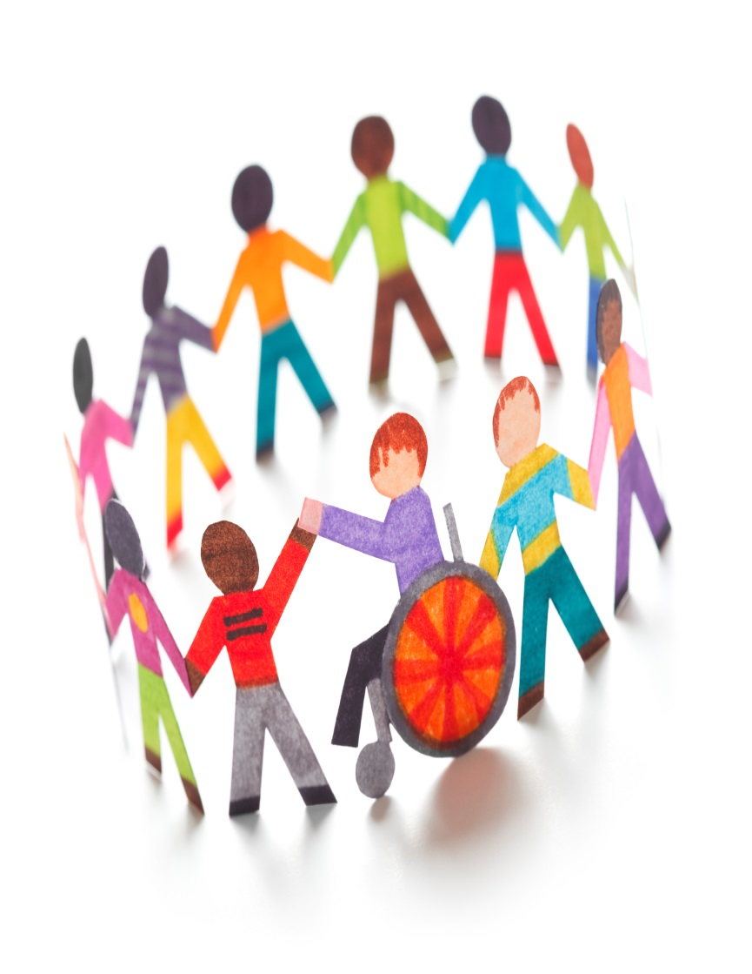
INCLUSIVE SCHOOL
TEACHING- LEARNING STRATERGIES: BUDDY SYSTEM
SEEMA MALIK
ASSTT PROF
SIER, MOAHALI

Slide 2
Being different from everyone else can both be a blessing and a curse. For children facing different challenges, sometimes considered as a burden. They may be challenged in some skills that their peers may find so easy to do that it is taken for granted. Some of these problematic skills are in the areas of communication and socialization.
Fortunately, several interventions have been designed to help these children cope with their difficulties and blend with typically-developing children. One educational intervention that many schools are already adopting is Inclusion.

Slide 3

Buddy systems teach, and give children the opportunity to practice, the important values of respect, care, valuing difference, responsibility, friendship and including others. Through looking after and caring for smaller, vulnerable children who are just starting school, older children learn the skills associated with empathy and compassion through activities in the classroom and in the playground.

Slide 4

INTRODUCTION
The interactive teaching and learning strategies are used to engage students in resilience and wellbeing.
The strategies aim to promote critical and reflective thinking, research and evaluation skills that will help students to take positive action to protect, enhance and advocate for their own and other’s health, wellbeing and safety.
Students use personal and social capability to work collaboratively with others in learning activities

Slide 5
THE BUDDY SYSTEM
MEANING
The buddy system is a procedure in which two individuals, the "buddies", operate together as a single unit so that they are able to monitor and help each other.

Slide 6
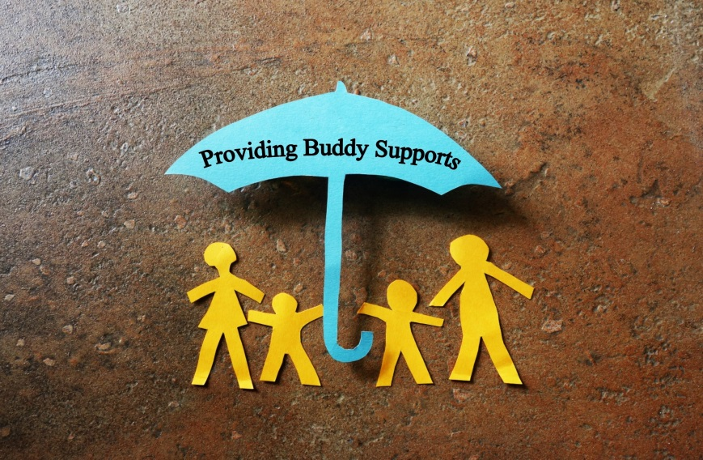
Peers are paired with students with disabilities who are there to support in school work, offer advices and just be a friend.
The peer buddy is usually a student who is interested in providing support, who understands the requirements of the class, is comfortable with the subject matter and would like to bring the students with a disability into his or her circle of friends.

Slide 7
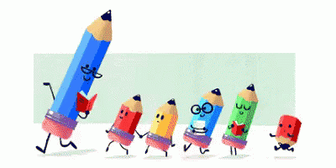
It boosts up the self esteem and competence of the mainstream student while making the child with special education needs feel accepted and supported by the peer.

Slide 8
BUDDY SYSTEM. The purpose of implementing a buddy system is to increase social interaction and appropriate play among children in your classroom. A peer buddy can help the child who has difficulty with transitions, difficulty remembering the rules and procedures of routines, or who seems to need a lot of peer attention

Slide 9
benefits
Through buddy system children learn to develop an awareness and respect for diversity.
It develops interactional skills.
It helps to develop deeper
understanding of the task.
Children may learn positive
skills from their buddies.
It helps in building friendship ties
and interpersonal relationships.
Helps in improving learning skills.
Makes independent and confident.
Develop social skills.

Slide 10

Responsibilities of a peer buddy
Treat everyone the same way as you yourself are, no matter if he or she suffers a disability.
Respect everyone.
Develop true friendships
Be a role model.
Attend to confidentiality.
Teach others in school
Assist in school work.
Inform the teacher about
the problem.

Slide 11
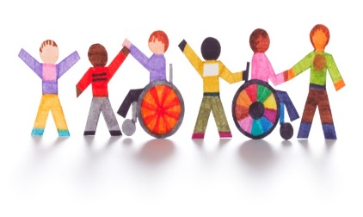
Essentials for successful implementation of buddy system
Be sure to match academically higher performing children with those that need more support.
Provide clear directions regarding what support the buddy is providing.
Make the buddy relationship reciprocal.
Carefully observe and record the successes and challenges of the buddy system.
Reinforce all participants for being good buddies.
Rotate buddies throughout the session.
The non-disabled students chosen as buddies should be selected with utmost care.

Slide 12


