Slide 1

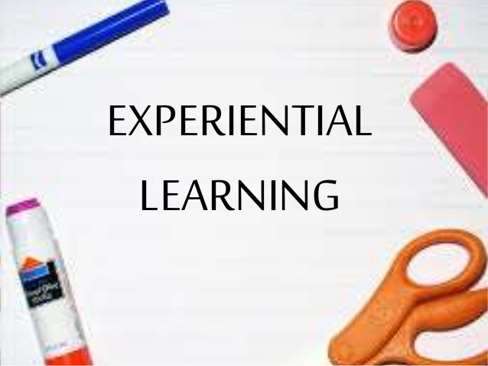

Slide 2
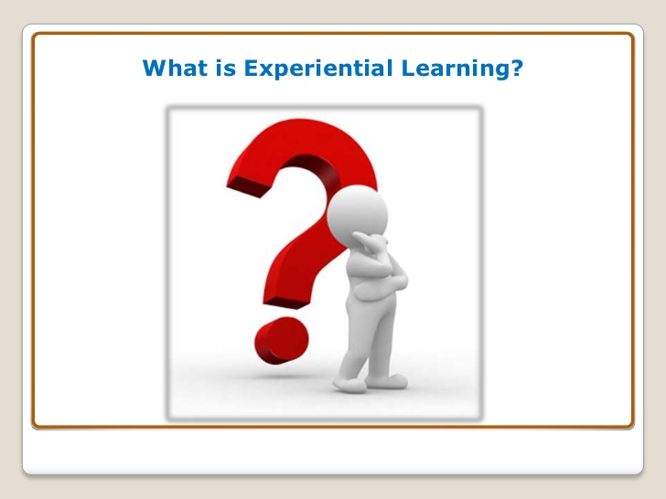

Slide 3
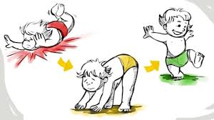

Slide 4
INTRODUCTION
Experiential learning is a well known model in education, training, facilitation and organizational development. Experiential learning engage students in critical thinking, problem solving, and decision making opportunities for debriefing and consolidation of ideas and skills through feedback, reflection and the application of ideas and skills to new situations.

Slide 5
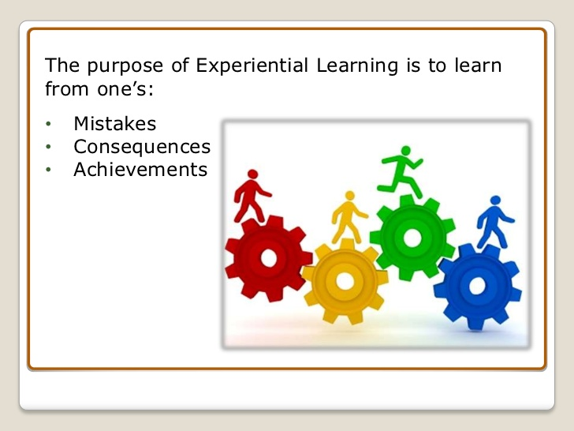

Slide 6
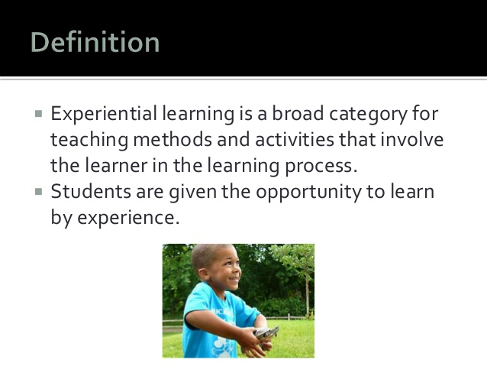

Slide 7
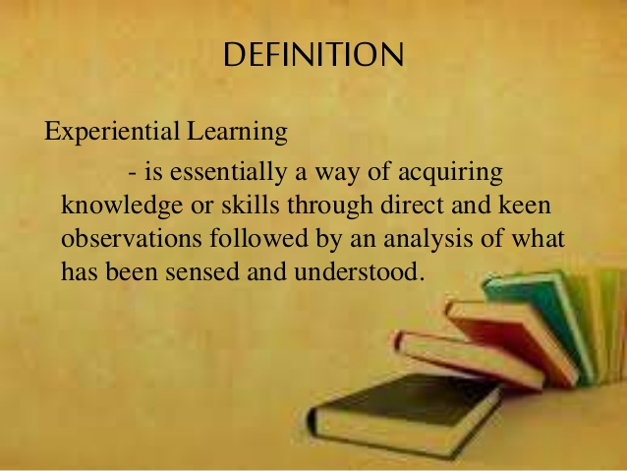
meaning
.

Slide 8
Definition
According to Kolb(1984) “ Experiential learning is described as the process whereby knowledge is created through a transformation of experiences.
According to John Dewey(1915) “Learning by doing”
According to Wolfe and Byrne(1975) “Experience based learning”

Slide 9
Nature of Experiential Learning
Reflection on doing
Pedagogical process
Different from rote learning
A way of doing
Review/ Reflection
Reflection an essential element
Development of skills
Different from experiential education
Learner centered
An approach to learning

Slide 10
Types of Experiential Learning
1.
Field Based Experiential Learning
2.
Classroom Based Experiential Learning

Slide 11
Types of Experiential Learning
Field Based Experiential learning
Classroom Based Experiential learning
Field based learning is the oldest and most established form of experiential learning ; having been integrated into higher education in the 1930’s. Field based learning includes internship, practicum's, cooperative education, and service learning.
Classroom based experiential learning can take a multiple of forms, including Role-playing, games, case studies, simulation, presentations and various types of group work.

Slide 12
Importance of Experiential learning
Makes learning relatable to students
Links theory to practice
Assists in memory retention
Leads to Development of skills for lifelong learning
Increases the effectiveness of learning
Introduces children to conducive environment
Develops skills of critical thinking and decision making

Slide 13
Scope of experiential Learning
A broad umbrella term
A wide range of design models
Different kinds of programmes
Business field
Experiential learning- The future of learning
Based on personal experiences
Bridges the gap between theory and practice
A future oriented learning
Produce accurate assessment results

Slide 14
Objectives of experiential learning
1.) General objectives
2.) Objectives related to students
3.) Objectives related to Teachers
4.) Objectives related to Institutions

Slide 15
Principles of Experiential Learning
Carefully chosen experiences
Structured experiences
Active engagement
Total involvement
Result as basis for future learning
Outcomes are not predicted
Opportunities are nurtured
Encouragement to spontaneous learning
Design of learning experiences
Instructor/ Teacher’s role
Teachers awareness

Slide 16
Issues and concerns of Experiential Learning
Misconceptions
Issue of time and energy
Too much Trial and Error
Group problem solving exercise
Limited class-time
Lack of experiential curriculum
Restriction on students engagement
Inadequate group work skills
Assessment of experiential activities
Variability of experiential activities
Ethics/Privacy and anonymity issues.

Slide 17


