Slide 1
EXHIBITIONS
For B.Ed Ist Semester Students
(Punjabi University)
By
Ms. Sarita Gulati
Librarian
Shivalik Institute of Education and Research, Mohali

Slide 2
INTRODUCTION
Education is the fusion process of teaching and learning. The purpose of education is installing new beliefs, habits, information, and knowledge. Although books are a major source of information and learning, yet to develop new beliefs and habits by just reading and cramming a few books is just not possible. The education world including the teachers, are always on their toes searching the new and productive methods of teaching and learning process. Apart from the theoretical knowledge the education system also aims to develop social skills and soft skills among the students. There are various methods to involve students in learning and various modes to evaluate teachers as well as students in the teaching-learning process. An exhibition is a wonderful tool that caters to these entire requirements at the same time.

Slide 3
DEFINITION
“It is a planned display of models, charts, specimens, posters etc., to present the public view for instruction and to put in a competition, advertising or entertainment".
Gilbert

Slide 4
Exhibition is…
The exhibition is a general term used for the organized collection of selected items and their display in public. The exhibition focuses on the identification, display, and interpretation of collective things.
Talking about the exhibition in the education process of teaching and learning, the exhibition is a test of the teachers as well as the students and their combined learning process. The teachers are tested on how far they have been successful in imparting the desired knowledge and skills whereas the students are tested on the parameters of how much they have acquired by the teaching process.

Slide 5
Where It is Conducted?
Exhibitions are generally conducted in the educational institutions for students. Museums, galleries, libraries, exhibition halls and world fairs can also be used for the purpose of the exhibition.

Slide 6
TYPES
1. EDUCATIONAL EXHIBITION
2. CONSUMER EXHIBITION
3. TRADE EXHIBITION

Slide 7
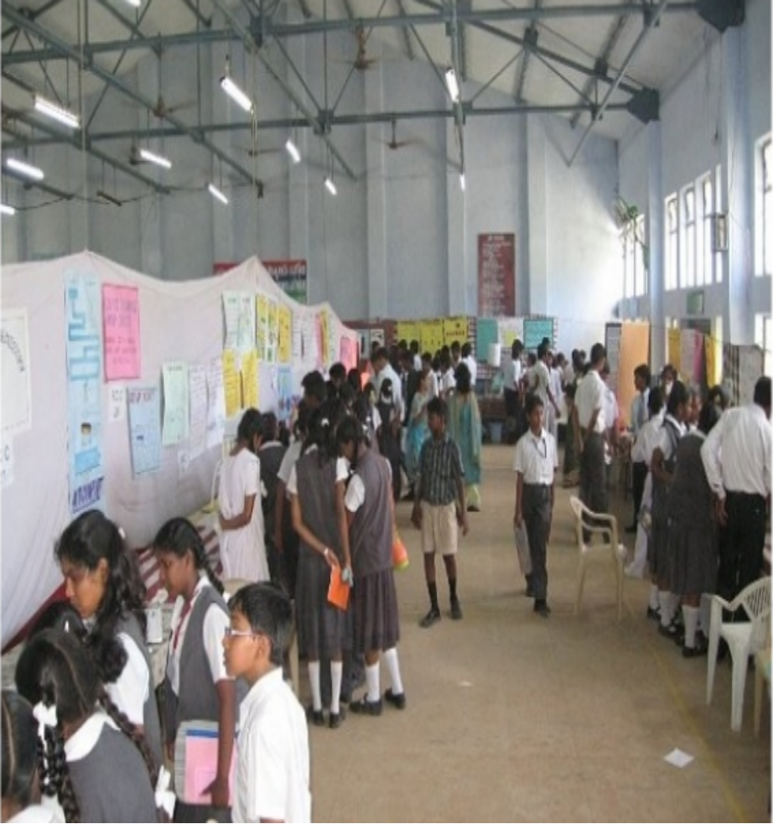
EDUCATIONAL EXHIBITION.
Educational exhibitions are conducted in educational institutions to educate the learners. Generally these are organized by the students.
Oral exhibition and multimedia exhibitions are the two kinds of educational exhibitions in which students take part.

Slide 8
2 TYPES OF EDUCATIONAL EXHIBITIONS
ORAL EXHIBITION: Here, the students present their model and explain the interpretation orally to their audiences. An audience can ask questions about the use and benefits of the model displayed and students are asked to answer all the queries.
MULTIMEDIA EXHIBITION: The exhibition where the displayed model is explained with the use of multimedia technology like PowerPoint presentations is termed as a multimedia exhibition.
Exhibitions serve as an influential platform to come together, share and build long-lasting relationships.

Slide 9
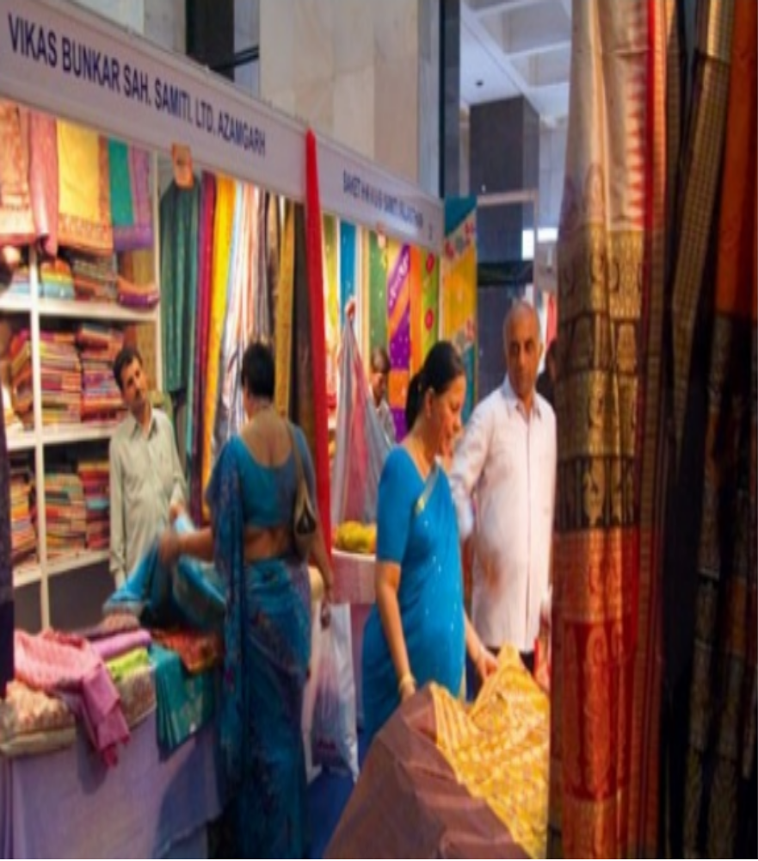
CONSUMER EXHIBITION
These are horizontal markets(broader audiences). They usually involve a large range of products from a number of different industries on display to the general public.

Slide 10

TRADE EXHIBITION
TRADE EXHIBITION are generally designed to meet the needs of one particular type of business or product or country. Only people involved in the field are invited to attend.

Slide 11
PURPOSE
• To achieve specialized knowledge among students and aim to consider learning as an adventure through exhibition.
• To inculcate in the minds of the students the educational needs to have an enquiry approach rather than a mere store house of information.
• To develop student's abilities in imagination and train them to focus on facts and figures in a manner that will attract the attention of viewers.
• To reveal the ideas clearly and effectively.
• To stimulate team spirit among students.
•

Slide 12
• To influence people to adopt better practices by arousing interest, stimulating thought and getting action.
• To promote participation in or to raise money for some public cause or activity.
• To give recognition to people or institutions by enabling them to display their products.

Slide 13
Importance of Exhibition
Exhibitions no doubt are a very effective tool of the learning process. There are numerous benefits to organizing an exhibition for students. Let us enlist the Importsance of an exhibition and find out the sole purpose of the exhibition in the education process.
MASS MEDIUM: Exhibitions provide the students with a large platform to showcase their talent and present it in public. The exhibition is a mass medium through which students can represent their learning and hidden talent among others.
EXPOSURE: An exhibition, of course, gives exposure to the students, exposure to the needs of the society, exposure to the new discoveries and inventions, exposure to working in the group.

Slide 14
RESEARCH AND TECHNICAL MINDSET: In the process of exhibiting a model, the students undergo a lot of research work to arrive at the required meaningful information. The mind develops the technical approach towards any given problem and starts analysing the hidden facts, working and procedure of the model.
SOCIAL SKILLS: Education’s one of the most important aims is to impart and instil in the students’ social skills necessary to live a life of peace. Social skills are very crucial to living together in a social surrounding. The students learn to work in the group and respect each other’s views. The students learn to care and love other human beings in the group. They also realize the value and power of working together in a group.
AWARENESS: Getting involved in an exhibition demands awareness and updations about the latest researches, challenges of the society, inventions and discoveries. A student who is not aware of what is happening around him would not be able to give the desired results during the exhibition.

Slide 15
CREATIVITY: The exhibition drives creativity from deep inside the students. The students search and explore creative solutions to the various challenges they have to deal with.
CRITICAL THINKING: The science exhibition demands critical analysis of any situation and the students needs to analyse both the pros and cons of the challenge. After analysing the situation from all possible perceptions, using the critical ability the students reach the desired conclusion or the solution.
SOLUTION DEVELOPING: Generally, people feel anxiety or nervousness when faced with a challenge in life. The students when experience an exhibition ripen the solution developing ability. This ability to not becoming anxious and instead approach towards the solution or finding the best possible solutions help the students throughout life in facing major challenges.
APPLICATION: Exhibition is one of the best methods to test the application of whatever has been taught or learned. The students learn to apply the knowledge and information collected through various sources and the teacher has the opportunity to test the students what and how much they have learned.

Slide 16
PRESERVANCE: The models represented in an exhibition are preserved for future reference. In this way, a number of solutions to several problems are preserved.
ACCEPTANCE: Many times the talent does not get revealed due to a number of reasons. The exhibition is a great method to get the talent accepted and noticed. The words of praise raise the confidence and self-esteem of the students to strive for more.

Slide 17
Apart from the above, the student has some extra benefits when the students become a part of an exhibition
STUDENTS ENGAGEMENT
LEARNING OF SIGNIFICANT CONTENT
SHARED INSTRUCTIONAL VISION
JOYFUL LEARNING AND TEACHING

Slide 18
Process During Exhibition
Selecting a topic and subject
Making a team
Observing and gathering information
Finding the key challenges
Drawing a plan
Finding the solution
Dividing the duties
Making a budget
Working on plan
Making your model exhibit
Review and make sure it works properly
Practice speaking about the product/model and its functioning
Exhibit at the exhibition

Slide 19
The purpose of exhibition or participating in an exhibition is surely not an easy task. A student is required to have the following qualities to successfully participate in an exhibition:
Happy and positive attitude
Patience in accepting the queries
Confidence and firmness
Complete knowledge about the model or the product
The purpose of exhibition is one of the best tools in the teaching-learning process which takes hard work of many days and costs and in return develops the competitive spirit among the young generation.

Slide 20
ADVANTAGES
It eminently suits to teach illiterates.
It promotes public relations and goodwill towards extension.
Creates a competitive spirit.
It makes learning activity more meaningful.
Exhibition will encourage bright students as well as weak students to learn the concepts in a practical way.
It will help the students and teachers to interact with each other which will help in the learning process of a student.

Slide 21
A student who get involved in such activities will get motivated in those subjects and thereby his learning abilities get enhanced.
Exhibitions conducted in schools bring a kind of togetherness among students as well as teachers.
Exhibitions conducted in school will form an important tool to bring out the hidden talents of students other than studies.

Slide 22
Apply What they Learn
In an exhibition, students get a chance to apply or do the practical aspect of the things that they have learned from the classroom. These are real opportunities for the kids to easily implement the things that they have learn from schools.
There are many students who always try to implement the things that they learn and they find these platforms of exhibitions a great way to showcase what and all that they have tried. It is always good to give the students a chance for implementing the things that they have learned and also to apply their ideas and present things differently in their own unique way.

Slide 23
Being Creative
For preparing science exhibits, astronomy, math and geography exhibits, students need to make the best use of their creativity. It is not enough to just tell or write what they know, but it is essential for the kids to present what they know in the best possible way.
Being creative and doing things should be promoted so that children can use their capabilities and skills in such a way to choose the best method to represent the things that they have learn.

Slide 24
A Good Platform
The school exhibition that is held in most of the schools is a great platform for the students to do things. It is always essential for the schools to organize exhibitions and such kind of events where the kids get some chance for showcasing their talents. This is a good way to find out the talented ones who are there in the school and also to open a platform for the kids to show their talents.
It is not enough for the kids to learn the lessons from the textbooks, but they should be given adequate space and time for letting the inner talents get a platform to be showcased.

Slide 25
Get Confidence to Speak
When an exhibition is held in a school, the students need to explain about what they are presenting. This is really a great chance for the students to speak well. In most cases, the students need to explain to the faculties, their fellow students, judges and may also need to explain to people who come from outside to see the exhibition. This can help in boosting in their skills in speaking and thus their confidence. There are chances for them to get that well.

