Slide 1
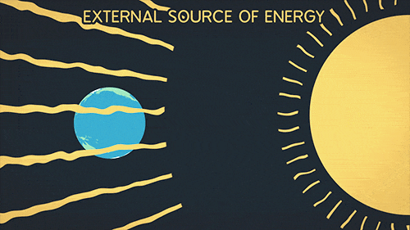
ENVIRONMENT HAZARD-GREENHOUSE EEFECT

Slide 2
ENVIRONMENT AL HAZARD?????
It is any process or state that has potential to threaten our natural surrounding or environment.
It can adversely affect the living and non living components of our environment.
For example, Green house effect, ozone layer depletion, Acid rain etc

Slide 3

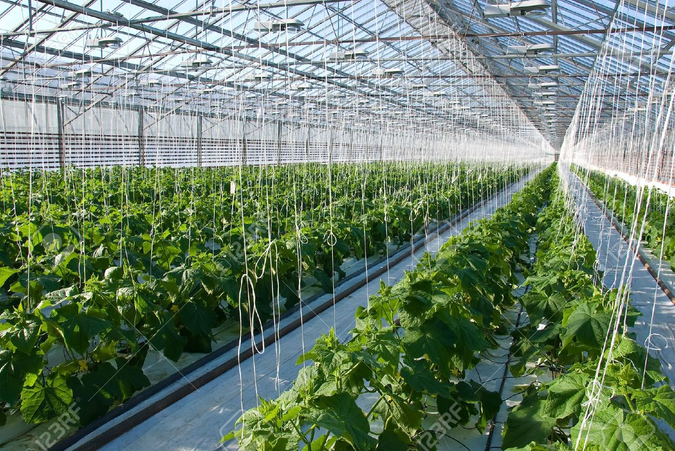
Greenhouse effect...
Green house is a house made up of glass , fiber glass in which plants are kept so as to provide them warm atmosphere for their survival in cold condition.
In this greenhouse , when the sun rays enters, it traps the rays and produce heat which is absorbed by the plants and they remain warm.

Slide 4
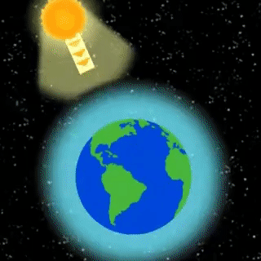
WHAT’S NEW IN THIS?????
Similarly, this greenhouse effect is now seen in the environment also.
The Greenhouse effect is a natural process that warms the earth’s surface.
The sunrays falls on the earth’s atmosphere and warms the earth with the help of certain gases.

Slide 5
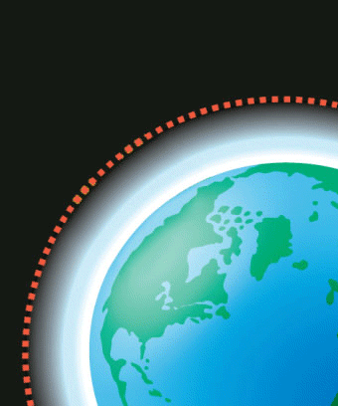
WHAT HAPPENS ACTUALLY????

Slide 6
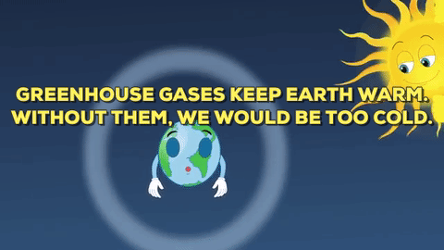
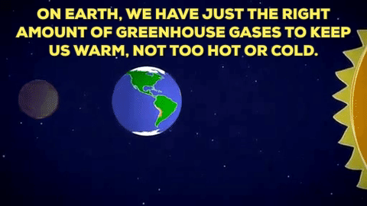
GREENHOUSE GASES....
These are the gases present in the atmosphere which absorbs or traps the sun rays and emit heat in return.
These gases are CO₂ (Carbon dioxide),Methane,N₂O (nitrous oxide), Ozone and CFCs.
But when the amount of these gases in
the atmosphere increases the effect also
increases and it is known as Enhanced
greenhouse effect producing more heat.

Slide 7
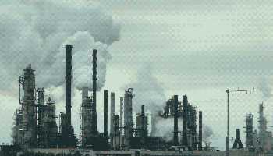
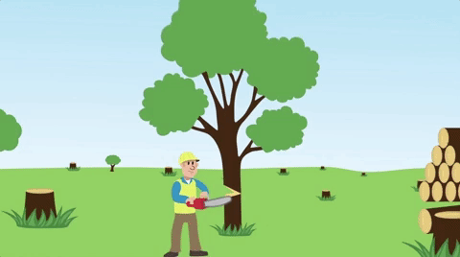
CAUSES OF ENHANCED GREENHOUSE EFFECT...
BURNING OF FOSSIL FUELS
ADVANCED AGRICULTURAL PRACTICES
INCREASE IN POPULATION
DEFORESTATION
INDUSTRIAL WASTE &amp; LANDFILLS

Slide 8
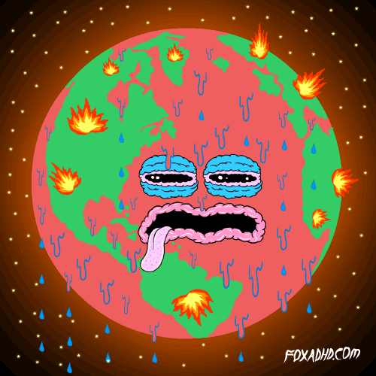
AFFECTS OF ENHANCED GREENHOUSE EFFECT
GLOBAL WARMING
OCEAN ACIDIFICATION
CHANGES IN PLANT GROWTH &amp; NUTRITION LEVELS
SMOG &amp; OZONE POLLUTION
OZONE LAYER DEPLETION &amp; OZOE HOLE
CLIMATIC CHANGES
HEALTH ISSUES LIKE RESPIRATORY DISEASES ETC

Slide 9
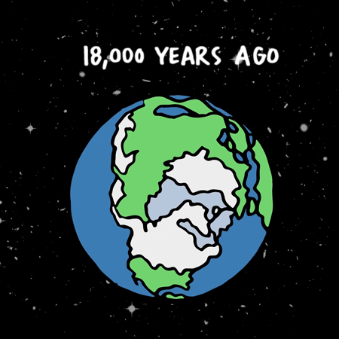

Slide 10
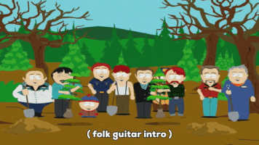
HOW TO CONTROL IT???
USE 8 R’s of ENVIRONMENT
AWARENESS ABOUT CARBON FOOTPRINTS
AFFORESTATION
USE NON TOXIC HOUSEHOLD PRODUCTS
USE SMART TECHNICAL WAYS

Slide 11

THANK YOU.....

