Slide 1
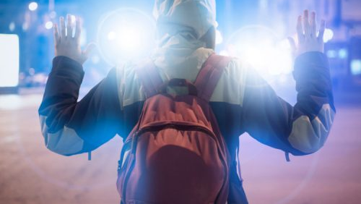
DELINQUENT CHILDREN

Slide 2
What is delinquent ?
A delinquent is a maladjusted person who creates difficulties for others and who is himself blocked in his own wholesome growth .
He is not a unique type of human being .
He adopts a sort of anti-social behavior or delinquency as a protest and rebellion against parents, teachers or social organizations which fail him in the satisfaction of his fundamental human urges and needs

Slide 3
DELINQUENT DEFINITIONS :
According to Education Dictionary,
“A delinquent is one who behave against social norms, breaks laws, creates indiscipline in school or other institutions and disobeys the rules. His immoral behavior is considered not so serious into his illegal behavior”.
According to Hadfield,
“ Delinquency may be defined as anti social behavior”.
According to Travis Hirschi,
“ Delinquency is defined by act, the detection of which is thought to result in punishment of the person committing them by agents of the larger society.”
According to Telford and Savory,
“Delinquency like aggressive behavior in general, can be understood as aggressive, hostile behavior or culturally acquired way of life.”

Slide 4

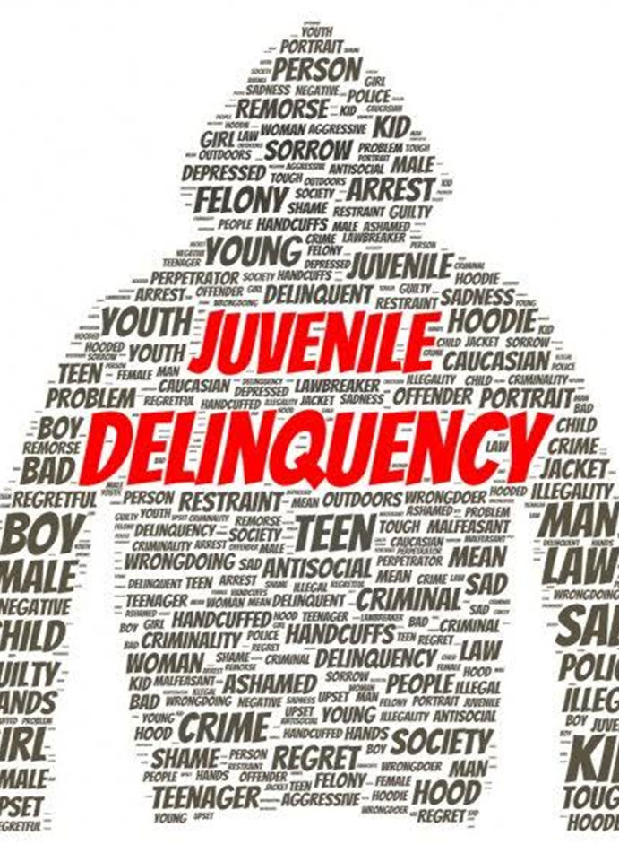
JUVENILE DELINQUENCY:
Juvenile delinquency may be defined as the phenomenon by which a punishable and criminal social offence normally committed by an adult is continuously repeated by a young person below the age of 18.

Slide 5
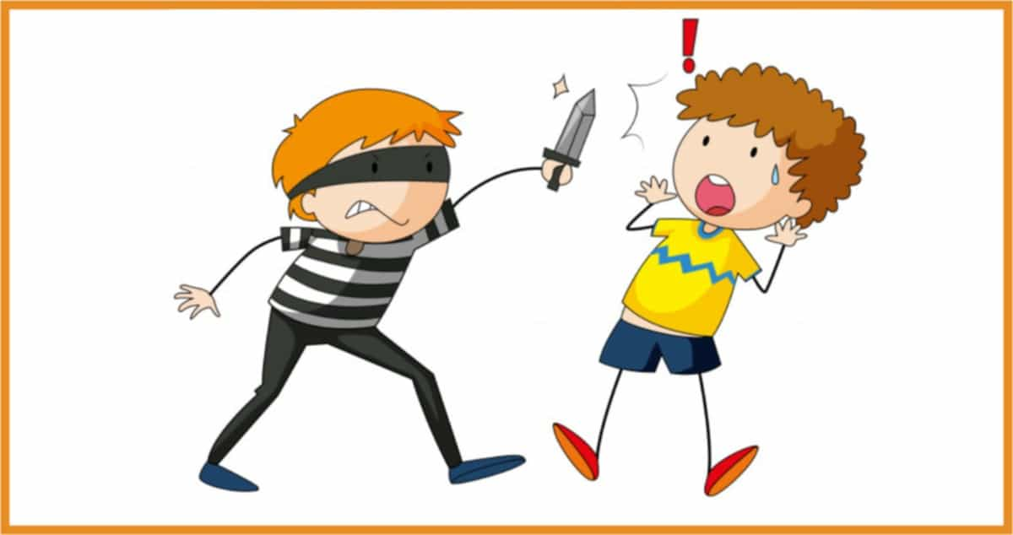
CHARACTERISTICS OF DELINQUENT CHILDREN:
PHYSICAL CHARACTERISTICS:
They are generally mesomorphic in body constitution , muscular and bold.
ANTI SOCIAL BEHAVIOUR :
A delinquent possess anti – social behavior. He breaks the law and creates indiscipline in the school , home and society.
HARMFUL BEHAVIOUR:
A delinquent behaves in such a way that it is harmful for himself and also for the others.
ANXIETY LEVEL:
Delinquent’s anxiety level is generally very high.

Slide 6
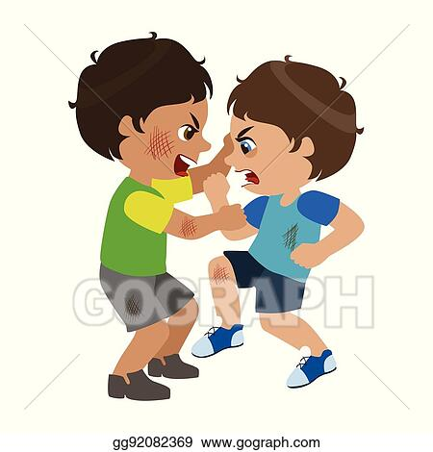
DISORGANISED THINKING: The thinking of the delinquent is disorganized and unsystematic. His ability to think properly is impaired and therefore, his conclusions are wrong and illogical. He takes decision and acts on the spur of the moment.
MALADJUSTED: The delinquent is essentially a maladjusted man who creates difficulties for others. He is himself blocked in his wholesome growth and he is hostile and rebellious against parents, teachers and other members of the society.
EMOTIONAL DISORGANISATION: Children of this type are disorganized and shows no interest and therefore, they are indifferent to all pleasures and pain. They are indifferent not only towards others but also towards themselves as they do not pay any attention to their diet and health.

Slide 7
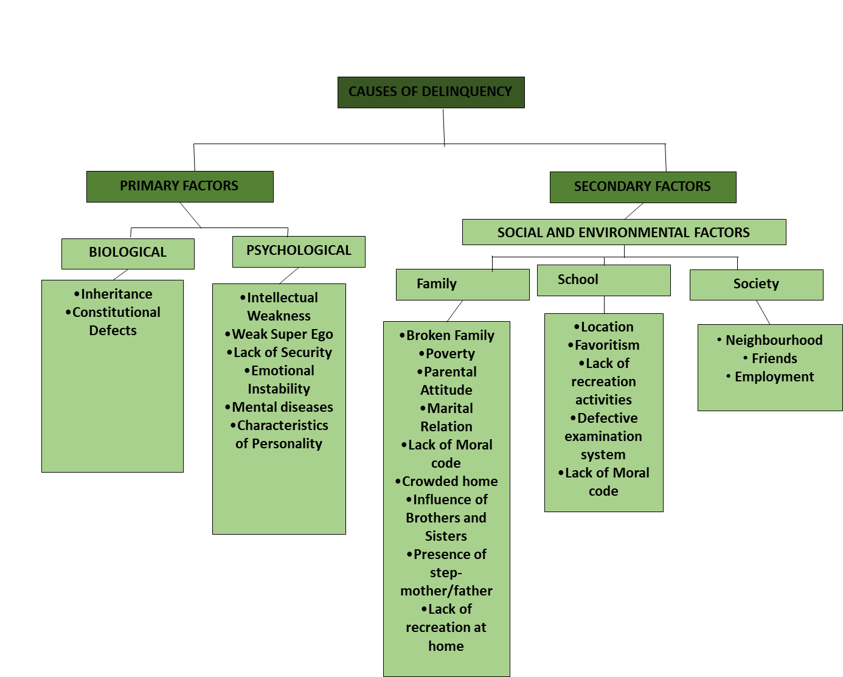
CAUSES OF DELINQUENCY:

Slide 8

Biological :
Inheritance:
In some of the scientific studies, it has been found that the heredity contributes for delinquency. The study of Dugdale reveals that heredity does play some part in bringing about delinquent tendencies. Lombroso, through a study of a number of criminals and their physical characteristics, established a truth that criminals are the product of heredity social forces, some of them beyond their control.thus,it can be said that the child inherits the tendency of delinquency from his heredity.
Constitutional defects:
These defects are like inborn mental deficiency, speed defects, deafness, blindness, brain injuries etc.in loss of control over behaviour.

Slide 9
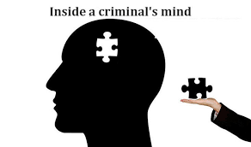
Psychological factors:
1. Intellectual weakness:
As these children cannot think systematically.
Weak super EGO:
Super EGO serves check on the behaviour of the individual when the child has no fear of being defected by anybody and has no inner check in inner self, child is easily lead to commit the anti-social acts.
3. Lack of security:
Emotional insecurity, lack of affection, inferiority feeling etc. Leads to the maladjustment and further delinquency behaviour.

Slide 10
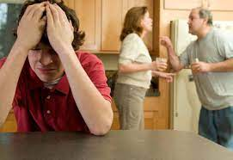
FAMILY AND HOME FACTOR :
  Broken Families :
  Child is not looked after properly and not brought up carefully. child becomes neglected and hence they adopt wrong ways and gradually child become delinquent.
  Poverty :
  Due to financial constraints the various needs of the child are not fulfilled even the basic need like hunger and education etc. That leads to the crime.
  Parental attitude or birth order :
  It is normally seen that elder child becomes the responsible child whereas the younger one becomes over-affectionate, but the middle one is neglected. Thus, birth also contributes to develop anti- social feelings in the children.

Slide 11
  Marital relation or Quarrels B/w Parents :
  It may so happen that due to frequent quarrel between the parents the child feels insecure, and his mental health is lost.
  Lack of Moral code :
  The character and morality of the child’s parents influences the child's personality to a very great extent. Mostly the child’s personality, conduct and character are considerably influenced by the personality.
  High Ambitions:
  Parents usually have high ambitions and expectations from their children which create confusion and inability to achieve and lead to delinquency.

Slide 12
  Discriminatory treatment :
  Sometimes parents care of one child more than the others, always insult a child in front of another child etc.. These acts crate jealousy and depression that leads to the delinquency.
  Discriminatory treatment :
  Sometimes parents care of one child more than the others, always insult a child in front of another child etc.. These acts crate jealousy and depression that leads to the delinquency.
  Influence of brother and sister:
  If the senior children in the family display criminal tendencies, the younger ones are bound to be influenced by those tendencies If the elder sister has indulged herself in immoral behavior, the younger sister will have little hesitation in following suits.
Presence of stepmother or father:
Sometimes orphans and some children are reared up by stepparents. They get rebukes and scolding from the stepparents. When these children face adverse situations, they develop feeling of insecurity.
Employed mother and father:
Many studies reveals that if the parents are in service and child is left in the care of servants, they are responsible for initiating young children to delinquent acts.

Slide 13

School Factors:
1. Location: Unhealthy and unfavourable physical environment of the school also contribute for developing anti-social tendencies.
2. Favouritism: The partial attitude on the part of the teacher creates hatred against the teacher. This attitude and feeling of the teacher result in permanent grouping among the children.
3. Lack of recreational activities: The present system of education gives more -emphasis on bookish knowledge. The school which do not have the recreational facilities create more delinquents.
4. Defective examination system : Bad examination are sometimes responsible for maladjustment among school children. Examination have no more the motivational effects.

Slide 14

Society Factors:
1.Neighbourhood: Defective environment around the home like presence of gamblers,drunkers,gambling dens etc.
2. Friends: Company of other delinquent and maladjustment children who have bad habits like smoking, stealing,gambliing, drinking etc. Also results delinquency. Child wants to earn money very easily and quickly that’s why he/she indulges in delinquent acts.
3. Employment : If the small children are doing some work/ employment due to family financial conditions then their repressed feelings may lead to the delinquent acts. On the another side of the adolescents are not properly employed or engaged in some works, they are also likely to take stealing or immoral acts.

Slide 15
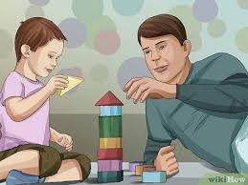
PREVENTIVE MEASURES:
Well-Adjusted Home Life: A well adjusted home provides a solid Bond of affection between parents and children.
(a) Proper atmosphere in the home: The parents should pay special attention to create good atmosphere in their homes.
(b) Adopting right attitude towards the bad habits of the child: The parents should be impartial and justify to all of the children . They should neither be too strict nor too loose to their children.

Slide 16
2. Adequate schooling: The school comes next to home which effects the personality of the child
a).Trained teachers: There is a great need for good and trained teachers with high moral character They should treat all of their students with sympathetic attitudes.
b). Child centered : Education should be imparted according to child’s interest and abilities . Opportunities should be provided to the children to proceed according to their own rate and pace.
C).Library facilities: Children should be encouraged to read many other good books than their textbooks.
d).Recreational facilities: The children should provide healthy recreational by the school If the school cannot provide such facilities, children try to search for them outside the school.
e). Parent-Teacher Relationship : A coordination between homes and school should be obtained . The teacher should put the problems of the students before their parents.
3) Role of state and social Agencies:
a). The state and social Agencies should establish good schools.
b). The children of poor parents should be imparted free education and the state should own the responsibility for the fulfilment of their needs.
d).Good children's films should be produced.

Slide 17
EDUCATIONAL PROGRAMME OF THE DELINQUENT CHILDREN:
PROBLEM SOLVING: The teachers should be prepared to solve the problems of the students psychologically.
2. MOTIVATE: The children should be motivated by the teachers.
3. VARIETY OF EXPERIENCE: Provide a child with a variety of experiences-craft, art, music, athletics, covering a wide range of difficulties and interests can serve the purpose.
4. UNHEALTHY SURROUNDING: It is necessary to take the child away from the unhealthy surroundings.
5. PROPERLY ORGANIZED AND SUPERVISED ACTIVITIES :Proper use of leisure time should be made through properly organized and supervised activities. Play and recreation cannot only prevent delinquency among children but also improve their physical and mental health.

Slide 18
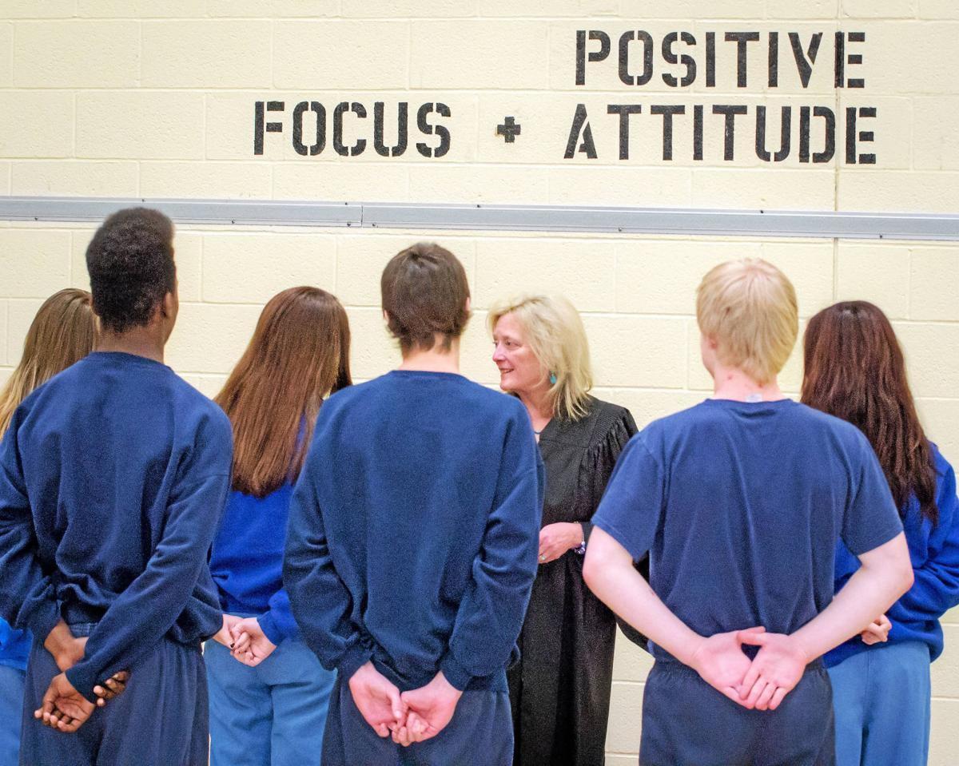
6.AGE,ABILITY AND LEVEL OF UNDERSTANDING: Teacher should teach according to the age, ability and level of understanding of the students. He should keep pace with students' needs
7.AUDIOVISUAL AIDS AND LIBRARY FACILITIES: Audiovisual aids and library facilities should be used to make lessons more interesting
8. GUIDANCE AND COUNSELLING: Educational, personal and vocational guidance programmed should be started. Counselling facility should be available
9. DEMOCRATIC ENVIRONMENT: Teacher should try to maintain democratic environment in the class and school.
10. MEDICAL CHECK UP: Medical check-up should be arranged periodically for diagnosing physical defects, deformities and diseases among students.

Slide 19
Conclusion:
All children due to their age are considered to be risk at for exploitation , abuse , violence and neglect . But vulnerability cannot be defined simply by age . Though age is component , vulnerability is also measured by the child’s capability for self – protection .
Now the question are : Are children capable of protecting themselves?
Can children provide for their basic needs , defend against a dangerous situation or even recognize a dangerous situation is developing ?
Here , governmental legislation plays a great role for taking care of protection of children and child rights .
A child’s vulnerability comes from various factors that hinder a child’s ability to function and grow normally . UNICEF view vulnerable children are those who are abused , exploited , and neglected . Child protection is derived out of the duty to respond to the needs of vulnerable groups of children .
Prevention / intervention programs for at risk youth will not eliminate crime but can be reduced it and will bring benefits to both society and the juvenile .

Slide 20
Thank you

