Slide 1

CREATIVE
CHILDREN

Slide 2

INTRODUCTION OF CREATIVITY
Creativity is the ability to generate , create or discover
new ideas ,solutions and possibilities. Although Creativity
is often associated with the arts , it is actually a vital form
of intelligence that drives people in many disciplines
to discover something new .
Creativity happens when someone comes up with a
creative idea. Very creative people often have intense
knowledge about something, work on it for years ,
look at novel solutions , seek out the advice and help of
other experts , and take risks .

Slide 3
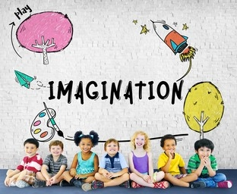
Creativity is the phenomenon of thinking beyond
the set boundaries and attempting to resolve
issues by original and unconventional ways . It is
one’s ability to make new things , generate new
ideas or unusual ways of doing things .

Slide 4


MEANING OF CREATIVE CHILDREN
Creative Children meaning stands
for the ability or capacity of a child to
produce something in a creative way.
Finding new ways of solving a problem, sometimes without using
logic .
Being Independent and Unconventional .
Creativity means seeing or expressing new relationship among
things or ideas .
Creativity emerges from Divergent Thinking .
That means thinking that moves outward from conventional solution
or knowledge or wisdom into unexplore path and unconventional
solution in an effort to develop novel solution to a problem .
Creativity is an activity resulting in new product of a deficit social
values .
Creative Children have ability to see things in a new way , to see
problem that no one else may realize exist and then they come up
with unique ideas and effective solution .

Slide 5

DEFINITION OF CREATIVITY
Barron’s view , “Creativity may be Defined quite simply as the
ability , to bring Something new into Existence”
Guilford’s view , “Creativity refers to the abilities that are characteristic of
creative people. Creative Behaviour is always Novel and Exploratory . Thus,
creativity refers to the abilities of individuals to create or produce results of
creative nature.”
Drevdahl’s view , “Creativity is the capacity of a person to produce
Compositions , Products or Ideas which are essentially new or novel
and previously unknown to the Producer.”

Slide 6

CHARACTERISTICS OF CREATIVE
CHILDREN
Creative Children have the ability to transfer learning or
training from one situation to another .
Creative Children have the ability to accept tentativeness
and to tolerate and integrate the opposites .
Creative Children are aware of their Obligations and
Responsibilities .
Creative Children have the ability to take independent
decisions. They take quick decisions
irrespective of others point of view .

Slide 7
      Creative person is aware of the problems present
      in his circumstances and he is commited towards these
      problems . He makes every effort to find out new
      solutions to these problems .
Creative person has ability to go beyond the immediate
circumstance and shows novelty in thinking and behaviour .
Creative persons are always ready to adopt new attitude ,
ideas or behaviour . It is this flexibility which paves way
for his success .

Slide 8
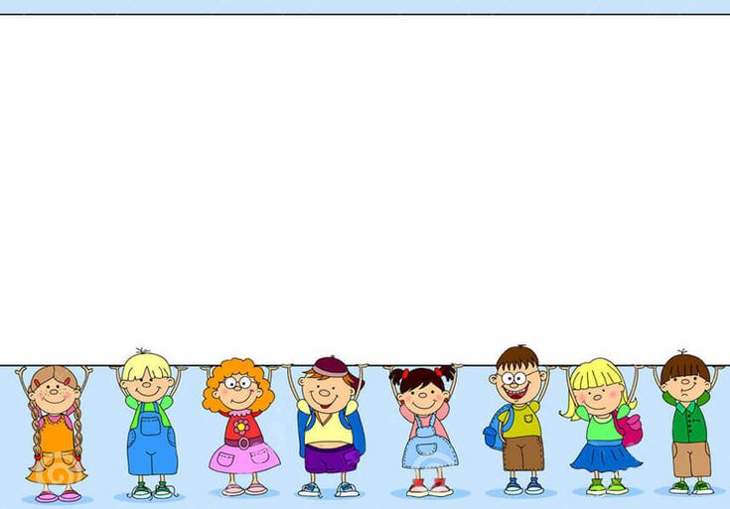
IDENTIFICATION OF CREATIVE CHILD
Imaginative Power --
Imagination plays a very important role in the creative development of a child.
Fantasies and imaginary worlds are the first steps to creativity that your child takes.
self disciplined --
Children are often out of control. They need to be disciplined and catered to most of the
time in normal cases. But creative children need less outside control because they are
self-disciplined. They are often seen to be fond of order and consistency.
Good Reasoning Abilities --
If your child is creative, you will notice that he will be capable of solving problems
and finding unique solutions because of his or her extraordinary reasoning power.

Slide 9
Originality in Expression --
Even if your child happens to be exposed to certain factors and sources of influence,if
he or she tends to show originality in his or her expression, in whatever sphere in may
be,there is no denying the fact that he or she is creative. Originality stems from
imagination and gives birth to creativity.
Interest in Arts and Painting --
If your child shows his or her interest in different spheres which are not necessarily
related to academics , such as arts, painting and music he is more inclined to be a
creative person. If he or she still continues to excel in studies, he or she is extraordinary.
Even if he or she does not, his or her level of giftedness is no less.
Emotionally Secure and Stable --
One of the most common signs of creativity in a child is his or her mental stability.
Because of their depth of focus and self-discipline they tend to be emotionally strong
all the more.

Slide 10

Problem of Day Dreaming
Conflicting Opinions
Higher rates of mood disorders such as Depression
and Anxiety
There is little encouragement for curiosity
These Children may not be motivated by Grades
DIFFICULTIES FACED
BY
CREATIVE CHILDREN

Slide 11
We lack a Reward System for Creative
They have heightened level of Stress Hormone
Things are too Easy or too Hard
Wanting to Work Alone
Nearly no Individualized learning opportunities
Nearly no Individualized
learning opportunities
DIFFICULTIES FACED
BY
CREATIVE CHILDREN

Slide 12

WAYS & MEANS OF NURTURING
CREATIVITY IN CLASSROOM
Providing Liberty to Respond:-
The students should be provided with liberty to respond.they should be
encouraged to think about as many ideas as can and motivate them to make a
particular sort of novel expression.
Helping to Remove Hesitation:-
The students should be persuaded by the teachers
and parents to have free expression of thought. They should be encouraged to
express ,how they think and feel without any hesitation.
Involvement of Ego of the Student :-
The feelings like “it’s my creation” or “I have done it” etc
give much satisfaction to children. Therefore we must involve
the ego of the students in all tasks so as to encourage their creative children.

Slide 13
Developing Healthy Habits among Children:-
Certain qualities such as, industriousness, Persistence,Self reliance or
self confidence etc Are helpful in creative output.Moreover they should
be encouraged to Stand up against criticism of their creative expression.
Avoiding Blocks for Creative Thinking:-
Factors such as anxiety,Conservation,faulty methods of teaching,
authoritarian attitude of teachers and parents etc are known as blocks to
creative thinking.therefore teacher and parents Should try to avoid such
factors in upbringing And educating the children.
Providing Appropriate Opportunities and Atmosphere for Creative
Expression:-
For the stimulation and nourishment of creativity , a healthy and cognial
atmosphere is essential . Children have creative abilities in them but they are
not taken into consideration . They need sympathetic atmosphere in schools
as well as at home.

Slide 14
Proper Organising of the Curriculum :-
The curriculum should be so designed as to foster creativity among the
students . The various learning experiences of the curriculum should be
based on concepts rather than facts . It should also be quite flexibleand
have provision for studying and working without the threat of evaluation.
Modification in the Evaluation System :-
Our education system requires a tremendous change as it is totally
examination centered . It emphasizes on rote learning , fixed and rigid
responses based on convergent thinking , which does not leave any
scope for the development of Creativity . Therefore , proper paper
evaluation system should be adopted for encouraging complete and
balanced experiences in developing the Creative Potential of Children .

Slide 15

SOME SPECIAL TECHNIQUES FOR
FOSTERING CREATIVITY
Gaming Technique.
Brainstorming Technique.
Group Discussion Technique.
Using Teaching Models.
Quiz.

Slide 16

CONCLUSION
Creative Thinking, has become a fundamental life skill . It
can be very helpful in a professional setting to get a job .
Through Creativity, people become job creators rather than
job seekers .Additionally success and satisfaction can be
replicated in other spheres of life too. Creativity should be
infused within every part of the curriculum , as it plays a
vital role in the development of a country as well
as an individual . Creative activities increase
comprehension .Therefore , creativity
should be encouraged among learners in
schools .Make sure to provide platform , to
help children reach the level where they can
“ CREATE ” .

Slide 17
Submitted By :-
TUTORIAL 5
Jashandeep Kaur
Amanita
Neha Kumari
Shaweta
Manpreet Kaur
Priyanka Verma
Chamanpreet Kaur
Shakshi
Submitted To :-
Dr. Rupinder Brar
Dr. Gunwant Kaur

Slide 18
Thankyou

