Slide 1
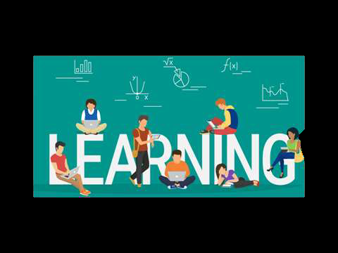
CONCEPT OF LEARNING

Slide 2
INTRODUCTION--Learning
Focus of all educational Programmes
Aim of education is to bring desirable change
Our personality, traits result of learning
It is cumulative improvement
Growth and improvement through experience

Slide 3
Learning - Meaning
A relatively permanent change in behaviour,
which occurs as a result of activity, training, practice or experience.
Learning is:
  An experiential process
  Resulting in a relatively permanent change
Not explained by temporary states or injury.

Slide 4
MEANING WITH DEFINITION
a) learning as a process
b) learning as a change in behaviour
c) learning as retention and acquisition
d)Learning as an enduring change
Definition
Gardner Murphy -
“The term Learning comes with every modification of behaviour to meet environment requirements.”

Slide 5
Three Limits on the Definition
The change that occurs during learning is a potential for behavior that depends on other conditions.
Learning is not always a permanent change.
  What can be learned can be unlearned.
Changes also occur for other reasons – maturation, motivation.

Slide 6
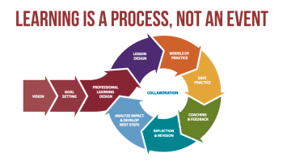

Slide 7
CONCEPT
Key concept in human behaviour
Axiom of all teaching and learning
Relatively permanent change in behaviour
Change takes place through experience, growth, maturation.

Slide 8
CONCEPT
Learning situation are most natural and common in life and everyone of us is learning one thing or the other, although he may not necessarily aware of it.
An individual starts learning immediately after his birth.
The behavior of an individual is changed through direct or indirect experiences.
This change in behavior brought about by experience is commonly known as learning.

Slide 9
CHARACTERSTICS OF LEARNING
Learning is the modification of behaviour
Learning is purposive
Learning is a universal phenomenon
Learning is progressive and developmental
Learning is transferable
Learning includes all three aspects of human behaviour
Learning is related to performance
Motivation is the key concept in learning
Learning is a process not a product.
Learning is a continuous life long process.
Learning is a universal process.

Slide 10
CHARACTERSTICS OF LEARNING
Learning involves reconstruction of experiences.
Learning is the product of active responding to the stimuli in teaching learning environment.
Learning is transferable from one situation to another.
Learning does not necessarily imply improvement.
Learning does not necessarily imply the development in right direction.
Learning helps in bringing desirable changes in behavior.
Learning helps in the attainment of teaching learning objectives.
Learning helps in proper growth and development.
Learning helps in all round development of personality.

Slide 11
Importance of learning
Teaching can be made effective
Teaching objectives can be identified
Effective teaching aids may be selected
Selection of teaching strategies and tactics
Learning situations may be created

Slide 12
RELATION BETWEEN TEACHING AND LEARNING
Teaching causes learning
Close relation between components of learning and teaching process
One is the means other is the end
Teaching principles are based on learning principles
Theories of teaching are based on learning principles
Observation is possible
Both are goal oriented
Both are related to the place where they conducted
Both are conscious and unconscious process

Slide 13
Teaching causes learning
Teaching is the stimulation and direction of learning.
Teaching learning process is the process of effective learning.
Helping the child to learn.

Slide 14
Close relation between components of learning and teaching process
Deliberate attempt to make learner acquire
May not result in learning
But produces learning

Slide 15
One is the means other is the end
Teaching is the means and learning is the result
Whenever we plan system of teaching, some learning objectives are set

Slide 16
Teaching principles are based on learning principles
Separate principles but both depend on each others
Teaching takes the help of learning principles, learning takes the help of teaching principles
Eg. Well planned, democratic, sympathetic and cooperative.

Slide 17
Theories of teaching are based on learning principles
No of theories in learning: trial and error theory, conditioning theory, insight theory etc
Learning is goal oriented, motivated by adjustment, active and creative etc.
These principles helps in teaching.

Slide 18
Observation is possible
Teaching can be observed by learning
Learning can be observed with tests etc

Slide 19
Both are goal oriented
Teaching is always a goal oriented
Learning takes place with the goal of teaching

Slide 20
Both are related to the place where they conducted
Democratic administration
Teaching in democracy
Learning in democracy

Slide 21
Both are conscious and unconscious process
Teaching affects directly and indirectly
Learning also directly and indirectly

Slide 22
Teaching Principles based on learning Principles
Good teaching involves guided learning
Good teaching is kindly and sympathetic
Good teaching is well planned
Good teaching is cooperative
Good teaching is suggestive
Good teaching is democratic
Good teaching is stimulating

Slide 23
Teaching Principles based on learning Principles
Good teaching involves past experiences of the children
Good teaching is progressive
Good teaching is remedial
Good teaching diagnosis difficulties
Good teaching liberates the learners

Slide 24
To conclude..
Knowledge is imparted
Undesirable traits and tendencies are curbed
Good teaching is of guiding and directing
Encourage towards learning
Suggestions rather than command
Good teaching opens up investigation, introduces new materials, procedures and aids

Slide 25
To Conclude..
Kindness and sympathy
Good teacher knows about their immaturity
Create homelike and pleasant atmosphere
To understand each child
To affect the students attitudes and tempraments

Slide 26
CONCLUSION
Therefore:
TLP is an important part of educational process
It is the stimulation and direction of learning
Development of knowledge, skills and attitudes
Overall effective adjustments and training of emotions

