Slide 1
Art in EDUCATION
Meaning, Concept,
Aims & Objectives,
Importance
For B.Ed . Ist Semester Students
(Punjabi University)
By
Ms. Sarita Gulati
Librarian
Shivalik Institute of Education and Research, Mohali

Slide 2
Introduction
Art in education means integration of arts in education. Arts integration is an approach to teaching and learning through which content standards are taught and assessed equitably in and through the arts. (Art Integrated Learning is “education through the arts, where learning takes place using different arts forms as tools in the teaching–learning process”.)Schools need to develop a balanced school curriculum so as to provide an all-round education for their students. Arts education is one of the five essential areas in the overall aim of education set out by the Education Commission to enable every person to attain all-round development in the domains of ethics, intellect, physique, social skills and aesthetics according to his/her own attributes so that he/she is capable of life-long learning, critical and exploratory thinking, innovating and adapting to change.

Slide 3
Art Education is a
primary pathway/way to learning
an expression of ideas created by students imagination, skill and invention.
There is a saying “Music is what feelings sound like”. Similarly this applies to other art forms. Movement manifests emotion, voice modulation gives way to the inner self, drawing reveals the inner layers of the mind, Sculpture mirrors the inner self. This is Art education . This is why we need Art education .
It focused on:
  lHow to improve teaching and learning through arts.
  How to transfer learning in and through the arts to other disciplines.
  Discovering and creating understanding of human learning especially through Art Experiences.

Slide 4
Art integrated learning is a way to teach artistic skills in conjunction with academic material. Art in Education ensures harmonious development of the individual to bring forth his abilities, his innate talents and his facilities and instincts. It is complementary to the bookish knowledge, it supplements the intellectual activities of the students and also widens their sense of appreciation and development of aesthetics in child .
The children comes to know that what are the things which are to be appreciated and how the abilities or instincts can be enhanced in the children.

Slide 5
Definitions
According to Heather Watts, Arts education is a big part of building a 21st century creative mind.”
According to Josh Groban “Arts education enhances leadership skills and help raise grades in school children”.
According to Gandhi ji’s philosophy, Art in education is a harmony between the soul and the outer appearance of our young students.
So to sum up we can say Art in education is of great importance for children’s all round development. Their intellectual, psychological, educational and moral development is ensured by art. Their power of invention, proportion, harmony in life is also encouraged with arts. Through art in Education School can certainly change enormously the power to express and direct the emotions.

Slide 6
Aims and Objectives of Art in Education
When children are small they want to be an astronaut, doctor, teacher or any other successful person. These wishes are the aims of a person’s life which he/she want to achieve in the lifetime. The word aim is often misconstrued with objective, as they talk about what an individual or entity may want to achieve. Both are the desired result of the work performed by an individual, however, they entail different concepts. The aim is the general statement of the expected outcome. In contrast, objectives are the steps taken to accomplish the long-term goals. Every subject taught to the students has their own aims and objectives.
The school uses a variety of teaching and learning styles in teaching various lessons. Their principal aim is to develop the children’s knowledge, skills and understanding and these aims can be fulfilled by making learning more interesting and permanent by incorporating art in education that is why art in education have the following aims and objectives:

Slide 7
1. To Increase Engagement: Unlike textbook learning, which can get monotonous and routine, art in education engages learners in new ways. Whether they are observing a drawing/painting or creating one of their own, they are required to be fully immersed in the activity. Art in education also helps in increasing the fun element of learning.
2. To Improve Quality of Learning: As the children are more engaged, it has a positive impact on the quality of learning. Because of greater participation, the learning’s remain in the minds of children long after they exit the classroom. Furthermore, studies have shown that art integration not only helps in improving engagement among children, but also has a noticeable effect on their academic achievements.
3. To Boost Creativity: To succeed in today’s times, creativity is a must-have skill. Not all kids are inclined towards art. For those who are not interested in art, integration of art into learning can be a good introduction to creativity.
4. To Increase Confidence: Whether its painting or drawing or coloring, engaging in these activities provides children with a creative outlet to communicate their feelings. Also creating a piece of art, even if it’s a simple drawing, gives a sense of fulfillment and achievement. Thus, integrating art into learning reduces the fear of failure among kids and encourages them to take more risks. While mastering a subject certainly builds a student’s confidence, there is something special about participating in the arts. Getting up on a stage and singing gives kids a chance to step outside their comfort zone. As they improve and see their own progress, their self-confidence will continue to grow.

Slide 8
5. To Develop of Motor Skills(movement of muscles , ability to "feel" or sense): This applies mostly to younger kids who do art or play an instrument. Simple things like holding a paintbrush and scribbling with a crayon in classrooms are an important element to developing a child’s fine motor skills. According to the National Institutes of Health, developmental milestones around age three should include drawing a circle and beginning to use safety scissors. Around age four, children may be able to draw a square and begin cutting straight lines with scissors.
6. To Enhance Visual Learning: Drawing, painting, and sculpting help to develop visual-spatial skills among students. Art in education teaches students how to interpret, criticize and use visual information and how to make choices based on it.
7. To Promote Decision Making: The arts strengthen problem solving and critical thinking skills. How do I express this feeling through my dance? How should I play this character? Learning how to make choices and decisions will certainly carry over into their education and other parts of life—as this is certainly a valuable skill in adulthood.
8. To Teach Perseverance (keep trying): Arts can be challenging sometimes. When students try to learn and master new things, there are times when they became so frustrated. After practicing hard to do that, they learn that hard work and perseverance pay off. This mindset will certainly matter as they grow—especially during their career where they will likely be asked to continually develop new skills and work through difficult projects.

Slide 9
9. To Improve Focus: As you persevere through painting or singing or learning a part in a play, focus is imperative/important and a necessity. And certainly focus is vital for studying and learning in class as well as doing a job later in life.
10. To Create Collaboration: Many of the arts such as band, choir and theater, require kids to work together. They must share responsibility and compromise to achieve their common goal. Kids learn that their contribution to the group is integral to its success—even if they don’t have the solo or lead role.
11. To Value Accountability: Just like collaboration, kids in the arts learn that they are accountable for their contributions to the group. If they drop the ball or mess up, they realize that it’s important to take responsibility for what they did. Mistakes are a part of life, and learning to accept them, fix them, and move on will serve kids well as they grow older.
12. To Promote Personal Development: Students pick up important life skills from art in education such as better memory, enhanced understanding and an ability to communicate symbolically. It can enhance a student’s drive to succeed and the ability to take on new challenges.

Slide 10
13. To Develop aesthetical values and judgments: Art in education helps us enjoy the beauty of our daily life. It has an importance which is immeasurable: From food to clothes to houses to festivities...all have various aesthetic expressions and impacts. It helps the students in Appreciation and experience the beauty of the universe. It Bring them closer to the environment. It helps them Appreciate of ones cultural heritage and Inculcate respect for each other in their behavior.
14. To contribute in child Cognitive Stimulation: Art in education has been linked to advanced cognitive development in children. In a 1998 report, “Young Children and the Arts: Making Creative Connections,” researchers found that art in education can contribute significantly to a child’s cognitive( perception: visual and audio, attention, logical memory), language and motor skills.
15 To enhance Personal profile and growth: There are Varied options of profession. These are taught in schools starting from kindergarten, primary and secondary schools and are also choices in higher levels of education such as universities. With enhanced aptitude in art students can successfully pursue so many professions like teachers in colleges and universities, commercial artists, actors/actress in theatre or television serials, educators, professional singers and dancer’s architects, cosmetic surgeons, designers, interior designing, and film world and so on.

Slide 11
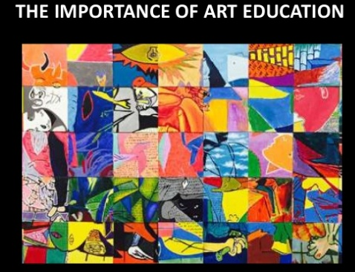

Slide 12
Importance of Art in Education
Art in education helps the students establishing their goals, and ultimately, enjoy doing everything to make those goals a reality. Following are the importance of art in education:
1. Enriches the curriculum: Art in education enriches the curriculum. It complements the pupil's own arts education and support learning in other curricular areas.
2. Gateway to the arts: Art in education is an important gateway to the arts. It provide a safe and nurturing environment where students are given a chance to explore and fully develop the skills of singing, dancing and acting, while establishing friendships, making connections and truly gaining a sense of self.
3. Life-enhancing pleasure: Art in education assist schools in addressing their responsibility to reveal to young students the life-enhancing pleasure to be derived from high-quality arts experiences.
4. Development of life skills: Art in education develops creativity, critical thinking, imagination and communication skills and nurture aesthetic sensitivity and cultural awareness among kids.

Slide 13
5. Nurture values :Art in education develops arts skills, construct knowledge, and cultivate positive values and attitudes.
6. Gives pleasure : Students gain delight, enjoyment and satisfaction through participating in arts activities.
7. Life long interest : Art in education develops lifelong interest in the arts. It help children learn constructive ways to describe their feelings, thoughts and experiences. It also introduce children to different worlds, cultures and ways of thinking. Art teaches problem-solving because with art, there’s always another solution, another answer. Art in education teaches exploration , thus making the students lifelong learners .
8. Makes knowledge interesting :Art makes knowledge interesting by Correlating with other subjects and makes other subjects easy, that also leads to mental growth.
9.Give practical training :Gives Practical and manual training to young minds. It increases self-esteem and presentation skills, strengthens concentration and memory, broadens expressive communication and animates the body, mind and spirit!

Slide 14
10.Art is important for a child’s future : Children who study the arts demonstrate stronger in academic performance . Integration of Arts in education help prepare students for the twenty-first century • Children involved in the arts are creative thinkers that world need in our increasingly complex workforce.
11. Art helps the development of the human brain: “New neural connections that make it possible for us to learn and remember and problem-solve and create can continue to form throughout life, particularly when human beings are in environments that are positive, nurturing, stimulating and that encourage action and interaction. Such environments are opposite from dull, boring, rigid environments in which students are the passive recipients of information. Well designed arts programs provide just the kind of environments in which student grow/flourish.
12. Arts improve child’s behaviour : Using arts to teach academic subjects results in improved understanding of the content and greatly improves regular behaviour. Art allows students to express thoughts, feeling, and hopes. It helps children to feel good about the world and about themselves.
13. Arts gives Confidence: A student who participates regularly in the arts develops self-esteem and confidence because of their ability to accomplish something that they enjoy and that satisfies them . They see themselves as capable of doing work that is personally satisfying and publicly acknowledged.

Slide 15
14. Students sharpen critical intellectual skills: The arts foster higher levels of thinking that carry over to learning other academic subjects as well as to life outside of school. Through the arts, children learn to observe, interpret, see different perspectives, analyze, and synthesize. In a world where students must frequently wade through a sea of information to determine which facts are trustworthy and relevant to a particular topic, critical thinking skills are key to lifelong learning.
15. Aesthetic learning is its own reward: The arts teach young people about beauty, proportion, and grace. Students can examine conflict, power, emotion and life itself. The power of the arts is in its wondrous ability to give us joy, help us understand tragedy, promote empathy .
16. Students practice teamwork: Art-making allows students to experience what it feels like to be active members of a community and to work as a team to determine and achieve common goals. In developing a theatrical production, group performance, or any type of collaborative artistic endeavour, students practice the fine art of teamwork. As they work together, they learn to understand differences and diversity and realize the ways that teamwork contributes to a great performance. By also teaching students how to live and work together, the arts contribute to making schools safer and more peaceful learning environments. In the arts, students learn to articulate their intentions, receive and offer constructive criticism and listen actively to others’ ideas.
17. Arts education increases capacity for leadership: Students who participate in the arts develop leadership skills, including decision-making, strategy building, planning and reflection. They also prepare to use these skills effectively by developing a strong sense of identity and confidence in their ability to affect the world around them in meaningful ways.

Slide 16
18. Visual Learning: Painting, sculpting, and drawing are considered to be great to develop visual learning in young kids. Researchers have highlighted the impact of the arts. Therefore, children shouldn’t be confined to text and numbers. Painting and drawing things on a paper helps them learn a lot about this world.
19. Educational Performance: Art isn’t just great for developing creative skills, but it plays an important role in helping your child gain manifold academic achievements. He begins to perform well in all subjects and extracurricular activities. Today, kids have started paying more attention to technological gadgets such as mobiles, tablets, and computers. They seldom take part in physical activities. Arts pave their way to perform better in study-related activities. Challenges: There can be more than a few challenging situations while creating art. Young kids learn to tackle such challenges and devise strategies to solve the problem. Life is full of trials and tribulations. Arts play its part to prepare students for the upcoming challenges.
20. Persistence: Determination and consistency can help you achieve anything in life. Although many other subjects play their role in this regard, yet arts has an exclusive to develop persistence in students of all levels.

Slide 17
21. Creativeness: We can’t imagine a child to become creative without having art skills. Although art may look like a dull activity, yet it has no parallel when it comes to becoming more creative. This particular branch of study helps children in expressing themselves more than other subjects such as science and math. Art is considered to be a great source of improving thinking creativity in kids of all ages. Therefore, creativity is a significant reason why arts education should be emphasised in schools.
22. Attention to Detail/make children attentive/focussed: Arts integration in school is also important because it helps kids develop attention to detail. They focus on each and every step while drawing something on a paper. Things like acting, singing, and painting improve focus. They start to pay attention from an early age, which is imperative for a successful didactic career. This is a key skill that helps kids succeed in their educational, personal, and professional lives.
23. Decision Making: Kids having an interest in arts strengthen critical thinking and problem-solving skills. You can imagine a student deciding to express their feelings in a particular character. They learn a lot about decision making while drawing paintings and performing the dance at the stage. Studies have shown that arts play a vital role in reinforcing the decision making process. It becomes easier for students to opt for the best option from given choices. That’s the reason why arts integration in schools is imperative.

Slide 18
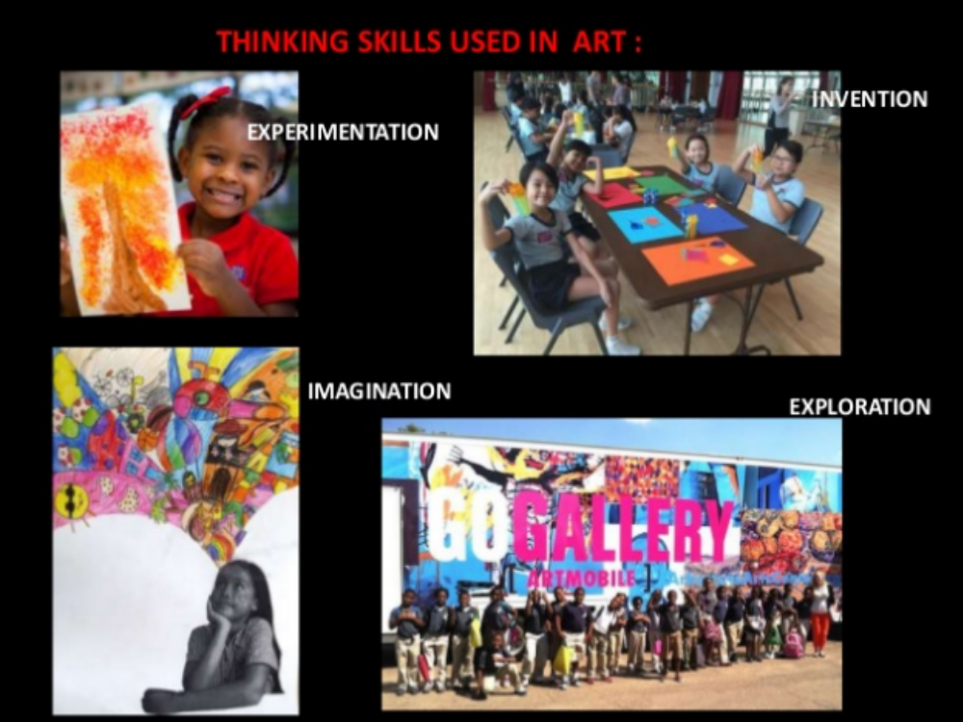

Slide 19
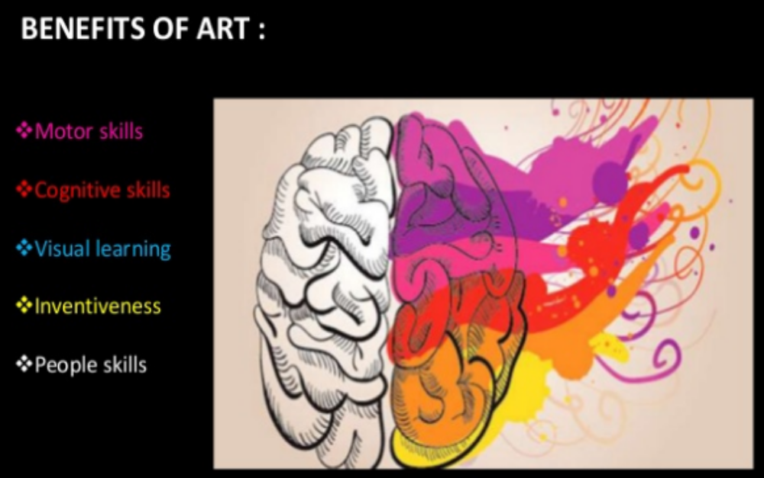

Slide 20
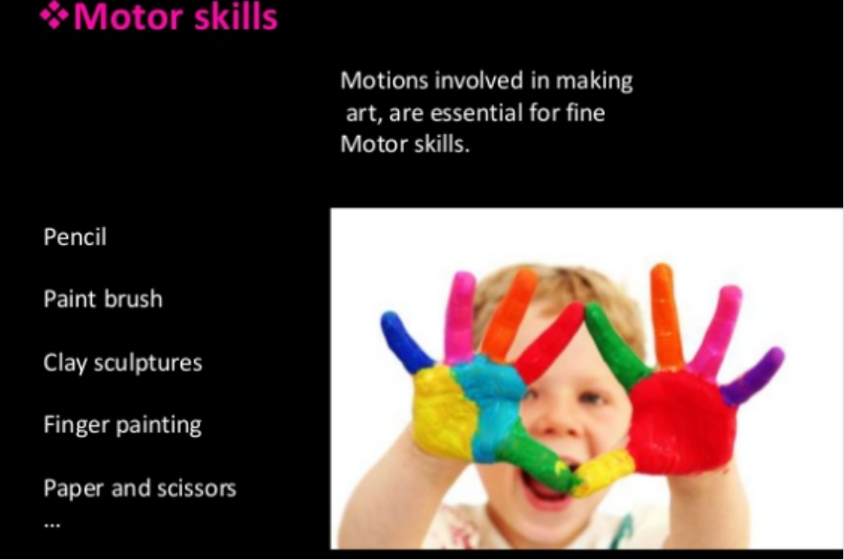
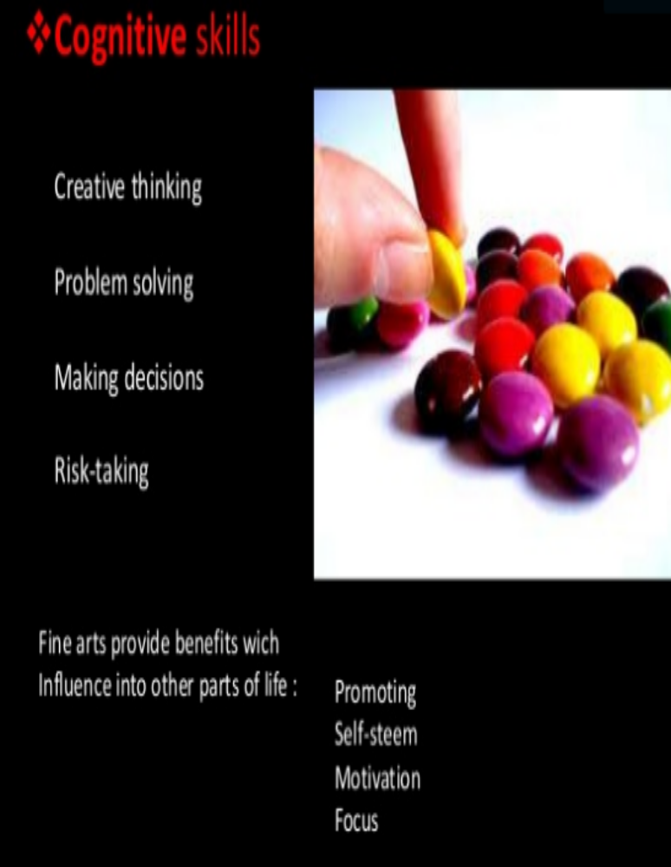

Slide 21
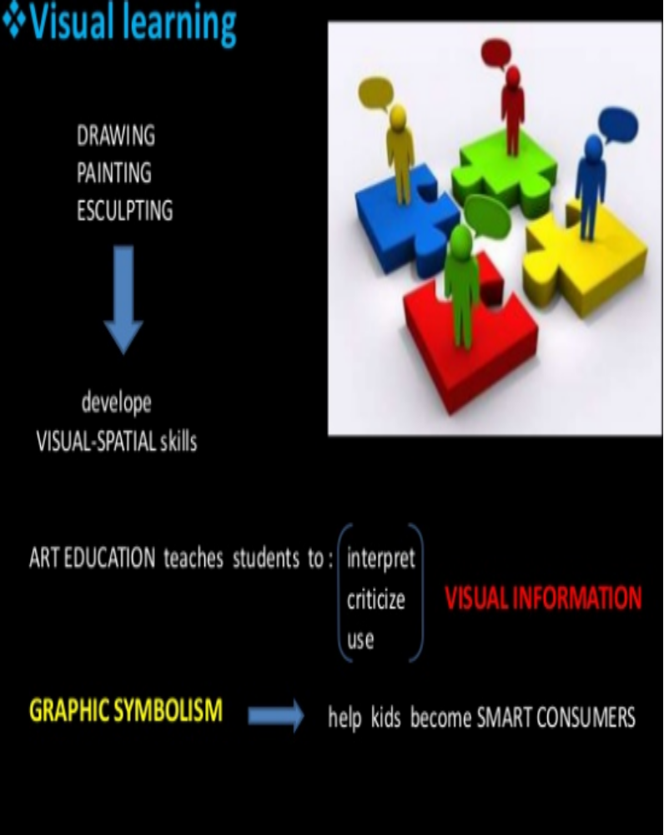
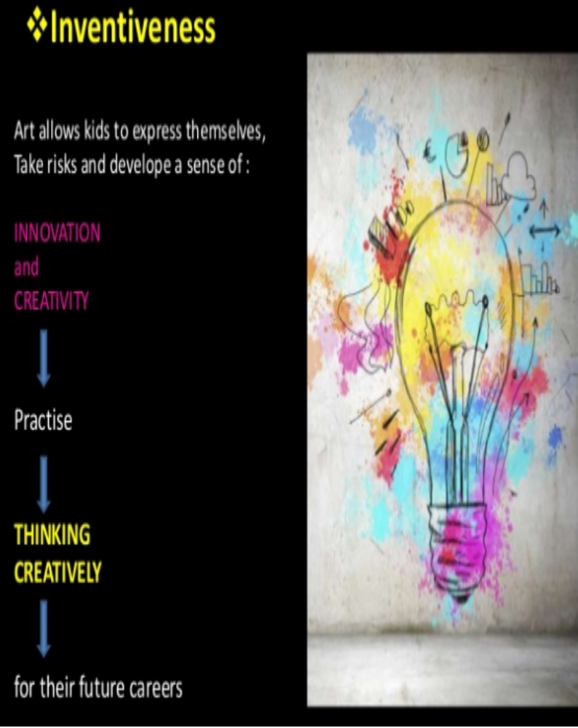

Slide 22
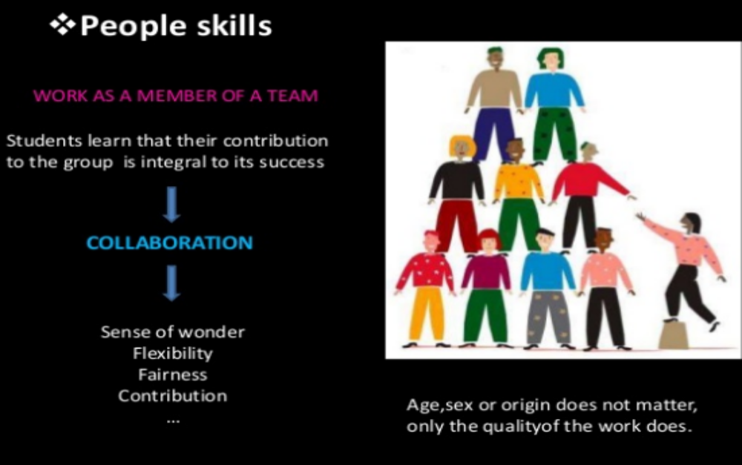

Slide 23
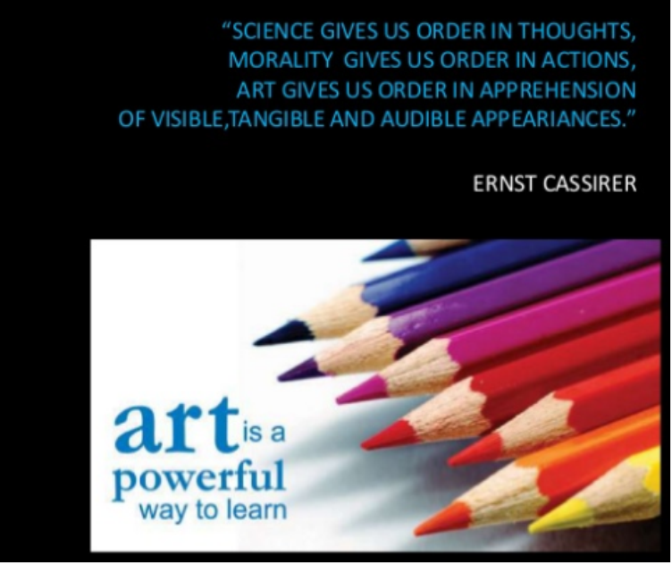
“Art is as natural as sunshine and as vital as nourishment.”
Art, in its many forms, is a necessity of life. It is beneath the building structure of anything and everything. A life and a world without art would be dull and quiet. Arts used to have a big share in the academic field & have a lot of benefits. Students who studied arts developed some of the most productive skills to perform better in their lives. However, arts integration in schools can revive the golden learning era and improve students’ lives for the better.

