Slide 1



Multimedia Courseware

Slide 2
MULTIMEDIA (MULTI + MEDIA)
Multi means Many, Multiple and Media is a distribution tool & information presentation tool – text, graphic, voice, images, music etc.
So multimedia means using more than one media element i.e. Sound, Text, Video, Graphics, Animation.

Slide 3

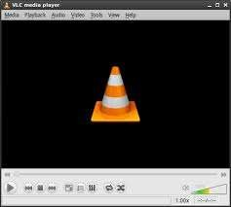


Multimedia
Multimedia is a combination of text, sound, graphics, video, and animation delivers by computer or any other electronic media. Elements of multimedia are:
Text
Image
Sound
Animation
Video

Slide 4

Text
GRAPHIC
VIDEO
AUDIO
ANIMATION

Slide 5

Text
Text is the most basic element of multimedia .All multimedia contains some amount of text. A good choice of words could help convey the intended message to the users.The text can have different font and size. .

Slide 6

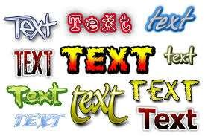
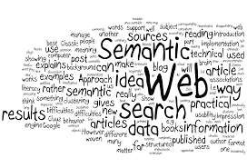








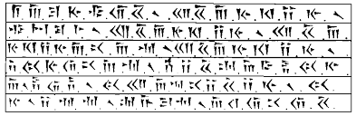
TEXT

Slide 7







Image/Graphics
A Picture means a thousand words
It is important and interesting component of multimedia. It is one of basic fact in multimedia is that people do not like reading large amount of text information . So graphics are used to make better presentation . Image can be created by using paint program or by scanning photograph.
Image

Slide 8



Sound
In multimedia, audio could come in the form of speech, sound effects and also music.

Slide 9

Animation
Animation makes static presentations come alive. In multimedia, animation is used to further enhance / enriched the experience of the user to further understand the information conveyed to them.
This makes it possible for a series of images that are changed very slightly and very rapidly, one after the other, to seemingly blend together into a visual illusion of movement.
Notes:
to create an illusion of movement when the film is shown as a sequence.

Slide 10
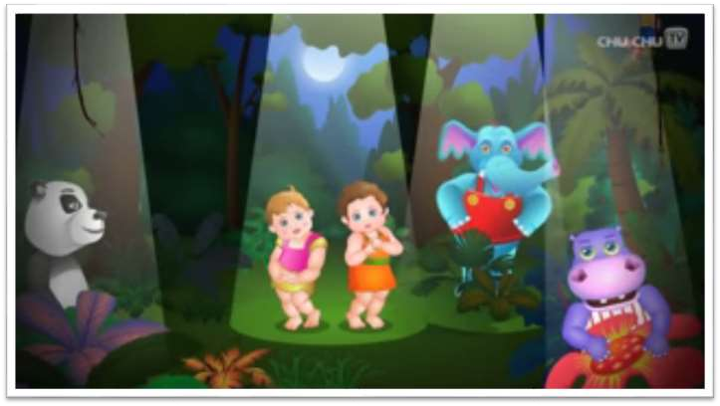
Video
It is the technology of capturing, recording, processing, transmitting and reconstructing moving pictures. Video is more towards photo realistic image sequence / live recording as in comparison to animation. Video also takes a lot of storage space.

Slide 11
Courseware
Courseware is educational material intended as kits for teachers or trainers or as tutorials for students, usually packaged for use with a computer.
Courseware is a Software designed specifically for use in a classroom or other educational setting, containing instructional material, educational software, or audiovisual materials.

Slide 12
A Courseware provides access to the primary teaching materials for courses taught at educational institutions, enabling educators to use materials for teaching purposes, and students and self-learners to use the materials for the development of their own personal knowledge.

Slide 13
Multimedia Courseware(MC)
Multimedia courseware is a method of providing education or training through ICT. MC is prepared as a software package with a combination of audio-video,text, animation to provide education. So MC is a kit of learning material used as tutorials for tutors.
The modern education is more focused on multimedia and ICT. Many educational institutions and open universities are providing MC to its learners through distance mode in India.

Slide 14
Multimedia Courseware can include:
Material for instructor-led classes.(Instructor giving training in class)
Material for self-directed computer based training (CBT)
Websites that offer Interactive tutorials
Material that is coordinated with distance learning, such as live classes conducted over the internet.
Videos for use individual or as part of classes.

Slide 15
EXAMPLES

Slide 16
MIT OpenCourseWare (MIT OCW)
MIT OpenCourseWare (OCW) is a free, publicly accessible, openly-licensed digital collection of high-quality teaching and learning materials, presented in an easily accessible format.
MIT OpenCourseWare (MIT OCW) is an initiative of the massachusetts Institute of technology (MIT) to publish all of the educational materials from its under graduate and graduate level courses online,freely and openly available to anyone, anywhere. The project was announced on April 4, 2001

Slide 17
Gyan Darshan (GD)
Gyan Darshan (GD) channel is a major milestone in the field of Educational Television in India. It is a joint venture of the (MHRD), Ministry of Information & Broadcasting (I & B Ministry), Prasar Bharati and IGNOU serving as the nodal agency.
Launched in the year 2000, GD is a 24-hour educational channel which offers the best of educational programmes covering a variety of subjects and catering to a wide range of viewers. the viewers can access Gyan Darshan on IGNOU’s website https://www.ignouonline.ac.in/gyandarshan/.
These include pre-school, primary, secondary and higher secondary students, college/university students, youth seeking career opportunities, homemakers and working professionals.

Slide 18
eGyankosh
(IGNOU) is a national open university that offers distance and open education in India and other countries. IGNOU has initiated the establishment of a National Digital Repository of learning resources eGyankosh.
This repository envision to store, index, preserve, distribute and share the digital learning resources of open and distance learning (ODL) institutions of the country. The repository supports seamless aggregation and integration of learning resources in different formats such as self-instructional study materials, audio-video programmes, and archives of radio and television-based live interactive sessions.

Slide 19
CEC LOR
Consortium for Educational Communication
Learning object repository
Consortium for Educational Communication (CEC) is an inter-university centre on electronic media, established by the University Grants Commission (UGC). CEC's Learning Object Repository (LOR) is an Open Courseware initiative having educational resources in different subjects like Biology, Botany, Chemistry, Commerce, Computer Science, Economics, Education, English, Fine Arts etc. Users have the facility to browse the LOR by using various options such as Topic, Subject, Learning Object, Keywords, etc.
Notes:
Repository :storage

Slide 20
NCERT (The National Council of Educational Research and Training) Online Textbooks
NCERT is an apex resource organization set up by the Government of India to assist and advice the Central and State Governments on academic matters related to school level education. NCERT publishes school textbooks and it has initiated a step towards making school textbooks freely available on the internet for students and teachers through its website. This portal provides easy navigation to textbook chapters by title/subject of the book for a particular class.
The textbooks available there are written in English, Hindi and a few in Urdu.

Slide 21
Benefits of Multimedia Courseware
Improves learning: When interactive multimedia is used in the classroom, it is being more enjoyed and it has increased learning. So learning is higher when information was presented via computer-based multimedia systems than traditional classroom lectures.
Interactive: Learners learn faster and have better attitudes toward learning when using multimedia.
Flexibility/ Just in time and any time access: Multimedia courseware, when on CD/pen drive, can be used anytime and anywhere. Multimedia Courseware facilitates any time access to its collections whenever and wherever the learner needs.

Slide 22
4. Module Based: Content is prepared in different modules having subjects, classes, chapters. Each topic or section can stand alone (in Modules), so learners can explore areas they need to learn and skip over the ones they don't.
5. Based on Practical. It is capable of presenting true to
life situations that allow learners to learn best when
faced with real problems. Video simulations, simple
animations – they all help learners to learn by doing or
coaching. Methods like these are all effective ways to
develop practical skills and increase information
retention.
6. Consistent. All learners learn the same principles and
skills. Multimedia courseware typically forces
instructional designers to better organise and structure
learning materials.

Slide 23
7. Engaging: When live-action videos, audio, graphics, feedback, expert advice, questions and answers, have been used, it keeps learners interested and reinforces their skills. Through continual practice, learning is absorbed and integrated into daily performance.
8. Cost-effective/Economical: It is less expensive and more effective than traditional classroom learning. Courseware eliminates travel costs.
9. Increase Concentration: A learner can concentrate on his study through live action, audio, graphics, feedback and question answer exercise.

Slide 24
Multimedia Courseware has brought a revolutionary change in the field of education. Many educational websites and apps are also launched to provide quality education to learners through multimedia. The learner has an option to choose any subject, chapter or exercise through video or animation. These multimedia learning apps can be uploaded easily through play store or App store.
Examples of multimedia courseware websites and apps are: BYJU’s App, khan academy, teacher tube, TED etc.
(The BYJU’s app offers learning programs for students in classes K-12 and competitive exams like JEE, NEET, CAT, IAS, GRE and GMAT.)

Slide 25
This is the right time to learn and update our self and at the same time combating Covid-19.
Well said by Michael Allen, “There are no refunds; learners cannot get their time back if we waste it.” Let’s beat Covid-19 not learning.
So keep learning and make best use of this time.

Slide 26
Conclusion
Multimedia can bring a number of advantages to the education. It can help learners come to a deeper understanding through supporting materials. It involves the learner actively into the learning process and promotes internal reflection. Also, the dialogue between teacher and student can be supported through combining interactive multimedia with communications technology.

Slide 27


