Slide 1
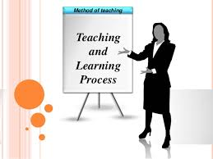
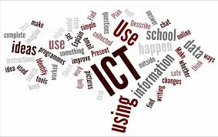
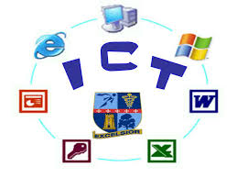
Integrating ICT in Teaching and Learning

Slide 2
ICT…
“ICTs are the computing and communication facilities that support teaching, learning and a range of activities in education.”

Slide 3
TEACHING
Teaching is the act of imparting instructions to the learners in the classroom.
Traditional teaching: Student silently listen
Technology driven teaching: Child centred teaching
Teaching is the act of imparting instructions to the learner in the classroom.
B.O. SMITH
NATURE OF TEACHING
Interactive process
Cause change in behavior
Motivates learning
Giving guidance
Leads to child development
Imparting information
Triangular process (student, teacher and content)

Slide 4
LEARNING
Learning means acquisition of knowledge that leads to change in behavior.
Learning is modification of behavior through experience.
Learning involves the acquisition of knowledge, habits and attitudes.
Crow and Crow
Characteristics
Acquisition of knowledge
Modification of behavior
It is purposeful and always help somewhere.
It leads to growth.
Help individual to make better adjustment.

Slide 5
Teaching and Learning
Teaching and Learning are 2 fundamental aspects of educational process. Both are closely related to each other. The most important objective of teaching is to facilitate learning.
Whenever there is teaching, there will be learning. Thus the concept of teaching is incomplete without learning.

Slide 6
ICT has become an important educational technique in the field of education today. ICT tools are effectively used in the field of education. These tools like computer, internet, projector, computer I/O devices, software, mobile phone, e-book, online library etc. are helpful in teaching learning process. ICT can be used in many ways during the teaching learning process.

Slide 7
Integration
of ICT in
Teaching & Learning

Slide 8
Use of ICT in TLP
To teach ICT as main Subject
ICT as a facility/Network Technology
ICT as a source for Presentation media
ICT as a Teaching Method

Slide 9
1. ICT as a main Subject: ICT or Computer is taught as a main Subject/Discipline in colleges and Universities. A computer lab is required for that purpose that includes desktops, projectors, Speakers etc.
2. ICT as a Teaching Method: Different methods are used for teaching like lecture method, discussion method, demonstration method, activity method etc. ICT can be used as one of new method of teaching in the classroom.

Slide 10
3. ICT as Source of presentation Media: ICT can be used as a media in any subject to get any information as presentation. ICT can be used as teaching aid in the form of audio, video, pictures, cartoons, in the subjects of science, history, mathematics, English and many other subjects. Computer, projector and speaker is used for this purpose.
4. ICT as a facility or Network Technology: Large numbers of facilities are provided using ICT. Various facilities used by teachers or learners/Researchers in educational institutions are Homework SMS, online assignments etc.

Slide 11
Different ways of Integrating ICT in Teaching Learning Process

Slide 12
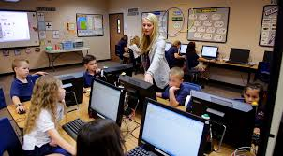
USE OF COMPUTERS
Computers can be used to create instructional materials, slide shows, worksheets, tests, rewards and displays.
These are also use for record keeping purpose in education.

Slide 13
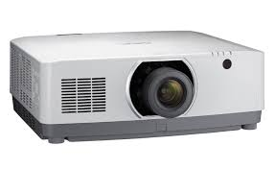
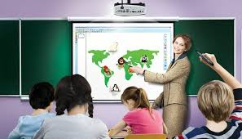
USE OF PPT’S,LCD,OHP, PROJECTORS
Old methods of teaching (chalk and talk)are replaced by technology based teaching learning methods(demonstration with the help of technology).
PPT’s, LCD etc. technology used in classroom for effective teaching.
LCD projectors can be used for effective training.

Slide 14
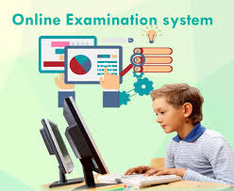
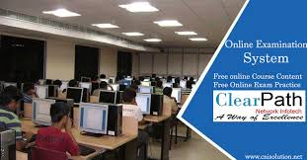
ONLINE EXAMINATION
It is revolutionary change in the field of education. The traditional exam system is taken place by online exam system.
Example : NET EXAM, Bank Exam

Slide 15


E- LEARNING/ ONLINE LEARNING
It makes use of an information network- such as LAN ,WAN whether wholly or in part, for learning, interaction etc. It refers to learning using an internet browser .
Self-paced learning, independent of geographic location and time.
It is very flexible education.

Slide 16
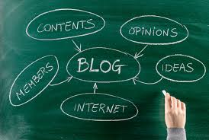

USE OF BLOGS AND WIKIS
A blog is a personal web page or informational website displaying information in the reverse chronological order, with the latest posts appearing first. It is a platform where a writer or even a group of writers share their views on an individual subject.
A wiki is a Web site that allows users to add and update content on the site using their own Web browser. Eg Wikipedia

Slide 17

These are online collaborative writing tools. These are used for developing creative writing skills. These tools motivates students for self learning.

Slide 18
‘'Popular Wikis
(1) Wikipedia – all-favorite, biggest online encyclopedia
(2) WikiTravel – world-wide travel guide, covers destination guides, hotels and resorts
(3) WikiHow – ‘How-To’ manuals for the problems of everyday life. (‘HowTo’s: Hack a Coke Machine, How to choose a Debt Management program, etc.)
(4) WikiBooks – huge collection of user-edited, open-content textbooks and guides. (Textbooks: Chess guide, Learn French … )

Slide 19
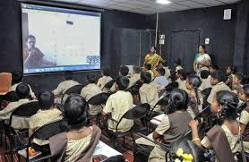
VIRTUAL CLASSROOM
Virtual means simulation of real thing. Virtual Classroom is a simulated classroom via internet.
Bridging geographic gap between learning requirements and delivery.
In this learning environment, students and teachers are separated by space, time or both . Learners can attend a class from anywhere. They communicate by video conferencing.
Multimedia has made Virtual Learning more interesting and lively. Students are more open to communicate and express.

Slide 20
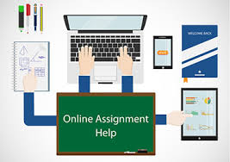
ONLINE ASSIGNMENT
Teacher can email assignment to students for practice. These assignments are prepared in Ms- Word, Excel or PPT. Students after completing the assignment email back to the teacher.
It reduces the paper handling requirement.

Slide 21
Homework SMS
The homework given to students can be sent to parents through SMS or via email so that parents also come to know about homework given to their wards. Some important messages and circulars about attendance, leave information, PT meeting and marks obtained in the tests are also conveyed through SMS/Email to parents.

Slide 22
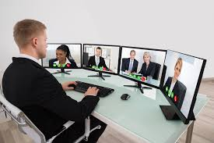
VIDEO CONFERENCING
It is the use of telecommunication technologies which allow two or more people to communicate that are separated geographically.
It’s a two way audio and video transmission.
Teachers and students are able to see each other, share documents and discuss topics.
Now students are not confined to their rooms, schools or even their countries.

Slide 23
Online Digital Library
Online digital library is operated through a website and database available on internet. Learning material is provided through e-books, e-journals, e-newspaper etc by paid or unpaid digital libraries. Many colleges and universities have developed their own online libraries for the learners.

Slide 24
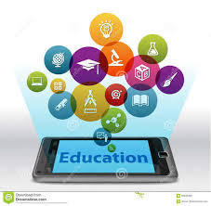
M-LEARNING
Learning through mobile phone is termed as mobile learning.
Mobiles are cheaper(affordable) as compare to other ICT tools.
These tools can provide suitable learning platforms as they have a lot of applications. Learner can use these apps in their academic activities.

Slide 25
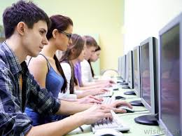
DISTANCE EDUCATION
A method of studying in which lectures are broadcast or lessons are conducted by correspondence, without the student needing to attend a school or college.
The main advantage of distance learning is that it allows you to fit your learning around your work and home life. You can usually also set your own pace of study. It is your decision as to when and where you study.
It doesn't matter where you live – you can gain a degree from anywhere in the world.
.

Slide 26
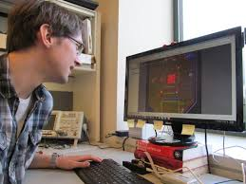

RESEARCH
Development of networks over the internet empowers research & development (R&D) in developing countries.
Existence of virtual research groups allows databases and information to be shared.
Search engines, E libraries, Internet, Wikipedia,
e-Shodhganga : (a reservoir of Indian theses @ INFLIBNET)

Slide 27
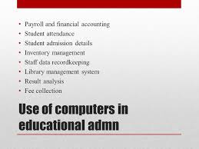
EDUCATION ADMINISTRATION
Enhances day-to-day management of institutions
Timetable
Student admission &Tracking
Financial Management
Employees attendance record
Progress reports
Students register
Placement cell
Alumni record
Campus record
Finance & accounts

Slide 28
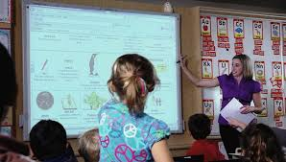
SMART CLASSROOM
It is one of new method used in teaching.
Smart classes use all interactive modules like videos, presentations etc. and these visually attractive methods of teaching becomes appealing to students.

Slide 29
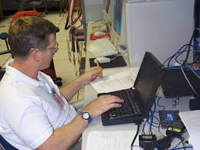
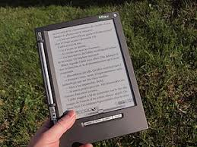
PUBLICTAION
• The notes, printed text books can be digitized with the help of computer technology.
• Many e-books are available on websites developed by different publishers.
• Encyclopaedia, dictionary, thesis etc. are also available on internet.

Slide 30
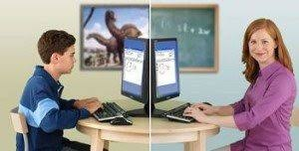
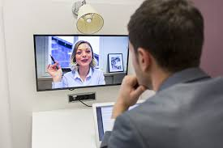
ONLINE TUTORING
In online tutoring, the student logs into his or her tutor through the use of internet at home.
The student asks the question and teacher replies it by writing on smart board or using PowerPoint presentation.

Slide 31
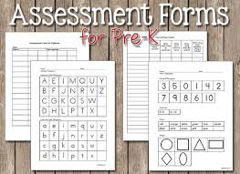
EVALUATION/ E-ASSESSMENT
Online tests, Results, Progress reports.
E-assessment technology is widely applied to teaching practices. It reduces paper consumption and quickly collects data.
Digital assessment provides machine scoring function that allows examiners to get their scores and feedback immediately after answering.
It provides instant feedback, reduces teacher workload.

Slide 32
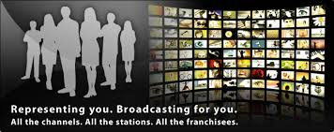

TELEVISION AND RADIO BROADCASTS
Both of them are powerful mass media tools used in education for disseminating instructions.
They also guide students about jobs and career.

Slide 33
As world is moving rapidly towards digital information, the role of ICTs in education becoming more and more important and this importance will continue to grow and develop in 21st century.

Slide 34
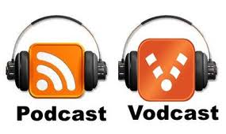
USE OF PODCAST AND VODCAST TECHNOLOGIES
Both are effective tools in teaching learning process.
These are audio and video technologies.
Podcast is an online pre selected audio on demand, delivered through a portable media device .
Vodcast is an online delivery of video content through video player .
These technologies are useful for self learning .

