Slide 1
CCE
Continous and comprehensive evaluation

Slide 2
CONCEPT
CCE stands for Continuous And Comprehensive Evaluation.
Based on recommendations to reform Evaluation system in School Education by National Curriculum for Elementary and Secondary education- A Framework(1988).
Objective- Based evaluation:
all round development of the personality of Child

Slide 3
2. Comprehensive Evaluation:
scholastic+ non scholastic areas
Personal and social qualities
Interests
Health status
Desirable attitudes
3. Continuous evaluation

Slide 4
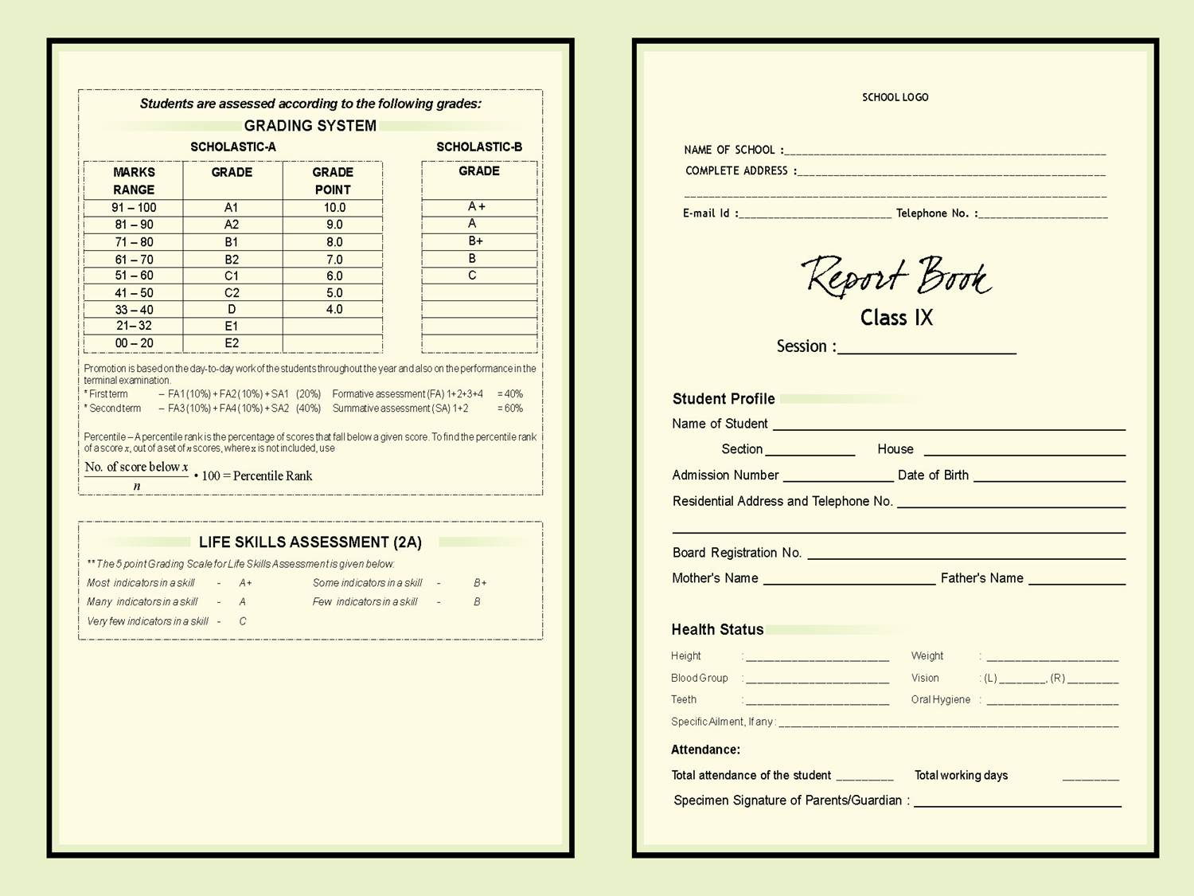
ASSESSMENT FOR AN ACADEMIC YEAR
Term I – FA1 and FA2
SA1
Term II - FA3 and FA4
SA2
FINAL Assessment-
FA1+FA2+FA3+FA4
10+ 10+ 10+ 10 = 40%
SA1+ SA2
20 + 40 = 60%
TOTAL = 100%

Slide 6
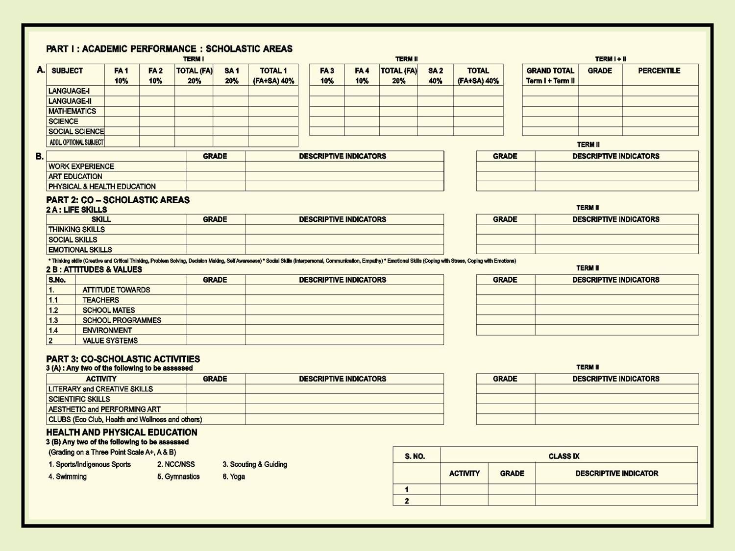

Slide 7
MAIN FEATURES
Emphasis on “Testing to Holistic Learning”.
Emphasizes Two fold objective- continuity in evaluation and assessment of broad based learning.
Identifying learning process of student on smaller content at regular intervals of time.
Employing various teaching remedial measures.
Employing variety of teachings aids and techniques.
Desisting from using negative comments on learner’s performance.

Slide 8


NEED OF CCE
To remove the defects of Traditional system of evaluation.
To make evaluation an Integral Part of the Total Teaching Process.
To meet the Demands of various Suggestions:
a)
“The internal assessment or evaluation conducted by schools is of greater importance. It should be comprehensive, evaluating all those aspects of student’s growth that are measured by the external examination and also those personality traits , interests and attitudes which can not be assessed by it.”
The Kothari Commission Report (1966)

Slide 9


“Continuous and comprehensive evaluation should incorporate both Scholastic and Non- Scholastic aspects of evaluation spread over the total span of instructional time.”
b)
c).
National Policy Of Education(1986)
“school base CCE system should be established , which can reduce stress on children , make evaluation comprehensive and regular and produce learners with greater skills and creative works.”
NCF (2005)

Slide 10


d)
Student up to std. Viii should not be made to appear in any board examination.
From year 2010-2011 , a scheme of continuous comprehension evaluation to be implemented from std. 1 to viii
Right To Education Act-2009

Slide 11


4. Specific reasons for need of CCE
To reduce stress and anxiety from children’s mind.
To reduce dropout rate.
Greater focus on learning rather then teaching to tests.
Conceptual clarification.
To develop- cognitive , affective and psychomotor skills.
Emphasise on thought process and de-emphasize memorization.
To make TLP- learner centred.
To minimize misclassification of students on the basis of marks.
Use of grades instead of marks.

Slide 12


Importance of CCE
Reform- to reduce burden and provide homely environment.
Reduces stress of students- By providing remedial measures, encourage learning.
Improves Student’s performance.
All round development.
Choice of Subjects.
Effective Teaching Strategies.
Identification.

Slide 13
Functions/purpose/advantages of CCE
Regular assessment
Effective teaching strategies
To provide report of progress of students in scholastic +non-scholastic areas
Immediate feedback to Teachers
Helps teachers to:
Plan remedial measures.
To select appropriate teaching aids
Reducing stress of students by finding their areas of interests

Slide 14
Limitations
Casual attitude of students towards studies.
Grading system.
Time consuming.
Insufficient reading time.
Favouritism in internal examination.
Potential for inconsistencies- requirement of trained teachers.
Potential for prejudice

Slide 15


